Slide 1
JEREMIAH
Book 24
© 2026 RCI. All rights reserved.
To God Alone Be the Glory
1

Slide 2
What is the Holy Bible?
The Holy Bible is a collection of writings that includes 66 books in English editions. The Bible consists of two parts, the Old Testament and New Testament. The word testament means covenant. The Old Testament includes 39 books, and the New Testament includes 27 books.
These 66 books were written over approximately 1,400 years by 40 different authors in Hebrew, Aramaic, and Greek. The Old Testament writings were affirmed by Jewish leaders, and moreover, by Jesus Christ.¹ The New Testament writings were confirmed by early church leaders. The 66 books of the Bible are the inspired words of God that are used to make and mature disciples of the One true God through Jesus Christ, his Son (Matthew 28:18-20, 2 Timothy 3:16-17). The Bible was not created by mere human wisdom but was inspired by God (2 Peter 1:20-21), is interpreted by His Holy Spirit (John 16:13, Matthew 23:8-10), and will last forever (Matthew 24:35).²
If you do a phrase search on the Bible you will find the phrase "the word of the Lord" and "Thus says the Lord" more than 700 times.³ In addition, this book has given reasonable evidence to the claim of being God’s word by:​
  providing answers that conform with the reality we see around us.
  being a reliable collection of historical documents.
  containing eyewitness accounts that were written during the lifetimes of other eyewitnesses.
  recording supernatural events that took place in fulfillment of specific prophecies.⁴
Notes:
¹ See Matthew 4:4-7, 12:3-5, Mark 7:6-7, 12:26-27, and Luke 19:46 for examples.
^{2 “}What are the Books of the Bible”, GotQuestions.org
³ Blue Letter Bible
⁴ Paraphrased from Voddie Baucham

Slide 3
Our Goals in Studying the Bible
To better …..
Understand the Only true God; the Author of the Bible. (2 Timothy 3:16-17, 2 Peter 1:20-21, 1 John 5:20 , Jeremiah 9:23-24)
Learn How He works in the World and in our Lives. (Job 40:6-14, Isaiah 45:6-7, Isaiah 46:8-10, Philippians 2:12-13)
Understand Ourselves and the Hearts of Mankind. (Jeremiah 17:9, 2 Timothy 3:13, Ephesians 5:7-10)
Come to Know What Pleases and Grieves God. (1 Thessalonians 4:1, Ephesians 4:26-31, Hebrews 11:6, 1 Peter 1:14-19)
To be Transformed into Fruitful Doers of God’s Word and not just Hearers. (Romans 12:2, James 1:27, Matthew 3:8)
Tether Ourselves to God’s Word for Our Wisdom, Discernment, and Safety. (1 Corinthians 6:9-10, Matthew 24:24, Ephesians 4:11-14)
Jeremiah 9:23-24 “Thus says the Lord: "Let not the wise man boast in his wisdom, let not the mighty man boast in his might, let not the rich man boast in his riches, but let him who boasts boast in this, that he understands and knows me, that I am the Lord who practices steadfast love, justice, and righteousness in the earth. For in these things I delight, declares the Lord."

Slide 4
How to Study the Bible
#1. Observation: What does the text say?
Who?
What?
When?
Where?
How?
Why?
#2. Interpretation: What does the text mean in context with the passage, book, and whole counsel of God?
#3. Application: How is the Holy Spirit instructing me to apply this understanding at this time in my life?

Slide 5
Study Resources
Opening Prayer
Background and Setting
Book Outline
Geography Maps
Key Verses
Study Questions
Major Event Timeline
Book Summary
Application and Closing Prayer
Study Leader Support Slides

Slide 6
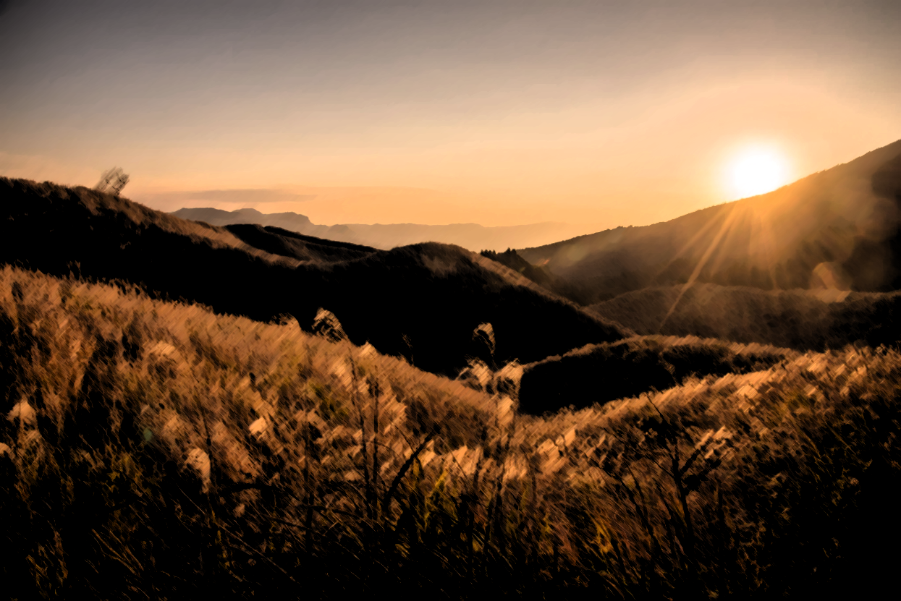
Opening Prayer Verses : Jeremiah
Jeremiah 9:12-14, “Who is the man so wise that he can understand this? To whom has the mouth of the LORD spoken, that he may declare it? Why is the land ruined and laid waste like a wilderness, so that no one passes through? And the LORD says: "Because they have forsaken my law that I set before them, and have not obeyed my voice or walked in accord with it, but have stubbornly followed their own hearts and have gone after the Baals, as their fathers taught them.”
Jeremiah 9:23-24, “Thus says the LORD: ‘Let not the wise man boast in his wisdom, let not the mighty man boast in his might, let not the rich man boast in his riches, but let him who boasts boast in this, that he understands and knows me, that I am the LORD who practices steadfast love, justice, and righteousness in the earth. For in these things I delight, declares the LORD.’"

Slide 7
Review of Isaiah
Learning Tip: For those studying the Bible in its table‑of‑contents order, this slide gives you a brief recap of the book you just completed. Studying in a different sequence? You can simply skip this slide or treat it as a gentle nudge to circle back when the time is right.
Brief Summary: The book of Isaiah reveals God’s judgment and salvation. God is “holy, holy, holy” (Isaiah 6:3), and therefore He cannot allow sin to go unpunished¹. Isaiah portrays God’s oncoming judgment as a “consuming fire”.²
In tandem, Isaiah teaches that God is a God of mercy, grace, and compassion.³ The nation of Israel (both Judah and N. Israel) is blind and deaf to God’s commands.⁴ Judah is compared to a vineyard that should be, and will be, trampled on (Isaiah 5:1-7). In fact, it is revealed that the whole earth will mourn, wither, and languish because all the peoples of the earth have transgressed God’s laws and broken the everlasting covenant (Isaiah 24:4-6). Only because of His mercy and His promises to Israel, will God not allow Israel or Judah or the whole earth to be completely destroyed. He will bring restoration, forgiveness, and healing.⁵
More than any other book in the Old Testament, Isaiah focuses on the salvation that will come through the Messiah. The Messiah will one day rule in justice and righteousness.⁶ The reign of the Messiah will bring peace and safety to Israel (Isaiah 11:6-9). Through the Messiah, Israel will be a light to all the nations.⁷ The Messiah’s kingdom on earth (Isaiah 65-66) is the goal toward which all the book of Isaiah points. It is during the reign of the Messiah that God’s righteousness will be fully revealed to the world.
In a seeming paradox, the book of Isaiah also presents the Messiah as one who will suffer. Isaiah 53 vividly describes the Messiah suffering for sin. It is through His wounds that healing is achieved. It is through His suffering that our iniquities are taken away. This apparent contradiction is solved in the Person of Jesus Christ. In His first advent, Jesus was the suffering servant of Isaiah 53. In His second advent, Jesus will be the conquering and ruling King, the Prince of Peace (Isaiah 9:6). These timelines of Messiah’s work in his first and second comings are compressed and mysteriously hidden in Isaiah. But, in the New Testament these timelines are expanded and revealed with the promised 1,000-year reign spoken of by the Apostle John (Revelation 20:1-6) followed by the new heaven and earth foretold by both Isaiah and John.⁸
Foreshadowings: As stated above, chapter 53 of Isaiah describes the coming Messiah and the suffering He would endure to pay for our sins. In His sovereignty, God orchestrated every detail of the crucifixion to fulfill every prophecy of this chapter, as well as all other messianic prophecies of the Old Testament. The imagery of Isaiah 53 is poignant and prophetic and contains a complete picture of the Gospel. Jesus was despised and rejected ⁹, stricken by God (v.4; Matthew 27:46), and pierced for our transgressions.¹⁰ By His suffering, He paid the punishment we deserved and became for us the ultimate and perfect sacrifice (v. 5; Hebrews 10:10). Although He was sinless, God laid on Him our sin, and we became God’s righteousness in Him (2 Corinthians 5:21). Therefore, God has highly exalted him and bestowed upon him the name that is above every name, so that all will bow the knee to King Jesus (Philippians 2:5-11).
Notes:
¹ Isaiah 1:2; 2:11-20; 5:30; 34:1-2; 42:25
² Isaiah 1:31; 30:33
³ Isaiah 5:25; 11:16; 14:1-2; 32:2; 40:3; 41:14-16
⁴ Isaiah 6:9-10; 42:7
⁵ Isaiah 43:2; 43:16-19; 52:10-12
⁶ Isaiah 9:7; 32:1
⁷ Isaiah 42:6; 55:4-5
⁸ Isaiah 65:17; Revelation 21:1
⁹ Isaiah 53:3; Luke 13:34; John 1:10-11
¹⁰ Isaiah 53:5; John 19:34; 1 Peter 2:24

Slide 8
Old Testament Table of Contents (39 Books)
THE LAW - 5
GENESIS
EXODUS
LEVITICUS
NUMBERS
DEUTERONOMY
POETRY - 5
JOB
PSALMS
PROVERBS
ECCLESIASTES
SONG OF SOLOMON
MINOR PROPHETS – 12
HOSEA
JOEL
AMOS
OBADIAH
JONAH
MICAH
NAHUM
HABAKKUK
ZEPHANIAH
HAGGAI
ZECHARIAH
MALACHI
HISTORY – 12
JOSHUA
JUDGES
RUTH
1 SAMUEL
2 SAMUEL
1 KINGS
2 KINGS
1 CHRONICLES
2 CHRONICLES
EZRA
NEHEMIAH
ESTHER
MAJOR PROPHETS - 5
ISAIAH
JEREMIAH
LAMENTATIONS
EZEKIEL
DANIEL

Slide 9
Old Testament Books by Date Written
Historical Books
Wisdom Book and Prophetic Books
Genesis:
c. 1445-1400 B.C.
Exodus:
c. 1445-1400 B.C.
Leviticus:
c. 1445-1400 B.C.
Numbers:
c. 1405 B.C.
Deut:
c. 1405 B.C.
Joshua:
c. 1405-1385 B.C.
Judges:
c. 1043 B.C.
1 & 2 Samuel:
c. 960-722 B.C.
1 & 2 Kings:
c. 560-540 B.C.
Ezra:
c. 460-440 B.C
Esther:
c. 460-350 B.C..
1 & 2 Chron:
c. 450-425 B.C.
Nehemiah:
c. 445-420 B.C.
Ruth:
c. 1011-971 B.C.
Job:
c. 1440 – 950 B.C.
Psalms:
c. 1410-500 B.C.
Proverbs and Song of Solomon:
c. 965 B.C.
Ecclesiastes:
c. 930 B.C.
Obadiah:
c. 848-840 B.C.
Joel:
c. 835 – 796 B.C
Jonah:
c. 790 – 739 B.C.
Isaiah and Micah:
c. 739 – 681 B.C.
Nahum:
c. 663–612 B.C.
Habakkuk and Zephaniah:
c. 635-605 B.C
Jeremiah and Lamentations:
c. 630-575 B.C.
Ezekiel and Daniel:
c. 593 – 530 B.C.
Haggai and Zechariah:
c. 520-470 B.C.
Malachi:
c. 440 – 400 B.C.
Hosea and Amos:
c. 760 -725 B.C.
Amos 3:7 : “For the Lord GOD does nothing without revealing his secret to his servants the prophets.”

Slide 10
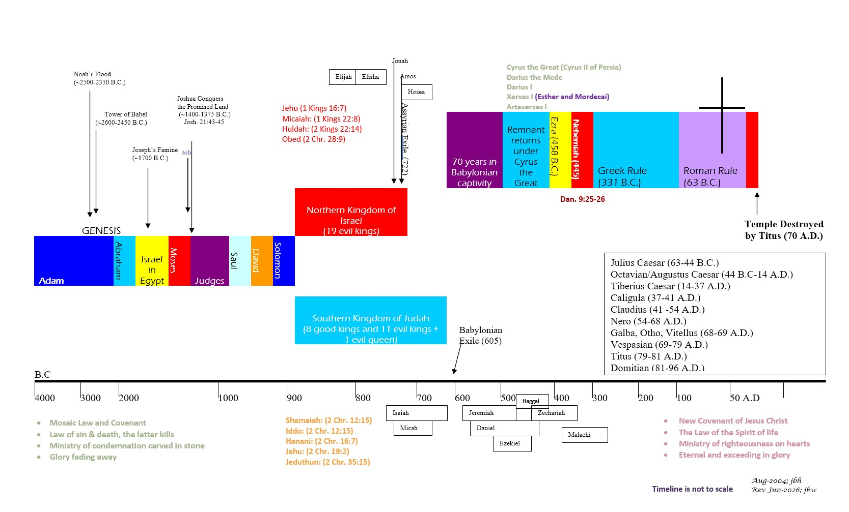
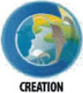

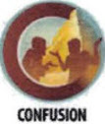
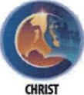


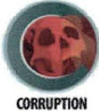
BIBLICAL CHRONOLOGICAL BACKGROUND
OT
NT
Prophets after Noah into the United Kingdom:
Abraham:
Moses:
Samuel:
Gad:
Nathan:
Ahijah
Asaph
(Gen. 20:7)
(Exo. 3:10)
(1 Sam. 3:20)
(1 Sam. 22:5)
(2 Sam. 7:2)
(1 Kings 11:29)
(2 Chr. 35:15)

Slide 11
Jeremiah
Author: Jeremiah, son of Hilkiah (a priest)
Date: c. 630-575 B.C.

Slide 12
GOD’s Prophetic Books
The Role of the Prophets
Time frames of God’s Prophetic Word
Speak
To speak God’s warnings with a goal to bring individuals and nations to repentance. Wording is often poetic and builds to a climax to make an impactful point.
Declare
To declare God’s imminent judgment and discipline for continued sinful behaviors.
Reveal
To reveal God’s future plans of judgment, deliverance, mercy, and grace.
God’s past actions and words in history (e.g., Creation – Confusion, Exodus from Egypt, fulfillment of God’s prophetic word, etc.). This is to remind the listeners/readers that God is always at work in the present fulfilling his word, and his past activity gives surety about future events God has declared.
God’s judgments that will impact the people of or near to the prophet’s generation as he speaks concerning specific nations or lands: (e.g., Judah’s exile to Babylon, the rise of Cyrus the Persian, the rebuilding of the temple in Jerusalem before it is even destroyed).
Events far into future generations that impact the whole earth: (e.g., the 1st coming of Jesus Christ, the 2nd coming of Jesus Christ, and the Millennial kingdom).
1 Peter 1:10-12: "Concerning this salvation, the prophets who prophesied about the grace that was to be yours searched and inquired carefully, inquiring what person or time the Spirit of Christ in them was indicating when he predicted the sufferings of Christ and the subsequent glories. It was revealed to them that they were serving not themselves but you, in the things that have now been announced to you through those who preached the good news to you by the Holy Spirit sent from heaven, things into which angels long to look.

Slide 13
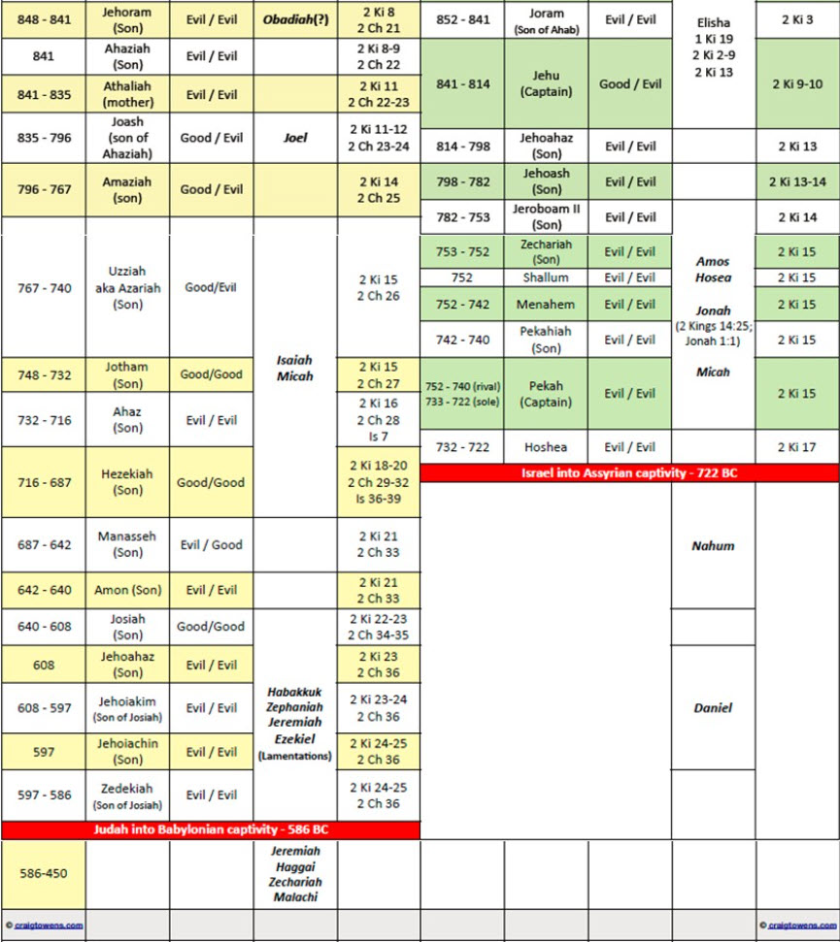
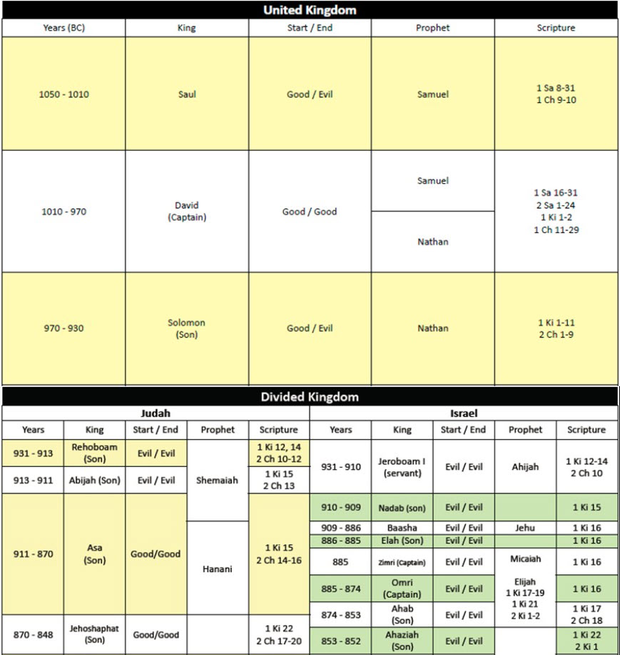
Israel’s Kings and Prophets¹
663-612 B.C.
¹ Biblegateway.com

Slide 14
About the Book and Author: JEREMIAH
This book gains its title from the human author, who begins this writing with “the words of Jeremiah . . . ” (Jeremiah 1:1-2). Jeremiah recounts more of his own life than any other prophet, telling of his ministry, the reactions of his audiences, testings, and his personal feelings. His name means “Jehovah throws,” in the sense of laying down a foundation, or “Jehovah establishes, appoints, or sends.”
Jeremiah, who served as both a priest and a prophet, was the son of a priest named Hilkiah. He was from the small village of Anathoth (Jeremiah 1:1-2), today called Anata, about 3 miles northeast of Jerusalem in Benjamin’s tribal inheritance. As an object lesson to Judah, Jeremiah remained unmarried (Jeremiah 16:1-4). He was assisted in ministry by a scribe, named Baruch, to whom Jeremiah dictated and who copied and had custody over the writings compiled from the prophet’s messages.¹ Jeremiah has been known as “the weeping prophet”², living a life of conflict because of his predictions of judgment by the invading Babylonians. He was threatened, tried for his life, put in stocks, forced to flee from Jehoiakim, publicly humiliated by a false prophet, and thrown into a pit.
Jeremiah carried out a ministry directed mostly to his own people in Judah, but which expanded to other nations at times. He appealed to his countrymen to repent and avoid God’s judgment via an invader (Jeremiah 7; Jeremiah 26). Once invasion was certain after Judah refused to repent, he pled with them not to resist the Babylonian conqueror in order to prevent total destruction (Jeremiah 27). He also called on delegates of other nations to heed his counsel and submit to Babylon (Jeremiah 27), and he predicted judgments from God on various nations (Jeremiah 25:12-38; Jeremiah 46-51).
The dates of his ministry, which spanned five decades, are from the Judean king Josiah’s thirteenth year in 627 B.C. to beyond the fall of Jerusalem to Babylon in 586 B.C.³ After 586 B.C., Jeremiah was forced to go with a fleeing remnant of Judah to Egypt.⁴ He was possibly still ministering in 570 B.C.⁵ A rabbinic note claims that when Babylon invaded Egypt in 568/67 B.C., Jeremiah was taken captive to Babylon. He could have lived even to pen the book’s closing record in Babylon c. 561 B.C., when Judah’s king Jehoiachin, imprisoned in Babylon since 597 B.C., was allowed liberties in his last days (Jeremiah 52:31-34). Jeremiah, if still alive at that time, was between 85 and 90 years old.
Seven other Jeremiahs appear in Scripture.⁶ Jeremiah the prophet is named at least nine times outside of his book,⁷ and the Old and New Testaments quote Jeremiah at least seven times.⁸
DATE: c. 630 – 575 B.C.
Notes:
¹ Jeremiah 36:4, 36:32; 45:1
² cf. Jeremiah 9:1; 13:17; 14:17
³ Jeremiah 1:1-2, Jeremiah 39; 40; 52
⁴ Jeremiah 43-44
⁵ cf. Jeremiah 44:29-30
⁶ 2 Kings 23:31; 1 Chron. 5:24; 12:4, 10, 13; Neh. 10:2; 12:1
⁷ (cf. 2 Chron. 35:25; 36:12, 21–22; Ezra 1:1; Dan. 9:2; Matt. 2:17; 16:14; 27:9)
⁸ Dan. 9:2 (Jer. 25:11–12; 29:10); Matt. 2:18 (Jer. 31:15); Matt. 27:9 (Jer. 18:2; 19:2, 11; 32:6–9); 1 Cor. 1:31(Jer. 9:24); 2 Cor. 10:17 (Jer. 9:24); Heb. 8:8–12 (Jer. 31:31–34); Heb. 10:16–17 (Jer. 31:33–34)

Slide 15
Jeremiah: Background and setting
Background details of Jeremiah’s times are portrayed in 2 Kings 22-25 and 2 Chronicles 34–36. Jeremiah’s messages paint pictures of:
his people’s sin
the invader God would send
the rigors of siege, and
calamities of destruction.
Jeremiah’s message of impending judgment for idolatry and other sins was preached over a period of 40 years (c. 627–586 B.C. and beyond). His prophecy took place during the reigns of Judah’s final five kings: Josiah, Jehoahaz, Jehoiakim, Jehoiachin, and Zedekiah.¹
The spiritual condition of Judah was one of flagrant idol worship ². King Ahaz, preceding his son Hezekiah long before Jeremiah in Isaiah’s day, had set up a system of sacrificing children to the god Molech in the Valley of Hinnom just outside Jerusalem (735–715 B.C.). Hezekiah led in reforms and clean-up ³, but his son Manasseh continued to foster child sacrifice along with gross idolatry, which continued into Jeremiah’s time.⁴ Many also worshiped the “queen of heaven”.⁵ Josiah’s reforms, reaching their apex in 622 B.C., forced a repressing of the worst practices outwardly, but the deadly cancer of sin was deep and flourished quickly again after a shallow revival. Religious insincerity, dishonesty, adultery, injustice, tyranny against the helpless, and slander prevailed as the norm not the exception.
Politically momentous events occurred in Jeremiah’s day. Assyria saw its power wane gradually. When their king, Ashurbanipal, died in 626 B.C., Assyria grew so feeble that in 612 B.C. her seemingly invincible capital, Nineveh, was destroyed.⁶ The Neo-Babylonian empire under Nabopolassar (625–605 B.C.) became the dominant militarily with victories against Assyria (612 B.C.), Egypt (609–605 B.C.), and Southern Israel in three phases (605 B.C. ⁷ ; 597 B.C. ⁸; and 586 B.C. ⁹).
While Joel and Micah had earlier prophesied of Judah’s judgment, during Josiah’s reign God’s leading prophets were Jeremiah, Habakkuk, and Zephaniah. Later, Jeremiah’s contemporaries, Ezekiel and Daniel, played prominent prophetic roles.
Notes:
¹ Josiah 640–609 B.C., Jehoahaz 609 B.C., Jehoiakim 609–598 B.C.,
Jehoiachin 598–597, and Zedekiah 597–586 B.C.
² cf. Jer. 2
³ Isa. 36:7
⁴ Jer. 7:31; 19:5; 32:35
⁵ Jer. 7:18; 44:19
⁶ cf. the book of Nahum
⁷ Dan. 1,
⁸ 2 Kings 24:10–16
⁹ Jer. 39; 40; 52

Slide 16
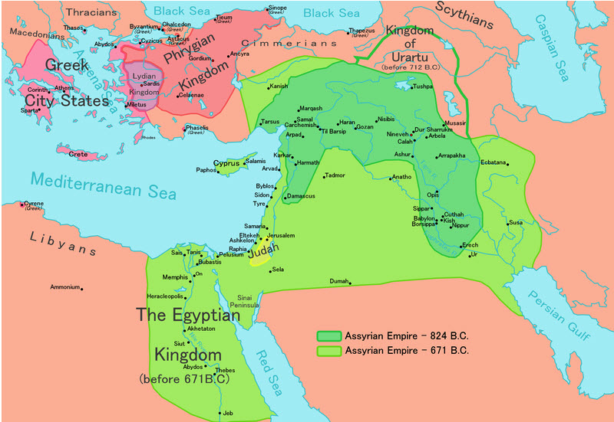
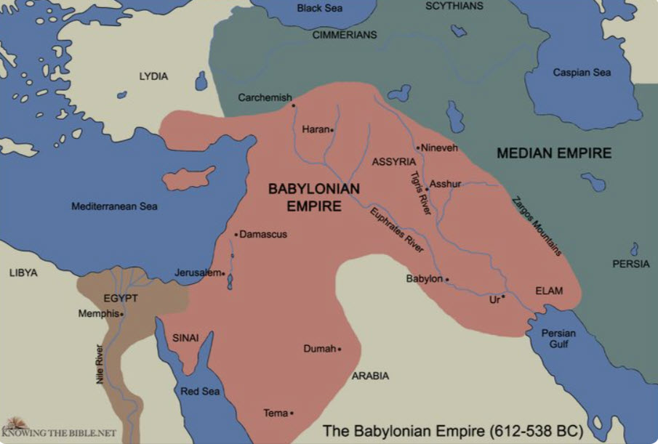
KEY GEOGRAPHY of JEREMIAH
Jeremiah 9:25-26, "Behold, the days are coming, declares the LORD, when I will punish all those who are circumcised merely in the flesh- Egypt, Judah, Edom, the sons of Ammon, Moab, and all who dwell in the desert who cut the corners of their hair, for all these nations are uncircumcised, and all the house of Israel are uncircumcised in heart."

Slide 17
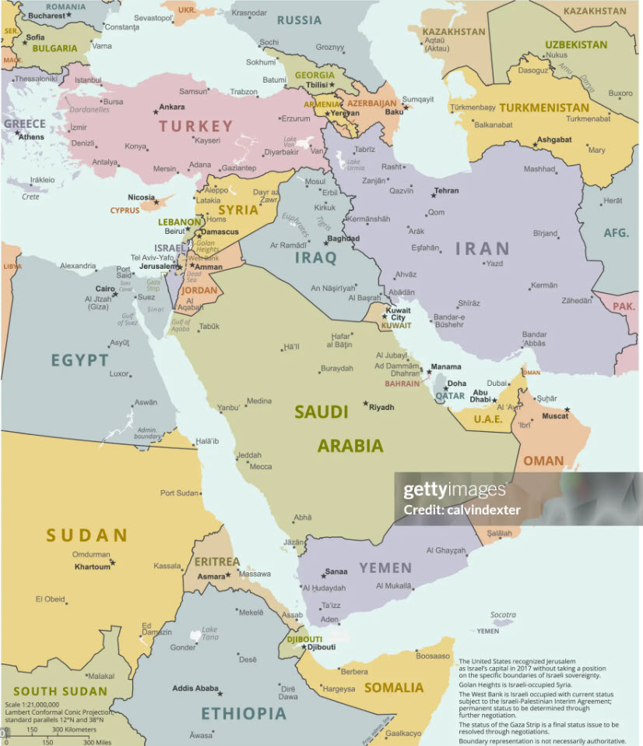
KEY GEOGRAPHY of JEREMIAH (PAST vs. PRESENT)
2017 A.D.
612 – 538 B.C.

Slide 18
JEREMIAH: OUTLINE
Proclamations to Judah
Condemnation to Judah (14 messages)
Consolation to Judah-New Covenant
Calamity on Judah
The Fall of Jerusalem
The Destruction of Jerusalem
The Deportation of Jews
The Deliverance of Jehoiachin
Jeremiah 1:1-19
Jeremiah 2:1-45:5
Jeremiah 46:1-51:64
Jeremiah 52:1-52:34
Preparation of Jeremiah
The Context of Jeremiah
The Choice of Jeremiah
The Charge to Jeremiah
Proclamations of Judgment on the Nations
Egypt, Philistia, Moab
Ammon, Edom, Damascus
Kedar, Elam, Babylon

Slide 19
JEREMIAH: Key Verses
Jeremiah 1:1-3, “The words of Jeremiah, the son of Hilkiah, one of the priests who were in Anathoth in the land of Benjamin, to whom the word of the Lord came in the days of Josiah the son of Amon, king of Judah, in the thirteenth year of his reign. It came also in the days of Jehoiakim the son of Josiah, king of Judah, and until the end of the eleventh year of Zedekiah, the son of Josiah, king of Judah, until the captivity of Jerusalem in the fifth month.”
Jeremiah 1:4-5, “Now the word of the LORD came to me, saying, ‘Before I formed you in the womb I knew you, before you were born I set you apart; I appointed you as a prophet to the nations.’”
Jeremiah 1:9-10, “Then the LORD put out his hand and touched my mouth. And the LORD said to me, "Behold, I have put my words in your mouth. See, I have set you this day over nations and over kingdoms, to pluck up and to break down, to destroy and to overthrow, to build and to plant."
Jeremiah 2:12, “Be appalled, O heavens, at this; be shocked, be utterly desolate, declares the LORD, for my people have committed two evils: they have forsaken me, the fountain of living waters, and hewed out cisterns for themselves, broken cisterns that can hold no water.”
Jeremiah 7:3-7, “Thus says the Lord of hosts, the God of Israel: “Amend your ways and your deeds, and I will let you dwell in this place. Do not trust in these deceptive words: ‘This is the temple of the Lord, the temple of the Lord, the temple of the Lord.’ For if you truly amend your ways and your deeds, if you truly execute justice one with another, if you do not oppress the sojourner, the fatherless, or the widow, or shed innocent blood in this place, and if you do not go after other gods to your own harm, then I will let you dwell in this place, in the land that I gave of old to your fathers forever.””
Jeremiah 17:9-10, “The heart is deceitful above all things, and desperately sick; who can understand it? I the Lord search the heart and test the mind, to give every man according to his ways, according to the fruit of his deeds. ”
Jeremiah 21:3-7, “Then Jeremiah said to them: "Thus you shall say to Zedekiah, ‘Thus says the Lord, the God of Israel: Behold, I will turn back the weapons of war that are in your hands and with which you are fighting against the king of Babylon and against the Chaldeans who are besieging you outside the walls. And I will bring them together into the midst of this city. I myself will fight against you with outstretched hand and strong arm, in anger and in fury and in great wrath. And I will strike down the inhabitants of this city, both man and beast. They shall die of a great pestilence. Afterward, declares the Lord, I will give Zedekiah king of Judah and his servants and the people in this city who survive the pestilence, sword, and famine into the hand of Nebuchadnezzar king of Babylon and into the hand of their enemies, into the hand of those who seek their lives. He shall strike them down with the edge of the sword. He shall not pity them or spare them or have compassion.’”
Jeremiah 29:10-14, “This is what the LORD says: ‘When seventy years are completed for Babylon, I will come to you and fulfill my gracious promise to bring you back to this place. For I know the plans I have for you,’ declares the LORD, ‘plans to prosper you and not to harm you, plans to give you hope and a future. Then you will call upon me and come and pray to me, and I will hear you. You will seek me and find me, when you seek me with all your heart. I will be found by you, declares the LORD, and I will restore your fortunes and gather you from all the nations and all the places where I have driven you, declares the LORD, and I will bring you back to the place from which I sent you into exile.’”
Jeremiah 46:25-26, The Lord of hosts, the God of Israel, said: "Behold, I am bringing punishment upon Amon of Thebes, and Pharaoh and Egypt and her gods and her kings, upon Pharaoh and those who trust in him. I will deliver them into the hand of those who seek their life, into the hand of Nebuchadnezzar king of Babylon and his officers. Afterward Egypt shall be inhabited as in the days of old, declares the Lord.
Jeremiah 52:12-13, “On the tenth day of the fifth month, in the nineteenth year of Nebuchadnezzar king of Babylon, Nebuzaradan commander of the imperial guard, who served the king of Babylon, came to Jerusalem. He set fire to the temple of the LORD, the royal palace and all the houses of Jerusalem. Every important building he burned down.”

Slide 20
JEREMIAH: Study Questions
I Will Punish Their Sins
Part 1: Jeremiah 14:10-12, “Thus says the LORD concerning this people: "They have loved to wander thus; they have not restrained their feet; therefore, the LORD does not accept them; now he will remember their iniquity and punish their sins." The LORD said to me: "Do not pray for the welfare of this people. Though they fast, I will not hear their cry, and though they offer burnt offering and grain offering, I will not accept them. But I will consume them by the sword, by famine, and by pestilence."
How does God’s instructions to Jeremiah not to pray for the welfare of the people of Judah differ from the instructions God gave in Isaiah 62:6-7?
As students of God’s word how does this help you understand the link between effective prayer and discerning God’s timeline?
In Jeremiah 7:27-34 God lists several of the sins of Judah that led to this sentence of judgment for this generation in Judah? What sins do you find listed there?
Part 2: Jeremiah 15:1-2, “Then the LORD said to me, "Though Moses and Samuel stood before me, yet my heart would not turn toward this people. Send them out of my sight and let them go! And when they ask you, 'Where shall we go?' you shall say to them, 'Thus says the LORD: "'Those who are for pestilence, to pestilence, and those who are for the sword, to the sword; those who are for famine, to famine, and those who are for captivity, to captivity.’”
The Lord had determined that He would punish those living in Judah during Jeremiah’s day. He had sent Jeremiah to warn them of His coming wrath but they did not repent. In Jeremiah 21:1-10, we read that Zedekiah sends Pashur to Jeremiah because the Chaldeans had come to make war on the land.
  What did the Lord say His part would be in this fight?
  What way of salvation from the sword, famine, and pestilence did the Lord give to the inhabitants of Judah?
  To be saved from the coming punishment, people had to discern which prophet(s) they believed was truly from the Lord. What application can you draw from situations we face in our time?
The Nations
Jeremiah 18:7-10, “If at any time I declare concerning a nation or a kingdom, that I will pluck up and break down and destroy it, and if that nation, concerning which I have spoken, turns from its evil, I will relent of the disaster that I intended to do to it. And if at any time I declare concerning a nation or a kingdom that I will build and plant it, and if it does evil in my sight, not listening to my voice, then I will relent of the good that I had intended to do to it. ”
What does this passage tell us about how nations and kingdoms are established? See also Acts 17:22-26.
Based on the passage, what is needed for any nation to be built up and to avoid being torn down?
Salvation for Israel and Judah
Jeremiah 33:14-16, "Behold, the days are coming, declares the LORD, when I will fulfill the promise I made to the house of Israel and the house of Judah. In those days and at that time I will cause a righteous Branch to spring up for David, and he shall execute justice and righteousness in the land. In those days Judah will be saved, and Jerusalem will dwell securely. And this is the name by which it will be called: 'The LORD is our righteousness.’
Can you see a relationship between God’s declaration concerning Israel and Judah in Jeremiah 33:14-16 with what we are taught in Romans 11:25-27? Explain.
What language does God use in Jeremiah 33:20-22 to indicate the certainty of his promised salvation to a remnant from the nations of Israel and Judah?

Slide 21
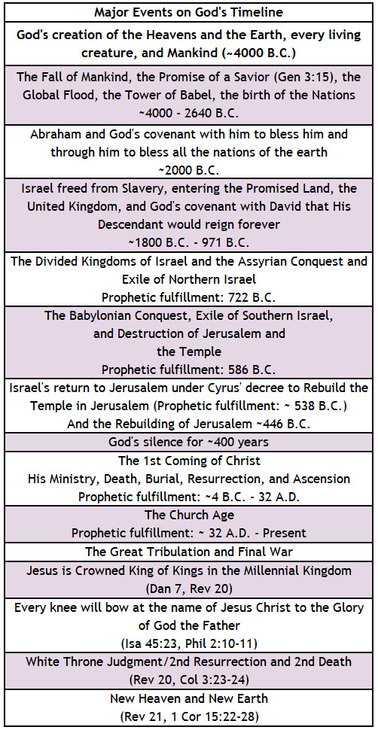
God’s Prophetic Timetable Events
JEREMIAH
Jeremiah 32:36-41, "Now therefore thus says the LORD, the God of Israel, concerning this city of which you say, 'It is given into the hand of the king of Babylon by sword, by famine, and by pestilence': Behold, I will gather them from all the countries to which I drove them in my anger and my wrath and in great indignation. I will bring them back to this place, and I will make them dwell in safety. And they shall be my people, and I will be their God. I will give them one heart and one way, that they may fear me forever, for their own good and the good of their children after them. I will make with them an everlasting covenant, that I will not turn away from doing good to them. And I will put the fear of me in their hearts, that they may not turn from me. I will rejoice in doing them good, and I will plant them in this land in faithfulness, with all my heart and all my soul.”
Jeremiah 29:10-13, “"For thus says the LORD, ‘When seventy years have been completed for Babylon, I will visit you and fulfill My good word to you, to bring you back to this place. ’For I know the plans that I have for you,’ declares the LORD, ‘plans for welfare and not for calamity to give you a future and a hope. ’Then you will call upon Me and come and pray to Me, and I will listen to you. ’You will seek Me and find [Me] when you search for Me with all your heart.”
Jeremiah 3:14-18, “Return, O faithless children, declares the LORD; for I am your master; I will take you, one from a city and two from a family, and I will bring you to Zion. And I will give you shepherds after my own heart, who will feed you with knowledge and understanding. And when you have multiplied and been fruitful in the land, in those days, declares the LORD, they shall no more say, "The ark of the covenant of the LORD." It shall not come to mind or be remembered or missed; it shall not be made again. At that time Jerusalem shall be called the throne of the LORD, and all nations shall gather to it, to the presence of the LORD in Jerusalem, and they shall no more stubbornly follow their own evil heart. In those days the house of Judah shall join the house of Israel, and together they shall come from the land of the north to the land that I gave your fathers for a heritage.”
Jeremiah 23:5-6, “Behold, the days are coming, declares the Lord, when I will raise up for David a righteous Branch, and he shall reign as king and deal wisely, and shall execute justice and righteousness in the land. In his days Judah will be saved, and Israel will dwell securely. And this is the name by which he will be called: ‘The Lord is our righteousness’”

Slide 22
Summary of Jeremiah
Brief Summary: The Book of Jeremiah is primarily a message of judgment on Judah for rampant idolatry¹. After the death of King Josiah, the last righteous king, the nation of Judah had almost completely abandoned God and His commandments. Jeremiah compares Judah to a prostitute². God had promised that He would judge idolatry most severely³, and Jeremiah was warning Judah that God’s judgment was at hand. God had delivered Judah from destruction on countless occasions, but His mercy was at its end. Jeremiah records King Nebuchadnezzar conquering Judah and making it subject to him (Jeremiah 24:1). After further rebellion, God brought Nebuchadnezzar and the Babylonian armies back to destroy and desolate Judah and Jerusalem (Jeremiah 52). Even in this most severe judgment, God promised the restoration of Judah. After 70 years God pledged to bring Judah back from the Babylonian captivity into the land he gave them (Jeremiah 25:11-12 , Jeremiah 29:10-14), and this was fulfilled in ~538 B.C. under Cyrus, king of Persia. Moreover, also during the declaration of this severe coming punishment, God promised a future time when He will restore all Israel to the land; a time when they will no more stubbornly follow their own evil hearts (Jeremiah 3:14-18, Romans 11:26).
It is also worth noting that Jeremiah’s prophecies also included God’s impending judgment against surrounding nations for their sins and some promises of future restoration (Jeremiah 46:25-26). God utilized the Babylonian conquests to execute his ruling (e.g., Jeremiah 46:25-26). However, the cruelty of the Babylonians went far beyond God’s justice. And, for this they would be later judged (Jeremiah 25:12).
Foreshadowings: Jeremiah 23:5-6 presents a prophecy of the coming Messiah, Jesus Christ. The prophet describes Him as a Branch from the house of David ⁴, the King who would reign in wisdom and righteousness (Revelation 11:15). It is Christ who will finally be recognized by Israel as her true Messiah as He provides salvation for His chosen ones (Jeremiah 23:6; Romans 11:25-26).
Notes:
¹ Jeremiah 7:30-34; 16:10-13; 22:9; 32:29; 44:2-3
² Jeremiah 2:20; 3:1-3
³ Leviticus 26:31-33; Deuteronomy 28:49-68
⁴ Jeremiah 23:5-6; Matthew 1

Slide 23
Jeremiah: Practical Application
Practical Application: The Prophet Jeremiah had a most difficult message to deliver. Jeremiah loved Judah, but he loved God much more. As painful as it was for Jeremiah to deliver a consistent message of judgment to his own people, Jeremiah was obedient to what God told him to do and say. Jeremiah hoped and prayed for mercy from God for Judah, but also trusted that God was good, just, and righteous. Even during God’s determined punishment for Judah, he offered the way of life through surrender to the Chaldeans (Jeremiah 21:8-10). We too must obey God, even when it is difficult, recognize God’s will as more important than our own desires, and trust that God, in His infinite wisdom and perfect plan, will bring about the best for His children (Romans 8:28).

Slide 24


Closing Prayer Verse
Jeremiah 17:5-10, “Thus says the LORD: "Cursed is the man who trusts in man and makes flesh his strength, whose heart turns away from the LORD. He is like a shrub in the desert, and shall not see any good come. He shall dwell in the parched places of the wilderness, in an uninhabited salt land.
Blessed is the man who trusts in the LORD, whose trust is the LORD. He is like a tree planted by water, that sends out its roots by the stream, and does not fear when heat comes, for its leaves remain green, and is not anxious in the year of drought, for it does not cease to bear fruit.' The heart is deceitful above all things, and desperately sick; who can understand it? 'I the LORD search the heart and test the mind, to give every man according to his ways, according to the fruit of his deeds.'"

Slide 25
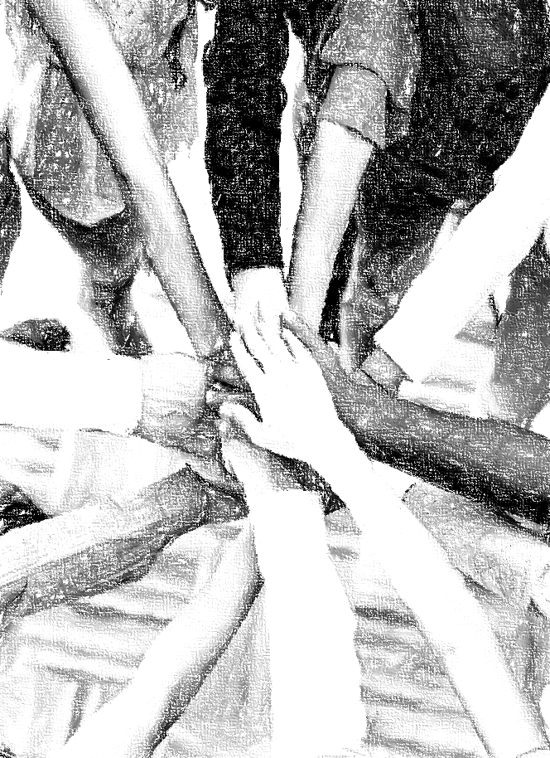
Acknowledgements
Background, Setting, Outlines, some Study Question answers, interpretative challenges, and some Summaries: Adapted from John MacArthur Study Bible at GTY.org.
Key verses, Practical Application, some Study Question answers, and some Summaries: Adapted from GotQuestions.org.
Inductive Bible Study Method: Adapted from Precept.org.
Creation – Consummation Icons: Adapted from AnswersInGenesis.org.
Definitions: Adapted from Websters 1828 Dictionary.
Bible Reference Software and Quotes: All Scripture quotations are taken from the Holy Bible using primarily the English Standard Version (ESV) or New American Standard Bible (NASB) translations. Links to Scripture references utilize BibleRef.com, which is a Got Questions Ministries’ website.

Slide 26
Study Leader Assistance
Sample Prayers
Study Question Answer Keys

Slide 27
Sample Opening Prayer: Jeremiah
Jeremiah 9:12-14, “Who is the man so wise that he can understand this? To whom has the mouth of the LORD spoken, that he may declare it? Why is the land ruined and laid waste like a wilderness, so that no one passes through? And the LORD says: "Because they have forsaken my law that I set before them, and have not obeyed my voice or walked in accord with it, but have stubbornly followed their own hearts and have gone after the Baals, as their fathers taught them.”
Jeremiah 9:23-24, “Thus says the LORD: ‘Let not the wise man boast in his wisdom, let not the mighty man boast in his might, let not the rich man boast in his riches, but let him who boasts boast in this, that he understands and knows me, that I am the LORD who practices steadfast love, justice, and righteousness in the earth. For in these things I delight, declares the LORD.’"
Sample Prayer: Dear Heavenly Father, forgive us for continuing to devise our own ways apart from you. Help us to understand that your commands are meant to keep us from harm and from injuring others. Grant us the wisdom we so desperately need to know and understand you. Holy Spirit work in us to obey you and help us to practice steadfast love, justice and righteousness in our personal lives, in our churches, and as a nation. Transform us into children you can delight in; for we do love you, Lord. In Jesus’ name we pray.

Slide 28
JEREMIAH: Study Question Answers
I Will Punish Their Sins
Part 1: Jeremiah 14:10-12, “Thus says the LORD concerning this people: ‘They have loved to wander thus; they have not restrained their feet; therefore, the LORD does not accept them; now he will remember their iniquity and punish their sins.’ The LORD said to me: ‘Do not pray for the welfare of this people. Though they fast, I will not hear their cry, and though they offer burnt offering and grain offering, I will not accept them. But I will consume them by the sword, by famine, and by pestilence.’"
How does God’s instructions to Jeremiah not to pray for the welfare of the people of Judah differ from the instructions God gave in Isaiah 62:6-7? Answer: God instructed Jeremiah not to pray for the generation in his day because they were unrepentant and thus, God had determined they would be punished for their sins. The matter was therefore settled and coming quickly. However, in Isaiah 62:6-7, God is speaking of the time when he will fully restore Israel and Judah and make Jerusalem a praise in the earth. This will be done in Jesus’ Millennial kingdom for the generation of Israel coming out of the Great Tribulation. For this outcome we are to pray without rest.
As students of God’s word how does this help you understand the link between effective prayer and discerning God’s timeline? Answer: We are to seek to learn the whole counsel of God and understand where we are in his timetable so that we can more effectively align our prayers with God’s plan. See also 1 Chronicles 12:32.
In Jeremiah 7:27-34 God lists several of the sins of Judah that led to this sentence of judgment for this generation in Judah? What sins do you find listed there? Answer: They did not obey God’s voice, accept discipline, and had stop speaking truth (v28). They had set up detestable things in God’s temple and their idolatry had become so evil that they were sacrificing their children by fire to a false god.
Part 2: Jeremiah 15:1-2, “Then the LORD said to me, "Though Moses and Samuel stood before me, yet my heart would not turn toward this people. Send them out of my sight and let them go! And when they ask you, 'Where shall we go?' you shall say to them, 'Thus says the LORD: "'Those who are for pestilence, to pestilence, and those who are for the sword, to the sword; those who are for famine, to famine, and those who are for captivity, to captivity.’”
The Lord had determined that He would punish those living in Judah during Jeremiah’s day. He had sent Jeremiah to warn them of His coming wrath but they did not repent. In Jeremiah 21:1-10, we read that Zedekiah sends Pashur to Jeremiah because the Chaldeans had come to make war on the land.
  What did the Lord say His part would be in this fight? Answer: God said, I will turn back your weapons, I will bring them [the Babylonians] into the city, and I will fight against you. I will strike down the inhabitants of this city, both man and beast, I will give Zedekiah into the hands of Nebuchadnezzar. Those in the city will die by pestilence, sword, or famine.
  What way of salvation from the sword, famine, and pestilence did the Lord give to the inhabitants of Judah? Answer: God promised that anyone who went out and surrendered to the Chaldeans would save his life.
  To be saved from the coming punishment, people had to discern which prophet(s) they believed was truly from the Lord. What application can you draw from situations we face in our time? Answer: In our day we also face many religions and leaders claiming to have heard from God. We must rely on the Holy Spirit of Jesus Christ as we study His word to guide us into Truth and protect us from error.
The Nations
Jeremiah 18:7-10, “If at any time I declare concerning a nation or a kingdom, that I will pluck up and break down and destroy it, and if that nation, concerning which I have spoken, turns from its evil, I will relent of the disaster that I intended to do to it. And if at any time I declare concerning a nation or a kingdom that I will build and plant it, and if it does evil in my sight, not listening to my voice, then I will relent of the good that I had intended to do to it. ”
What does this passage tell us about how nations and kingdoms are established? See also Acts 17:22-26. Answer: God determines the allotted periods and boundaries of all nations. It is God who plants nations and brings them to an end.
Based on the passage, what is needed for any nation to be built up and to avoid being torn down? Answer: The extent to which a nation’s leaders and people listen and obey God’s voice determines whether He will build them up or bring disaster and pluck them up.
Salvation for Israel and Judah
Jeremiah 33:14-16, "Behold, the days are coming, declares the LORD, when I will fulfill the promise I made to the house of Israel and the house of Judah. In those days and at that time I will cause a righteous Branch to spring up for David, and he shall execute justice and righteousness in the land. In those days Judah will be saved, and Jerusalem will dwell securely. And this is the name by which it will be called: 'The LORD is our righteousness.
Can you see a relationship between God’s declaration concerning Israel and Judah in Jeremiah 33:14-16 with what we are taught in Romans 11:25-27? Explain. Answer: Yes, both these passages speak of the day when God will bring the salvation of Jesus to all Israel and Judah. Gentile believers are to realize that since ~30 A.D. there has always been a remnant of Jewish Christians, but God has allowed a partial hardening of Israel while he brings in the Gentiles. But God has promised that one day all Israel will be saved. Scripture ties this salvation of Israel in with the end time events where God will purge the Earth of evil, bring salvation to the Jews, and establish the visible kingdom of Jesus Christ.
What figurative language does God use in Jeremiah 33:20-22 to indicate the certainty of his promised salvation to a remnant from the nations of Israel and Judah? Answer: God says only if someone can break his covenant with day and night so that they do not come at their appointed times would his covenant with David be broken. In other words, it is impossible for no one can thwart the Almighty and cause Him to break a covenant.

Slide 29
Sample Closing Prayer Verse
Jeremiah 17:5-10, “Thus says the LORD: "Cursed is the man who trusts in man and makes flesh his strength, whose heart turns away from the LORD. He is like a shrub in the desert, and shall not see any good come. He shall dwell in the parched places of the wilderness, in an uninhabited salt land.
Blessed is the man who trusts in the LORD, whose trust is the LORD. He is like a tree planted by water, that sends out its roots by the stream, and does not fear when heat comes, for its leaves remain green, and is not anxious in the year of drought, for it does not cease to bear fruit.' The heart is deceitful above all things, and desperately sick; who can understand it? 'I the LORD search the heart and test the mind, to give every man according to his ways, according to the fruit of his deeds.'"
Sample Prayer: Dear Heavenly Father, thank you that you have shown us how to be like a tree planted by the water. Such a tree you have promised will be without anxiety and bearing fruit even in seasons of drought. You are the Living Water. Plant us and keep us near you. Let us not trust in our own hearts or in the wisdom and strength of other men. You have warned us that the human heart is deceitful and desperately sick. This is the reality we see around us each day. You, O Lord, alone are good and the source of everything that is beneficial and right. May our trust be in You alone all our days. In Jesus we pray. Amen.

