Slide 1
Genesis
Book 1

Slide 2
What is the Holy Bible?
The Holy Bible is a collection of writings that includes 66 books in English editions. The Bible consists of two parts, the Old Testament and New Testament. The word testament means covenant. The Old Testament includes 39 books, and the New Testament includes 27 books.
These 66 books were written over approximately 1,400 years by 40 different authors in Hebrew, Aramaic, and Greek. The Old Testament writings were affirmed by Jewish leaders, and moreover, by Jesus Christ.¹ The New Testament writings were confirmed by early church leaders. The 66 books of the Bible are the inspired words of God that are used to make and mature disciples of the One true God through Jesus Christ, his Son (Matthew 28:18-20, 2 Timothy 3:16-17). The Bible was not created by mere human wisdom but was inspired by God (2 Peter 1:20-21), is interpreted by His Holy Spirit (John 16:13, Matthew 23:8-10), and will last forever (Matthew 24:35).²
If you do a phrase search on the Bible you will find the phrase "the word of the Lord" and "Thus says the Lord" more than 700 times.³ In addition, this book has given reasonable evidence to the claim of being God’s word by:​
  providing answers that conform with the reality we see around us.
  being a reliable collection of historical documents.
  containing eyewitness accounts that were written during the lifetimes of other eyewitnesses.
  recording supernatural events that took place in fulfillment of specific prophecies.⁴
Notes:
¹ See Matthew 4:4-7, 12:3-5, Mark 7:6-7, 12:26-27, and Luke 19:46 for examples.
^{2 “}What are the Books of the Bible”, GotQuestions.org
³ Blue Letter Bible
⁴ Paraphrased from Voddie Baucham

Slide 3
Our Goals in Studying the Bible
To better …..
Understand the Only true God; the Author of the Bible. (2 Timothy 3:16-17, 2 Peter 1:20-21, 1 John 5:20 , Jeremiah 9:23-24)
Learn How He works in the World and in our Lives. (Job 40:6-14, Isaiah 45:6-7, Isaiah 46:8-10, Philippians 2:12-13)
Understand Ourselves and the Hearts of Mankind. (Jeremiah 17:9, 2 Timothy 3:13, Ephesians 5:7-10)
Come to Know What Pleases and Grieves God. (1 Thessalonians 4:1, Ephesians 4:26-31, Hebrews 11:6, 1 Peter 1:14-19)
To be Transformed into Fruitful Doers of God’s Word and not just Hearers. (Romans 12:2, James 1:27, Matthew 3:8)
Tether Ourselves to God’s Word for Our Wisdom, Discernment, and Safety. (1 Corinthians 6:9-10, Matthew 24:24, Ephesians 4:11-14)
Jeremiah 9:23-24 “Thus says the Lord: "Let not the wise man boast in his wisdom, let not the mighty man boast in his might, let not the rich man boast in his riches, but let him who boasts boast in this, that he understands and knows me, that I am the Lord who practices steadfast love, justice, and righteousness in the earth. For in these things I delight, declares the Lord."

Slide 4
How to Study the Bible
#1. Observation: What does the text say.
Who?
What?
When?
Where?
How?
Why?
#2. Interpretation: What does the text mean in context with the passage, book, and whole counsel of God?
#3. Application: How is the Holy Spirit instructing me to apply this understanding at this time in my life?

Slide 5
Study Resources
Opening Prayer
Background and Setting
Book Outline
Geography Maps
Key Verses
Study Questions
Major Event Timeline
Book Summary
Application and Closing Prayer
Study Leader Support Slides

Slide 6

Opening Prayer Verse: Genesis
Genesis 1:1-5, "In the beginning, God created the heavens and the earth. The earth was without form and void, and darkness was over the face of the deep. And the Spirit of God was hovering over the face of the waters. And God said, "Let there be light," and there was light. And God saw that the light was good. And God separated the light from the darkness. God called the light Day, and the darkness he called Night. And there was evening and there was morning, the first day."

Slide 7
Old Testament Table of Contents (39 Books)
THE LAW - 5
GENESIS
EXODUS
LEVITICUS
NUMBERS
DEUTERONOMY
POETRY - 5
JOB
PSALMS
PROVERBS
ECCLESIASTES
SONG OF SOLOMON
MINOR PROPHETS – 12
HOSEA
JOEL
AMOS
OBADIAH
JONAH
MICAH
NAHUM
HABAKKUK
ZEPHANIAH
HAGGAI
ZECHARIAH
MALACHI
HISTORY – 12
JOSHUA
JUDGES
RUTH
1 SAMUEL
2 SAMUEL
1 KINGS
2 KINGS
1 CHRONICLES
2 CHRONICLES
EZRA
NEHEMIAH
ESTHER
MAJOR PROPHETS - 5
ISAIAH
JEREMIAH
LAMENTATIONS
EZEKIEL
DANIEL

Slide 8
Old Testament Books by Date Written
Historical Books
Wisdom Book and Prophetic Books
Genesis:
c. 1445-1400 B.C.
Exodus:
c. 1445-1400 B.C.
Leviticus:
c. 1445-1400 B.C.
Numbers:
c. 1405 B.C.
Deut:
c. 1405 B.C.
Joshua:
c. 1405-1385 B.C.
Judges:
c. 1043 B.C.
1 & 2 Samuel:
c. 960-722 B.C.
1 & 2 Kings:
c. 560-540 B.C.
Ezra:
c. 460-440 B.C
Esther:
c. 460-350 B.C..
1 & 2 Chron:
c. 450-425 B.C.
Nehemiah:
c. 445-420 B.C.
Ruth
c. 1011-971 B.C.
Job:
c. 1440 – 950 B.C.
Psalms:
c. 1410-500 B.C.
Proverbs and Song of Solomon:
c. 965 B.C.
Ecclesiastes:
c. 930 B.C.
Obadiah:
c. 848-840 B.C.
Joel:
c. 835 – 796 B.C
Jonah
c. 790 – 739 B.C.
Isaiah and Micah:
c. 739 – 681 B.C.
Nahum:
c. 663–612 B.C.
Habakkuk and Zephaniah:
c. 635-605 B.C
Jeremiah and Lamentations
c. 630-575 B.C.
Ezekiel and Daniel:
c. 593 – 530 B.C.
Haggai and Zechariah
c. 520-470 B.C.
Malachi
c. 440 – 400 B.C.
Hosea and Amos:
c. 760 -725 B.C.
Amos 3:7 : “For the Lord GOD does nothing without revealing his secret to his servants the prophets.”

Slide 9


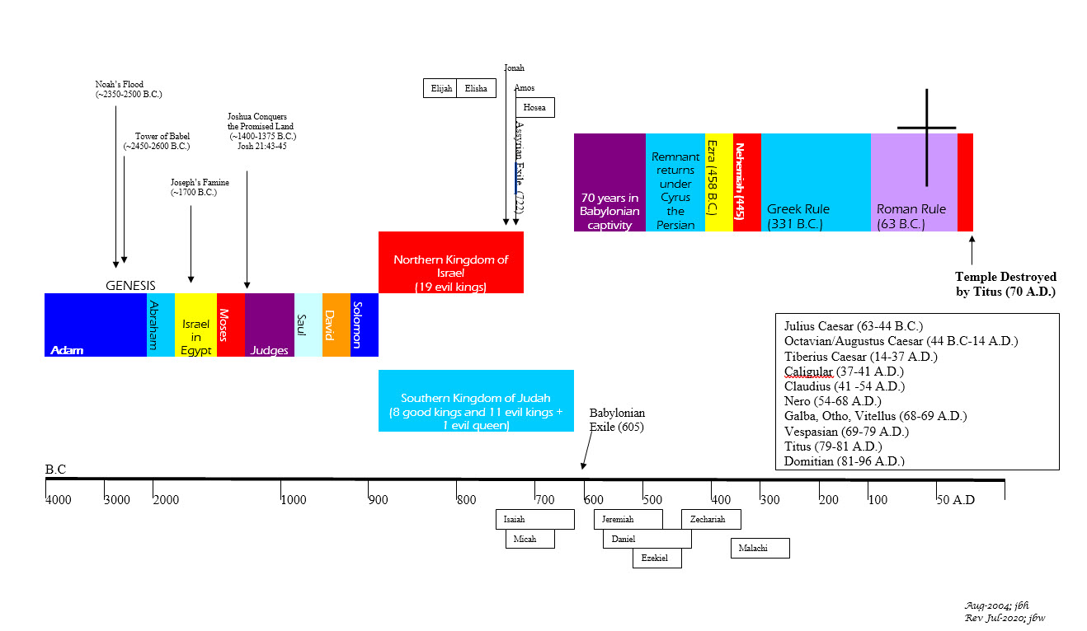





BIBLICAL CHRONOLOGICAL BACKGROUND
OT
Cyrus the Great (Cyrus II)
Darius the Mede
Darius I
Xerxes I (Esther and Mordecai)
Artaxerxes I
NT
Jehu (1 Kings 16:7)
Micaiah: (1 Kings 22:8)
Huldah: (2 Kings 22:14)
Obed (2 Chr 28:9)
Job
Daniel 9:25-26
Prophets after Noah into the United Kingdom:
Abraham:
Moses:
Samuel:
Gad:
Nathan:
Ahijah
Asaph
(Gen 20:7)
(Exo 3:10)
(1 Sam 3:20)
(1 Sam 22:5)
(2 Sam 7:2)
(1 Kings 11:29)
(2 Chron 35:15)
Haggai
Mosaic Law and Covenant
Law of sin & death, the letter kills
Ministry of condemnation carved in stone
Glory fading away
Shemaiah: (2 Chr 12:15)
Iddo: (2 Chr 12:15)
Hanani: (2 Chr 16:7)
Jehu: (2 Chr 19:2)
Jeduthun: (2 Chr 35:15)
New Covenant of Jesus Christ
The Law of the Spirit of life
Ministry of righteousness on hearts
Eternal and exceeding in glory
Timeline is not to scale

Slide 10
Genesis
Author: Moses
Date of Writing: c.1445 - 1400 B.C.

Slide 11
About Genesis and the Author: Moses
The English title, Genesis, comes from the Greek Bible translation (i.e., Septuagint, LXX) meaning “origins”; whereas the Hebrew title is derived from the Bible’s very first word, translated “in the beginning.” Genesis serves to introduce the Pentateuch (the first five books of the Old Testament) and the entire Bible. The influence of Genesis in Scripture is demonstrated by its being quoted over 35 times in the New Testament and hundreds of references appearing in both Testaments. The story line of salvation that begins in Genesis 3 is not completed until Revelation 21–22, where the eternal kingdom of redeemed believers is gloriously pictured.
While the author does not identify himself in Genesis, and Genesis ends almost three centuries before Moses was born, both the Old Testament¹ (e.g., Exodus 17:14; Numbers 33:2) and the New Testament² (e.g., Matthew 8:4; Mark 12:26) ascribe this composition to Moses. The educational background of Moses also lends support to his authorship (Acts 7:22). No compelling reasons have been forthcoming to challenge Mosaic authorship. Genesis was written after the Exodus (c. 1445 B.C.), but before Moses’ death (c. 1405 B.C.). For a brief biographical sketch of Moses read Exodus 1–6.
DATE: c. 1445 -1400 B.C.
Notes:
¹ Ex. 17:14; Num. 33:2; Josh. 8:31; 1 Kings 2:3; 2 Kings 14:6; Ezra 6:18; Neh. 13:1; Dan. 9:11, 13; Mal. 4:4
² Matt. 8:4; Mark 12:26; Luke 16:29; 24:27, 44; John 5:46; 7:22; Acts 15:1; Rom. 10:19; 1 Cor. 9:9; 2 Cor. 3:15

Slide 12
Genesis Background and Setting
The initial setting for Genesis is eternity past. God then, by willful act and divine word, spoke all creation into existence, furnished it, and finally breathed life into a lump of dirt, which he fashioned in his image to become Adam. God made mankind the crowning point of his creation (i.e., his companions who would enjoy fellowship with him and bring glory to his name).
The historical background for the early events in Genesis is clearly Mesopotamia. While it is difficult to pinpoint precisely the historical moment for which this book was written, Israel first heard Genesis read sometime prior to crossing the Jordan River and entering the Promised Land (c. 1405 B.C.).
Genesis has three distinct, sequential geographical settings:
  Chapters 1 – 11 in Mesopotamia covering Creation c. 4000 B.C. until ~2090 B.C.
  Chapters 12 – 36 in the Promised Land spanning c. 2090 –1897 B.C.
  Chapters 37 – 50 in Egypt covering c. 1897–1804 B.C.
By content Genesis is comprised of two basic sections: 1) Primitive history (Genesis 1–11) and 2) Patriarchal history (Genesis 12–50).
Genesis covers more time than the remaining books of the Bible combined.
Primitive history records four major events:
  Creation: Gen. 1–2
  Corruption (aka the Fall): Gen. 3–5
  Catastrophe (aka the world-wide Flood): Gen. 6–9
  Confusion (aka the dispersion at Babel): Gen. 10–11
Patriarchal history spotlights four great men:
  Abraham: Gen. 12:1–25:8
  Isaac: Gen. 21:1–35:29
  Jacob: Gen. 25:21–50:14
  Joseph: Gen. 30:22–50:26

Slide 13
Genesis: Outlined As the “Book of the Generations of”
The Generations of Isaac
  God's Word to Rebekah on Esau and Jacob
  Esau Sells His Birthright to Jacob
  Covenant Blessings to Isaac
  Jacob’s Deception for the Blessing
  Blessing on Jacob in a Foreign Land
  Covenant Blessings to Jacob
  God renames Jacob to Israel
  Return to the Promised Land
The Generations of Terah
  Abraham
  Abrahamic Covenant
  Journey to the Promised Land
  The covenant confirmed
  Abraham’s act of faith with Isaac
  Abraham’s Promised Seed
  Isaac the only heir
The Generations of Jacob
  Joseph's Dreams
  Family Tragedy
  Joseph's Rise to Power in Egypt
  Family Reunion
  Journey to Egypt
  Jacob's Blesses His Sons
  Joseph's Request and Death
The Creation of Heaven and Earth
The Generations of Adam
  Seth to Noah
  Rampant Sin
The Generations of Shem, Ham, and Japheth
  The Nations
  Dispersion of the Nations at Babel
Genesis 1:1–2:3
Genesis 2:4–4:26
Genesis 5:1–6:8
Genesis 6:9–9:29
Genesis 10:1-11:9
Genesis 11:10-26
Genesis 11:27–25:11
Genesis 25:12–18
Genesis 25:19–35:29
Genesis 36:1–37:1
Genesis 37:2–50:26
The Generations of the Heavens and the Earth
  Adam and Eve
  The Fall
  Cain’s murder of Abel
  Hope through Seth
The Generations of Noah
Flood preparation
The Flood & Deliverance
Noahic Covenant
Noah’s Descendants
The Generations of Shem to Terah
The Generations of Esau
The Generations of Ishmael

Slide 14
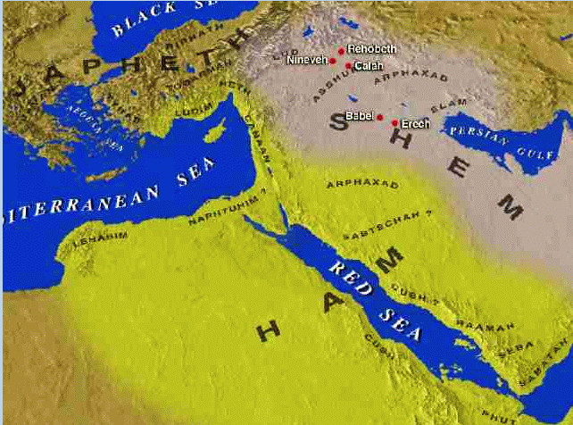
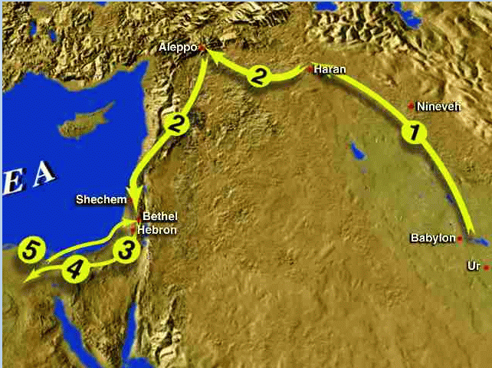
Geography
Map of Nations after Babel
Abraham’s Journey from Ur

Slide 15
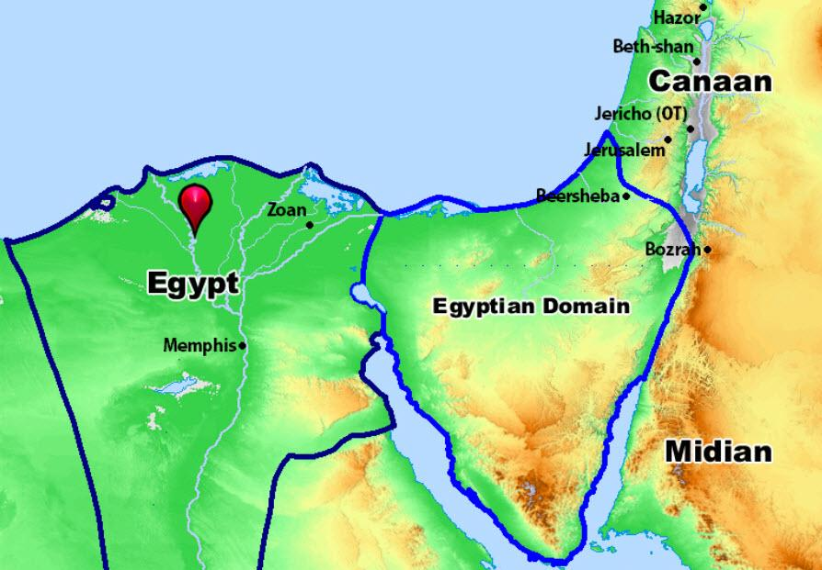
Geography (continued)
Abram’s Journey from Ur
Map of Canaan

Slide 16
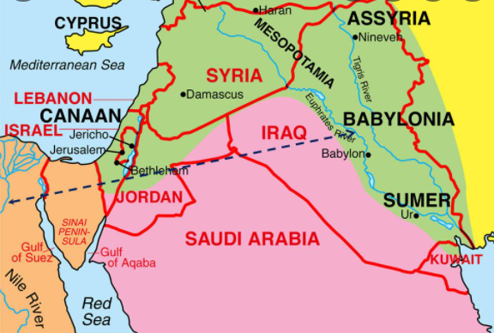
Geography (continued)
Map of Canaan
Land from Nile to Euphrates River

Slide 17
Genesis: Key Verses
Genesis 1:1, "In the beginning God created the heavens and the earth."
Genesis 1:26-27, "Then God said, 'Let Us make mankind in Our image, according to Our likeness; and let them rule over the fish of the sea and over the birds of the sky and over the livestock and over all the earth, and over every crawling thing that crawls on the earth.' So God created man in His own image, in the image of God He created him; male and female He created them.“
Genesis 3:6, "When the woman saw that the tree was good for food, and that it was a delight to the eyes, and that the tree was desirable to make one wise, she took some of its fruit and ate; and she also gave some to her husband with her, and he ate.“
Genesis 3:15, "And I will put enmity between you and the woman, and between your offspring and hers; he will crush your head, and you will strike his heel.“
Genesis 3:20, "Now the man named his wife Eve, because she was the mother of all the living."
Genesis 5:1-2, "This is the book of the generations of Adam. On the day when God created man, He made him in the likeness of God. He created them male and female, and He blessed them and named them 'mankind' on the day when they were created.“
Genesis 12:1-3, "Now the Lord said to Abram, "Go from your country and your kindred and your father 's house to the land that I will show you. And I will make of you a great nation, and I will bless you and make your name great, so that you will be a blessing. I will bless those who bless you, and him who dishonors you I will curse, and in you all the families of the earth shall be blessed.“
Genesis 26:1b-5, "And Isaac went to Gerar to Abimelech king of the Philistines. And the Lord appeared to him and said, "Do not go down to Egypt; dwell in the land of which I shall tell you. Sojourn in this land, and I will be with you and will bless you, for to you and to your offspring I will give all these lands, and I will establish the oath that I swore to Abraham your father. I will multiply your offspring as the stars of heaven and will give to your offspring all these lands. And in your offspring all the nations of the earth shall be blessed, because Abraham obeyed my voice and kept my charge, my commandments, my statutes, and my laws.“
Genesis 28:10-15, "Jacob left Beersheba and went toward Haran. And he came to a certain place and stayed there that night, because the sun had set. Taking one of the stones of the place, he put it under his head and lay down in that place to sleep. And he dreamed, and behold, there was a ladder set up on the earth, and the top of it reached to heaven. And behold, the angels of God were ascending and descending on it! And behold, the Lord stood above it and said, "I am the Lord, the God of Abraham your father and the God of Isaac. The land on which you lie I will give to you and to your offspring. Your offspring shall be like the dust of the earth, and you shall spread abroad to the west and to the east and to the north and to the south, and in you and your offspring shall all the families of the earth be blessed. Behold, I am with you and will.“
Genesis 49:10, "The scepter shall not depart from Judah, nor the ruler 's staff from between his feet, until tribute comes to him; and to him shall be the obedience of the peoples."
Genesis 50:20, "You intended to harm me, but God intended it for good to accomplish what is now being done, the saving of many lives."

Slide 18
Genesis: Study Questions
Using the NASB or ESV Bible, read Genesis 1:1-31 and record the number of times you read the phrases 1) “there was evening and there was morning” and 2) “after their kind” (NASB) or “according to their/its kind(s)” (ESV) in this passage?
The Holy Spirit covers more than two millennium in this book. What sound conclusion can you draw for why God took the time to repeat the two phrases from question #1?
According to Genesis 3:20 who became the mother of all the living and what does this mean (see also Acts 17:26)?
Read Genesis 1:26-31 and 5:1-2. What special insights do we learn about Mankind from these two passages and how does knowing this impact your view of yourself and others?
After the world-wide flood recorded in Genesis 6-8, God gives instructions to Noah and his sons in Genesis 9:1-19 and makes a covenant with them. List as many distinct items you can find recorded in God’s blessings and covenant in this passage.
The book of Genesis takes us into eternity past where God allows us to see that by his will and divine word He spoke into existence and furnished a perfect universe. God lays the foundation for us to understand who He is, who we are, where we came from, why we are here, why we wear clothes, why we marry, and how sin and death entered his perfect creation. Take a moment to reflect on God’s dealings with Adam and Eve, Noah, Abraham, Isaac, and Joseph, and record a few things you have gleaned regarding God’s character and interaction with man.

Slide 19
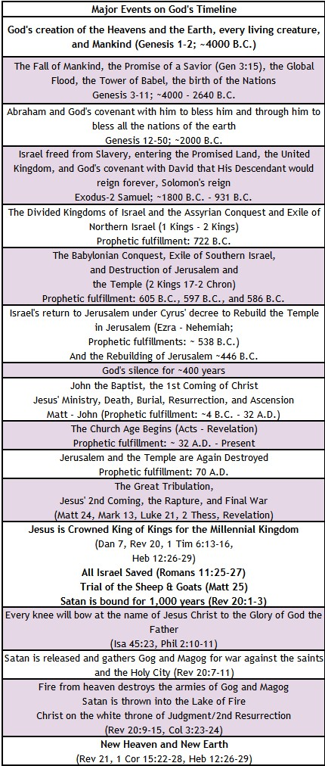


GOD’S TIMELINE
Genesis
Genesis 1:15-17, "The Lord God took the man and put him in the garden of Eden to work it and keep it. And the Lord God commanded the man, saying, "You may surely eat of every tree of the garden, but of the tree of the knowledge of good and evil you shall not eat, for in the day that you eat of it you shall surely die."
Genesis 1:31, "And God saw everything that he had made, and behold, it was very good. And there was evening and there was morning, the sixth day."
Genesis 3:1 and 3:6, Now the serpent was more crafty than any other beast of the field that the Lord God had made. He said to the woman, "Did God actually say, ‘You shall not eat of any tree in the garden’?"..."So when the woman saw that the tree was good for food, and that it was a delight to the eyes, and that the tree was to be desired to make one wise, she took of its fruit and ate, and she also gave some to her husband who was with her, and he ate."
Genesis 3:14a and 3:15, "The Lord God said to the serpent, .... 'I will put enmity between you and the woman, and between your offspring and her offspring; he shall bruise your head, and you shall bruise his heel."
Genesis 11:6-8, "And the Lord said, "Behold, they are one people, and they have all one language, and this is only the beginning of what they will do. And nothing that they propose to do will now be impossible for them. Come, let us go down and there confuse their language, so that they may not understand one another's speech. 8So the Lord dispersed them from there over the face of all the earth, and they left off building the city."
Genesis 6:11-13, "Now the earth was corrupt in God 's sight, and the earth was filled with violence. And God saw the earth, and behold, it was corrupt, for all flesh had corrupted their way on the earth. And God said to Noah, "I have determined to make an end of all flesh, for the earth is filled with violence through them. Behold, I will destroy them with the earth."
Genesis 12:1-3, "Now the Lord said to Abram, "Go from your country and your kindred and your father 's house to the land that I will show you. And I will make of you a great nation, and I will bless you and make your name great, so that you will be a blessing. I will bless those who bless you, and him who dishonors you I will curse, and in you all the families of the earth shall be blessed."

Slide 20
Summary of Genesis
Brief Summary: The Book of Genesis was written c. 1445-1400 B.C. by Moses as affirmed by Jesus Christ (see Mark 12:24-27, Luke 20:34-38). This is the book of the beginnings, which provides the historical account of the universe God created. In the beginning God created the earth for habitation (Isaiah 45:18), the universe to declare his glory (Psalm 19:1-3), and all living creatures after their own kinds in six days and rested on the seventh day (Genesis 1:1-31); establishing our work week (Exodus 20:8-11). He made mankind, male and female, specifically, Adam and Eve, in his own image to have communion with Him, be the original parents of all human beings, and to have dominion over all other living creatures. God gave them only one commandment to obey; and everything was very good. But man believed the evil one, mistrusted God’s words, and disobeyed God. This brought God's punishment of death into the world, pain in childbirth, and burdensome toil in bringing food from the ground. Yet God in His mercy also promised a Seed of the woman who would bruise the head of the serpent (Genesis 3:1-24). In Genesis God lays the foundation for us to understand who He is, who we are, where we came from, why we are here, why we wear clothes, why we marry and have families, and how sin, hardship, and death entered his perfect world. In the sequence of accounts that make up these chapters of Scripture, a pattern emerges that reveals God’s abundant grace as he responded to the repeated willful disobedience of mankind.
Genesis can be divided into two sections: Primitive History (Genesis 1-11) and Patriarchal History (Genesis 12-50). Primitive history records (1) Creation, (2) Corruption (the Fall of man), (3) Catastrophe (the Flood), and (4) Confusion (God’s confounding of the languages that resulted in the nations). Patriarchal history records the lives of four great men: (1) Abraham, (2) Isaac, (3) Jacob, and (4) Joseph. God chose Abraham through whom He would create a chosen people and eventually bring the promised Messiah. This covenant promise was passed on to Abraham’s son Isaac, and then to Isaac’s son Jacob. God changed Jacob’s name to Israel, and his twelve sons became the ancestors of the twelve tribes of Israel. In His sovereignty, God allowed Jacob’s son Joseph to be sent to Egypt by the vile actions of Joseph’s brothers. This act, intended for evil by the brothers, was meant for good by God. Through God’s providence Joseph rose to power in Egypt and his actions saved many lives from a devastating famine including the lives of Jacob, his brothers, and their families. Before Jacob’s death he bestowed prophetic blessings upon his sons. God ends this book with a message of hope as we read that when Joseph was near death, he requested that his bones be taken to the Promised Land when God fulfilled his pledge to Abraham to give his descendants the land.
Foreshadowings: Many New Testament themes have their roots in Genesis. Jesus Christ is the Seed of the woman who will destroy Satan’s power (Genesis 3:15, John 3:16). As with Joseph, God’s plan for the good of mankind through the sacrifice of His Son was intended for good, even though those who crucified Jesus intended it for evil (Acts 2:22-24). Noah and his family are the first of many remnants pictured in the Bible (Genesis 6-9). Despite overwhelming odds and difficult circumstances, God always preserves a remnant of the faithful for Himself. God told Elijah he had preserved 7,000 in Israel who had not turned to idolatry (1 Kings 19:13-18) and saved 100 prophets from Jezebel’s murderous rampage (1 Kings 18:3-4). A remnant of Israelites returned to Jerusalem after the Babylonian captivity and destruction (Ezra 1). God has preserved a remnant of faithful Jews through history (Acts 1-9, Jews for Jesus). Moreover, God promises that a remnant generation of all Israel will one day embrace their true Messiah (Romans 11:25-27). The faith displayed by Abraham would be the gift of God and the basis of salvation for both Jew and Gentile (Ephesians 2:8-9; Hebrews 11).

Slide 21
Genesis: Practial Application
Practical Application: The overriding theme of Genesis is God’s eternal existence and His creation of the world. There is no effort on the part of the author to defend the existence of God; he simply states that God is, always was, and always will be, almighty over all. In the same way, we have confidence in the truths of Genesis, despite the claims of those who would deny them. All people, regardless of culture, nationality or language, are accountable to the Creator. But because of sin, introduced into the world at the Fall, we are separated from Him. But through one small nation, Israel, God’s redemptive plan for mankind was revealed and made available to all. We rejoice in that plan.
God created the universe, the earth, and every living being. We can trust Him to handle the concerns in our lives. God can take a hopeless situation, e.g. Abraham and Sarah being childless, and do amazing things if we will simply trust and obey. Terrible and unjust things may happen in our lives, as with Joseph, but God will always bring about a greater good if we have faith in Him and His sovereign plan. “And we know that all things work together for good to them that love God, to them who are the called according to his purpose” (Romans 8:28).

Slide 22
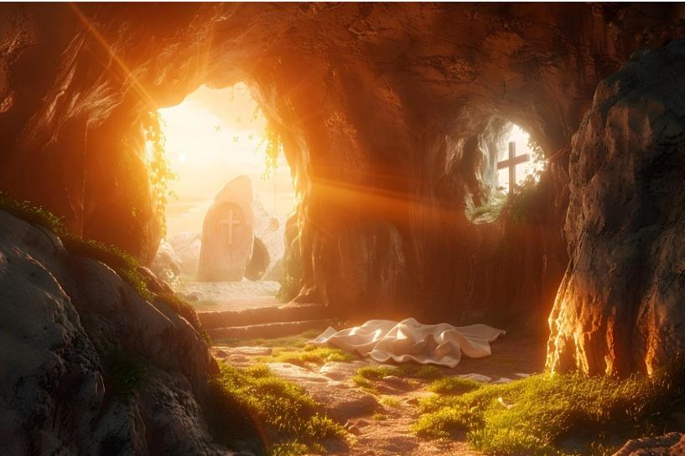
Closing Prayer Verse
Genesis 50:24-25, "And Joseph said to his brothers, "I am about to die, but God will visit you and bring you up out of this land to the land that he swore to Abraham, to Isaac, and to Jacob." Then Joseph made the sons of Israel swear, saying, "God will surely visit you, and you shall carry up my bones from here." So, Joseph died, being 110 years old. They embalmed him, and he was put in a coffin in Egypt."

Slide 23
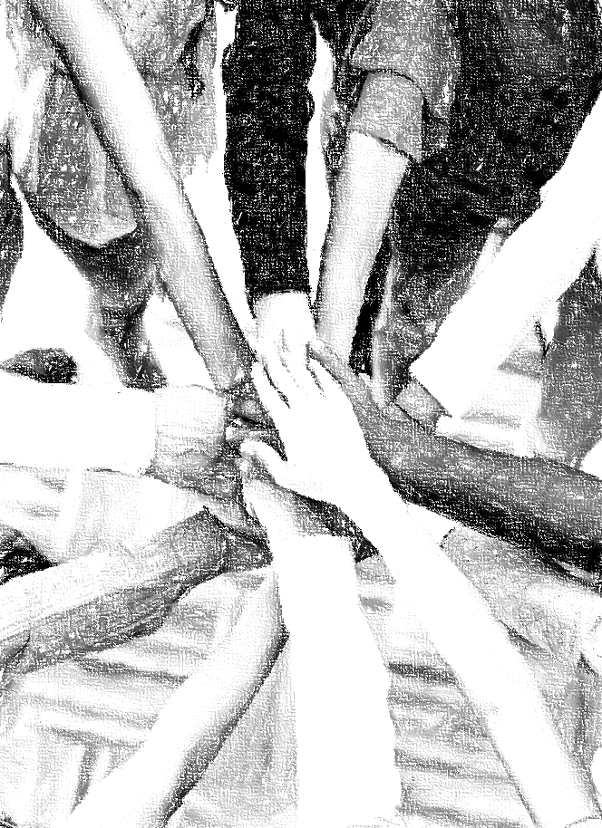
Acknowledgements
Background, Setting, Outlines, some Study Question answers, interpretative challenges, and some Summaries: Adapted from John MacArthur Study Bible at GTY.org.
Key verses, Practical Application, some Study Question answers, and some Summaries: Adapted from GotQuestions.org.
Inductive Bible Study Method: Adapted from Precept.org.
Creation – Consummation Icons: Adapted from AnswersInGenesis.org.
Definitions: Adapted from Websters 1828 Dictionary.

Slide 24
Study Leader Assistance
Sample Opening Prayer
Study Question Answer Keys
Sample Closing Prayer

Slide 25
Sample Opening Prayer: Genesis
Genesis 1:1-5, "In the beginning, God created the heavens and the earth. The earth was without form and void, and darkness was over the face of the deep. And the Spirit of God was hovering over the face of the waters. And God said, "Let there be light," and there was light. And God saw that the light was good. And God separated the light from the darkness. God called the light Day, and the darkness he called Night. And there was evening and there was morning, the first day.“
Sample Prayer: Dear Heavenly Father, we are amazed by your power and generosity on display with each new evening and morning. Thank you for furnishing the heavens and the earth with so much beauty and enabling us to see the evidence of your glory and lovingkindness. We praise you that we are fearfully and wonderfully made in your image though we have marred our human image with our rebellion. We repent of our part in the wickedness that continues the curse. Thank you that before you founded the earth you had a plan to rescue us through Jesus Christ, your Son. Empower us to live in a manner worthy of Him and keep us in His name we pray. Amen.

Slide 26
Genesis: Study Questions Answers
Using the NASB or ESV Bible, read Genesis 1:1-31 and record the number of times you read the phrases 1) “there was evening and there was morning” and 2) “after their kind” (NASB) or “according to their/its kind(s)” (ESV) in this passage? Answer: Six times for “there was evening and there was morning” and eight times for “after their kind” or “according to their or its kind(s)”.
The Holy Spirit covers more than two millennium in this book. What sound conclusion can you draw for why God took the time to repeat the two phrases from question #1? Answer: First, God wanted us to understand the truth about the six literal 24-hour days he spent to create and furnish the heavens and the earth. He provided a light source on the first day so that when the earth he created that day rotated on its axis, there would be evening and morning, the first day. This was before he created the sun and the stars on day 4. Also, God established the timeframe for our week by setting the example with Creation. All the earth has a 7-day week, God’s number of completion in the Scriptures. We are commanded in Exodus 20:8-11 to remember the Sabbath day and keep it holy. For just as God worked 6 days to create the heavens and the earth and rested on the 7th day, we too are to follow his example every week. We declare the glory of God as Creator of the universe every week as we observe a Sabbath rest. Secondly, knowing in advance the theories man would create (e.g., macro-Evolution) to suppress the truth (Romans 1:18-20), God made it clear that He furnished creation with creatures that produce after their own kind. This is exactly what we witness in the reality around us as we see dogs reproduce dogs, birds reproduce birds, etc.
According to Genesis 3:20 who became the mother of all the living and what does this mean (see also Acts 17:26)? Answer: Genesis 3:20 tells us that Eve became the mother of all the living. This teaches us that all of mankind can trace their first parents back to Adam and Eve. We are all distant relatives, made in the image of God, fallen by the nature passed down to us by Adam and by our own rebellion in breaking God’s laws. We have offended our Creator, stand guilty before Him, and are in need of a Savior.
Read Genesis 1:26-31 and 5:1-2. What special insights do we learn about Mankind from these two passages and how does knowing this impact your view of yourself and others? Answer: First, the passage tells us that we are made in God’s image as both male and female. These are the only two genders God made for Mankind, and he blessed us to have dominion over the rest of his creatures and gave us crops and fruit to eat. In Genesis 5:1-2 we learn that God himself named us. Where Adam named the other kinds of land animals God created, we have the special privilege of being named by God. Let’s embrace the fact that we have been named “Man”, both male and female, by God. Let’s cease striving to carve out some non-existent female kind or other gender kind, for God neither created nor named any other kind for humans except Mankind.
After the world-wide flood recorded in Genesis 6-8, God gives instructions to Noah and his sons in Genesis 9:1-19 and makes a covenant with them. List as many distinct items you can find recorded in God’s blessings and covenant in this passage. Answer: 1) As with Adam and Eve, God blessed them to be fruitful and multiply and fill the earth. Thus, again we know that all of mankind living after the flood can trace their heritage back to Noah through one of his sons. How’s that for a genealogical ancestry tree? 2) God placed the fear of man upon all the other creatures of the earth. This is another truth we see that conforms with the reality around us. 3) In addition to plants, God gave animals to Man for food. Mankind had been vegetarian until after the flood. 4) God forbade Man to eat an animal with its life blood still in it. 5) God instituted capital punishment for taking a human. 6) God made an everlasting covenant with Man and the living creatures on the earth to never destroy the whole earth again with flood waters. He put his bow in the clouds as a reminder of this covenant. This bow is likely a copy of the one around God’s very throne (see Revelation 4:3).
The book of Genesis takes us into eternity past where God allows us to see that by his will and divine word He spoke into existence and furnished a perfect universe. God lays the foundation for us to understand who He is, who we are, where we came from, why we are here, why we wear clothes, why we marry, and how sin and death entered his perfect creation. Take a moment to reflect on God’s dealings with Adam and Eve, Noah, Abraham, Isaac, and Joseph, and record a few things you have gleaned regarding God’s character and interaction with man. . Answer: We see that while God is patient as man willfully continues to disobey him, he does set limits and will not allow the guilty to go unpunished. In addition, we see his abundant grace as a God who makes covenant promises of blessing with his people as he did in the Adamic, Noahic, and Abrahamic covenants. Lastly, we see that our God redeems us out of adverse circumstances and brings us into victory as we saw in the lives of Noah, Abraham, Jacob, and Joseph.

Slide 27
Closing Prayer
Genesis 50:24-25, "And Joseph said to his brothers, "I am about to die, but God will visit you and bring you up out of this land to the land that he swore to Abraham, to Isaac, and to Jacob." Then Joseph made the sons of Israel swear, saying, "God will surely visit you, and you shall carry up my bones from here." So, Joseph died, being 110 years old. They embalmed him, and he was put in a coffin in Egypt.”
Sample Prayer: Dear Heavenly Father, thank you for all the promises you made to Abraham to bless him and through him to bless all the nations of the earth. Thank you for Joseph’s great faith recorded here for us. He knew You and that your promises were sure. Joseph’s recorded request stands as a testimony that he was looking forward to the fulfillment of Israel being given the Promised Land and his desire to be in that land when you call us out of our graves, and the perishable puts on the imperishable. Keep us in this same faith that you gave to Abraham and Joseph; the faith that you would provide the Lamb. We ask this in the name of our Lord and Savior, Jesus Christ. Amen.

