Slide 1
DANIEL
Books 27
© 2026 RCI. All rights reserved.
To God Alone Be the Glory
1

Slide 2
What is the Holy Bible?
The Holy Bible is a collection of writings that includes 66 books in English editions. The Bible consists of two parts, the Old Testament and New Testament. The word testament means covenant. The Old Testament includes 39 books, and the New Testament includes 27 books.
These 66 books were written over approximately 1,400 years by 40 different authors in Hebrew, Aramaic, and Greek. The Old Testament writings were affirmed by Jewish leaders, and moreover, by Jesus Christ.¹ The New Testament writings were confirmed by early church leaders. The 66 books of the Bible are the inspired words of God that are used to make and mature disciples of the One true God through Jesus Christ, his Son (Matthew 28:18-20, 2 Timothy 3:16-17). The Bible was not created by mere human wisdom but was inspired by God (2 Peter 1:20-21), is interpreted by His Holy Spirit (John 16:13, Matthew 23:8-10), and will last forever (Matthew 24:35).²
If you do a phrase search on the Bible you will find the phrase "the word of the Lord" and "Thus says the Lord" more than 700 times.³ In addition, this book has given reasonable evidence to the claim of being God’s word by:​
  providing answers that conform with the reality we see around us.
  being a reliable collection of historical documents.
  containing eyewitness accounts that were written during the lifetimes of other eyewitnesses.
  recording supernatural events that took place in fulfillment of specific prophecies.⁴
Notes:
¹ See Matthew 4:4-7, 12:3-5, Mark 7:6-7, 12:26-27, and Luke 19:46 for examples.
^{2 “}What are the Books of the Bible”, GotQuestions.org
³ Blue Letter Bible
⁴ Paraphrased from Voddie Baucham

Slide 3
Our Goals in Studying the Bible
To better …..
Understand the Only true God; the Author of the Bible. (2 Timothy 3:16-17, 2 Peter 1:20-21, 1 John 5:20 , Jeremiah 9:23-24)
Learn How He works in the World and in our Lives. (Job 40:6-14, Isaiah 45:6-7, Isaiah 46:8-10, Philippians 2:12-13)
Understand Ourselves and the Hearts of Mankind. (Jeremiah 17:9, 2 Timothy 3:13, Ephesians 5:7-10)
Come to Know What Pleases and Grieves God. (1 Thessalonians 4:1, Ephesians 4:26-31, Hebrews 11:6, 1 Peter 1:14-19)
To be Transformed into Fruitful Doers of God’s Word and not just Hearers. (Romans 12:2, James 1:27, Matthew 3:8)
Tether Ourselves to God’s Word for Our Wisdom, Discernment, and Safety. (1 Corinthians 6:9-10, Matthew 24:24, Ephesians 4:11-14)
Jeremiah 9:23-24 “Thus says the Lord: "Let not the wise man boast in his wisdom, let not the mighty man boast in his might, let not the rich man boast in his riches, but let him who boasts boast in this, that he understands and knows me, that I am the Lord who practices steadfast love, justice, and righteousness in the earth. For in these things I delight, declares the Lord."

Slide 4
How to Study the Bible
#1. Observation: What does the text say?
Who?
What?
When?
Where?
How?
Why?
#2. Interpretation: What does the text mean in context with the passage, book, and whole counsel of God?
#3. Application: How is the Holy Spirit instructing me to apply this understanding at this time in my life?

Slide 5
Study Resources
Opening Prayer
Background and Setting
Book Outline
Geography Maps
Key Verses
Study Questions
Major Event Timeline
Book Summary
Application and Closing Prayer
Study Leader Support Slides
5

Slide 6

DANIEL: Opening Prayer
DANIEL 2:14-18, "Then Daniel replied with prudence and discretion to Arioch, the captain of the king's guard, who had gone out to kill the wise men of Babylon. He declared to Arioch, the king's captain, "Why is the decree of the king so urgent?"
Then Arioch made the matter known to Daniel. And Daniel went in and requested the king to appoint him a time, that he might show the interpretation to the king. Then Daniel went to his house and made the matter known to Hananiah, Mishael, and Azariah, his companions, and told them to seek mercy from the God of heaven concerning this mystery, so that Daniel and his companions might not be destroyed with the rest of the wise men of Babylon.”

Slide 7
Review of Ezekiel
Learning Tip: For those studying the Bible in its table‑of‑contents order, this slide gives you a brief recap of the book you just completed. Studying in a different sequence? You can simply skip this slide or treat it as a gentle nudge to circle back when the time is right.
Brief Summary: Ezekiel and his wife along with 10,000 captives were among the second group from the southern kingdom of Israel (aka Judah) deported to Babylon. This occurred in c. 597 B.C. when King Jehoiachin surrendered to Babylon. Ezekiel’s ministry began c. 593 B.C., ~13 years after the first exiles from Judah were deported to Babylon in 605 B.C. (Ezekiel 1:1). The “glory of the Lord” is central to Ezekiel, appearing in six chapters.¹ The book includes graphic descriptions of the disobedience of Israel and Judah, despite God’s kindness.² It shows God’s desire for Israel to bear fruit which he can bless; however, selfish indulgence had left Judah ready for judgment, like a torched vine (Ezekiel 15). References are plentiful to Israel’s idolatry and its consequences, such as Pelatiah dropping dead (Ezekiel 11:13), a symbolic illustration of overall disaster for the people.
Many picturesque scenes illustrate spiritual principles. Among these are Ezekiel eating a scroll (Ezekiel 2); the faces on four angels representing aspects of creation over which God rules (Ezekiel 1:10); a “barbershop” scene (Ezekiel 5:1–4); graffiti on temple walls reminding readers of what God really wants in his dwelling place, namely holiness and not ugliness (Ezekiel 8:7-10); and sprinkled hot coals depicting judgment (Ezekiel 10:2, 10:7).
Chief among the theological themes are God’s holiness and sovereignty. These are conveyed by frequent contrast of his bright glory against the despicable backdrop of Judah’s sins.³ Closely related is God’s purpose of glorious triumph so that all may “know that I am the Lord.” This divine monogram, God’s signature authenticating his acts, is mentioned more than 60 times, usually with a judgment,⁴ but occasionally after the promised restoration.⁵ God is righteous and truthful, and thankfully, He will not allow men or angels to live forever believing lies about his character and rule.
Other subjects involve God’s angels carrying out his program behind the scenes,⁶ God’s holding each individual accountable for pursuing righteousness,⁷ and the sinfulness in Israel and other nations.⁸ Ezekiel addresses the necessity of God’s wrath to deal with sin, ⁹ God’s frustration over man’s devices to escape from besieged Jerusalem,¹⁰ God’s grace pledged in the Abrahamic Covenant to restore Abraham’s people to the land of the covenant, and also through Abraham, to bless all nations with the knowledge of God.^{11 ,12} God has promised to preserve a remnant of Israelites through whom he will fulfill his restoration promises and keep his inviolate word.
Foreshadowings: Ezekiel 34 is the chapter wherein God denounces the leaders of Israel as false shepherds for their poor care of His people. Instead of caring for the sheep of Israel, they cared for themselves. They ate well, were well-clothed, and well-cared for by the very people they had been placed over (Ezekiel 34:1-3). By contrast, Jesus is the Good Shepherd who lays down His life for the sheep and who protects them from the wolves who would destroy the flock (John 10:11-12). Verse 4 of chapter 34 describes people whom the shepherds failed to minister to as weak, sick, injured, and lost. Jesus is the Great Physician who heals our spiritual wounds (Isaiah 53:5) by His death on the cross. He is the one who seeks and saves that which is lost (Luke 19:10). Ezekiel also points to many events that will occur during the great tribulation, the day when all Israel will be saved, and the Millennial kingdom.¹³ Finally, Ezekiel gives precise measurements of a holy district in Jerusalem and another temple where the glory of God will fill it. ¹⁴ This could not be the heavenly temple since Ezekiel was taken to Israel to see it (Ezekiel 40:1-3). It could not be Zerubbabel’s temple since the glory of God was not present then.¹⁵ It could not be the eternal temple since the Lord and the Lamb are its temple.¹⁶ Therefore, it must be the earthly temple built before the great tribulation with all of the exquisite details that are yet to be outlined; an earthly temple that will serve a function during the millennial kingdom (Revelation 11:1-2).
Notes:
¹ Ezekiel 1:28; 3:12, 3:23; 10:4, 10:18; 11:23; 43:4–5; 44:4
² Ezekiel chapters 23; cf. chapter 16
³ Ezekiel 1:26–28; often in chapters. 8–11; and 43:1–7
⁴ Ezekiel 6:7; 7:4
⁵ Ezekiel 34:27; 36:11, 38; 39:28
⁶ Ezekiel 1:5–25; 10:1–22
⁷ Ezekiel 18:3–32
⁸ Ezekiel 2:3–7; 8:9–10, 25:1-32:32
⁹ Ezekiel 7:1–8; 15:8
¹⁰ Ezekiel 12:1–13; cf. Jer. 39:4–7
¹¹ Genesis 12:1–3
¹² Ezekiel 34; 36–48; cf. Gen. 12:1-7
¹³ Ezekiel 38:14-23, 11:16-20, Romans 11:25-27
¹⁴ Ezekiel 40-47
¹⁵ cf. Revelation 21:22
¹⁶ cf. Revelation 21:22

Slide 8
Old Testament Table of Contents (39 Books)
THE LAW - 5
GENESIS
EXODUS
LEVITICUS
NUMBERS
DEUTERONOMY
POETRY - 5
JOB
PSALMS
PROVERBS
ECCLESIASTES
SONG OF SOLOMON
MINOR PROPHETS – 12
HOSEA
JOEL
AMOS
OBADIAH
JONAH
MICAH
NAHUM
HABAKKUK
ZEPHANIAH
HAGGAI
ZECHARIAH
MALACHI
HISTORY – 12
JOSHUA
JUDGES
RUTH
1 SAMUEL
2 SAMUEL
1 KINGS
2 KINGS
1 CHRONICLES
2 CHRONICLES
EZRA
NEHEMIAH
ESTHER
MAJOR PROPHETS - 5
ISAIAH
JEREMIAH
LAMENTATIONS
EZEKIEL
DANIEL

Slide 9
Old Testament Books by Date Written
Historical Books
Wisdom Book and Prophetic Books
Genesis:
c. 1445-1400 B.C.
Exodus:
c. 1445-1400 B.C.
Leviticus:
c. 1445-1400 B.C.
Numbers:
c. 1405 B.C.
Deut:
c. 1405 B.C.
Joshua:
c. 1405-1385 B.C.
Judges:
c. 1043 B.C.
1 & 2 Samuel:
c. 960-722 B.C.
1 & 2 Kings:
c. 560-540 B.C.
Ezra:
c. 460-440 B.C
Esther:
c. 460-350 B.C..
1 & 2 Chron:
c. 450-425 B.C.
Nehemiah:
c. 445-420 B.C.
Ruth:
c. 1011-971 B.C.
Job:
c. 1440 – 950 B.C.
Psalms:
c. 1410-500 B.C.
Proverbs and Song of Solomon:
c. 965 B.C.
Ecclesiastes:
c. 930 B.C.
Obadiah:
c. 848-840 B.C.
Joel:
c. 835 – 796 B.C
Jonah:
c. 790 – 739 B.C.
Isaiah and Micah:
c. 739 – 681 B.C.
Nahum:
c. 663–612 B.C.
Habakkuk and Zephaniah:
c. 635-605 B.C
Jeremiah and Lamentations:
c. 630-575 B.C.
Ezekiel and Daniel:
c. 593 – 530 B.C.
Haggai and Zechariah:
c. 520-470 B.C.
Malachi:
c. 440 – 400 B.C.
Hosea and Amos:
c. 760 -725 B.C.
Amos 3:7 : “For the Lord GOD does nothing without revealing his secret to his servants the prophets.”

Slide 10
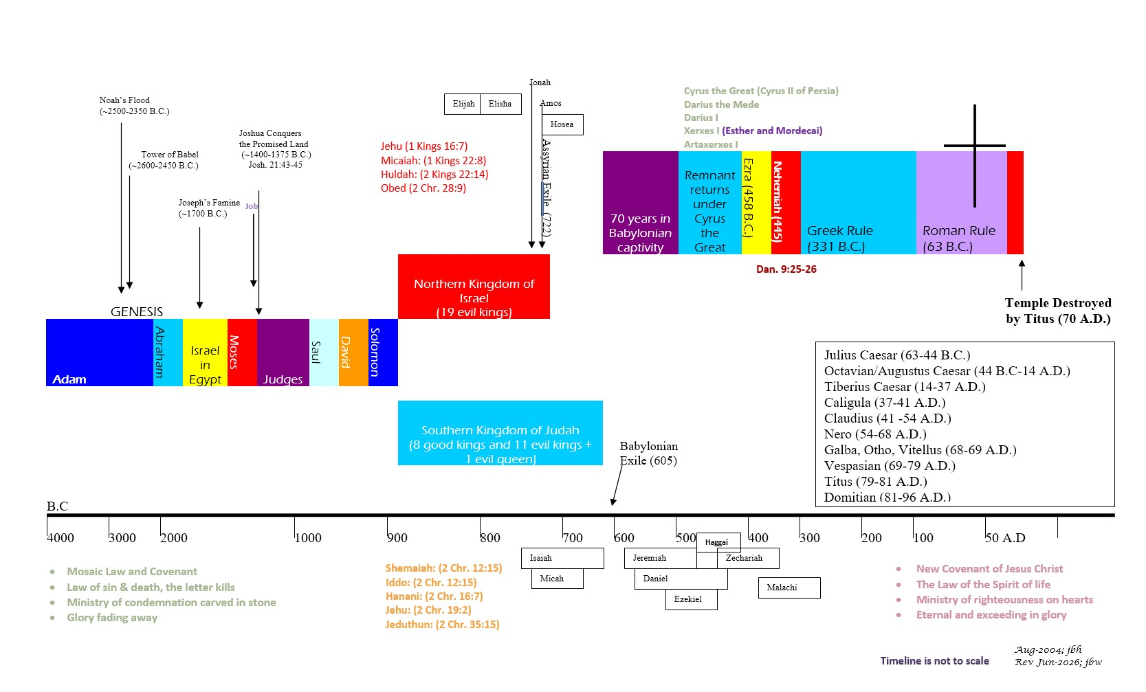


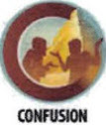




BIBLICAL CHRONOLOGICAL BACKGROUND
OT
NT
Prophets after Noah into the United Kingdom:
Abraham:
Moses:
Samuel:
Gad:
Nathan:
Ahijah
Asaph
(Gen. 20:7)
(Exo. 3:10)
(1 Sam. 3:20)
(1 Sam. 22:5)
(2 Sam. 7:2)
(1 Kings 11:29)
(2 Chr. 35:15)

Slide 11
GOD’s Prophetic Books
The Role of the Prophets
Time frames of God’s Prophetic Word
Speak
To speak God’s warnings with a goal to bring individuals and nations to repentance. Wording is often poetic and builds to a climax to make an impactful point.
Declare
To declare God’s imminent judgment and discipline for continued sinful behaviors.
Reveal
To reveal God’s future plans of judgment, deliverance, mercy, and grace.
God’s past actions and words in history (e.g., Creation – Confusion, Exodus from Egypt, fulfillment of God’s prophetic word, etc.). This is to remind the listeners/readers that God is always at work in the present fulfilling his word, and his past activity gives surety about future events God has declared.
God’s judgments that will impact the people of or near to the prophet’s generation as he speaks concerning specific nations or lands: (e.g., Judah’s exile to Babylon, the rise of Cyrus the Persian, the rebuilding of the temple in Jerusalem before it is even destroyed).
Events far into future generations that impact the whole earth: (e.g., the 1st coming of Jesus Christ, the 2nd coming of Jesus Christ, and the Millennial kingdom).
1 Peter 1:10-12: "Concerning this salvation, the prophets who prophesied about the grace that was to be yours searched and inquired carefully, inquiring what person or time the Spirit of Christ in them was indicating when he predicted the sufferings of Christ and the subsequent glories. It was revealed to them that they were serving not themselves but you, in the things that have now been announced to you through those who preached the good news to you by the Holy Spirit sent from heaven, things into which angels long to look.

Slide 12
DANIEL
Author: Daniel, of the tribe of Judah
Date: c. 540-530 B.C.

Slide 13
About the Author and Book: DANIEL
According to Hebrew custom, the title is drawn from the prophet who throughout the book received revelations from God. Daniel bridges the entire 70 years of the Babylonian captivity (c. 605–536 B.C.).¹ Nine of the 12 chapters relate revelation through dreams or visions. Daniel was God’s mouthpiece to the Gentile and Jewish world, declaring God’s current and future plans. What Revelation is to the New Testament prophetically and apocalyptically, Daniel is to the Old Testament.
Several verses indicate that the writer is Daniel,² whose name means “God is my judge.” He wrote in the autobiographical first person from Daniel 7:2 onward and is to be distinguished from the other three Daniels of the Old Testament.³ As a teenager, possibly about 15 years old, Daniel was among the first citizens to be deported to Babylon when God gave Judah into the hands of Nebuchadnezzar. He was then selected among the young nobles who were considered to be of good appearance and skillful in all wisdom and knowledge to be trained and placed into the king’s service (Daniel 1:1-6). There he spent the remainder of a long life (85 years or more). He made the most of the exile, successfully bringing glory to God by his character and service. He quickly rose to the role of statesman by official royal appointment and served as a confidante of kings as well as a prophet in two world empires, the Babylonian (Daniel 2:48) and the Medo-Persian (Daniel 5:30-6:2). Christ confirmed Daniel as the author of this book (cf. Matthew 24:15).
Daniel lived beyond the time described in Daniel 10:1 (c. 536 B.C.). It seems most probable that he wrote the book shortly after this date but before 530 B.C.
Daniel 2:4b–7:28, which prophetically describes the course of Gentile world history, was originally and appropriately written in Aramaic, the contemporary language of international business. Ezekiel, Habakkuk, Jeremiah, and Zephaniah were Daniel’s prophetic contemporaries.
DATE: c. 540 – 530 B.C
Notes:
¹ cf. Daniel 1:1 and Daniel 9:1–3
² Daniel 8:15, 27; 9:2; 10:2, 7; 12:4–5
³ cf. 1 Chronicles 3:1; Ezra 8:2; Nehemiah. 10:6

Slide 14
DANIEL: Background and Setting
The book begins in 605 B.C. when Babylon conquered Jerusalem and exiled Daniel, his three friends, and others during the reign of Jehoiakim in Judah. It continues to the eventual demise of Babylonian supremacy in 539 B.C., when Medo-Persian besiegers conquered Babylon (Daniel 5:30-31), and goes even beyond that to 536 B.C. (Daniel 10:1). After Daniel was transported to Babylon, the Babylonian victors conquered Jerusalem in two further stages (597 B.C. and 586 B.C.). In both takeovers, they deported more Jewish captives. Daniel passionately remembered his home, particularly the temple at Jerusalem, almost 70 years after having been taken away from it (Daniel 6:10).
Daniel is mentioned by Ezekiel (see Ezekiel 14:14-20; 28:3) as being righteous and wise. He is also alluded to by the writer of Hebrews as one of “the prophets—who through faith . . . stopped the mouths of lions” (Hebrews 11:32-33).
The long-continued sin of the Judeans without national repentance eventually led to God’s judgment for which Jeremiah, Habakkuk, and Zephaniah had given fair warning. Earlier, Isaiah and other faithful prophets of God had also trumpeted the danger. When Assyrian power had ebbed by 625 B.C., the Neo-Babylonians conquered:
  Assyria with its capital Nineveh in 612 B.C.;
  Egypt in the following years; and
  Judah in 605 B.C. when they overthrew Jerusalem in the first of three steps (also 597 B.C., 586 B.C.).
Daniel was one of the first groups of deportees, and Ezekiel followed in 597 B.C.
Israel of the northern kingdom had earlier fallen to Assyria in 722 B.C. With Judah’s captivity, the judgment was complete. In Babylon, Daniel received God’s word concerning successive stages of Gentile world domination through the centuries until the greatest Conqueror, Messiah, would put down all Gentile lordship. He then will defeat all foes and raise his covenant people to blessing in his glorious millennial kingdom.

Slide 15
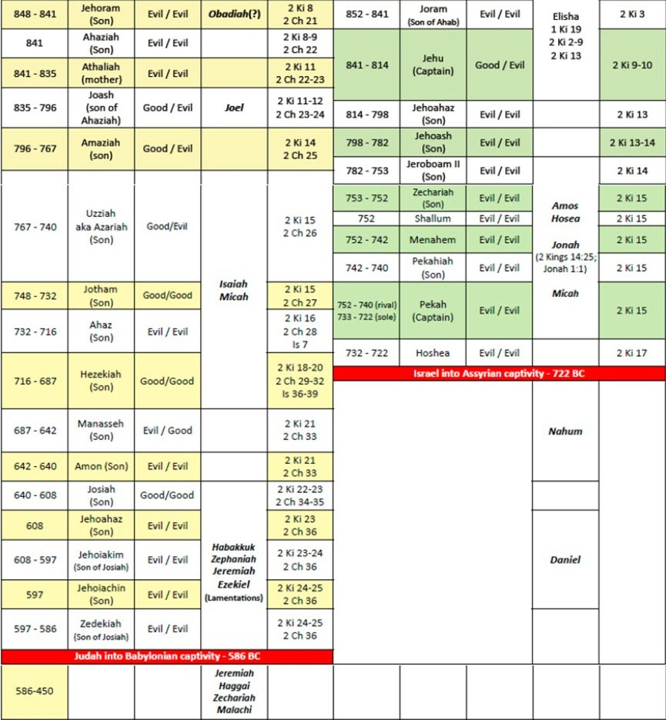
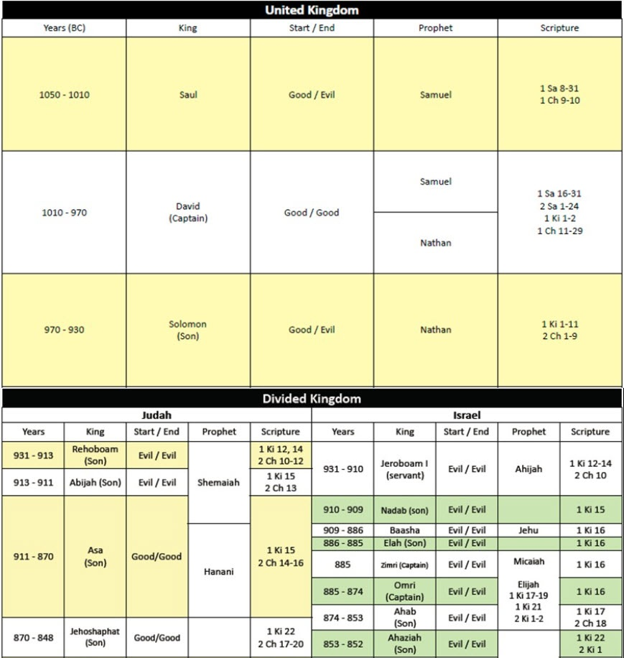
Israel’s Kings and Prophets¹
663-612 B.C.
¹ Biblegateway.com

Slide 16
Daniel: Outline
Personal Background of Daniel
Prophetic Course of Gentile Dominion
Prophetic Course of Israel’s Destiny
Daniel 1:1–21
Daniel 2:1–7:28
Daniel 8:1–12:13
Conquest of Jerusalem
Conscription of Jews for Training
Courage of Four Men in Trial
Choice of Four Men for Royal Positions
Dilemmas of Nebuchadnezzar
  His dream of the latter days (Daniel 2)
  His idolatrous golden image (Daniel 3)
  His time of being cut down (Daniel 4)
Debauchery and Demise of Belshazzar (Daniel 5)
Deliverance of Daniel from the lions (Daniel 6)
Daniel’s Dream: 4 beasts (Daniel 7)
Prophecy of the Ram and Male Goat (Daniel 8)
Prophecy of the Seventy Weeks (Daniel 9)
Prophecy of Israel’s Humiliation and Restoration (Daniel 10-12)
“With many such parables he spoke the word to them, as they were able to hear it. He did not speak to them without a parable, but privately to his own disciples he explained everything.(Mark 4:33-34)

Slide 17
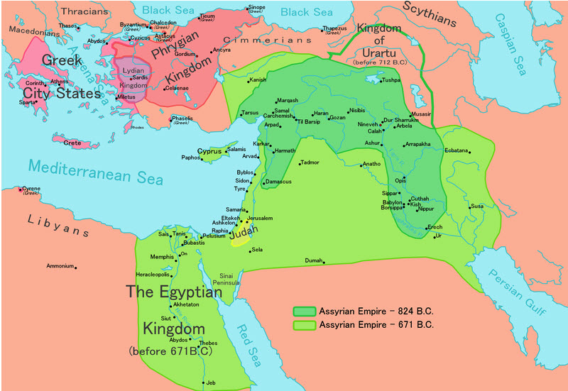
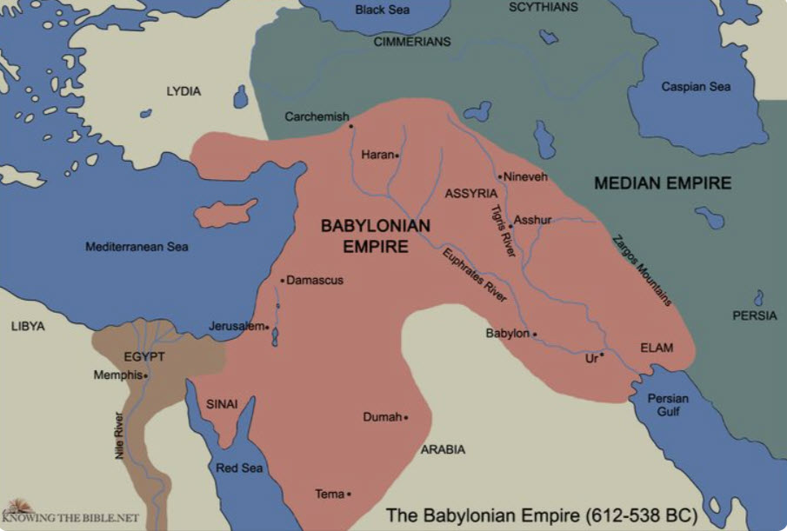
KEY GEOGRAPHY: 670 B.C. – 538 B.C.

Slide 18
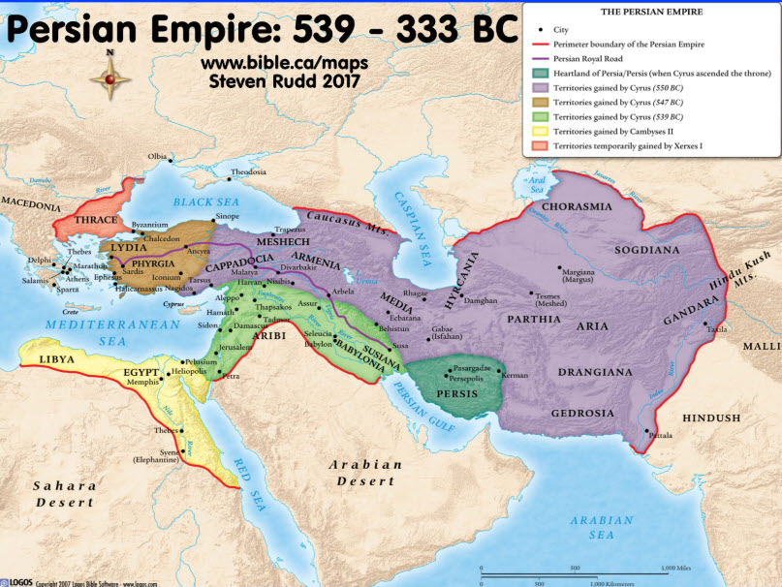
KEY GEOGRAPHY: 612 B.C. – 333 B.C.
539 – 333 B.C.
612 – 538 B.C.

Slide 19
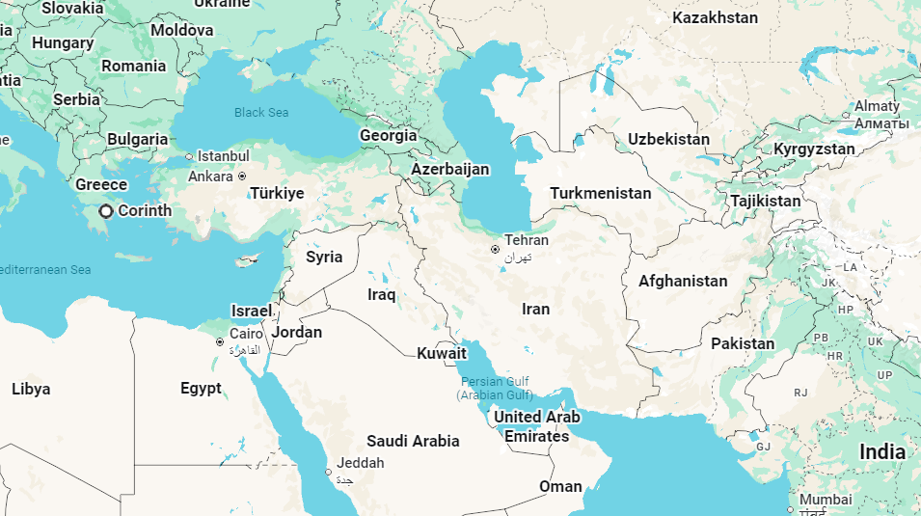
GEOGRAPHY: Past Persian Empire vs. Present Day

Slide 20
DANIEL: Key Verses
Daniel 1:19-20, “And the king spoke with them, and among all of them none was found like Daniel, Hananiah, Mishael, and Azariah. Therefore they stood before the king. And in every matter of wisdom and understanding about which the king inquired of them, he found them ten times better than all the magicians and enchanters that were in all his kingdom.”
Daniel 2:26-31, “The king declared to Daniel, whose name was Belteshazzar, ‘Are you able to make known to me the dream that I have seen and its interpretation?’ Daniel answered the king and said, ‘No wise men, enchanters, magicians, or astrologers can show to the king the mystery that the king has asked, but there is a God in heaven who reveals mysteries, and he has made known to King Nebuchadnezzar what will be in the latter days. Your dream and the visions of your head as you lay in bed are these: To you, O king, as you lay in bed came thoughts of what would be after this, and he who reveals mysteries made known to you what is to be. But as for me, this mystery has been revealed to me, not because of any wisdom that I have more than all the living, but in order that the interpretation may be made known to the king, and that you may know the thoughts of your mind. You saw, O king, and behold, a great image. This image, mighty and of exceeding brightness, stood before you, and its appearance was frightening.’”
Daniel 2:46-48, “Then King Nebuchadnezzar fell upon his face and paid homage to Daniel, and commanded that an offering and incense be offered up to him. The king answered and said to Daniel, ‘Truly, your God is God of gods and Lord of kings, and a revealer of mysteries, for you have been able to reveal this mystery.’ Then the king gave Daniel high honors and many great gifts, and made him ruler over the whole province of Babylon and chief prefect over all the wise men of Babylon.”
Daniel 3:17-18, “If this be so, our God whom we serve is able to deliver us from the burning fiery furnace, and he will deliver us out of your hand, O king. But if not, be it known to you, O king, that we will not serve your gods or worship the golden image that you have set up."
Daniel 3:24-25, "Then King Nebuchadnezzar was astonished and rose up in haste. He declared to his counselors, ‘Did we not cast three men bound into the fire?’ They answered and said to the king, ‘True, O king.’ He answered and said, ‘But I see four men unbound, walking in the midst of the fire, and they are not hurt; and the appearance of the fourth is like a son of the gods.’”
Daniel 4:34-35, “At the end of the days I, Nebuchadnezzar, lifted my eyes to heaven, and my reason returned to me, and I blessed the Most High, and praised and honored him who lives forever, for his dominion is an everlasting dominion, and his kingdom endures from generation to generation; all the inhabitants of the earth are accounted as nothing, and he does according to his will among the host of heaven and among the inhabitants of the earth; and none can stay his hand or say to him, ‘What have you done?’”
Daniel 9:25-27, “Know therefore and understand that from the going out of the word to restore and build Jerusalem to the coming of an anointed one, a prince, there shall be seven weeks. And for sixty-two weeks it shall be built again with squares and moat, but in a troubled time. And after the sixty-two weeks, an anointed one shall be cut off and shall have nothing. And the people of the prince who is to come shall destroy the city and the sanctuary. Its end shall come with a flood, and to the end there shall be war. Desolations are decreed. And he shall make a strong covenant with many for one week, and for half of the week he shall put an end to sacrifice and offering. And on the wing of abominations shall come one who makes desolate, until the decreed end is poured out on the desolator."
20

Slide 21
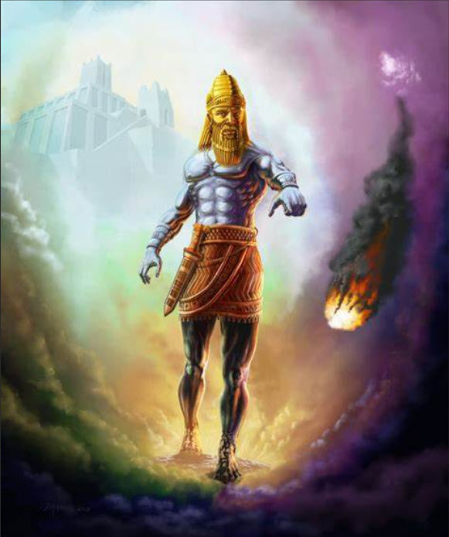
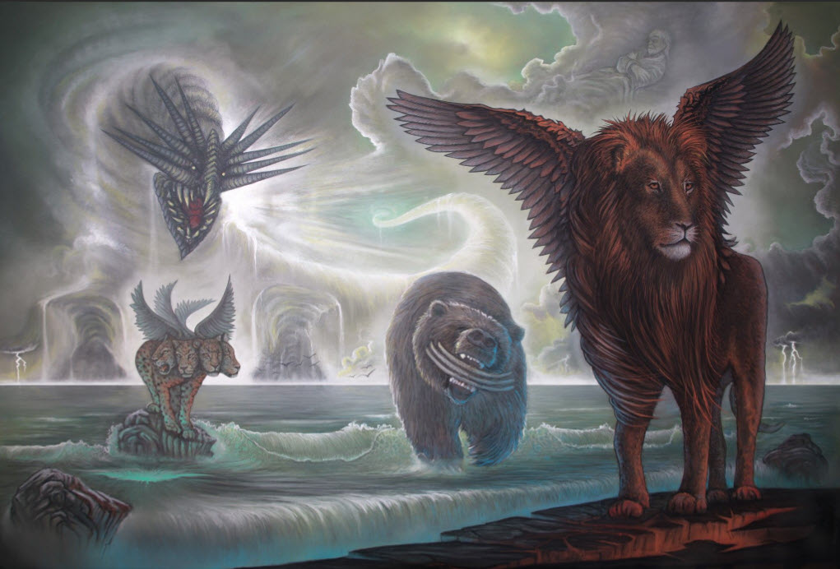
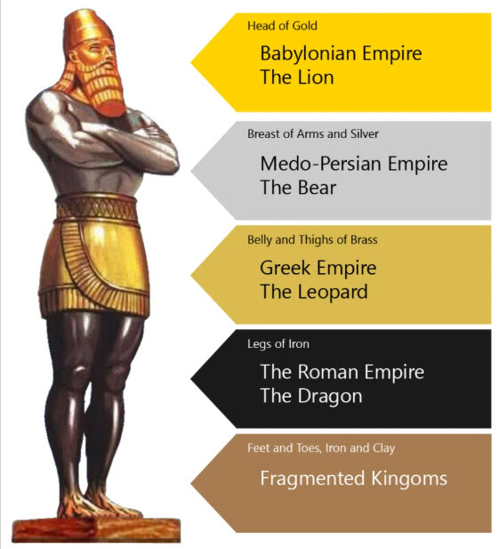
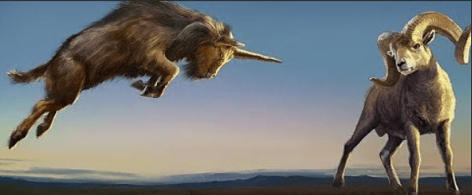
Visions and Dreams in Daniel 2, 7 and 8
2nd Year of Nebuchadnezzar (c. 602 B.C.) – Daniel 2
1st Year of Belshazzar (c. 553 B.C.) – Daniel 7
3rd Year of Belshazzar (c. 551 B.C.) – Daniel 8
“And he [Jesus] said to them [his disciples], “Do you not understand this parable? How then will you understand all the parables?” (Mark 4:13)
“With many such parables he spoke the word to them, as they were able to hear it. He did not speak to them without a parable, but privately to his own disciples he explained everything. (Mark 4:33-34)

Slide 22
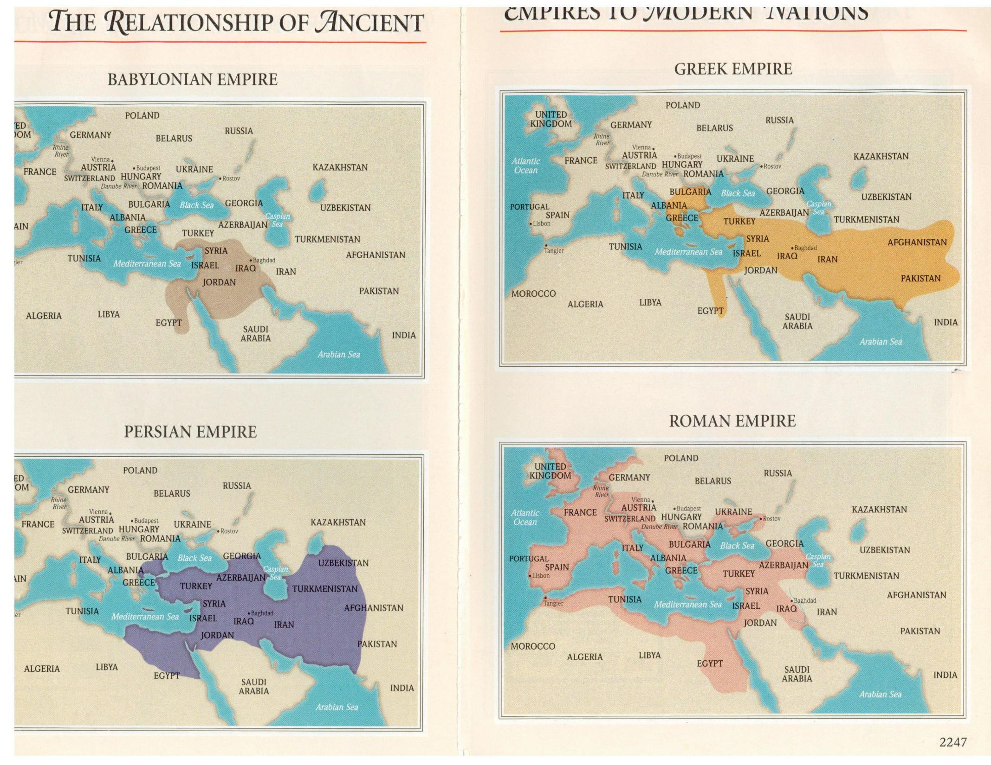
Geography of the Four Empires (Daniel chapters 2, 7, and 8)
Daniel 8:19-22 , “He said, “Behold, I will make known to you what shall be at the latter end of the indignation, for it refers to the appointed time of the end. As for the ram that you saw with the two horns, these are the kings of Media and Persia. And the goat is the king of Greece. And the great horn between his eyes is the first king. As for the horn that was broken, in place of which four others arose, four kingdoms shall arise from his nation, but not with his power.”
Daniel 7:23-26, “Thus he said: ‘As for the fourth beast, there shall be a fourth kingdom on earth, which shall be different from all the kingdoms, and it shall devour the whole earth, and trample it down, and break it to pieces. As for the ten horns, out of this kingdom ten kings shall arise, and another shall arise after them; he shall be different from the former ones, and shall put down three kings. He shall speak words against the Most High, and shall wear out the saints of the Most High, and shall think to change the times and the law; and they shall be given into his hand for a time, times, and half a time. But the court shall sit in judgment, and his dominion shall be taken away, to be consumed and destroyed to the end.”
“With many such parables he spoke the word to them, as they were able to hear it. He did not speak to them without a parable, but privately to his own disciples he explained everything. (Mark 4:33-34)

Slide 23
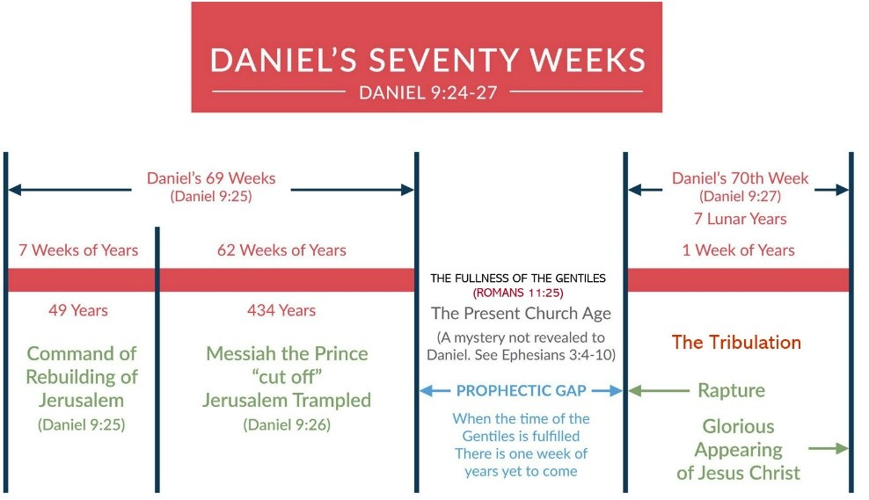
Daniel: Study Questions
Read Daniel 9:1-8. Based on Daniel 9:2, what was the focus of Daniel’s prayer?
Based on Daniel 9:3-8, how did Daniel go about entreating the Lord and asking Him to fulfill what He had spoken to the prophet Jeremiah?
Read Daniel 9:20-24. How swiftly do verses 9:20-21 tell us that God responded to Daniel’s petition?
What more do we learn in Daniel 9:22-23 about God’s swift response?
Daniel prayed for God to fulfill the promise made to Jeremiah that after 70 years the people of Israel would be allowed to return to the Promised Land and rebuild. God not only assured Daniel that this would be granted, but also sent Gabriel to help Daniel understand how his visions would be fulfilled through coming world events. Specifically, Gabriel explained how the world’s events would unfold according to the ___________ weeks decreed for Daniel’s people.
23

Slide 24
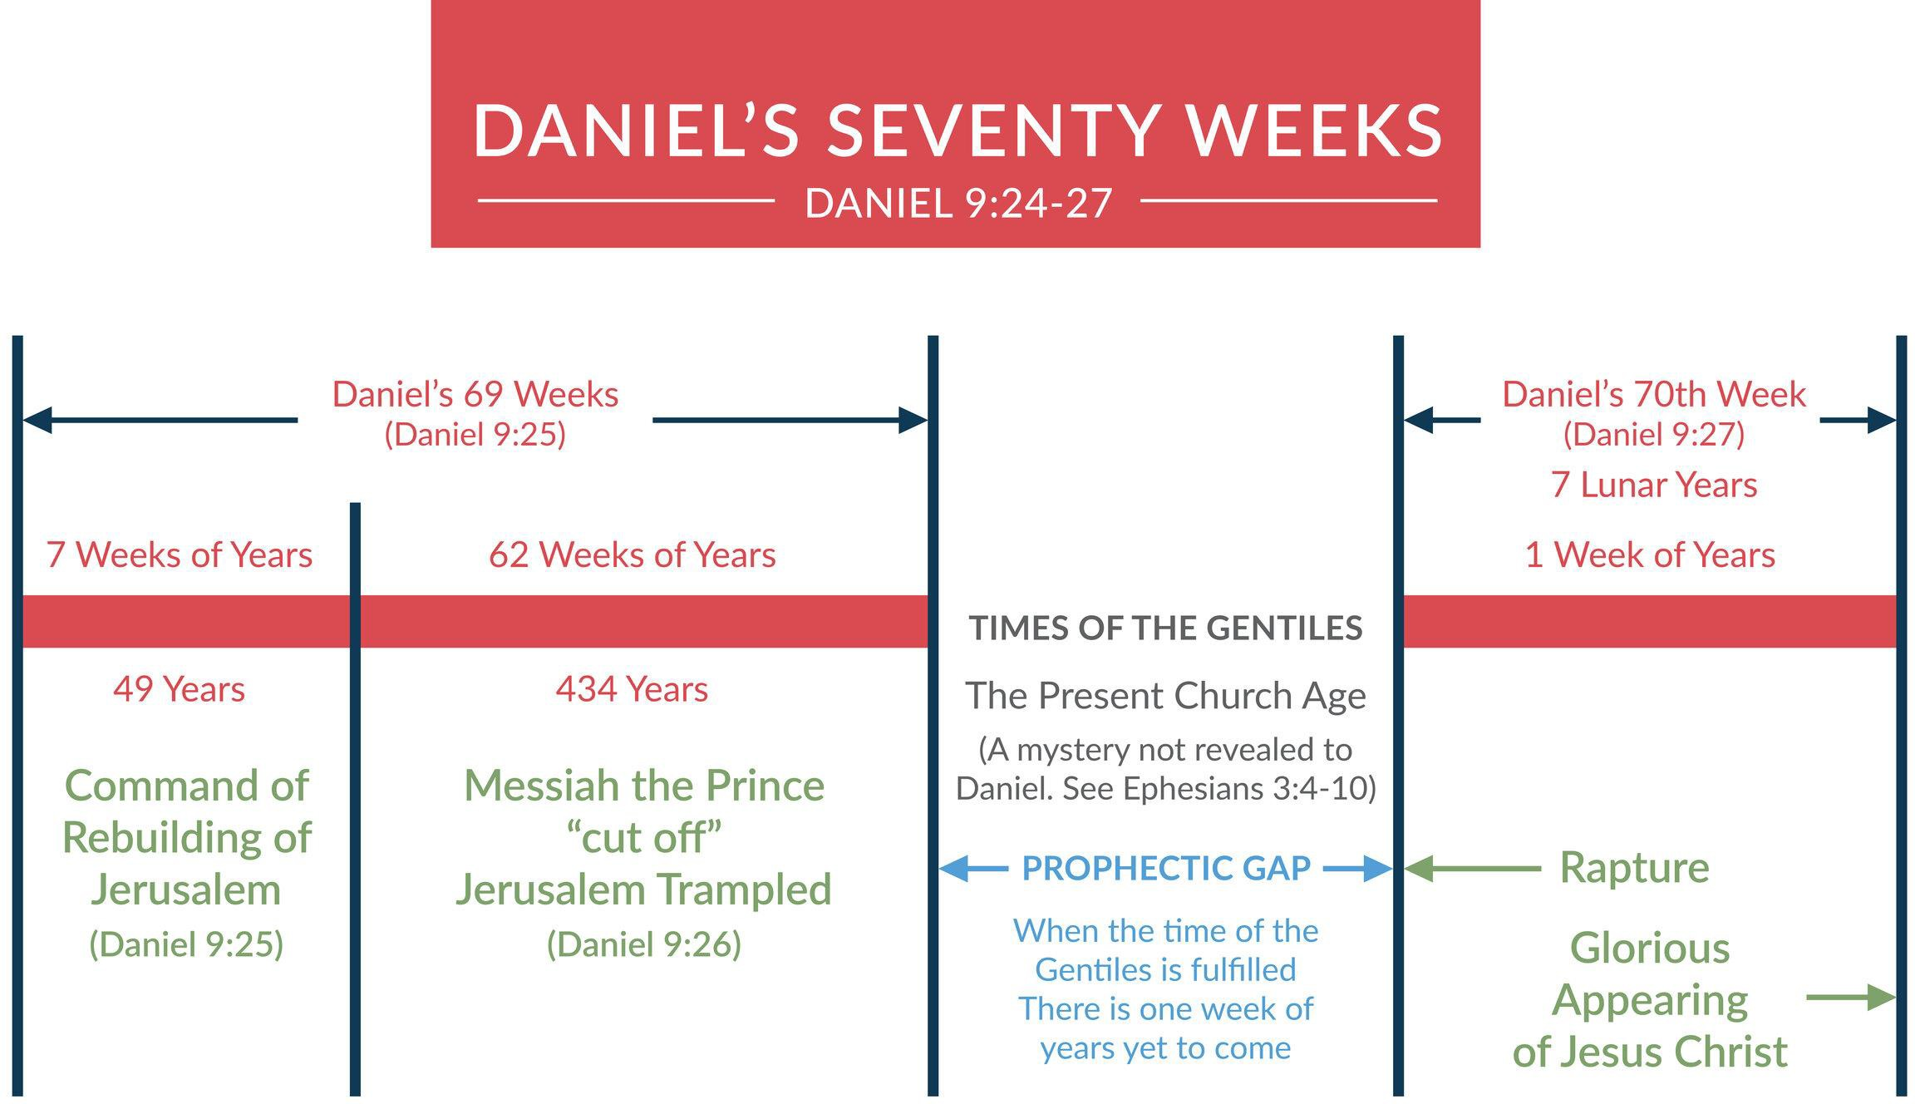
DANIEL’S SEVENTY WEEKS

Slide 25
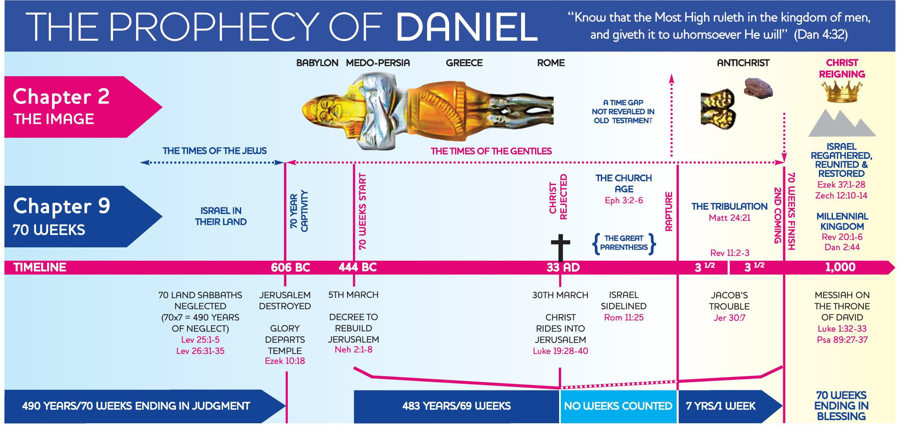
The Prophecy of Daniel

Slide 26
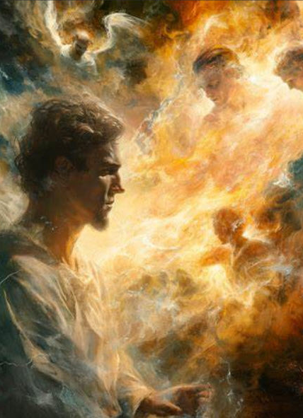
Daniel 9-12 Key Events
Daniel 9: First year of Darius the Mede – Daniel’s prayer, visit from Grabriel, and prophecy of the 70 weeks.
Daniel 10: Third year of Cyrus, king of Persia – Daniel’s vision of a warrior angel by the Tigris River in the 1st month.
Daniel 11: This angel introduced in Daniel 10 gives Daniel great details of world events. A few highlights are below.
  Four more kings to rise in Medo-Persia (c. 538 -465 B.C.: visions = the bear with 3 ribs and the ram with two horns).
  The 4th Medo-Persian king would be rich and stir up the kingdom of Greece (Daniel 11:1-2).
  Greece would have a mighty king but be split into four kingdoms (Daniel 11:3-4: visions = the goat with one horn and the leopard with four heads. (Historically fulfilled c. 331 B.C. by Alexander the Great, and then his kingdom was divided among four generals in 323 B.C.)
  From these four Greek kingdoms, the northern (Syria) and southern (Egypt) kingdoms would be at war (Daniel 11:6-26: Historical fulfillment includes almost 200 years of wars between these powers.)
  A king from the northern Greco kingdom would arise and while making war with the southern Greek kingdom would profane the Holy Land and the temple that had been restored under Zerubabbel, Joshua, and Ezra. (Fulfilled c. 167 B.C. by Antiochus Epiphanies, a type of Antichrist. Aided by Rome he was overthrown by Judas Maccabeus).
Daniel 11:36-12: Shifts to the end times and the resurrection of the dead. Daniel is told some of the events that will happen in the final conflicts of the Antichrist in the great tribulation before the Stone from heaven brings human kingdoms to destruction (Daniel 2:34-35 and Daniel 7:9-15).
Daniel 12:11-12, “And from the time that the regular burnt offering is taken away and the abomination that makes desolate is set up, there shall be 1,290 days. Blessed is he who waits and arrives at the 1,335 days.”

Slide 27
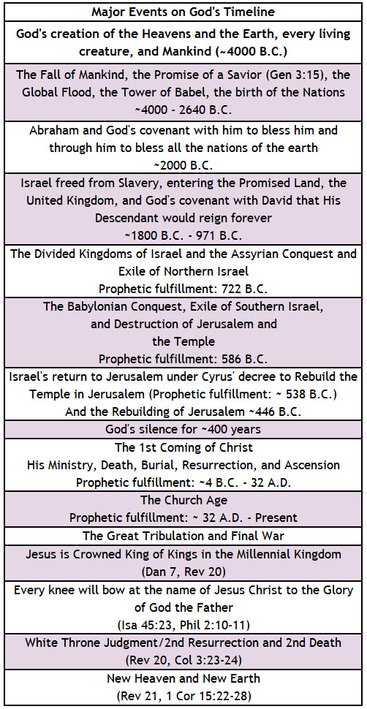
God’s Prophetic Timetable Events
DANIEL
Daniel 9:24-27, “Seventy weeks are decreed about your people and your holy city, to finish the transgression, to put an end to sin, and to atone for iniquity, to bring in everlasting righteousness, to seal both vision and prophet, and to anoint a most holy place. Know therefore and understand that from the going out of the word to restore and build Jerusalem to the coming of an anointed one, a prince, there shall be seven weeks. Then for sixty–two weeks it shall be built again with squares and moat, but in a troubled time. And after the sixty–two weeks, an anointed one shall be cut off and shall have nothing. And the people of the prince who is to come shall destroy the city and the sanctuary. Its end shall come with a flood, and to the end there shall be war. Desolations are decreed. And he shall make a strong covenant with many for one week, and for half of the week he shall put an end to sacrifice and offering. And on the wing of abominations shall come one who makes desolate, until the decreed end is poured out on the desolator.” (See also Matt 24:15-20 )
Daniel 7:9-15, "As I looked, thrones were placed, and the Ancient of days took his seat; his clothing was white as snow, and the hair of his head like pure wool; his throne was fiery flames; its wheels were burning fire. A stream of fire issued and came out from before him; a thousand thousands served him, and ten thousand times ten thousand stood before him; the court sat in judgment, and the books were opened. I looked then because of the sound of the great words that the horn was speaking. And as I looked, the beast was killed, and its body destroyed and given over to be burned with fire. As for the rest of the beasts, their dominion was taken away, but their lives were prolonged for a season and a time. I saw in the night visions, and behold, with the clouds of heaven there came one like a son of man, and he came to the Ancient of Days and was presented before him. And to him was given dominion and glory and a kingdom, that all peoples, nations, and languages should serve him; his dominion is an everlasting dominion, which shall not pass away, and his kingdom one that shall not be destroyed. As for me, Daniel, my spirit within me was anxious, and the visions of my head alarmed me.” (See also Revelation 19:19-21, 20:1-4)
Daniel 12:11-12, “And from the time that the regular burnt offering is taken away and the abomination that makes desolate is set up, there shall be 1,290 days. Blessed is he who waits and arrives at the 1,335 days.” (See also Revelation 11:1-2)
27

Slide 28
Summary of Daniel
Brief Summary: The historical record in Daniel begins in 605 B.C. with the Babylonian conquest of Jerusalem and the conscription of Daniel and other Jewish nobles during the reign of King Jehoaikim (Daniel 1). It was written to encourage the exiled Jews and to inform mankind of God’s program for the nations and the world into the latter days and the end of this age. Prominent above every other theme in the book is God’s sovereign control over the affairs of all rulers and nations, and their final replacement with the true King (Daniel 2).
Because of the blessings of God upon them, Daniel and his three companions, Hananiah, Mishael and Azariah, had courage and skills that resulted in their promotions while in exile into the king’s service (Daniel 1:17-20). Chapters 2-4 progress into God’s dealings with King Nebuchadnezzar as He reveals his plan first with a dream that so troubled this Babylonian king that he decreed to destroy all the wise men of Babylon if they could not tell him both the dream and its interpretation. Daniel and his friends prayed to God, and God revealed the dream and its interpretation to Daniel. God was making himself known to Earth’s inhabitants by revealing world events that would take place in the coming centuries. Though Nebuchadnezzar praised the God of Daniel for this revelation (Daniel 2:47-48), he had by no means become a repentant God-fearing man. Scriptures record Nebuchadnezzar’s pride ushering him into at least two more life-changing events before he recognized the one true God as King over Heaven and Earth (Daniel 4:24-37). These two events included:
Nebuchadnezzar building a golden statue and demanding all to worship it. Hananiah, Mishael and Azariah (aka Shadrach, Meshach, and Abednego) refused and were miraculously spared by God in the fiery furnace where one like the Son of God walked with them (Daniel 3).
God warning Nebuchadnezzar in a dream, which Daniel interpreted to mean that because of his pride, God would strip him of his mind and kingdom for seven years. When God restored Nebuchadnezzar’s mind and kingdom, he finally understood that the Most High rules the kingdom of men (Daniel 4).
Chapter 5 ushers in the fall of the Babylonian empire when Belshazzar misused the items taken from the Jerusalem Temple. He received a message from God, written into the wall, in response. Daniel was given the interpretation, which was that Belshazzar had been weighed and found lacking and God was bringing his kingdom to an end at the hands of Medo-Persia. That very night Belshazzar was slain. Daniel, however, continued to find favor in the king’s service under the Medo-Persian rule. In chapter 6 we learn that other satraps who were jealous of Daniel, set a trap to have him murdered. Darius, though grieved that he had fallen for their plot, had Daniel thrown into the lions’ den to fulfill the decree he had made. But God miraculously spared Daniel, and those who had devised the plot received the execution they had plotted for Daniel.
In chapters 7-12 God unfolds more future world events with phenomenal detail all the way to the Second Coming and Kingdom of Jesus Christ. Daniel is visited and strengthened by these messengers, one of which is the angel Gabriel, who explain the visions to Daniel (Daniel 8:15-16, 9:20-22). The details include the rise and fall of four world empires: Babylon, Medo-Persia, Greece, and Rome, and then a final world empire. Moreover, they include the prophetic 70 weeks of years that lay out the course of Israel’s destiny: the precise timing of Messiah’s first coming and being cut off, the great tribulation when a boastful king will make a seven-year covenant with Israel and break it after three and a half years, followed shortly thereafter by the fulfillment of Israel’s salvation (Zechariah 12:9-10, Luke 13:34-35, Romans 11:11-12, 11:25-27), the Second Coming of Christ, the great judgment and consummation of all things (Daniel 7:11-14).
Foreshadowings: We see in the accounts of the fiery furnace and Daniel in the lions’ den foreshadowing of the salvation provided by Christ. These men declare God is a saving God who can provide a way of escape from the fire and the roaring lion that seeks to destroy. In the same way, by sending Jesus to die for our sins, God has provided an escape from the fires of hell and Satan (1 Peter 3:18). Jesus Christ is our provision and rescue from the things that threaten to consume us. Lastly, Daniel’s vision of the end times depicts Israel’s Messiah by whom many will be made pure and holy (Daniel 12:10). He is our righteousness (1 Corinthians 1:30) by whom our sins, though blood-red, will be washed away, and we will be as white as snow (Isaiah 1:18). And when He returns, He will come again as Israel’s salvation (Romans 11:25-27) and the Stone from heaven, the King of kings, whose kingdom will have no end (Daniel 2:41-45, Revelation 13:1-2).

Slide 29
Daniel: Practical Application
Practical Application: Daniel stands as an exemplary example to us of a person who devoted his life to God’s will. His life gives us examples in humility (Daniel 2:27-28), prayer and study (Daniel 9:1-21), stewardship (Daniel 2:48-49), wisdom, and courage (Daniel 6). Likewise, Hananiah (Shadrach), Mishael (Meshach) and Azariah (Abednego), also demonstrated the power and discipline of prayer and the courage God had given them to remain faithful even unto death.
Through their obedience, not knowing whether they would live or die, we see the Lord visibly with them in the fire and saving them from lions (Daniel 5-6).
God has a plan, and His plan is down to the intricate detail in our lives and in this world. God knows and is in control of the future. Everything that God has predicted has come true exactly as He predicted. Therefore, we have the prophetic word made more sure, to which we do well to believe and trust that the things He has predicted for the future will one day occur exactly as God has declared (2 Peter 1:19-21).

Slide 30
Closing Prayer: DANIEL
Daniel 9:18-23, “‘O my God, incline your ear and hear. Open your eyes and see our desolations, and the city that is called by your name. For we do not present our pleas before you because of our righteousness, but because of your great mercy. O Lord, hear; O Lord, forgive. O Lord, pay attention and act. Delay not, for your own sake, O my God, because your city and your people are called by your name.’ While I was speaking and praying, confessing my sin and the sin of my people Israel, and presenting my plea before the LORD my God for the holy hill of my God, while I was speaking in prayer, the man Gabriel, whom I had seen in the vision at the first, came to me in swift flight at the time of the evening sacrifice. He made me understand, speaking with me and saying, ‘O Daniel, I have now come out to give you insight and understanding. At the beginning of your pleas for mercy a word went out, and I have come to tell it to you, for you are greatly loved. Therefore, consider the word and understand the vision.’”
30

Slide 31
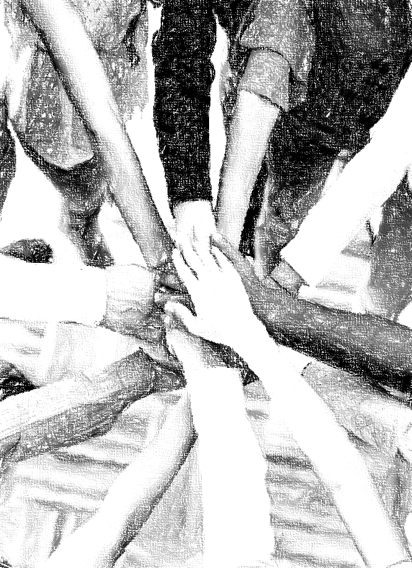
Acknowledgements
Background, Setting, Outlines, some Study Question answers, interpretative challenges, and some Summaries: Adapted from John MacArthur Study Bible at GTY.org.
Key verses, Practical Application, some Study Question answers, and some Summaries: Adapted from GotQuestions.org.
Inductive Bible Study Method: Adapted from Precept.org.
Creation – Consummation Icons: Adapted from AnswersInGenesis.org.
Definitions: Adapted from Websters 1828 Dictionary.
Bible Reference Software and Quotes: All Scripture quotations are taken from the Holy Bible using primarily the English Standard Version (ESV) or New American Standard Bible (NASB) translations. Links to Scripture references utilize BibleRef.com, which is a Got Questions Ministries’ website.

Slide 32
Study Leader Assistance
Sample Prayers
Study Question Answer Keys
32

Slide 33
DANIEL: Sample Opening Prayer
DANIEL 2:14-18, "Then Daniel replied with prudence and discretion to Arioch, the captain of the king's guard, who had gone out to kill the wise men of Babylon. He declared to Arioch, the king's captain, "Why is the decree of the king so urgent?"
Then Arioch made the matter known to Daniel. And Daniel went in and requested the king to appoint him a time, that he might show the interpretation to the king. Then Daniel went to his house and made the matter known to Hananiah, Mishael, and Azariah, his companions, and told them to seek mercy from the God of heaven concerning this mystery, so that Daniel and his companions might not be destroyed with the rest of the wise men of Babylon.”
Sample Prayer: Dear Heavenly Father, thank you for the example of courage and wisdom you have given us through your prophet Daniel and his companions. We pray that you would give us the wisdom and boldness we need to face the circumstances that come into our lives. Remind us to prayerfully seek your mercy and power to rescue us out of all life’s dangers. Help us to rest in the truth that just as you answered the prayers of Daniel and his friends, you will also rescue us ensuring that we are brought into your presence blameless and with great joy. We love you and pray these things in Jesus’s name. Amen.

Slide 34
Daniel: Study Question Answers
Read Daniel 9:1-8. Based on Daniel 9:2, what was the focus of Daniel’s prayer? Answer: Daniel had observed that the 70 years were coming to an end. Namely, the 70 years God had foretold through Jeremiah that must pass to end Jerusalem’s desolation. He was petitioning God to fulfill this promise given through Jeremiah to restore Israel to the Promised Land.
Based on Daniel 9:3-8, how did Daniel go about entreating the Lord and asking Him to fulfill what He had spoken to the prophet Jeremiah? Answer: Daniel turned his face to the Lord God, seeking him by prayer, with pleas for mercy, fasting, and mourning. He praised God for his faithfulness and love and confessed his sin and the sins of the men of Judah, Jerusalem, and all Israel.
Read Daniel 9:20-24. How swiftly do verses 9:20-21 tell us that God responded to Daniel’s petition? Answer: It says that while Daniel was still speaking his prayers, confessing sin and lifting up his petition to God, Gabriel came to him in swift flight at the evening sacrifice.
What more do we learn in Daniel 9:22-23 about God’s swift response? Answer: God dispatched Gabriel “at the beginning of [Daniel’s] pleas for mercy” because Daniel was “greatly loved”. God gave Gabriel a proclamation to take to Daniel to give him understanding and insight.
Daniel prayed for God to fulfill the promise made to Jeremiah that after 70 years the people of Israel would be allowed to return to the Promised Land and rebuild. God not only assured Daniel that this would be granted, but also sent Gabriel to help Daniel understand how his visions would be fulfilled through coming world events. Specifically, Gabriel explained how the world’s events would unfold according to the Seventy weeks decreed for Daniel’s people.
34

Slide 35
Sample Closing Prayer
Daniel 9:18-23, "O my God, incline your ear and hear. Open your eyes and see our desolations, and the city that is called by your name. For we do not present our pleas before you because of our righteousness, but because of your great mercy. O Lord, hear; O Lord, forgive. O Lord, pay attention and act. Delay not, for your own sake, O my God, because your city and your people are called by your name." While I was speaking and praying, confessing my sin and the sin of my people Israel, and presenting my plea before the LORD my God for the holy hill of my God, while I was speaking in prayer, the man Gabriel, whom I had seen in the vision at the first, came to me in swift flight at the time of the evening sacrifice. He made me understand, speaking with me and saying, "O Daniel, I have now come out to give you insight and understanding. At the beginning of your pleas for mercy a word went out, and I have come to tell it to you, for you are greatly loved. Therefore, consider the word and understand the vision.“
Sample Prayer: Dear Heavenly Father, thank you for teaching us that we are to pray for you to fulfill the remaining prophecies you have given us in your word. Daniel understood from your written word the 70 years of exile you foretold through your prophet Jeremiah and why the exile had happened. Accordingly, when the time came, Daniel prayed for you to fulfill what you had promised by your great mercy as he confessed his sins and the sins of Israel before you. Thank you for showing us that you begin to answer our prayers while we are still speaking the words. As you did with Daniel, enable us to understand the Scriptures so that at the right time, we too can ask for your mercy, confessing our sins, and pray for you to fulfill what remains of what you have foretold to your prophets.
35

