Slide 1
JOHN
Book 43

Slide 2
What is the Holy Bible?
The Holy Bible is a collection of writings that includes 66 books in English editions. The Bible consists of two parts, the Old Testament and New Testament. The word testament means covenant. The Old Testament includes 39 books, and the New Testament includes 27 books.
These 66 books were written over approximately 1,400 years by 40 different authors in Hebrew, Aramaic, and Greek. The Old Testament writings were affirmed by Jewish leaders, and moreover, by Jesus Christ.¹ The New Testament writings were confirmed by early church leaders. The 66 books of the Bible are the inspired words of God that are used to make and mature disciples of the One true God through Jesus Christ, his Son (Matthew 28:18-20, 2 Timothy 3:16-17). The Bible was not created by mere human wisdom but was inspired by God (2 Peter 1:20-21), is interpreted by His Holy Spirit (John 16:13, Matthew 23:8-10), and will last forever (Matthew 24:35).²
If you do a phrase search on the Bible you will find the phrase "the word of the Lord" and "Thus says the Lord" more than 700 times.³ In addition, this book has given reasonable evidence to the claim of being God’s word by:​
  providing answers that conform with the reality we see around us.
  being a reliable collection of historical documents.
  containing eyewitness accounts that were written during the lifetimes of other eyewitnesses.
  recording supernatural events that took place in fulfillment of specific prophecies.⁴
Notes:
¹ See Matthew 4:4-7, 12:3-5, Mark 7:6-7, 12:26-27, and Luke 19:46 for examples.
^{2 “}What are the Books of the Bible”, GotQuestions.org
³ Blue Letter Bible
⁴ Paraphrased from Voddie Baucham

Slide 3
Our Goals in Studying the Bible
To better …..
Understand the Only true God; the Author of the Bible. (2 Timothy 3:16-17, 2 Peter 1:20-21, 1 John 5:20 , Jeremiah 9:23-24)
Learn How He works in the World and in our Lives. (Job 40:6-14, Isaiah 45:6-7, Isaiah 46:8-10, Philippians 2:12-13)
Understand Ourselves and the Hearts of Mankind. (Jeremiah 17:9, 2 Timothy 3:13, Ephesians 5:7-10)
Come to Know What Pleases and Grieves God. (1 Thessalonians 4:1, Ephesians 4:26-31, Hebrews 11:6, 1 Peter 1:14-19)
To be Transformed into Fruitful Doers of God’s Word and not just Hearers. (Romans 12:2, James 1:27, Matthew 3:8)
Tether Ourselves to God’s Word for Our Wisdom, Discernment, and Safety. (1 Corinthians 6:9-10, Matthew 24:24, Ephesians 4:11-14)
Jeremiah 9:23-24 “Thus says the Lord: "Let not the wise man boast in his wisdom, let not the mighty man boast in his might, let not the rich man boast in his riches, but let him who boasts boast in this, that he understands and knows me, that I am the Lord who practices steadfast love, justice, and righteousness in the earth. For in these things I delight, declares the Lord."

Slide 4
How to Study the Bible
#1. Observation: What does the text say.
Who?
What?
When?
Where?
How?
Why?
#2. Interpretation: What does the text mean in context with the passage, book, and whole counsel of God?
#3. Application: How is the Holy Spirit instructing me to apply this understanding at this time in my life?

Slide 5
Study Resources
Opening Prayer
Background and Setting
Book Outline
Geography Maps
Key Verses
Study Questions
Major Event Timeline
Book Summary
Application and Closing Prayer
Study Leader Support Slides

Slide 6
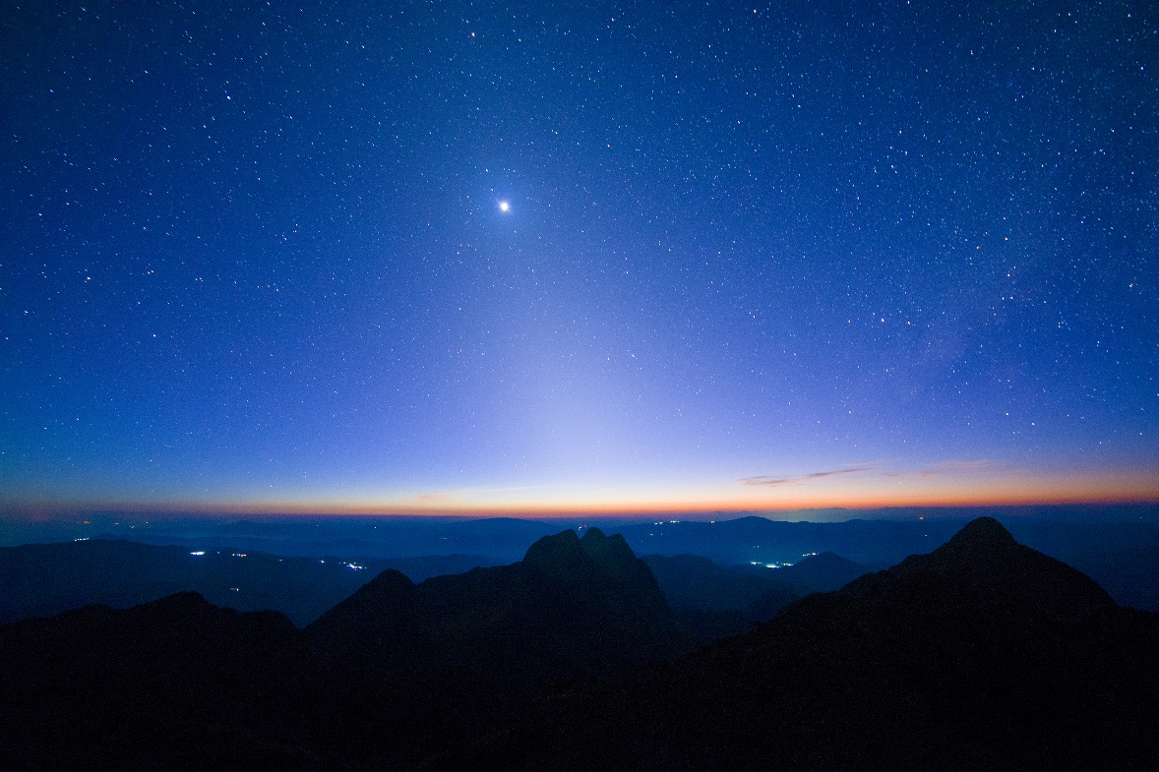
Opening Prayer Verse: John
John 1:1-5, “In the beginning was the Word, and the Word was with God, and the Word was God. He was in the beginning with God. All things were made through him, and without him was not any thing made that was made. In him was life, and the life was the light of men. The light shines in the darkness, and the darkness has not overcome it.”

Slide 7
Review of Luke
Brief Summary: Luke opens his account disclosing his purpose for writing; his goal being an orderly account of the things that had been accomplished among them having followed all things closely so that his reader, Theophilus, could have certainty concerning the things he had been taught (Luke 1:1-4). In this gospel the authority of the Lord Jesus is corroborated over nature, demons, sickness, and death. In addition, Jesus’ righteousness, forgiveness¹ and compassion are on display. While Luke’s gospel incudes similar details regarding Jesus’ inauguration from heaven at his baptism, his ministry, final journey to Jerusalem, his betrayal, crucifixion, death, burial and resurrection, Luke also provides details and teachings that are not found in any of the other gospels.
Luke alone provides a genealogy for Jesus back to the first Adam in Genesis (Luke 3:23-38) and gives us a snippet of Jesus as a young boy (Luke 2:39-52). In addition, Luke alone records the accounts below.
  The angel Gabriel’s announcements to Zechariah and Mary (Luke 1:5-38).
  Jesus raising the only son of a widow (Luke 7:11-17)
  Jesus sending out 70 disciples with authority over demons and disease (Luke 10:1-24) .
  Jesus healing a woman disabled by a demonic spirit (Luke 13:10-17)
  Parables of the good Samaritan, the lost sheep, lost coin, the prodigal Son, and the rich man and Lazarus (Luke 10:25-37, Luke 15, Luke 16:19-31).
  Jesus’ cleansing of ten lepers with only one returning to give thanks (Luke 17:11-19).
  Jesus bringing salvation to Zacchaeus (Luke 19:1-10).
  The salvation of the thief on the cross (Luke 23:26-42).
Luke’s account also emphasizes the role of the Holy Spirit.² Luke ends his account explaining to us that after Jesus’ resurrection, He opened the minds of his disciples to understand the Scriptures and everything written about Him in the Law of Moses, the Prophets, and the Psalms. Jesus taught them that it was written, that the Christ should suffer and on the third day rise from the dead, “and that repentance for the forgiveness of sins should be proclaimed in his name to all nations, beginning from Jerusalem”. Lastly, when Jesus had led them out as far as Bethany, He blessed them and “parted from them and was carried into heaven” (Luke 24:44-53). This book is part one in a two-part series that was addressed to Theophilus concerning the things accomplished among them through Jesus Christ. Luke’s account recorded in the book of Acts is part 2.
Connections: Luke records the fulfillment of several Old Testament prophesies: 1) the birth of John the Baptist as the forerunner of Jesusª, 2) the birth of Jesus through a virgin ^{b}, 3) Jesus to be declared the Son of the Most High and God’s Salvation ^{c}, 4) Jesus preaching the good news to the poor, restoring sight to the blind, causing the lame to walk ^{d}, 5) Jesus’ triumphal entry into Jerusalem ^{e}, and 6) Jesus’ sufferings, crucifixion, and resurrection ^{f}. In addition, Luke records Jesus own prophetic words regarding his rejection, death, and resurrection (Luke 9:21-22), Peter’s denial (Luke 22:24-62), the impending destruction of Jerusalem (70 A.D.), and the signs of his return (Luke 21). In doing this Luke highlights that God is fulfilling his plan for all the peoples, Jew and Gentile, in his perfect timing (Mark 1:14-15, Galatians 4:4-5).
Notes:
¹ Luke 3:3; 5:20-25; 6:37; 7:41–50; 11:4; 12:10; 17:3-4; 23:34; 24:47
² Luke 1:15, 1:35, 1:41, 1:67; 2:25–27; 3:16, 3:22; 4:1, 4:14-18; 10:21; 11:13; 12:10-12
ª Compare Luke 1:11-17 with Malachi 4:5-6 and Isaiah 40:3
^{b} Compare Luke 1:25-38 with Isaiah 7:14, Matthew 1:22-23, and Isaiah 9:6-7
^{c} Compare Luke 1:32-35 and 2:22-38 with Psalm 89:35-37, Isaiah 49:6
^{d} Compare Luke 7:22-23 with Isaiah 35:5-6; 61:1
^{e} Compare Luke 19:28-40 with Daniel 9:24-26, Zechariah 9:9
^{f} Compare Luke 17:25 and Luke 24:26 with Isaiah 53:1-12, Psalm 22, Psalm 16:10

Slide 8
New Testament Table of Contents (27 Books)
THE GOSPELS & ACTS - 5
MATTHEW
MARK
LUKE
JOHN
ACTS
PAUL’S LETTERS TO CHURCHES - 9
ROMANS
1 CORINTHIANS
2 CORINTHIANS
GALATIANS
EPHESIANS
PHILIPPIANS
COLOSSIANS
1 THESSALONIANS
2 THESSALONIANS
PAUL’S LETTERS TO INDIVIDUALS - 4
1 TIMOTHY
2 TIMOTHY
TITUS
PHILEMON
LETTERS BY OTHERS – 9
HEBREWS
JAMES
1 PETER
2 PETER
1 JOHN
2 JOHN
3 JOHN
JUDE
REVELATION

Slide 9
New Testament Books by Date Written
James:
45-50 A.D.
Galatians:
49-55 A.D.
1 Thess:
51 A.D.
2 Thess:
52 A.D.
1 Cor:
53-55 A.D.
2 Cor:
55-56 A.D.
Mark:
55-60 A.D.
Matthew:
55-65 A.D.
Romans:
57-58 A.D.
Luke:
60 A.D.
1 & 2 Peter: 60-65 A.D.
Jude:
60-70 A.D.
Ephesians: 60-61 A.D.
Philippians: 60-61 A.D.
Colossians: 61 A.D.
Philemon:
61 A.D.
Titus:
62-67 A.D.
1 Timothy:
63-66 A.D.
Acts:
65 A.D.
Hebrews:
65 A.D.
2 Timothy:
67 A.D.
John:
85-90 A.D.
1, 2 & 3 John:
85-95 A.D.
Revelation: 90-95 A.D.

Slide 10


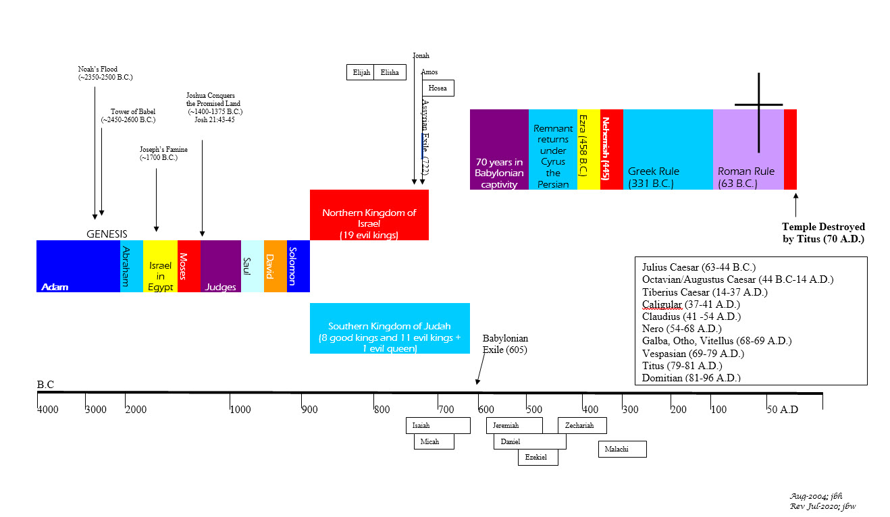





BIBLICAL CHRONOLOGICAL BACKGROUND
OT
Cyrus the Great (Cyrus II)
Darius the Mede
Darius I
Xerxes I (Esther and Mordecai)
Artaxerxes I
NT
Jehu (1 Kings 16:7)
Micaiah: (1 Kings 22:8)
Huldah: (2 Kings 22:14)
Obed (2 Chr 28:9)
Job
Daniel 9:25-26
Prophets after Noah into the United Kingdom:
Abraham:
Moses:
Samuel:
Gad:
Nathan:
Ahijah
Asaph
(Gen 20:7)
(Exo 3:10)
(1 Sam 3:20)
(1 Sam 22:5)
(2 Sam 7:2)
(1 Kings 11:29)
(2 Chron 35:15)
Haggai
Mosaic Law and Covenant
Law of sin & death, the letter kills
Ministry of condemnation carved in stone
Glory fading away
Shemaiah: (2 Chr 12:15)
Iddo: (2 Chr 12:15)
Hanani: (2 Chr 16:7)
Jehu: (2 Chr 19:2)
Jeduthun: (2 Chr 35:15)
New Covenant of Jesus Christ
The Law of the Spirit of life
Ministry of righteousness on hearts
Eternal and exceeding in glory
Timeline is not to scale

Slide 11
John
Author: John the Apostle
Date of Writing: c. 85 - 90 A.D.

Slide 12
About this Gospel and Its Author - John
The title of the fourth Gospel continues the pattern of the other Gospels, being identified originally as “According to John.” Like the others, “The Gospel” was added later.
Although the author’s name does not appear in the Gospel, early church tradition strongly and consistently identified him as the apostle John. The early church father Irenaeus (c. 130–200 A.D.) was a disciple of Polycarp (c. 70–160 A.D.), who was a disciple of the apostle John, and he testified on Polycarp’s authority that John wrote the Gospel during his residence at Ephesus in Asia Minor when he was advanced in age.¹ Subsequent to Irenaeus, all the church Fathers assumed John to be the Gospel’s author. Clement of Alexandria (c. 150–215 A.D.) wrote that John, aware of the facts set forth in the other Gospels and being moved by the Holy Spirit, composed a “spiritual Gospel”.²
Reinforcing early church tradition are significant internal characteristics of the Gospel. While the synoptic Gospels (Matthew, Mark, and Luke) identify the apostle John by name approximately 20 times (including parallels), he is not directly mentioned by name in the Gospel of John. Instead, the author prefers to identify himself as the disciple “whom Jesus loved”.³ The absence of any mention of John’s name directly is remarkable when one considers the important part played by other named disciples in this Gospel. Yet, the recurring designation of himself as the disciple “whom Jesus loved,” a deliberate avoidance by John of his personal name, reflects his humility and celebrates his relation to his Lord Jesus. No mention of his name was necessary since his original readers clearly understood that he was the Gospel’s author. Also, through a process of elimination based primarily on analyzing the material in chapters 20–21, this disciple “whom Jesus loved” narrows down to the apostle John.⁴ Since the Gospel’s author is exacting in mentioning the names of other characters in the book, if the author had been someone other than John the apostle, he would not have omitted John’s name.
The Gospel’s anonymity strongly reinforces the arguments favoring John’s authorship, for only someone of his well known and preeminent authority as an apostle would be able to write a Gospel that differed so markedly in form and substance from the other Gospels and have it receive unanimous acceptance in the early church. In contrast, apocryphal Gospels produced from the mid-second century onward were falsely ascribed to apostles or other famous persons closely associated with Jesus yet universally rejected by the church.
John and James, his older brother (Acts 12:2), were known as “the sons of Zebedee” (Matthew 10:2-4), and Jesus gave them the name “Sons of Thunder” (Mark 3:17). John was an apostle (Luke 6:12-16) and one of the three most intimate associates of Jesus (along with Peter and James),⁵ being an eyewitness to and participant in Jesus’ earthly ministry (1 John 1:1-4). After Christ’s ascension, John became a “pillar” in the Jerusalem church (Galatians 2:9) and ministered with Peter (Acts 3:1; 4:13; 8:14). Later he went to Ephesus (tradition says before the destruction of Jerusalem), from where he wrote this Gospel and from where the Romans exiled him to Patmos (Revelation 1:9). Besides the Gospel that bears his name, John also authored 1–3 John and the book of Revelation (Revelation 1:1).
Because the writings of some church Fathers indicate that John was actively writing in his old age and that he was already aware of the synoptic Gospels, many date the Gospel sometime after their composition, but prior to John’s writing of 1–3 John or Revelation. John wrote his Gospel c. 80–90 A.D., about 50 years after he witnessed Jesus’ earthly ministry.
Notes:
¹ Against Heresies 2.22.5; 3.1.1
² see Eusebius’s Ecclesiastical History 6.14.7
³ John 13:23; 19:26; 20:2; 21:7, 21:20
⁴ e.g., 21:24; cf. 21:2
⁵ cf. Matthew 17:1; 26:37

Slide 13
John: Background and Setting
Strategic to John’s background and setting is the fact that according to tradition John was aware of the synoptic Gospels. Apparently, he wrote his Gospel to make a unique contribution to the record of the Lord’s life (“a spiritual Gospel”) and, in part, to be supplementary as well as complementary to Matthew, Mark, and Luke.
The Gospel’s unique characteristics reinforce this purpose: First, John supplied a large amount of unique material not recorded in the other Gospels. Second, he often supplied information that helps the understanding of the events in the synoptics. For example, while the synoptics begin with Jesus’ ministry in Galilee, they imply that Jesus had a ministry prior to that.¹ John supplies the answer with information on Jesus’ prior ministry in Judea (John 3) and Samaria (John 4). In Mark 6:42-45, after the feeding of the 5,000, Jesus compelled his disciples to cross the Sea of Galilee to Bethsaida. John recorded the reason. The people were about to make Jesus king because of his miraculous multiplying of food, and he was avoiding their ill-motivated efforts (John 6:12-17). Third, John is the most theological of the Gospels, containing, for example, a heavily theological prologue (John 1:1-18), larger amounts of doctrinal instruction and discourse material in proportion to narrative,² and the largest amount of teaching on the Holy Spirit.³ Although John was aware of the synoptics and fashioned his Gospel with them in mind, he did not depend upon them for information. Rather, under the inspiration of the Holy Spirit, he utilized his own memory as an eyewitness in composing the Gospel.⁴
John’s Gospel is the second (cf. Luke 1:1-4) that contains a precise statement regarding the author’s purpose. He declares, “these are written so that you may believe that Jesus is the Christ, the Son of God, and that by believing you may have life in his name” (John 20:31). The primary purposes, therefore, are twofold: evangelistic and apologetic. Reinforcing the evangelistic purpose is the fact that the word “believe” occurs approximately 100 times in the Gospel (the synoptics use the term less than half as much). John composed his Gospel to provide reasons for saving faith in his readers and, as a result, to assure them that they would receive the divine gift of eternal life (John 1:12).
The apologetic purpose is closely related to the evangelistic purpose. John wrote to convince his readers of Jesus’ true identity as the incarnate God-Man whose divine and human natures were perfectly united into one person who was the prophesied Christ (“Messiah”) and Savior of the world.⁵ He organized his whole Gospel around eight “signs” or proofs that reinforce Jesus’ true identity leading to faith. The first half of his work centers around seven miraculous signs selected to reveal Christ’s person and engender belief, and the eighth sign is recorded in John 21 after Jesus’ resurrection.
      Water made into wine (John 2:1-11)..
      The healing of the official’s son (John 4:46-54).
      The healing of the lame man (John 5:1-18).
      The feeding of a multitude (John 6:1-15).
      Walking on water (John 6:16-21).
      Healing of the blind man (John 9:1-41).
      The raising of Lazarus (John 11:1-57).
      The miraculous catch of fish (John 21:6-11) after Jesus’ resurrection.
Notes:
¹ e.g., Matthew 4:12; Mark 1:14
² e.g., John 3:13-17
³ e.g., John 14:16-17, 14:26; 16:7-14
⁴ John 1:14; 19:35; 21:24
⁵ e.g., John 1:41; 3:16; 4:25-26; 8:58

Slide 14
John: Outline
The Opposition to the Son of God
  Opposition at the Feast in Jerusalem:
  Third sign: healing the paralytic
  Rejection by the Jews
  Opposition at the During Passover
  Fourth sign: feeding the 5,000
  Fifth sign: walking on water
  Opposition at the Feast of Booths
  The opposition
  Sixth sign: healing the blind man
  Opposition at the Feast of Dedication
  Opposition at Bethany
  Seventh sign: raising of Lazarus
  Pharisees’ plot to kill Christ
  Opposition at Jerusalem
  The triumphal entry
  The discourse on faith and rejection
Prologue: The Incarnation of the Son of God
  His Eternality
  His Preincarnate Work
  His Forerunner
  His Rejection
  His Reception
  His Deity
The Execution of the Son of God
  The Rejection of Christ:
  His arrest
  His trials
  The Crucifixion of Christ
Conclusion
  The Disciple Whom Jesus Loved is the One Who:
  Bears witness to these things
  Has written these things
  Whose testimony is true
John 1:1–18
John 1:19–4:54
John 5:1–12:50
John 13:1–17:26
John 18:1–19:37
John 19:38–21:23
John 21:24–25
The Presentation of the Son of God
  Presentation by John the Baptist:
  To the religious leaders
  At Christ’s baptism
  To John’s Disciples
  To Andrew, Peter, Philip and Nathanael
  Presentation in Galilee, Judea, Samaria:
  First sign: water to wine
  Cleansing the temple
  Teaching Nicodemus
  Witness to the Samaritan woman
  His Reception by the Galileans
  Second sign: healing the official’s son
Preparation of the Disciples by the Son of God
  In the Upper Room:
  Washing their feet
  Announcing His betrayal
  Discourse on Christ’s departure
  On the Way to the Garden:
  Instructing the disciples
  Interceding with the Father
The Resurrection of the Son of God
  The Burial of Christ
  The Resurrection of Christ
  The Appearances of Christ:
    To Mary Magdalene
    To the disciples without Thomas
    To the disciples with Thomas
    Statement of purpose for the Gospel
    To the disciples
    To Peter

Slide 15
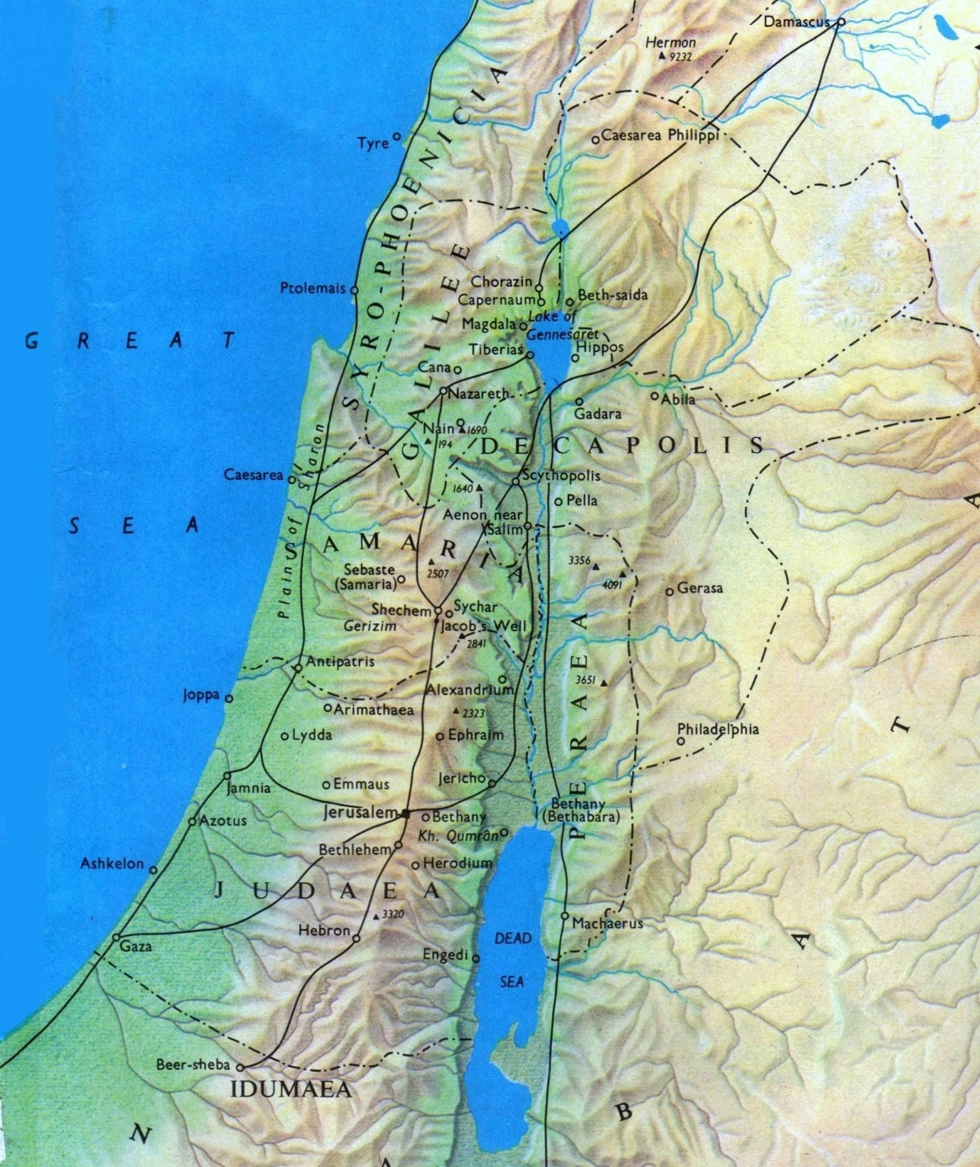

Geography for New Testament
Israel

Slide 16
John: Key Verses
John 1:1, 14: “In the beginning was the Word, and the Word was with God, and the Word was God.. . . . And the Word became flesh and dwelt among us, and we have seen his glory, glory as of the only Son from the Father, full of grace and truth.”
John 1:29: “The next day he saw Jesus coming toward him, and said, "Behold, the Lamb of God, who takes away the sin of the world!” (John 1:29, NKJV).
John 3:16: “For God so loved the world that He gave His only begotten Son, that whoever believes in Him should not perish but have everlasting life”.
John 6:29: “Jesus answered and said to them, ‘This is the work of God, that you believe in Him whom He sent’”.
John 10:10: “The thief does not come except to steal, and to kill, and to destroy. I have come that they may have life, and that they may have it more abundantly”.
John 10:28: “And I give them eternal life, and they shall never perish; neither shall anyone snatch them out of My hand”.
John 11:25-26: “Jesus said to her, ‘I am the resurrection and the life. He who believes in Me, though he may die, he shall live. And whoever lives and believes in Me shall never die. Do you believe this?’”
John 13:35: “By this all will know that you are My disciples, if you have love for one another”.
John 14:6: “Jesus said to him, ‘I am the way, the truth, and the life. No one comes to the Father except through Me’”.
John 14:9: “Jesus said to him, ‘Have I been with you so long, and yet you have not known Me, Philip? He who has seen Me has seen the Father; so how can you say, “Show us the Father?’”.
John 17:17: “Sanctify them by Your truth. Your word is truth”.
John 19:30: “So when Jesus had received the sour wine, He said, ‘It is finished!’ And bowing His head, He gave up His spirit”.
John 20:26-29: “Eight days later, his disciples were inside again, and Thomas was with them. Although the doors were locked, Jesus came and stood among them and said, "Peace be with you." Then he said to Thomas, "Put your finger here, and see my hands; and put out your hand, and place it in my side. Do not disbelieve, but believe." Thomas answered him, "My Lord and my God!" Jesus said to him, "Have you believed because you have seen me? Blessed are those who have not seen and yet have believed."”.
John 20:30-31: "Now Jesus did many other signs in the presence of the disciples, which are not written in this book; but these are written so that you may believe that Jesus is the Christ, the Son of God, and that by believing you may have life in his name."

Slide 17
Timetable of Jesus’ Ministry in John’s Gospel
(Part 1)
A.D. 27 -28 | A.D. 28-29 | A.D. 29-30
The Wedding at Cana: Jesus' First Miracle (John 2:1-12). | The Healing of the lame man at the Pool on the Sabbath (3rd miracle), and the Authority of the Son not only over the Sabbath but over life itself and judgment (John 5:1-29) | Jesus Feeds the 5000 and Walks on Water; 4th and 5th miracles recorded (John 6:1-21).
Jesus Cleanses the Temple the 1st time and Knew What Was in Men (John 2:13-25). | Witnesses that testify to Jesus’s claim : John the Baptist, the Father, Jesus’ works, the Scriptures, Moses (John 5:30-47). | I AM the Bread of Life and Word of Eternal Life (John 6:22-71)
You Must Be Born Again; therefore, God Loving the World, Gave his Only Son (John 3:1-21). |  | Jesus at the Feast of Booths; Can this Be the Christ (John 7:1-24)
John the Baptist Exalted (John 3:22-36). |  | Officers Sent to Arrest Jesus, Believe in me and out of your heart will flow rivers of living water, Division among the People (John 7:25-52).
Jesus and the Samaritan Woman at the Well (John 4:1-45) |  | [[The Woman Caught in Adultery]] (John 8:1-11)
Jesus Heals an Officials Son; the second miracle recorded in John. (John 4:1-46) |  | I AM the Light of the World and the Truth Shall Set You Free (John 8:12-38).
 |  | You Are of Your Father the Devil and Before Abraham was I AM (John 8:39-59).
 |  | Jesus Heals the Man Born Blind; 6th miracle (John 9:1-41).
 |  | I AM the door and I AM the Good Shepherd (John 10:1-21).
 |  | I and the Father Are One (John 10:22-42).
 |  | The Death of Lazarus. 7th miracle (John 11:1-16).
 |  | I AM the Resurrection and the Life and Jesus Raises Lazarus (John 11:17-44).
*Tabulated using One Perfect Life, by John MacArthur

Slide 18
Timetable of Jesus’ Ministry in John’s Gospel
(Part 2)
Passion Week (A.D. 29-30) | The Upper Room (A.D. 29-30) | The Arrest, Trial, Crucifixion, Burial and Resurrection (A.D. 29-30)
The Plot to Kill Jesus, and Mary’s Anointing of Jesus at Bethany (John 11:45-12:8). | Jesus Washes the Disciples' Feet (John 13:1-20). | Betrayal and Arrest of Jesus (John 18:1-11).
The Plot to Kill Lazarus (John 12:9-11). | One of You Will Betray Me (John 13:21-30). | Jesus Faces Annas and Caiaphas, and Peter Denies Jesus (John 18:12-27).
The Triumphal Entry (John 12:12-19). | A New Commandment, and Peter's Denial Prophesied (John 13:31-36). | Jesus Before Pilate; My Kingdom is not of This World (John 18:28-40).
The Son of Man Must be Lifted Up, and many even of the rulers believed Him but were not confessing from fear (John 12:27-43). | I AM the Way, the Truth and the Life (John 14:1-14). | Jesus Delivered to Be Crucified (John 19:1-16).
He who sees me has seen the One who sent Me, I have come as Light into the world, if anyone hears my sayings and does not keep them, I do not judge him; for I [came] to save the world. He who rejects My sayings, has one who judges him, I speak just as the Father has told Me (John 12:44-50). | Jesus Promises the Holy Spirit (John 14:15-31). | The Crucifixion, Death and Burial of our Lord Jesus (John 19:17-42).
 | I AM the True Vine (15:1-17). | The Resurrection (John 20:1-10).
 | The Hatred of the World and the Promise of the Holy Spirit (John 15:18-16:15). | Jesus Appears to Mary Magdalene, the Disciples and Thomas (John 20:11-29).
 | Your Sorrow Will Turn into Joy; I Have Overcome the World (John 16:16-33). | The Purpose of John's Book (John 20:30-31).
 | Jesus’ High Priestly Prayer (John 17:1-26). | Jesus Appears to Seven Disciples; the miraculous catch of fish and the 8th miracle (John 21:1-14).
 |  | Jesus Restores Peter (John 21:15-19).
 |  | Jesus and the Beloved Apostle (John 21:20-25)
*Tabulated using One Perfect Life, by John MacArthur

Slide 19
John: Study Questions
In the opening prologue of John’s gospel (Chapter 1), he introduces the person of Jesus using several descriptions. Which of the following descriptors did John apply to Jesus? (Check all that apply.)
In John 6:35 we read: “Jesus said to them, “I am the bread of life; whoever comes to me shall not hunger, and whoever believes in me shall never thirst.” Which scripture below is the best cross reference to support the primary interpretation of John 6:35?
Jesus identifies himself with eight “I AM” statements in the book of John. Which one of the following is not one of His “I AM” statements?
John records eight miraculous works of Jesus, and seven have been listed below. Which sign from Jesus listed on the left do you believe best demonstrated each declaration listed on the right? [Note: There are no perfect answers, so just prayerfully enjoy meditating on our Savior.]
  The Word
  God
  Creator
  The Archangel
  The True Light
  Glory of the only begotten [Son] of the Father
  The Morning Star
  Messiah
  King of Israel
  Priest in the order of Melchizedek
  Son of Man
  The Lamb of God who takes away the sin of the world
  Son of God
  The source of Life
  Nehemiah 9:15
  Deuteronomy 8:3
  Matthew 5:6
  Isaiah 49:10
  I AM the Bread of Life
  I AM the Living Water
  I AM the Door
  I AM the Way, the Truth, and the Life
  I AM the Good Shepherd
  I AM the Resurrection and the Life
  I AM the Light of the World
  Before Abraham was, I AM
  Turned water into wine
  Healed a man born blind
  Raised Lazarus from the dead
  Healed a sick official’s son
  Fed the 5,000 men
  Walked on Water
  Brought forth a miraculous catch of fish
  I AM the Resurrection and the Life
  Before Abraham was, I AM
  I AM the Light of the World
  I AM the True Vine
  I AM the Way, the Truth, and the Life
  I AM the Bread of Life
  I AM the Good Shepherd

Slide 20
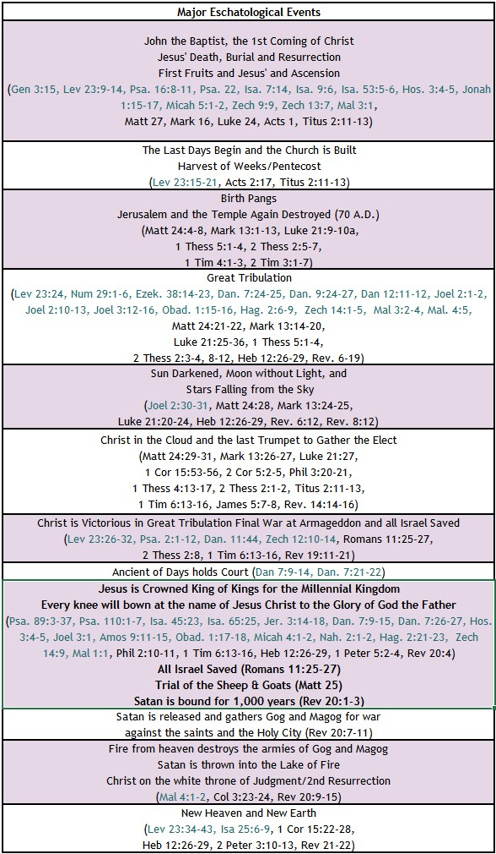


BIBLE ESCHATOLOGY
JOHN
John 1:19-27, "And this is the testimony of John, when the Jews sent priests and Levites from Jerusalem to ask him, "Who are you?" He confessed, and did not deny, but confessed, "I am not the Christ." And they asked him, "What then? Are you Elijah?" He said, "I am not." "Are you the Prophet?" And he answered, "No." So they said to him, "Who are you? We need to give an answer to those who sent us. What do you say about yourself?" He said, "I am the voice of one crying out in the wilderness, ‘Make straight the way of the Lord,’ as the prophet Isaiah said.“
(Now they had been sent from the Pharisees.) They asked him, "Then why are you baptizing, if you are neither the Christ, nor Elijah, nor the Prophet?" John answered them, "I baptize with water, but among you stands one you do not know, even he who comes after me, the strap of whose sandal I am not worthy to untie."
John 1:29-36, "The next day he saw Jesus coming toward him, and said, "Behold, the Lamb of God, who takes away the sin of the world! This is he of whom I said, ‘After me comes a man who ranks before me, because he was before me.’ I myself did not know him, but for this purpose I came baptizing with water, that he might be revealed to Israel." And John bore witness: "I saw the Spirit descend from heaven like a dove, and it remained on him. I myself did not know him, but he who sent me to baptize with water said to me, ‘He on whom you see the Spirit descend and remain, this is he who baptizes with the Holy Spirit.’ And I have seen and have borne witness that this is the Son of God."
The next day again John was standing with two of his disciples, and he looked at Jesus as he walked by and said, "Behold, the Lamb of God!"
John 14:1-3, "Let not your hearts be troubled. Believe in God; believe also in me. In my Father 's house are many rooms. If it were not so, would I have told you that I go to prepare a place for you? And if I go and prepare a place for you, I will come again and will take you to myself, that where I am you may be also.
John 6:39, “And this is the will of him who sent me, that I should lose nothing of all that he has given me, but raise it up on the last day.”
John 12:48, “The one who rejects me and does not receive my words has a judge; the word that I have spoken will judge him on the last day.”

Slide 21
Summary of John
Brief Summary: Whereas Matthew and Luke trace Jesus’ earthly heritage back to Abraham and Adam, respectively, and Mark opens with the beginning of Jesus’ earthly ministry; the gospel of John transports us back to the beginning before Creation. John tells us that “in the beginning was the Word, and the word was with God, and the Word was God.” All things came into being through Him, and in Him was life. The God from the Father’s side became flesh, was named Jesus, and dwelt among us full of glory, grace, and truth as the only begotten Son from the Father (John 1:1-18) in order that He might take away our sins as the spotless Lamb of God (John 1:29). John focused his text on the identity of Jesus beginning with the prologue and continuing with eight “I AM” statements from Jesus.
I AM the Bread of Life (John 6:22-71)
I AM the Light of the World (John 8:12-38)
Before Abraham was, I AM (John 8:39-59)
I AM the Door (John 10:1-10)
I AM the Good Shepherd (John 10:11-21)
I AM the Resurrection and the Life (John 11:17-44)
I AM the Way, the Truth, and the Life (John 14:1-14)
I AM the True Vine (John 15:1-17)
Likewise, John documented eight miracles as evidence to reinforce Jesus’ declarations.¹ Jesus taught you must be born again, born from above, born of the Spirit to be saved. He is the Way, the Truth, and the Life, and no one comes to the Father except through God’s Son. Once born from above by the Spirit through Jesus Christ, we are to express our love for Him by obeying his commands (John 14:15-21, 15:9-10). Jesus is the vine, we are the branches, and we must remain in Him to be fruitful in any endeavor that will have eternal impact. When we sin, we are slaves to sin, but when we are free in Jesus, we are free indeed with His power to overcome sin.
As with the other gospels, John records the plot of the Jewish leaders to kill Jesus, our Lord’s crucifixion, death, burial, and glorious resurrection on the third day. The Lord Jesus willingly died on the cross to pay in full the debt owed to God for the sins of all who place their trust in His work and righteousness. Jesus appeared to his disciples after his resurrection giving proof that He conquered the grave, he taught them and personally strengthened Peter by giving him three opportunities to again declare his love for the Lord and instructing Peter to feed his lambs and sheep.
Near the end of his book, John states his purpose: “these have been written so that you may believe that Jesus is the Christ, the Son of God; and that believing you may have life in His name” (John 20:30-31). For “those born of God, who receive Him and believe in His name, to them He gave the right to become children of God” (John 1:10-12).
Connections: The gospel of John’s portrayal of Jesus as the God of the Old Testament is seen most emphatically in the seven “I AM” statements of Jesus. He is the “Bread of life” (John 6:35), provided by God to feed the souls of His people. Just as He provided manna from heaven to feed the Israelites in the wilderness; Jesus now satisfies those who hunger and thirst for righteousness.² Jesus is the “Light of the world” (John 8:12), the same Light that God promised to His people in the Old Testament (Isaiah 30:26; 60:19-22) and which will find its culmination in the New Jerusalem when Christ the Lamb will be its Light (Revelation 21:23). Two of the “I AM” statements refer to Jesus as both the “Good Shepherd” and the “Door of the sheep.” Here are clear references to Jesus as the God of the Old Testament, the Shepherd of Israel (Psalm 23:1; 80:1; Jeremiah 31:10; Ezekiel 34:23) and, as the only Door into the sheepfold, the only way of salvation by which we escape God’s judgment.
Notes:
¹ see John chapters 2, 4-6, 9, 11, and 21
² See Exodus 16:11–36 and Matthew 5:6

Slide 22
John: Practical Application
Practical Application: The gospel of John continues to fulfill its purpose
that the reader may believe that Jesus is the Christ, the Son of God; and that believing we may have life in His name. John focuses us one the Person and the Power of Christ through eight recorded miracles, eight I AM declarations of Jesus, and the testimony of the Hoy Spirit, the Father, John the Baptist and the Scriptures.
We too now have these truths to aid us in helping others find life in Jesus Christ as we declare and explain John 3:16, the death of Jesus for our sins, his burial, and resurrection on the third day. This is the Good News. God’s Son, Jesus, paid the penalty for sinners with his life, conquered death, and extends this resurrection power and promise to all who believe Him. Jesus’ “high priestly prayer” for believers in John chapter 17 is also a wonderful source of encouragement and strength for believers. Let us abide in this love and strength and serve to extend it to others.

Slide 23
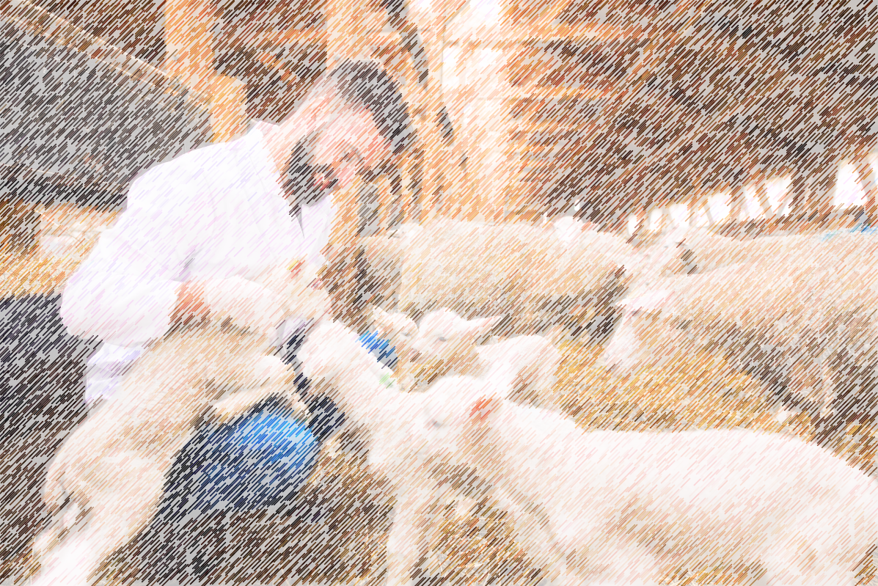
Closing Prayer Verse
John 21:15-17: “When they had finished breakfast, Jesus said to Simon Peter, "Simon, son of John, do you love me more than these?" He said to him, "Yes, Lord; you know that I love you." He said to him, "Feed my lambs." He said to him a second time, "Simon, son of John, do you love me?" He said to him, "Yes, Lord; you know that I love you." He said to him, "Tend my sheep." He said to him the third time, "Simon, son of John, do you love me?" Peter was grieved because he said to him the third time, "Do you love me?" and he said to him, "Lord, you know everything; you know that I love you." Jesus said to him, "Feed my sheep.”

Slide 24
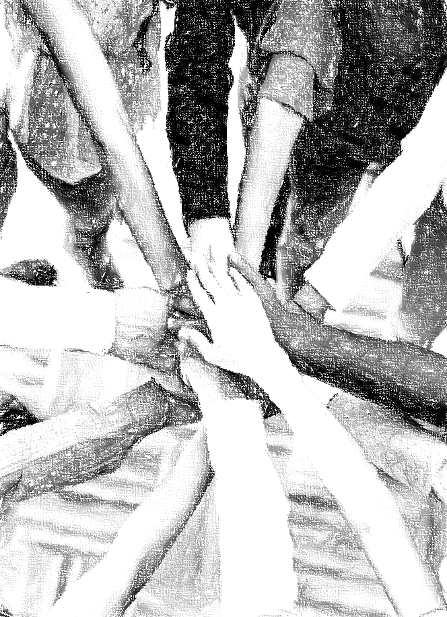
Acknowledgements
Background, Setting, Outlines, some Study Question answers, interpretative challenges, and some Summaries: Adapted from John MacArthur Study Bible at GTY.org.
Key verses, Practical Application, some Study Question answers, and some Summaries: Adapted from GotQuestions.org.
Inductive Bible Study Method: Adapted from Precept.org.
Creation – Consummation Icons: Adapted from AnswersInGenesis.org.
Definitions: Adapted from Websters 1828 Dictionary.

Slide 25
Study Leader Assistance
Sample Prayers
Study Question Answer Keys
Bonus slides

Slide 26
Sample Opening Prayer Verse: John
John 1:1-5, “In the beginning was the Word, and the Word was with God, and the Word was God. He was in the beginning with God. All things were made through him, and without him was not any thing made that was made. In him was life, and the life was the light of men. The light shines in the darkness, and the darkness has not overcome it.”
Sample Prayer: Dear Heavenly Father, thank you for the Word who willingly left your side in heaven, took on human flesh and dwelt among us. Thank you for teaching us that He was with You, that all things were made through Him, that in Him is life, and he too is God. We praise you that you are One with the Word and the Holy Spirit, existing in perfect harmony. And we are so grateful that you sent the Light to drive out our personal darknesses, forgive us and cleanse us from all unrighteousness. Thank you for making us new creations, adopting us and giving us the Holy Spirit to instruct and comfort us. Make us fruitful in our service. In Jesus’ name we pray.

Slide 27
John: Study Questions
In the opening prologue of John’s gospel (Chapter 1), he introduces the person of Jesus using several descriptions. Which of the following descriptors did John apply to Jesus? (Check all that apply.)
In John 6:35 we read: “Jesus said to them, “I am the bread of life; whoever comes to me shall not hunger, and whoever believes in me shall never thirst.” Which scripture below is the best cross reference to support the primary interpretation of John 6:35?
Jesus identifies himself with eight “I AM” statements in the book of John. Which one of the following is not one of His “I AM” statements?
John records eight miraculous works of Jesus, and seven have been listed below. Which sign from Jesus listed on the left do you believe best demonstrated each declaration listed on the right? [Note: There are no perfect answers, so just prayerfully enjoy meditating on our Savior.]
  The Word (John 1:1)
  God (John 1:1)
  Creator (John 1:3, 1:10)
  The Archangel
  The True Light (John 1:4-5, 1:8-9)
  Glory of the only begotten [Son] of the Father (John 1:18)
  The Morning Star
  Messiah (John 1:41)
  King of Israel (John 1:49)
  Priest in the order of Melchizedek
  Son of Man (John 1:51)
  The Lamb of God who takes away the sin of the world (John 1:29)
  Son of God (John 1:34, 1:49)
  The source of Life (John 1:4)
  Nehemiah 9:15
  Deuteronomy 8:3
  Matthew 5:6,"Blessed are those who hunger and thirst for righteousness, for they shall be satisfied.”
  Isaiah 49:10
  I AM the Bread of Life
  I AM the Living Water
  I AM the Door
  I AM the Way, the Truth, and the Life
  I AM the Good Shepherd
  I AM the Resurrection and the Life
  I AM the Light of the World
  Before Abraham was, I AM
3
  Turned water into wine
  Healed a man born blind
  Raised Lazarus from the dead
  Healed a sick official’s son
  Fed the 5,000 men
  Walked on Water
  Brought forth a miraculous catch of fish
  I AM the Resurrection and the Life
  Before Abraham was, I AM
  I AM the Light of the World
  I AM the True Vine
  I AM the Way, the Truth, and the Life. No one comes to the Father except through me.
  I AM the Bread of Life
  I AM the Good Shepherd
6
2
1
7
5
4
Note: The 8th miracle recorded in John is the healing of the lame man at the pool. See John 5:1-18. I like this miracle for “I AM the door”. The lame man was now able to walk thru.

Slide 28
Sample Closing Prayer Verse
John 21:15-17: “When they had finished breakfast, Jesus said to Simon Peter, "Simon, son of John, do you love me more than these?" He said to him, "Yes, Lord; you know that I love you." He said to him, "Feed my lambs." He said to him a second time, "Simon, son of John, do you love me?" He said to him, "Yes, Lord; you know that I love you." He said to him, "Tend my sheep." He said to him the third time, "Simon, son of John, do you love me?" Peter was grieved because he said to him the third time, "Do you love me?" and he said to him, "Lord, you know everything; you know that I love you." Jesus said to him, "Feed my sheep.”
Sample Prayer: Dear Heavenly Father, thank you for Peter and all your apostles and prophets through whom you have built the foundations of faith and truth unto salvation with Jesus Christ as the cornerstone. As Peter prayed, we too exclaim that “Lord you know all things; you know that we love you.” Work in us to demonstrate this love by keeping your commandments and giving you glory in our thoughts, words, and actions. Work through us to feed and guard your lambs and sheep as you feed and guard us. In Jesus’s matchless name we pray. Amen.

Slide 29
John’s Prologue on Jesus
Chapter 1
The Word (1:1)
The Word was with God from the beginning (1:1-2, 15)
The Word was God (1:1)
The world was made through him (1:3, 10)
In him was life (1:4-5)
The light of men and the darkness has not overcome it (1:4-5, 8)
True Light who enlightens everyone (1:4-5,8-9)
Gives those who receive him the right to become children of God (1:12-13)
The Word became flesh and dwelt among us (1:14)
Glory as the only Son, the only begotten from the Father (1:14)
Full of grace and truth (1:14)
Of His fullness we receive grace upon grace (1:16-17)
The Only God, who is in the bosom of the Father explained Him [the Father] (1:18)
Lamb of God, who takes away the sin of the world (1:29)
Son of God (1:34,49)
Messiah (1:41)
King of Israel (1:49)
Son of man (1:51)

Slide 30
Digging Deeper (John)
Did Judas Iscariot have a choice in his betrayal of Jesus?
Real Questions:
Who was responsible for Judas’ betrayal of Jesus?
James 1:13-15
Genesis 3:1-24
Titus 1:1-2
John 12:3-6
Matt 12:38-45
Could Judas’ final destiny have been different?
John 13:11
John 13:18
John 17:12
John 1:12
John 6:37
John 6:44
How do we reconcile God’s sovereignty with man’s responsibility?
Isa 46:8-11
Matt 18:7

