Slide 1
Deuteronomy
Book 5
© 2026 RCI. All rights reserved.
To God Alone Be the Glory

Slide 2
What is the Holy Bible?
The Holy Bible is a collection of writings that includes 66 books in English editions. The Bible consists of two parts, the Old Testament and New Testament. The word testament means covenant. The Old Testament includes 39 books, and the New Testament includes 27 books.
These 66 books were written over approximately 1,400 years by 40 different authors in Hebrew, Aramaic, and Greek. The Old Testament writings were affirmed by Jewish leaders, and moreover, by Jesus Christ.¹ The New Testament writings were confirmed by early church leaders. The 66 books of the Bible are the inspired words of God that are used to make and mature disciples of the One true God through Jesus Christ, his Son (Matthew 28:18-20, 2 Timothy 3:16-17). The Bible was not created by mere human wisdom but was inspired by God (2 Peter 1:20-21), is interpreted by His Holy Spirit (John 16:13, Matthew 23:8-10), and will last forever (Matthew 24:35).²
If you do a phrase search on the Bible you will find the phrase "the word of the Lord" and "Thus says the Lord" more than 700 times.³ In addition, this book has given reasonable evidence to the claim of being God’s word by:​
  providing answers that conform with the reality we see around us.
  being a reliable collection of historical documents.
  containing eyewitness accounts that were written during the lifetimes of other eyewitnesses.
  recording supernatural events that took place in fulfillment of specific prophecies.⁴
Notes:
¹ See Matthew 4:4-7, 12:3-5, Mark 7:6-7, 12:26-27, and Luke 19:46 for examples.
^{2 “}What are the Books of the Bible”, GotQuestions.org
³ Blue Letter Bible
⁴ Paraphrased from Voddie Baucham

Slide 3
Our Goals in Studying the Bible
To better …..
Understand the Only true God; the Author of the Bible. (2 Timothy 3:16-17, 2 Peter 1:20-21, 1 John 5:20 , Jeremiah 9:23-24)
Learn How He works in the World and in our Lives. (Job 40:6-14, Isaiah 45:6-7, Isaiah 46:8-10, Philippians 2:12-13)
Understand Ourselves and the Hearts of Mankind. (Jeremiah 17:9, 2 Timothy 3:13, Ephesians 5:7-10)
Come to Know What Pleases and Grieves God. (1 Thessalonians 4:1, Ephesians 4:26-31, Hebrews 11:6, 1 Peter 1:14-19)
To be Transformed into Fruitful Doers of God’s Word and not just Hearers. (Romans 12:2, James 1:27, Matthew 3:8)
Tether Ourselves to God’s Word for Our Wisdom, Discernment, and Safety. (1 Corinthians 6:9-10, Matthew 24:24, Ephesians 4:11-14)
Jeremiah 9:23-24 “Thus says the Lord: "Let not the wise man boast in his wisdom, let not the mighty man boast in his might, let not the rich man boast in his riches, but let him who boasts boast in this, that he understands and knows me, that I am the Lord who practices steadfast love, justice, and righteousness in the earth. For in these things I delight, declares the Lord."

Slide 4
How to Study the Bible
#1. Observation: What does the text say?
Who?
What?
When?
Where?
How?
Why?
#2. Interpretation: What does the text mean in context with the passage, book, and whole counsel of God?
#3. Application: How is the Holy Spirit instructing me to apply this understanding at this time in my life?

Slide 5
Study Resources
Opening Prayer
Background and Setting
Book Outline
Geography Maps
Key Verses
Study Questions
Major Event Timeline
Book Summary
Application and Closing Prayer
Study Leader Support Slides

Slide 6

Opening Prayer Verse: Numbers
Deuteronomy 32:4, "The Rock, his work is perfect,
for all his ways are justice.
A God of faithfulness and without iniquity,
just and upright is he.”

Slide 7
Review of Numbers
Learning Tip: For those studying the Bible in its table‑of‑contents order, this slide gives you a brief recap of the book you just completed. Studying in a different sequence? You can simply skip this slide or treat it as a gentle nudge to circle back when the time is right.
Brief Summary: The book of Numbers gets its name from the numerous people, livestock, and items counted; most notably the numbering of the fighting men in censuses taken in the second and fortieth years of the Exodus (c. 1444 B.C. and 1405 B.C., respectively). However, the book is primarily about a holy God preparing to bring his people into the Promised Land, a holy and clean people to worship, serve, and represent Him to the nations. Most of the events of the book take place in the wilderness, primarily between the second and fortieth years of the wandering of the Israelites. The first 25 chapters of the book chronicle the experiences of the first generation of Israel in the wilderness, while the rest of the book describes the experiences of the second generation. The theme of obedience and rebellion followed by repentance and blessing runs through the entire book, as well as the entire Old Testament. The importance of the Book of Numbers is indicated by its being referred to in the New Testament many times. The Holy Spirit called special attention to Numbers in 1 Corinthians 10:1-12. The words "all these things happened to them for examples" refers to the sin of the Israelites and God’s displeasure with them.
In Romans 11:22, Paul speaks about the “kindness and severity of God." That, in a nutshell, is the message of Numbers. The severity of God is seen in the death of the rebellious generation who had put God to the test ten times in the wilderness; these men never entered the Promised Land. The kindness of God is realized in the new generation. God protected, preserved, and provided for these people until they possessed the land. This reminds us of the justice and loving mercy of God, which are always in sovereign harmony.
Even Moses was unable to enter the Promised Land at that time because He had disobeyed God and had not held God holy before the congregation at the Rock of Meribah (Numbers 20). Instead, Joshua was commissioned to lead this next generation into the Land, and Moses only saw the Land from afar before his death on Mount Nebo at 120 years old (Deuteronomy 34:1-6). Centuries later, however, Moses appeared to the disciples in the Promised Land on the Mount of Transfiguration with our Lord Jesus (Matthew 17:3) demonstrating God’s mercy, grace, and love toward him.
Numbers demonstrates God as holy, slow to anger, but also the Judge who will not allow the guilty to go unpunished. In addition, this book exhibits God’s faithfulness to His covenant promise to Abraham, Isaac, and Israel; to bring their descendants into the Promised Land.
Foreshadowings: God’s demand for holiness in His people is completely and finally satisfied in Jesus Christ, who came to fulfill the Law on our behalf (Matthew 5:17). The concept of the promised Messiah pervades the book. The story in Numbers 19 of the sacrifice of the red heifer “without defect or blemish” prefigures Christ, the Lamb of God without spot or blemish who was sacrificed for our sins. The image of the bronze snake lifted up on the pole to provide physical healing (Numbers 21) also prefigures the lifting up of Christ upon the cross and that those who trust in Christ’s work there will live spiritually and eternally (John 3:13-15).
In chapter 24, Balaam’s fourth oracle speaks of the star and the scepter who is to rise out of Jacob. Here is a prophecy of Christ who is called the "morning star" in Revelation 22:16 for His glory, brightness, and splendor, and for the light that comes by Him. He may also be called a scepter, that is, a scepter bearer, because of his royalty. He not only has the name of a king but is King of kings who will rule with a scepter of power, grace, mercy, and righteousness.

Slide 8
Old Testament Table of Contents (39 Books)
THE LAW - 5
GENESIS
EXODUS
LEVITICUS
NUMBERS
DEUTERONOMY
POETRY - 5
JOB
PSALMS
PROVERBS
ECCLESIASTES
SONG OF SOLOMON
MINOR PROPHETS – 12
HOSEA
JOEL
AMOS
OBADIAH
JONAH
MICAH
NAHUM
HABAKKUK
ZEPHANIAH
HAGGAI
ZECHARIAH
MALACHI
HISTORY – 12
JOSHUA
JUDGES
RUTH
1 SAMUEL
2 SAMUEL
1 KINGS
2 KINGS
1 CHRONICLES
2 CHRONICLES
EZRA
NEHEMIAH
ESTHER
MAJOR PROPHETS - 5
ISAIAH
JEREMIAH
LAMENTATIONS
EZEKIEL
DANIEL

Slide 9
Old Testament Books by Date Written
Historical Books
Wisdom Book and Prophetic Books
Genesis:
c. 1445-1400 B.C.
Exodus:
c. 1445-1400 B.C.
Leviticus:
c. 1445-1400 B.C.
Numbers:
c. 1405 B.C.
Deut:
c. 1405 B.C.
Joshua:
c. 1405-1385 B.C.
Judges:
c. 1043 B.C.
1 & 2 Samuel:
c. 960-722 B.C.
1 & 2 Kings:
c. 560-540 B.C.
Ezra:
c. 460-440 B.C
Esther:
c. 460-350 B.C..
1 & 2 Chron:
c. 450-425 B.C.
Nehemiah:
c. 445-420 B.C.
Ruth:
c. 1011-971 B.C.
Job:
c. 1440 – 950 B.C.
Psalms:
c. 1410-500 B.C.
Proverbs and Song of Solomon:
c. 965 B.C.
Ecclesiastes:
c. 930 B.C.
Obadiah:
c. 848-840 B.C.
Joel:
c. 835 – 796 B.C
Jonah:
c. 790 – 739 B.C.
Isaiah and Micah:
c. 739 – 681 B.C.
Nahum:
c. 663–612 B.C.
Habakkuk and Zephaniah:
c. 635-605 B.C
Jeremiah and Lamentations:
c. 630-575 B.C.
Ezekiel and Daniel:
c. 593 – 530 B.C.
Haggai and Zechariah:
c. 520-470 B.C.
Malachi:
c. 440 – 400 B.C.
Hosea and Amos:
c. 760 -725 B.C.
Amos 3:7 : “For the Lord GOD does nothing without revealing his secret to his servants the prophets.”

Slide 10
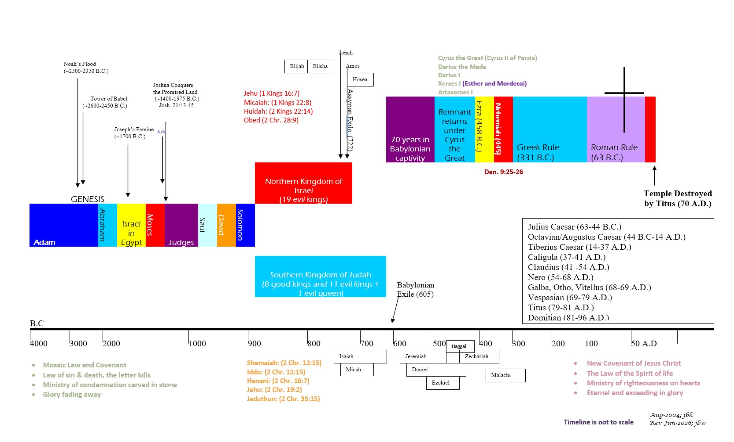


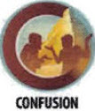

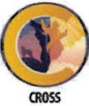

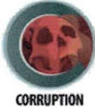
BIBLICAL CHRONOLOGICAL BACKGROUND
OT
NT
Prophets after Noah into the United Kingdom:
Abraham:
Moses:
Samuel:
Gad:
Nathan:
Ahijah
Asaph
(Gen. 20:7)
(Exo. 3:10)
(1 Sam. 3:20)
(1 Sam. 22:5)
(2 Sam. 7:2)
(1 Kings 11:29)
(2 Chr. 35:15)

Slide 11
Deuteronomy
Author: Moses
Date of Writing: c. 1405 B.C.

Slide 12
About Numbers and its Author: Moses
The English title “Deuteronomy” comes from the Greek Septuagint (LXX) mistranslation of “copy of this law” in Deuteronomy 17:18 as “second law,” which was rendered Deuteronomium in the Latin version (Vulgate). The Hebrew title of the book is translated “These are the words,” from the first two Hebrew words of the book. The Hebrew title is a better description of the book since it is not a “second law,” but rather the record of Moses’ words of explanation concerning the law. Deuteronomy completes the five-part literary unit called the Pentateuch.
Moses has been traditionally recognized as the author of Deuteronomy, since the book itself testifies that Moses wrote it.¹ Both the Old and the New Testaments support the claim of Mosaic authorship.² While Deuteronomy 32:48-34:12 was added after Moses’ death (probably by Joshua), the rest of the book came from Moses’ hand just before his death in 1405 B.C.
The majority of the book is comprised of farewell speeches that the 120-year-old Moses gave to Israel, beginning on the first day of the eleventh month of the fortieth year after the exodus from Egypt (Deuteronomy 1:3). These speeches can be dated January–February, 1405 B.C. In the last few weeks of Moses’ life, he committed these speeches to writing and gave them to the priests and elders for the coming generations of Israel.³
DATE: c. 1405 B.C.
Notes:
¹ Deuteronomy 1:1, 1:5; 31:9, 31:22, 31:24
² 1 Kings 2:3; 8:53; 2 Kings 14:6; 18:12, Acts 3:22-23; Romans 10:19
³ Deuteronomy 31:9, 31:24-26

Slide 13
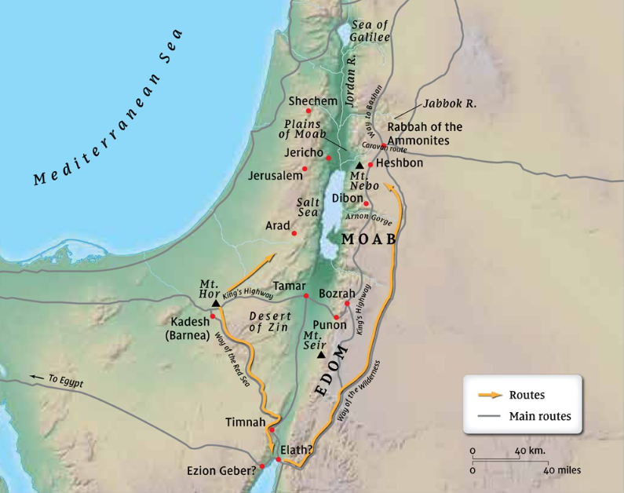
Deuteronomy Background and Geography
Like Leviticus, Deuteronomy does not advance historically but takes place entirely in one location over about one month of time.¹ Israel was encamped in the central rift valley to the east of the Jordan River.² This location was referred to in Numbers 36:13 as “the plains of Moab,” an area north of the Arnon River across the Jordan River from Jericho. It had been almost 40 years since the Israelites had exited Egypt.
The book of Deuteronomy concentrates on events that took place in the final weeks of Moses’ life. The major event was the verbal communication of divine revelation from Moses to the people of Israel.³ The only other events logged were:
Moses’ recording the law in a book and his commissioning of Joshua as the new leader (Deuteronomy 31:1-29);
Moses’ viewing of the land of Canaan from Mount Nebo (Deuteronomy 32:48-52; 34:1-4); and
Moses’ death (Deuteronomy 34:5-12).
The original recipients of Deuteronomy, both in its verbal and written presentations, were the second generation of the nation of Israel. All of the men 20 years and older, except Joshua and Caleb, died during the 40 years in the wilderness (Deuteronomy 1:34-36). The men over 40 had been born in Egypt and had participated as children or teens in the Exodus. Those under 40 had been born and reared in the wilderness. Together, they comprised the generation that was on the verge of conquering the land of Canaan under Joshua, 40 years after they had left Egypt.⁴ These and their living relatives would possess them Land.
Notes:
¹ Deuteronomy 1:3 , Deuteronomy 34:8 with Joshua 5:6-12
² Deuteronomy 1:1
³ Deuteronomy 1-30; , Deuteronomy 31:30-32:47; Deuteronomy 33:1-29
⁴ Deuteronomy 1:34-39
Map from preceptaustin.org

Slide 14
Deuteronomy: Outline
The Second Address by Moses
  Basic Elements of Israel’s Relationship with the Lord:
  The Ten Commandments
  Total commitment to the Lord
  Separation from other gods
  Warning not to forget the Lord
  Israel’s past rebellion
  Admonition to fear, love, and obey the Lord
  The Specific Stipulations for Life in the New Land:
  Instructions for the life of worship
  Instructions for leadership, societal order, and laws
  The first fruits and tithes
  The affirmation of obedience
  The Blessings and Curses of the Covenant
The Concluding Events
  The Change of Leadership
  The Future Reading of the Law
  The Song of Moses
  The anticipation of Israel’s failure
  The witness of Moses’ song
  The communicating of Moses’ song
  The Final Events of Moses’ Life
  The directives for Moses’ death
  The blessing of Moses
  The death of Moses
The Historical Setting of Moses’ Speeches
Deuteronomy 1:1–4
Deuteronomy 1:5–4:43
Deuteronomy 4:44–28:68
Deuteronomy 29:1–30:20
Deuteronomy 31:1–34:12
The First Address by Moses
  A Historical Prologue
  A Historical Review of God’s Gracious Acts from Horeb to Beth Peor
  An Exhortation to Obey the Law
  The Setting Apart of Three Cities of Refuge
The Third Address by Moses
  Another Covenant with the Second Generation

Slide 15
Repeated Words and/or Phrases in the Book of Deuteronomy
Word/Phrase | Approx. No. | Comments
“The Lord Your God”/ “The Lord Our God” | 261 | Speaks to God’s personal relationship with his chosen people.
Commandments, Command of the Lord, Law, Testimonies, Statues, Judgments, and Ordinances | 94 | Commanded and prescribed tasks for the people of Israel to follow in their personal lives and laws, judgments and ordinances for their civil society.
Listen, Obey, Keep, Observe | 90
Against | 58 | Either rebellion against God, God's anger against Israel, judgments against the guilty in court or instructions on going against an enemy.
Egypt | 47 | Mainly recounting that the LORD brought them out of Egypt with great power, signs, and wonders.
Bless, Blessing, Blessed | 44 | Favor, protection and prosperity for obeying God.
Command/Commanding | 39 | The Lord or Moses on behalf of the Lord commanding the people.
Fear/Afraid | 39 | Either reference to fear of the Lord or to not fear their enemies. Or, how God would make their enemies be afraid of them.
Die/Death | 35 | Either recounting the consequences of the wilderness rebellion or judgments for breaking certain laws.
Other gods, idol(s), image(s) | 30
Curse/Cursed | 27 | Punishment for willfully breaking God's commands (sinning).
Covenant | 26
Love/loves/Lovingkindness | 22 | Love for God, love for others, God's love for us.
Remember/ Do not forget | 20
You can use the Blue Letter Bible to check for repeated word counts

Slide 16
Deuteronomy: Key Verses
Deuteronomy 1:3, "In the fortieth year, on the first day of the eleventh month, Moses spoke to the people of Israel according to all that the Lord had given him in commandment to them."
Deuteronomy 4:2, “Do not add to what I command you and do not subtract from it, but keep the commands of the LORD your God that I give you.”
Deuteronomy 4:32-35, "For ask now of the days that are past, which were before you, since the day that God created man on the earth, and ask from one end of heaven to the other, whether such a great thing as this has ever happened or was ever heard of. Did any people ever hear the voice of a god speaking out of the midst of the fire, as you have heard, and still live? Or has any god ever attempted to go and take a nation for himself from the midst of another nation, by trials, by signs, by wonders, and by war, by a mighty hand and an outstretched arm, and by great deeds of terror, all of which the Lord your God did for you in Egypt before your eyes? To you it was shown, that you might know that the Lord is God; there is no other besides him.”
Deuteronomy 6:4-7, “Hear, O Israel: The LORD our God, the LORD is one. Love the LORD your God with all your heart and with all your soul and with all your strength. These commandments that I give you today are to be upon your hearts. Impress them on your children. Talk about them when you sit at home and when you walk along the road, when you lie down and when you get up.”
Deuteronomy 8:11-14, "Take care lest you forget the Lord your God by not keeping his commandments and his rules and his statutes, which I command you today, lest, when you have eaten and are full and have built good houses and live in them, and when your herds and flocks multiply and your silver and gold is multiplied and all that you have is multiplied, then your heart be lifted up, and you forget the Lord your God, who brought you out of the land of Egypt, out of the house of slavery”
Deuteronomy 16:18-20, "You shall appoint judges and officers in all your towns that the Lord your God is giving you, according to your tribes, and they shall judge the people with righteous judgment. You shall not pervert justice. You shall not show partiality, and you shall not accept a bribe, for a bribe blinds the eyes of the wise and subverts the cause of the righteous. Justice, and only justice, you shall follow, that you may live and inherit the land that the Lord your God is giving you.”
Deuteronomy 18:13-14, “You shall be blameless before the Lord your God, for these nations, which you are about to dispossess, listen to fortune-tellers and to diviners. But as for you, the Lord your God has not allowed you to do this. The Lord your God will raise up for you a prophet like me from among you, from your brothers — it is to him you shall listen.”
Deuteronomy 30:19-20, “I call heaven and earth to witness against you today, that I have set before you life and death, blessing and curse. Therefore, choose life, that you and your offspring may live, loving the Lord your God, obeying his voice and holding fast to him, for he is your life and length of days, that you may dwell in the land that the Lord swore to your fathers, to Abraham, to Isaac, and to Jacob, to give them.“
Deuteronomy 31:7-8, “Then Moses summoned Joshua and said to him in the sight of all Israel, "Be strong and courageous, for you shall go with this people into the land that the Lord has sworn to their fathers to give them, and you shall put them in possession of it. It is the Lord who goes before you. He will be with you; he will not leave you or forsake you. Do not fear or be dismayed."
Deuteronomy 32:46-47, “He said to them, ‘Take to heart all the words I have solemnly declared to you this day, so that you may command your children to obey carefully all the words of this law. They are not just idle words for you—they are your life. By them you will live long in the land you are crossing the Jordan to possess.”

Slide 17
Easy to Miss Principles/Facts from Deuteronomy
The Lord God has not left it to our sinful imaginations to understand what it means to love Him and our neighbor; nor has he left us to guess at what true justice looks like. He has thankfully fully explained it in Leviticus 17-27 and reiterated it in Deuteronomy 4-27. Moreover, Jesus expounded on it further in Matthew 5-7.
Tithing instructions given in Deuteronomy 14:22-29.
  Annual tithe of grain, wine and oil along with firstborn of flock was to be taken to a central location and eaten as a joyous feast to the Lord and shared with the Levite.
  Every three years a tithe of their produce was to be stored within their towns for the Levite, sojourner, orphans and widows.
Days of the weeks and months of the year are rarely mentioned in Scripture and never by the customary names of the pagan culture as these generally referred to pagan idols.¹
God designated 16 offenses as punishable by death.²
Notes:
¹ See table of Israel’s Sacred and Civil Calendar
² God’s Capital Offenses

Slide 18
Israel’s Sacred and Civil Calendar
“The water decreased steadily until the tenth month; in the tenth month, on the first day of the month, the tops of the mountains became visible.” (Genesis 8:5 NAS95)
“Now in the sixth month the angel Gabriel was sent from God to a city in Galilee called Nazareth,” (Luke 1:26 NAS95)
Months | Verse (s) | Definition | Sacred/Civil | Modern Equivalent | Characteristics
Abib/Nisan | Exo 13:4 | fresh young barley ears / their flight | 1/7 | March/April | Latter rains; barley harvest
Ziv/Iyyar | 1 Ki 6:1 | brightness / light | 2/8 | April/May | Dry season begins
Sivan | Esther 8:9 | their covering | 3/9 | May/June | Wheat harvest, early figs
Tammuz | Ezek 8:14 | sprout of life | 4/10 | June/July | Hot season; grape harvest
Ab |  | father (e.g., Abba) | 5/11 | July/August | Olive harvest
Elul | Neh 6:15 | nothingness | 6/12 | August/September | Dates, summer figs
Ethanim/Tishri |  | enduring / beginning | 7/1 | September/October | Former rains; plowing time
Bul/Heshvan | 1 Ki 6:38 | increase: produce / heaven | 8/2 | October/November | Rains; wheat, barley sown
Chislev | Neh 1:1, Zech 7:1 | his confidence | 9/3 | November/December | Winter begins
Tebeth | Esther 2:16 | goodness | 10/4 | December/January | Rains; Wheat, Barley sown
Shebat | Zech 1:7 | a rod | 11/5 | January/February | Almond trees blossom
Adar | Ezra 6:15, Esther (8x) | glorious | 12/6 | February/March | Latter rains; citrus harvest
Indicates a month name that does not appear in the Bible.
Adapted from MacArthur ESV Study Bible, ©2010, page 271.

Slide 19
Capital Offenses in God’s Eyes
Crime | Scripture Reference
1. Premeditated Murder | Gen. 9:6, Exo. 21:12-14,22-23
2. Kidnapping | Exo. 21:16, Deut. 24:7
3. Striking or Cursing Parents | Exo. 21:15, Lev. 20:9, Prov. 29:20, Matt. 15:4, Mark 7:10
4. Magic and Divination | Exo. 22:18
5. Bestiality | Exo. 22:19, Lev. 20:15-16
6. Sacrificing to False Gods | Exo. 22:20
7. Profaning the Sabbath | Exo. 35:2; Num. 15:32-36
8. Offering Human Sacrifice | Lev. 20:2
Crime | Scripture Reference
9. Adultery | Lev. 20:10-21; Deut. 22:13-22
10. Incest | Lev. 20:11, 12, 14
11. Homosexuality | Lev. 20:13
12. Blasphemy | Lev. 24:11-14, 16, 23
13. False Prophecy | Deut. 13:1-10
14. Incorrigible Rebelliousness | Deut. 17:12, 21:18-21
15. Consentual fornication by those betrothed to others | Deut. 22:23-24
16. Rape | Deut. 22:23-27
Adapted from MacArthur ESV Study Bible, ©2010, page 268.

Slide 20
Deuteronomy: Study Questions
Read Deuteronomy 7:7-13 and Deuteronomy 10:15-18 and answer the two questions below.
  What do these verses teach you about the character of God?
  How do these passages help you understand the things that please God? (See also Ephesians 4:1-3, 1 Corinthians 11:26-30, and Hebrews 10:26-31.)
Read Deuteronomy 2:16-18. Who was punished with death in the wilderness before Israel could enter the Promised Land and why? (See also Numbers 14:20-30.)
What does Deuteronomy 16:18-20 tell us about how democracy fits within a theocracy?
How do Exodus 22:16-17 and Deuteronomy 22:22-29 address the following offenses against God and mankind?
  Consenting fornication between a man and a woman when neither of them were betrothed to other people.
  Consenting fornication between a man and a woman when the woman was betrothed or married to someone else.
  Rape of a woman.

Slide 21
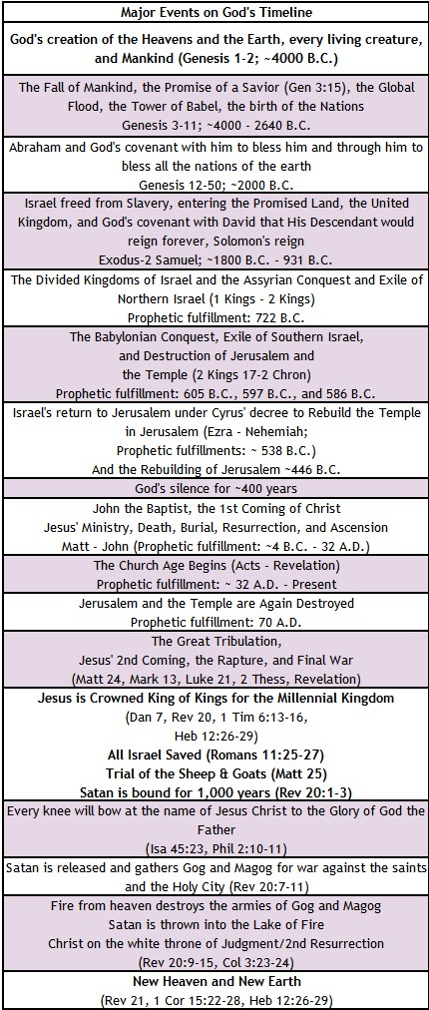
KEY EVENTS
GOD’s TIMELINE
Deuteronomy 30:1-4
Deuteronomy 32:21
“So it will be when all of these things have come upon you, the blessing and the curse which I have placed before you, and you call them to mind in all the nations where the Lord your God has scattered you, and you return to the Lord your God and obey Him with all your heart and soul in accordance with everything that I am commanding you today, you and your sons, then the Lord your God will restore you from captivity, and have compassion on you, and will gather you again from all the peoples where the Lord your God has scattered you. If any of your scattered countrymen are at the ends of the earth, from there the Lord your God will gather you, and from there He will bring you back.”
“They have made Me jealous with what is not God; They have provoked Me to anger with their idols. So I will make them jealous with those who are not a people; I will provoke them to anger with a foolish nation.” (See also Romans 10:18-21 and Romans 11:25-27).

Slide 22
Digging Deeper: What Have We Learned About God from Genesis - Deuteronomy
God’s Attributes and Character
Creator
Provider
The Self-existing One (I AM WHO I AM)
The God of Abraham, the God of Isaac, and the God of Jacob
Powerful
Power also displayed through his people
He dwells with His People
Holy
Makes Covenants
Faithful to His Word
A Warrior
Just
Has a Plan
Sovereign
Slow to anger
Gracious
Compassionate
Abounding in loving-kindness
Truthful
Forgiving
Punisher of the guilty
Rewarder of the obedient
Protector of His people
Relational: The Lord Your God who loves you and sets his affection upon his people (Deuteronomy 10:14-15)
Gives order and leadership
Receives our love through our trusting obedience to His commands and promises to do us good in this life and in the life to come.

Slide 23
Deuteronomy: Summary
Brief Summary: The events of Deuteronomy take place in the plains of Moab east of the Jordan River across from Jericho over a period of approximately one month before the new generation of Israelite warriors were to begin the conquest of the Promised Land (c. 1405 B.C).¹ The book can be divided into three communications from Moses to the people followed by some concluding historical events.
The first discourse of Moses consisted of a historical recounting of God’s grace and power toward Israel and an exhortation for the people’s obedience (Deuteronomy 1-4).
Moses’s second discourse reminded this new generation of the basic elements of their relationship with the Lord and the statues for life in the new Land. It is here we find a second account of the Ten Commandments (Deuteronomy 5-28).
In Moses’ final address he calls the people to make a covenant with the Living God to worship and serve him alone and to keep their hearts from foreign gods. The people are exhorted to “choose life” and God’s blessings rather than death and God’s curses (Deuteronomy 29-30).
The final chapters of the book highlight the change of leadership from Moses to Joshua, Moses’ song and his encouragement to the people, and the final events of Moses’ life and death at 120 years old (Deuteronomy 31-34).
In the Promised Land the nation of Israel was to be set apart from the surrounding nations through the wisdom of God shown in His statutes and righteous judgments (Deuteronomy 4:7-8). Israel was to fear and love the Lord their God, to demonstrate that love by obeying his commands, and to remember the Lord who kept his covenant with their fathers and brought them out of Egyptian slavery with great power and signs. Obedience to the Lord was for their good, life and blessing; disobedience would result in God’s curses and death. The phrase “the Lord Your God” is used over 200 times in Deuteronomy making God’s election of his people personal; and it is in this book where the Lord God further emphasizes his personal love and affection for his people (Deuteronomy 7:1-26), not because of their righteousness but because of God’s faithfulness to his covenant with Abraham, Isaac, and Jacob (Deuteronomy 9:1-29).
Foreshadowings: Many New Testament themes are present in the Book of Deuteronomy. Jesus Christ is foreshadowed again in the sacrifices and prescribed feasts (Deuteronomy 16:1-17:7) and as the ultimate Prophet like Moses who God would later send (Deuteronomy 18:15-22). God emphasizes the necessity of keeping perfectly the Mosaic Law and the impossibility of doing so; for we like Israel continually transgressed the Law. But thanks be to God for Christ who is our “once for all” atoning sacrifice (Hebrews 10:10). Through Him we are cleansed from our unrighteousness and sealed with the Holy Spirit who empowers us to live for God. In the New Testament Moses continues to be an example of God’s gracious and complete forgiveness as Matthew 17:1-3 records his appearance in the Promised Land with Christ on the Mount of Transfiguration; the land from which he was previously forbidden to enter.² Lastly, God’s choosing of the Israelites as His special people foreshadows His choosing of all those who would believe in Christ (1 Peter 2:9).
Notes:
¹ Deuteronomy 1:1-4
² Deuteronomy 34:1-8

Slide 24
Deuteronomy: Practical Application
Practical Application: The book of Deuteronomy underscores the importance of God’s Word. It is a vital part of our lives individually and corporately. Although we are no longer under the Old Testament ceremonial laws, we are still responsible to submit to the will of God in our lives. And he has made His will plain to us.
  “You shall love the Lord your God with all your heart and with all your soul and with all your might.” (Deuteronomy 6:5)
  “You shall not take vengeance or bear a grudge against the sons of your own people, but you shall love your neighbor as yourself: I am the Lord.” Leviticus 19:18
Moreover, God has not left us to our own imaginations to understand what it means to love Him and to love others as we love ourselves. He has clearly expounded upon his justice in both the Old and New Testaments, and no where else are there such righteous decrees and statues as His body of laws (Deuteronomy 4:8). None of us is “above the law” and there are consequences to disobeying the God of heaven and earth. Galatians 5:16-26 exhorts believers to be led by the Holy Spirit because there is no law against the fruit of the Spirit.
During the time of His testing in the wilderness, Jesus quoted from the book of Deuteronomy three times (Matthew 4). In so doing, Jesus illustrated for us the necessity of hiding God’s Word in our hearts that we might not sin against Him (Psalm 119:11).
As Israel remembered God’s faithfulness, so should we. The crossing of the Red Sea, the holy presence at Sinai, and the blessing of manna in the desert should be an encouragement to us as well. A great way to keep going forward is to take some time to look back and see what God has done.
We also have a beautiful picture in Deuteronomy of a loving God who desires a relationship with His children. The Lord names love as the reason that He brought Israel out of Egypt “with a mighty hand” and redeemed them (Deuteronomy 7:7-9). What a wonderful thing to be free from the bondage of sin and loved by the all-powerful God!

Slide 25

Closing Prayer Verse
Deuteronomy 5:28-29, "And the LORD heard your words, when you spoke to me. And the LORD said to me, 'I have heard the words of this people, which they have spoken to you. They are right in all that they have spoken. Oh, that they had such a heart as this always, to fear me and to keep all my commandments, that it might go well with them and with their descendants forever!”

Slide 26
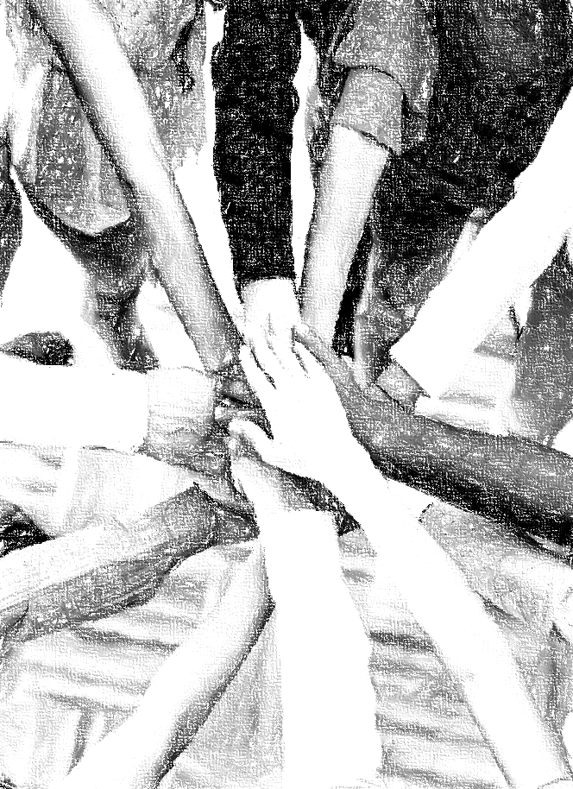
Acknowledgements
Background, Setting, Outlines, some Study Question answers, interpretative challenges, and some Summaries: Adapted from John MacArthur Study Bible at GTY.org.
Key verses, Practical Application, some Study Question answers, and some Summaries: Adapted from GotQuestions.org.
Inductive Bible Study Method: Adapted from Precept.org.
Creation – Consummation Icons: Adapted from AnswersInGenesis.org.
Definitions: Adapted from Websters 1828 Dictionary.
Bible Reference Software and Quotes: All Scripture quotations are taken from the Holy Bible using primarily the English Standard Version (ESV) or New American Standard Bible (NASB) translations. Links to Scripture references utilize BibleRef.com, which is a Got Questions Ministries’ website.

Slide 27
Study Leader Assistance
Sample Prayers
Study Question Answer Keys

Slide 28
Sample Opening Prayer: Deuteronomy
Deuteronomy 32:4, "The Rock, his work is perfect,
for all his ways are justice.
A God of faithfulness and without iniquity,
just and upright is he.”
Sample Prayer: Dear Heavenly Father, we rejoice that you are just and perfect in all your ways. Thank you for giving us your Law in such detail that we can known what true justice is and can walk in this wisdom in our own lives and in selecting those who lead us. Our desire is to live in a nation that obeys your just ways; a nation whose God is the Lord. We are so grateful for your faithfulness to us through sustaining your creation each day, and most of all, through your Holy Spirit who keeps us in the saving knowledge of Jesus Christ. May our lives glorify you each day. Amen.

Slide 29
Deuteronomy: Study Question Answers
Read Deuteronomy 7:7-13 and Deuteronomy 10:15-18 and answer the two questions below.
  What do these verses teach you about the character of God? Answer: These passages teach us that Israel’s God is the only Lord God (7:9, 10:17), that he chose them and set his love on them to keep the oath he made to their fathers (Abraham, Isaac, and Jacob). It is God who chooses to set his heart in love toward his people (10:15, 1 John 4:10). God is faithful in keeping his covenants and is steadfast in his love toward those who love him and keep his commandments. It is God alone who blesses and multiplies us with family, food, and all other goods (7:12-13). In addition, God is just and fair in all his judgments. He will not show partiality but will execute justice for the orphan, the widow, and sojourner. He warns that he will destroy those who hate him (i.e., those who willfully disobey him and teach others to do the same), and He will repay them to their faces.
  How do these passages help you understand the things that please God? (See also Ephesians 4:1-3, 1 Corinthians 11:26-30, and Hebrews 10:26-31.) Answer: We show our love to God and please him by striving to obey his commandments and by knowing and trusting that he has set these for our good and our joy (7:9,12). The verse in 10:16 calls the Israelites to circumcise their hearts and no longer stubbornly live by their own rules. Only the Holy Spirit can truly circumcise our hearts. He did this for the remnant of God in the Old Testament and does so for us now. Moreover, the Holy Spirit dwells in us now that we have been fully cleansed by Christ Jesus. To be filled with the Holy Spirit (Ephesians 5:18) means to rely on His resources to obey God moment by moment. In this way we can walk in a manner worthy of the Lord Jesus (Ephesians 4:1-3), we can do it with humility and bring glory to God knowing that this power is not of ourselves (1 Corinthians 11:26-30), and we can make our election sure by no longer deliberately continuing in sin (Hebrews 10:26-31).
Read Deuteronomy 2:16-18. Who was punished with death in the wilderness before Israel could enter the Promised Land and why? (See also Numbers 14:20-30.) Answer: All the men of war (i.e., 20 years and older), except Joshua and Caleb, received the punishment to die in the wilderness during the 40-year wandering. They received this punishment because even after they had seen the great works of the Lord against Egypt to bring them out of the land and how He had provided and protected them on their journey, that first generation of fighting men refused to trust the Lord to make them victorious in taking the Promised Land.
What does Deuteronomy 16:18-20 tell us about how democracy fits within a theocracy? Answer: Israel was to live in the land governed by the Ten Commandments, and all the statues and laws the Lord had given them through Moses making God their ultimate King. And within this theocracy, God instructed them to appoint judges and officers in their town to carry out His righteous judgments with wisdom in the pursuit of justice without partiality. The people were given the task to select those who would carry out God’s righteous laws, which means they had the privilege and responsibility to choose wisely like we are to do within our democracy.
How do Exodus 22:16-17 and Deuteronomy 22:22-29 address the following offenses against God and mankind?
  Consenting fornication between a man and a woman when neither of them were betrothed to other people. Answer: If a man seduced a virgin woman who was not betrothed; he was to marry her unless her father refused him. The man was still obligated to pay the bride price even if her father refused to give her in marriage. (Exodus 22:16-17, Deuteronomy 22:28-29)
  Consenting fornication between a man and a woman when the woman was betrothed or married to someone else. Answer: Both the man and the woman were to die. (Deuteronomy 22:22-24)
  Rape of a woman. Answer: Only the man was to be executed because there was no fault in the woman who cried out with no one to rescue her. (Deuteronomy 22:25-27)

Slide 30
Sample Closing Prayer
Deuteronomy 5:28-29, "And the LORD heard your words, when you spoke to me. And the LORD said to me, 'I have heard the words of this people, which they have spoken to you. They are right in all that they have spoken. Oh, that they had such a heart as this always, to fear me and to keep all my commandments, that it might go well with them and with their descendants forever!”
Sample Prayer: Dear Heavenly Father, we thank you for making us new creations through Jesus Christ our Lord. It is because of this that we come boldly to your throne asking that you give us hearts that will always fear you and keep your commandments. Work in us to will and to do as your Holy Spirit leads us. In Jesus’ name we ask these things. Amen.

