Slide 1
NUMBERS
Book 4

Slide 2
What is the Holy Bible?
The Holy Bible is a collection of writings that includes 66 books in English editions. The Bible consists of two parts, the Old Testament and New Testament. The word testament means covenant. The Old Testament includes 39 books, and the New Testament includes 27 books.
These 66 books were written over approximately 1,400 years by 40 different authors in Hebrew, Aramaic, and Greek. The Old Testament writings were affirmed by Jewish leaders, and moreover, by Jesus Christ.¹ The New Testament writings were confirmed by early church leaders. The 66 books of the Bible are the inspired words of God that are used to make and mature disciples of the One true God through Jesus Christ, his Son (Matthew 28:18-20, 2 Timothy 3:16-17). The Bible was not created by mere human wisdom but was inspired by God (2 Peter 1:20-21), is interpreted by His Holy Spirit (John 16:13, Matthew 23:8-10), and will last forever (Matthew 24:35).²
If you do a phrase search on the Bible you will find the phrase "the word of the Lord" and "Thus says the Lord" more than 700 times.³ In addition, this book has given reasonable evidence to the claim of being God’s word by:​
  providing answers that conform with the reality we see around us.
  being a reliable collection of historical documents.
  containing eyewitness accounts that were written during the lifetimes of other eyewitnesses.
  recording supernatural events that took place in fulfillment of specific prophecies.⁴
Notes:
¹ See Matthew 4:4-7, 12:3-5, Mark 7:6-7, 12:26-27, and Luke 19:46 for examples.
^{2 “}What are the Books of the Bible”, GotQuestions.org
³ Blue Letter Bible
⁴ Paraphrased from Voddie Baucham

Slide 3
Our Goals in Studying the Bible
To better …..
Understand the Only true God; the Author of the Bible. (2 Timothy 3:16-17, 2 Peter 1:20-21, 1 John 5:20 , Jeremiah 9:23-24)
Learn How He works in the World and in our Lives. (Job 40:6-14, Isaiah 45:6-7, Isaiah 46:8-10, Philippians 2:12-13)
Understand Ourselves and the Hearts of Mankind. (Jeremiah 17:9, 2 Timothy 3:13, Ephesians 5:7-10)
Come to Know What Pleases and Grieves God. (1 Thessalonians 4:1, Ephesians 4:26-31, Hebrews 11:6, 1 Peter 1:14-19)
To be Transformed into Fruitful Doers of God’s Word and not just Hearers. (Romans 12:2, James 1:27, Matthew 3:8)
Tether Ourselves to God’s Word for Our Wisdom, Discernment, and Safety. (1 Corinthians 6:9-10, Matthew 24:24, Ephesians 4:11-14)
Jeremiah 9:23-24 “Thus says the Lord: "Let not the wise man boast in his wisdom, let not the mighty man boast in his might, let not the rich man boast in his riches, but let him who boasts boast in this, that he understands and knows me, that I am the Lord who practices steadfast love, justice, and righteousness in the earth. For in these things I delight, declares the Lord."

Slide 4
How to Study the Bible
#1. Observation: What does the text say.
Who?
What?
When?
Where?
How?
Why?
#2. Interpretation: What does the text mean in context with the passage, book, and whole counsel of God?
#3. Application: How is the Holy Spirit instructing me to apply this understanding at this time in my life?

Slide 5
Study Resources
Opening Prayer
Background and Setting
Book Outline
Geography Maps
Key Verses
Study Questions
Major Event Timeline
Book Summary
Application and Closing Prayer
Study Leader Support Slides

Slide 6

Opening Prayer Verse: Numbers
Numbers 6:24-26, "The LORD bless you and keep you;
The LORD make His face shine upon you,
and be gracious to you;
The LORD lift up His countenance upon you and give you peace."
Bless: 1) to consecrate, to make sacred/holy; 2) to praise or glorify, 3) to prosper, protect, endow with favor
Countenance: 1) expression toward another; 2) face as an indication of emotion
Gracious: 1) kindness; 2) merciful, compassionate
Peace: 1) a state of tranquility 2) freedom from disquieting or oppressive thoughts or emotions

Slide 7
Review of Leviticus
Brief Summary: The entire book of Leviticus occurs at Mount Sinai where God has the Israelites camp after He miraculously rescued them from Egypt. The book of Exodus ends with God demonstrating his acceptance of the consecrated Tabernacle and priesthood established under Moses’ leadership per God’s instructions with the cloud of his glory filling the tent. God had given the Israelites a central place of worship and consecrated a priestly line from Aaron. Now in Leviticus we see God explaining what was necessary for a sinful and unholy people to be cleansed and live in fellowship with a holy God. God is holy, pure and clean in His totality; we are unclean because of our sinful natures (Mark 7:20-23) and because we have individually offended God (Romans 3:23).
Leviticus Chapters 1–7 outline the offerings required of both the laity and the priesthood. God instituted five offerings: the burnt offering, sin offering, grain offering, peace offering, and guilt offering which represented atonement, propitiation, dedication, reconciliation, and repentance from unintentional sin. The people were to revere God by obeying his instructions for worship without deviation for He is God, and because these things pointed to the realities that would be fulfilled in heaven by our Lord Jesus Christ (Hebrews 9). The Israelites were to offer these sacrifices from obedience hearts; the heart of obedience made the offerings pleasing aromas to God and pointed to the ultimate obedience Christ Jesus would fulfill (Philippians 2:5-8).
Leviticus Chapters 8–10 describe the ordination of Aaron and his sons to the priesthood. The one true God was to be approached and worshiped only as He prescribed. Nadab and Abihu, two of Aaron’s sons, stand as an example of how divergences from God's worship instructions further offend Him. The Scriptures record they offered "strange fire“ (i.e., worship from their own imaginations) and were consumed by fire from the Lord.
Chapters 11–16 are the prescriptions for various types of uncleanness. The final 10 chapters are God’s guidelines to His people for the nations justice system, practical individual holy living, and seven feasts to be practiced as part of worship. God’s statues clearly identified capital crimes and just reparations for other injuries so that vengeance could not exact more than justly due. God commanded his people to be holy as He is holy and to love their neighbors as they loved themselves. He provided clear commands regarding the moral behavior that was required for holiness in sexual relations, kindness to the poor, the blind, the deaf, for children and the elderly and things to abstain from such as unclean foods and demonic practices (e.g., spiritism and child sacrifice). Blessings or curses would accompany either the keeping or neglect of God’s commandments and statues. Even before Israel enters the land, the Holy Spirit prophetically points to the day when Israel will be exiled out of it for failing to obey the Lord’s commands. However, God will never fully abandon them or forget the covenant He made with their forefathers (Leviticus 26:44-45).
Foreshadowings: The priesthood, sacrifices, and feasts established by God picture in many ways the person and work of our Savior, the Lord Jesus Christ. Hebrews 10 tells us that the Mosaic Law is “only a shadow of the good things that are coming” by which is meant that the daily sacrifices offered by the priests for the sin of the people were a representation of the ultimate Sacrifice—Jesus Christ, whose sacrifice was once for all time for those who would believe in Him. The holiness imparted temporarily by the Law is now replaced by the absolute attainment of holiness when Christians exchange their sin for the righteousness of Christ (2 Corinthians 5:21). God through the first coming of Christ has fulfilled the feasts of Passover (1 Corinthians 5:7), Unleavened Bread (John 6:32-33), First Fruits (1 Corinthians 15:20, Matthew 27:52-53), and the Harvest of Weeks (Acts 2). As believers we await expectantly for His return and the complete fulfilment of the feasts of Trumpets (1 Thessalonians 4:16-17, 1 Corinthians 15:51-52), Day of Atonement (Zechariah 12:10, Romans 11:25-27), and Feast of Booths (Zechariah 14:16-19).

Slide 8
Old Testament Table of Contents (39 Books)
THE LAW - 5
GENESIS
EXODUS
LEVITICUS
NUMBERS
DEUTERONOMY
POETRY - 5
JOB
PSALMS
PROVERBS
ECCLESIASTES
SONG OF SOLOMON
MINOR PROPHETS – 12
HOSEA
JOEL
AMOS
OBADIAH
JONAH
MICAH
NAHUM
HABAKKUK
ZEPHANIAH
HAGGAI
ZECHARIAH
MALACHI
HISTORY – 12
JOSHUA
JUDGES
RUTH
1 SAMUEL
2 SAMUEL
1 KINGS
2 KINGS
1 CHRONICLES
2 CHRONICLES
EZRA
NEHEMIAH
ESTHER
MAJOR PROPHETS - 5
ISAIAH
JEREMIAH
LAMENTATIONS
EZEKIEL
DANIEL

Slide 9
Old Testament Books by Date Written
Historical Books
Wisdom Book and Prophetic Books
Genesis:
c. 1445-1400 B.C.
Exodus:
c. 1445-1400 B.C.
Leviticus:
c. 1445-1400 B.C.
Numbers:
c. 1405 B.C.
Deut:
c. 1445-1400 B.C.
Joshua:
c. 1405-1385 B.C.
Judges:
c. 1043 B.C.
1 & 2 Samuel:
c. 960-722 B.C.
1 & 2 Kings:
c. 560-540 B.C.
Ezra:
c. 460-440 B.C
Esther:
c. 460-350 B.C..
1 & 2 Chron:
c. 450-425 B.C.
Nehemiah:
c. 445-420 B.C.
Ruth
c. 1011-971 B.C.
Job:
c. 1440 – 950 B.C.
Psalms:
c. 1410-500 B.C.
Proverbs and Song of Solomon:
c. 965 B.C.
Ecclesiastes:
c. 930 B.C.
Obadiah:
c. 848-840 B.C.
Joel:
c. 835 – 796 B.C
Jonah
c. 790 – 739 B.C.
Isaiah and Micah:
c. 739 – 681 B.C.
Nahum:
c. 663–612 B.C.
Habakkuk and Zephaniah:
c. 635-605 B.C
Jeremiah and Lamentations
c. 630-575 B.C.
Ezekiel and Daniel:
c. 593 – 530 B.C.
Haggai and Zechariah
c. 520-470 B.C.
Malachi
c. 440 – 400 B.C.
Hosea and Amos:
c. 760 -725 B.C.
Amos 3:7 : “For the Lord GOD does nothing without revealing his secret to his servants the prophets.”

Slide 10


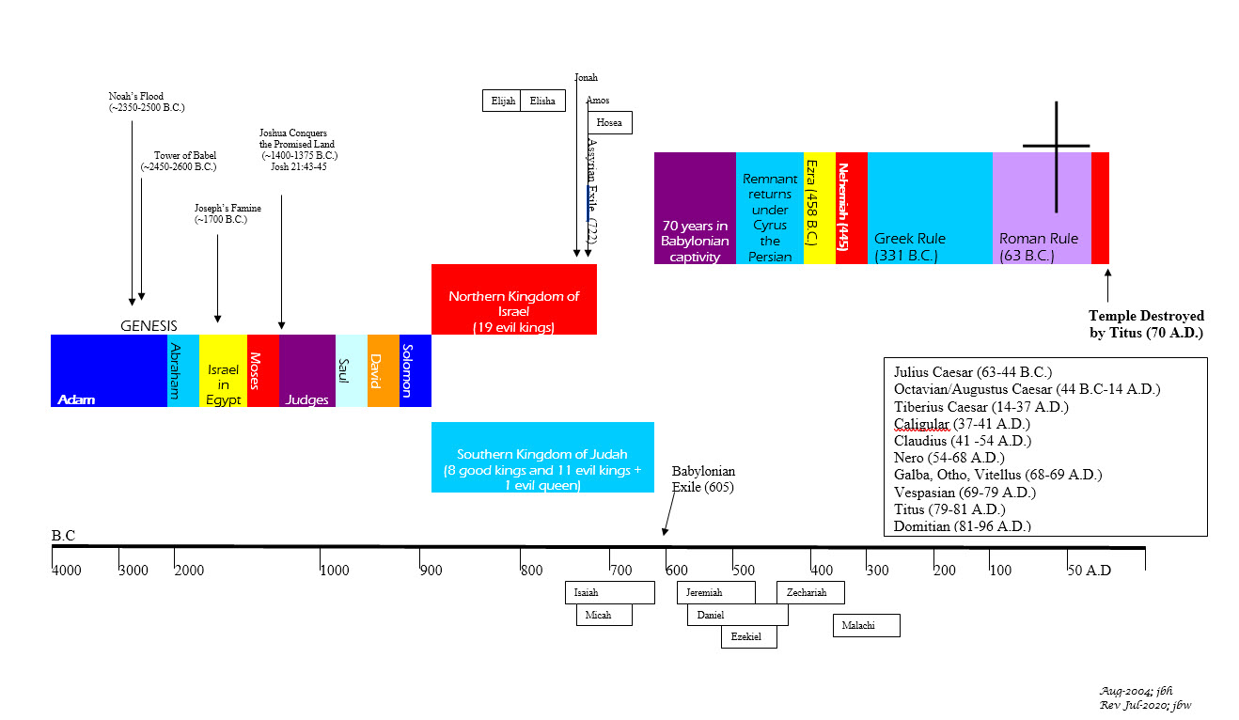
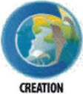
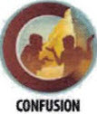
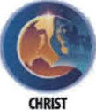
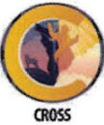
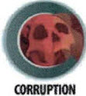
BIBLICAL CHRONOLOGICAL BACKGROUND
OT
Cyrus the Great (Cyrus II)
Darius the Mede
Darius I
Xerxes I (Esther and Mordecai)
Artaxerxes I
NT
Jehu (1 Kings 16:7)
Micaiah: (1 Kings 22:8)
Huldah: (2 Kings 22:14)
Obed (2 Chr 28:9)
Job
Daniel 9:25-26
Prophets after Noah into the United Kingdom:
Abraham:
Moses:
Samuel:
Gad:
Nathan:
Ahijah
Asaph
(Gen 20:7)
(Exo 3:10)
(1 Sam 3:20)
(1 Sam 22:5)
(2 Sam 7:2)
(1 Kings 11:29)
(2 Chron 35:15)
Haggai
Mosaic Law and Covenant
Law of sin & death, the letter kills
Ministry of condemnation carved in stone
Glory fading away
Shemaiah: (2 Chr 12:15)
Iddo: (2 Chr 12:15)
Hanani: (2 Chr 16:7)
Jehu: (2 Chr 19:2)
Jeduthun: (2 Chr 35:15)
New Covenant of Jesus Christ
The Law of the Spirit of life
Ministry of righteousness on hearts
Eternal and exceeding in glory
Timeline is not to scale

Slide 11
Numbers
Author: Moses
Date of Writing: c. 1405 B.C.

Slide 12
About Numbers and its Author: Moses
The English title “Numbers” comes from the Greek Septuagint and Latin Vulgate versions. This designation is based on the numberings that are a major focus of chapters 1–4 and 26. The most common Hebrew title comes from the fifth word in the Hebrew text of Numbers 1:1, “in the wilderness [of].” This name is much more descriptive of the total contents of the book, which recount the history of Israel during almost 39 years of wandering in the wilderness. Another Hebrew title, favored by some early church fathers, is based on the first word of the Hebrew text of Numbers 1:1, “and he spoke.” This designation emphasizes that the book records the word of God to Israel.
The first five books of the Bible, called the Law, of which Numbers is the fourth, are ascribed to Moses throughout Scripture.¹ The book of Numbers itself refers to the writing of Moses in Numbers 33:2 and 36:13.
Numbers was written in the final year of Moses’ life. The events from Numbers 20:1 to the end occur in the 40th year after the exodus. The account ends with Israel poised on the eastern side of the Jordan River across from Jericho (Numbers 36:13), which is where the conquest of the land of Canaan began (Joshua 3–6). The book of Numbers must be dated c. 1405 B.C., since it is foundational to the book of Deuteronomy, and Deuteronomy is dated in the 11th month of the fortieth year after the exodus (Deuteronomy 1:3)³
DATE: c. 1405 B.C.
Notes:
¹ Joshua 8:31; 2 Kings 14:6; Nehemiah 8:1; Mark 12:26; John 7:19

Slide 13
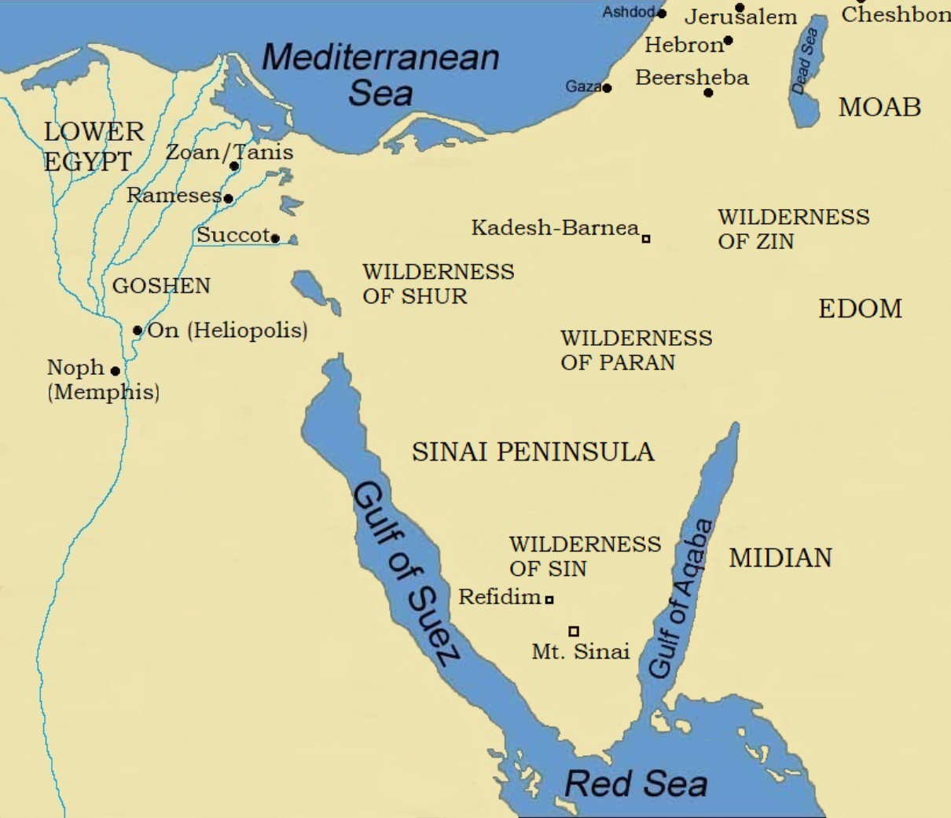
Numbers Background
Most of the events of the book are set “in the wilderness.” The word “wilderness” is used 48 times in Numbers. This term refers to land that contains little vegetation or trees, and because of a sparsity of rainfall, it cannot be cultivated. This land is best used for tending flocks of animals. The geography for the book of Numbers flows as follows:
  Numbers 1:1–10:10: Israel encamped in “the wilderness of Sinai”, where the Lord entered into the Mosaic Covenant with them.¹
  Numbers 10:11–12:16: Israel traveled from Sinai to Kadesh, which was located in “the wilderness of Paran”.²
  Numbers 13:1–20:13: Events occurred in and around Kadesh, in “the wilderness of Paran” and “the wilderness of Zin”. ^{2,3}
  Numbers 20:14–22:1: Israel traveled from Kadesh to the “plains of Moab.”
  Numbers 22:2–36:13 : All the events occurred while Israel was encamped in the plain to the north of Moab. That plain was a flat and fertile piece of land in the middle of the wasteland.⁴
The book of Numbers concentrates on events that take place in the second and fortieth years after the exodus. All incidents recorded in Numbers 1:1–14:45 occur in 1444 B.C., the year after the exodus. Everything referred to after Numbers 20:1 is dated c. 1406/1405 B.C., the fortieth year after the exodus. The laws and events found in Numbers 15:1–19:22 are undated, but probably all should be dated c. 1443 to 1407 B.C. The lack of material devoted to this 37-year period, in comparison with the other years of the journey from Egypt to Canaan, communicates how wasted these years were because of Israel’s rebellion against the Lord and his consequent judgment.
Notes:
¹ Exodus 19–24
² Numbers 12:16; 13:3, 13:26
³ Numbers 13:21; 20:1
⁴ Numbers 21:20; 23:28; 24:1

Slide 14
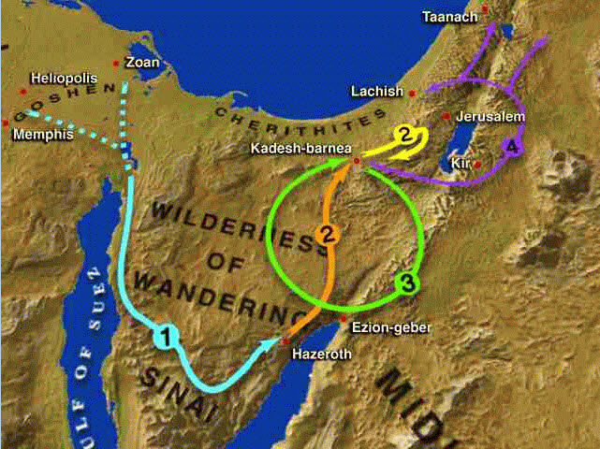
Numbers Geography
First Generation’s Wilderness Wanderings
Second Generation Near the Plain of Moab and
Headed to Promised Land

Slide 15
Numbers Outline
The Experience of the Second
Generation of Israel in the
Plains north of Moab
The Experience of the First
Generation of Israel in the Wilderness
Numbers 1:1–25:18
Numbers 26:1–36:13
The Obedience of Israel toward the Lord
  The Obedience of Israel toward the Lord
  The organization of Israel around the tabernacle of the Lord
  The orientation of Israel toward the tabernacle of the Lord
The Disobedience of Israel toward the Lord
  The complaining of Israel on the journey
  The rebellion of Israel and its leaders at Kadesh
    The rebellion of Israel and the consequences
    The rebellion of Moses and Aaron and the consequences
    The renewed complaining of Israel on the journey
    The blessing of Israel by Balaam
    The final rebellion of Israel with Baal of Peor
The Preparations for the Conquest of the Land
The Review of the Journey in the Wilderness
The Anticipation of the Conquest of the Land

Slide 16
Repeated Words and/or Phrases in the Book of Numbers
Word/Phrase | Approx. No. | Comments
Offering/Offerings | 197 | Atonement/burnt (69),Sin (46), Grain(55), Peace (21), Guilt (7)
Numbered | 73
Against/ (rebel/complain/grumble) | 53 | Forty-seven uses of the word "against" and a little more than 1/2 of these were in the context of Israel's rebellion.
Die/Died | 45 | Used either in the context of a warnings about capital offenses or regarding those who died in rebellious actions against the Lord.
Wilderness | 48
Holy | 35
Egypt | 28
Unclean | 19
Pleasing aroma | 18
Plague | 13
Clean | 12
Anger | 10 | Eight were God's reaction to Israel's rebellions. One was about God being slow to anger.
You can use the Blue Letter Bible to check for repeated word counts

Slide 17
List of Required Offerings (Numbers 19:1-22, 28:1-29:40)
Offering | Timing | Prescription
Water of Purification – for someone who touched a dead body | As needed to supply ashes for the water of purification | Red heifer without defect to be taken outside the camp by the priest, slaughtered in front of him. The priest then took some of the blood and sprinkled it toward the tent of meeting. The remains were to be burned and the ashes were considered holy and to be kept in a clean place for the water of purification.
Daily | Morning and evening burnt offerings | Two male lambs one year old without defect with grain, oil, and drink offerings
Weekly | Sabbath | Double the daily burnt offering
Monthly | 1st Day of each month | Two bulls, one ram, seven male lambs without defect as burnt offerings with their grain, oil, and drink offerings; and one male goat for a sin offering
Passover | 14th Day of 1st month | Male lamb per family sacrificed at twilight and eaten with unleavened bread and bitter herbs. None was to be left until morning, and no bones broken.
Unleavened Bread | 15 -21 of 1st month | Same as monthly offering performed daily for 7 days. No laborious work on 1st and 7th day. These two days were holy Sabbaths and in addition to the weekly Sabbath.
First Fruits | Day after the weekly Sabbath during Unleavened Bread | A male lamb one year old as a burnt offering with its grain, oil and drink offering
Feasts of Weeks (aka Pentecost) | 50 days after first fruits | Two loaves of leaven bread as a wave offering plus the same as monthly offerings and two lambs as a peace offering
Feasts of Trumpets | 1st Day of 7th month | Double the monthly offering. No laborious work.
Day of Atonement | 10th Day of 7th month | Double the monthly offering. No laborious work.
Feasts of Booths | 15 -21 of 7th month | Thirteen bulls, two rams, and fourteen one-year old male lambs all without blemish with their grain, oil, and drink offerings. Also one male goat for the sin offering. No laborious work on the first day. And the bull offerings decreased by one each day of the feast’s offerings.

Slide 18
Numbers: Key Verses
Numbers 1:1-3, "The Lord spoke to Moses in the wilderness of Sinai, in the tent of meeting, on the first day of the second month, in the second year after they had come out of the land of Egypt, saying, 'Take a census of all the congregation of the people of Israel, by clans, by fathers' houses, according to the number of names, every male, head by head. From twenty years old and upward, all in Israel who are able to go to war, you and Aaron shall list them, company by company.'"
Numbers 6:22-27, "Lord spoke to Moses, saying, "Speak to Aaron and his sons, saying, Thus you shall bless the people of Israel: you shall say to them, ‘The LORD bless you and keep you; the LORD make his face shine upon you and be gracious to you; the LORD turn his face toward you and give you peace. So shall they put my name upon the people of Israel, and I will bless them.’"
Numbers 12:6-8, "When a prophet of the LORD is among you, I reveal myself to him in visions, I speak to him in dreams. But this is not true of my servant Moses; he is faithful in all my house. With him I speak face to face, clearly and not in riddles; he sees the form of the LORD. Why then were you not afraid to speak against my servant Moses?"
Numbers 13:25-28, "At the end of forty days they returned from spying out the land. And they came to Moses and Aaron and to all the congregation of the people of Israel in the wilderness of Paran, at Kadesh. They brought back word to them and to all the congregation and showed them the fruit of the land. And they told him, "We came to the land to which you sent us. It flows with milk and honey, and this is its fruit. However, the people who dwell in the land are strong, and the cities are fortified and very large. And besides, we saw the descendants of Anak there.“
Numbers 14:1-4, "Then all the congregation raised a loud cry, and the people wept that night. And all the people of Israel grumbled against Moses and Aaron. The whole congregation said to them, "Would that we had died in the land of Egypt! Or would that we had died in this wilderness! Why is the Lord bringing us into this land, to fall by the sword? Our wives and our little ones will become a prey. Would it not be better for us to go back to Egypt?" And they said to one another, "Let us choose a leader and go back to Egypt."
Numbers 14:28-34, "Say to them, ‘As I live, declares the Lord, what you have said in my hearing I will do to you: your dead bodies shall fall in this wilderness, and of all your number, listed in the census from twenty years old and upward, who have grumbled against me, not one of you will enter the land I swore with uplifted hand to make your home, except Caleb son of Jephunneh and Joshua son of Nun. As for your children that you said would be taken as plunder, I will bring them in to enjoy the land you have rejected. But you — your bodies will fall in this desert. Your children will be shepherds here for forty years, suffering for your unfaithfulness, until the last of your bodies lies in the desert. For forty years — one year for each of the forty days you explored the land — you will suffer for your sins and know what it is like to have me against you.’”
Numbers 26:63-65, "These were those listed by Moses and Eleazar the priest, who listed the people of Israel in the plains of Moab by the Jordan at Jericho. But among these there was not one of those listed by Moses and Aaron the priest, who had listed the people of Israel in the wilderness of Sinai. For the Lord had said of them, "They shall die in the wilderness." Not one of them was left, except Caleb the son of Jephunneh and Joshua the son of Nun.”
Numbers 27:22-23, "And Moses did as the Lord commanded him. He took Joshua and made him stand before Eleazar the priest and the whole congregation, and he laid his hands on him and commissioned him as the Lord directed through Moses."
Numbers 36:13, "These are the commandments and the rules that the Lord commanded through Moses to the people of Israel in the plains of Moab by the Jordan at Jericho."

Slide 19
Numbers: Study Questions
Read and reflect on Numbers 6:22-27 and Numbers 14:34 then answer the two questions below.
  How do these two passages provide insight into the attributes of God?
  How do the two passages from Numbers help you better understand Romans 11:21-22, 2 Peter 1:10-11, and Hebrews 10:38-39?
Read Numbers 14:1-23 and answer the questions below.
  What are the most noticeable items about Moses’ intercessory prayer for Israel in Numbers 14:13-19?
  What does Numbers 14:20 teach us about how God responds to our intercessory prayers?
Read Numbers 14:36-38, What is the difference between the judgment God dispensed in this passage compared to the one He pronounced in Numbers 14:20-23?

Slide 20
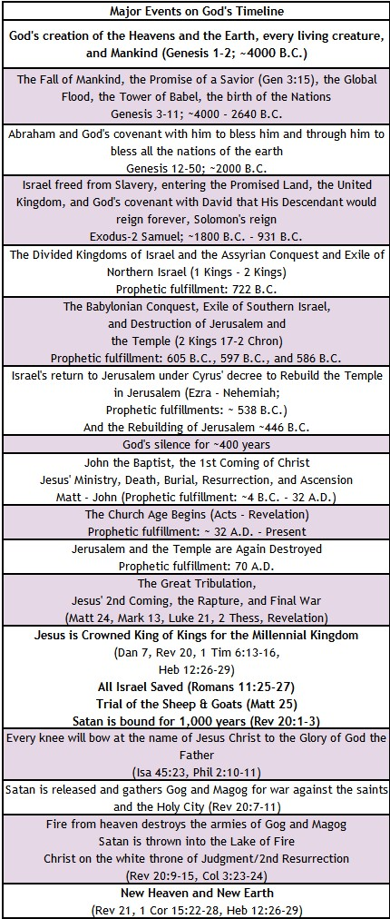
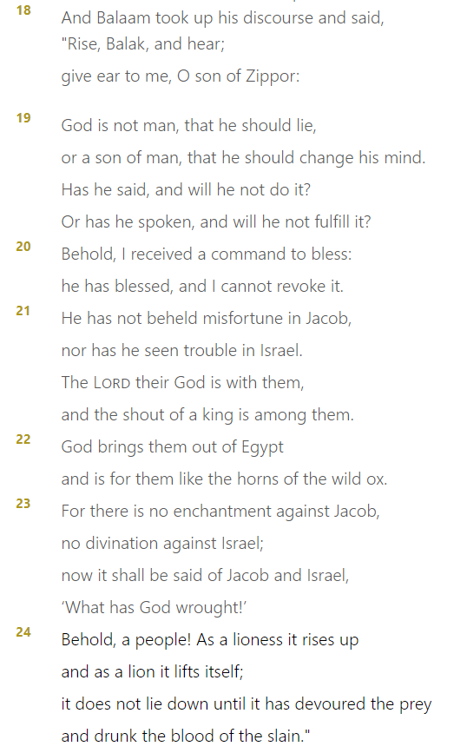
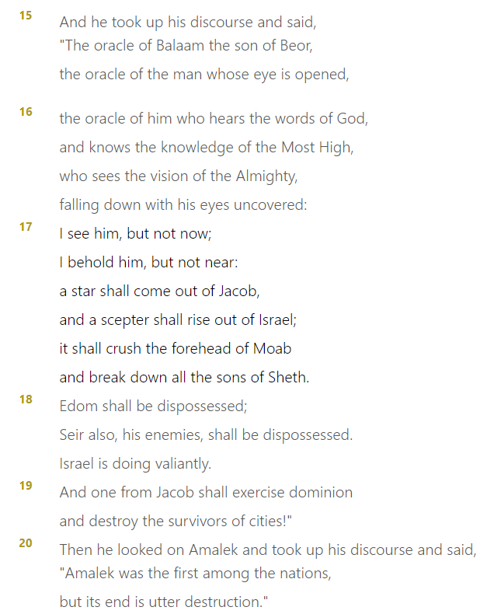
KEY EVENTS
GOD’s TIMELINE
Numbers 23:18-24
Numbers 24:15-20

Slide 21
Easy to Miss Principles and Facts from Numbers
Levites, who were taken in place of the firstborn males of Israel, served 20 – 25 years and then retired. The priest, those in charge of the holy items, started service at age 30, and those in charge of the tent items started service at age 25 (Numbers 4:1-4 and 8:15-26).
Atonement could be made for unintentional sin but not defiant rebellion (Numbers 15:22-31, Hebrews 10:26-31).
We discover that the Nephilim (giants of Genesis 6:4) were descendants of a man named Anak (Numbers 13:22-28).
Even though the priests and other Levites had no inheritance of a territory within the Promised Land, God made provisions for them from the best of the land within the territories of the other tribes.
  Any offering given by the congregation that was not a burnt offering was food for the priest who received it (Numbers 5:9-10, 18:8-19).
  The Tithe of Leviticus that was holy and given to the Lord (Leviticus 27:30-34) was to go to the Levites for their service in the tabernacle (Numbers 18:21-26).
  The Levites were to give a tithe of their Tithe to the priests (Numbers 18:26).
  Also, 48 cities from the inheritance of the tribes with their pasturelands plus six cities of refuge were to be given to the Levites (Numbers 35:1-8).
God’s wisdom in the equitable distribution of the spoils of war is ingenious (Numbers 31:25-31).
Daughters were allowed to inherit when a man had no sons. They were to marry within their tribe to keep the inheritance within the tribe (Numbers 36).

Slide 22
Numbers: Summary
Brief Summary: The book of Numbers gets its name from the numerous people, livestock, and items counted; most notably the numbering of the fighting men in censuses taken in the second and fortieth years of the Exodus (c. 1444 B.C. and 1405 B.C., respectively). However, the book is primarily about a holy God preparing to bring his people into the Promised Land, a holy and clean people to worship, serve, and represent Him to the nations. Most of the events of the book take place in the wilderness, primarily between the second and fortieth years of the wandering of the Israelites. The first 25 chapters of the book chronicle the experiences of the first generation of Israel in the wilderness, while the rest of the book describes the experiences of the second generation. The theme of obedience and rebellion followed by repentance and blessing runs through the entire book, as well as the entire Old Testament. The importance of the Book of Numbers is indicated by its being referred to in the New Testament many times. The Holy Spirit called special attention to Numbers in 1 Corinthians 10:1-12. The words "all these things happened to them for examples" refers to the sin of the Israelites and God’s displeasure with them.
In Romans 11:22, Paul speaks about the “kindness and severity of God." That, in a nutshell, is the message of Numbers. The severity of God is seen in the death of the rebellious generation who had put God to the test ten times in the wilderness; these men never entered the Promised Land. The kindness of God is realized in the new generation. God protected, preserved, and provided for these people until they possessed the land. This reminds us of the justice and loving mercy of God, which are always in sovereign harmony.
Even Moses was unable to enter the Promised Land at that time because He had disobeyed God and had not held God holy before the congregation at the Rock of Meribah (Numbers 20). Instead, Joshua was commissioned to lead this next generation into the Land, and Moses only saw the Land from afar before his death on Mount Nebo at 120 years old (Deuteronomy 34:1–6). Centuries later, however, Moses appeared to the disciples in the Promised Land on the Mount of Transfiguration with our Lord Jesus (Matthew 17:3) demonstrating God’s mercy, grace, and love toward him.
Numbers demonstrates God as holy, slow to anger, but also the Judge who will not allow the guilty to go unpunished. In addition, this book exhibits God’s faithfulness to His covenant promise to Abraham, Isaac, and Israel; to bring their descendants into the Promised Land.
Foreshadowings: God’s demand for holiness in His people is completely and finally satisfied in Jesus Christ, who came to fulfill the Law on our behalf (Matthew 5:17). The concept of the promised Messiah pervades the book. The story in Numbers 19 of the sacrifice of the red heifer “without defect or blemish” prefigures Christ, the Lamb of God without spot or blemish who was sacrificed for our sins. The image of the bronze snake lifted up on the pole to provide physical healing (Numbers 21) also prefigures the lifting up of Christ upon the cross and that those who trust in Christ’s work there will live spiritually and eternally (John 3:13-15).
In chapter 24, Balaam’s fourth oracle speaks of the star and the scepter who is to rise out of Jacob. Here is a prophecy of Christ who is called the "morning star" in Revelation 22:16 for His glory, brightness, and splendor, and for the light that comes by Him. He may also be called a scepter, that is, a scepter bearer, because of his royalty. He not only has the name of a king but is King of kings who will rule with a scepter of power, grace, mercy, and righteousness.

Slide 23
Digging Deeper: What Have We Learned About God from Genesis - Numbers
God’s Attributes and Character
Creator
Provider
The Self-existing One (I AM WHO I AM)
The God of Abraham, the God of Isaac, and the God of Jacob
Powerful
Power also displayed through his people
He dwells with His People
Holy
Faithful
A Warrior
Just
Has a Plan
Sovereign
Slow to anger
Gracious
Compassionate
Abounding in loving-kindness
Truthful
Forgiving
Punisher of the guilty

Slide 24
Numbers: Practical Application
Practical Application: A major theological theme developed in the New Testament from Numbers is that sin and unbelief, especially rebellion, reap the judgment of God. First Corinthians specifically says—and Hebrews 3:7— 4:13 strongly implies— that these events were written as examples for believers to observe and avoid. We are not to “set our hearts on evil things” (1 Corinthians 10:6), be sexually immoral (1 Corinthians 10:8), put God to the test (1 Corinthians 10:9), or grumble against God (1 Corinthians 10:10).
Just as the Israelites wandered in the wilderness 40 years because of their rebellion, so too does God sometimes allow us to wander away from Him and suffer loneliness and lack of blessings when we rebel against Him. As we read about Israel’s interactions with the Lord through their obedience (Numbers 1-10), disobedience (Numbers 11-25), and the renewed obedience of the second generation (Numbers 26-36), we are exhorted to walk in a manner pleasing to our Lord.
God is faithful and just, and just as He protected, preserved, and provided for the Israelites, He will always also restore Christians to the place of blessing and intimate fellowship with Him when we repent and return to Him (1 John 1:9). Have you sinned and received the consequences of your rebellion? Take heart and remember Moses on the Mount of Transfiguration (Matthew 17:3).

Slide 25
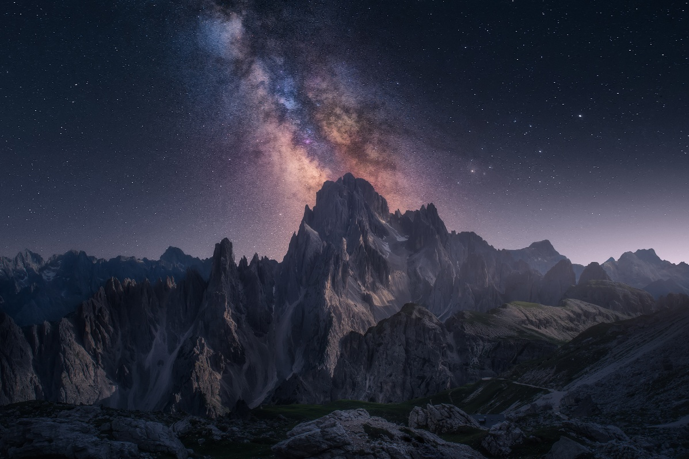
Closing Prayer Verse
Numbers 12:6-8, "When a prophet of the LORD is among you, I reveal myself to him in visions, I speak to him in dreams. But this is not true of my servant Moses; he is faithful in all my house. With him I speak face to face, clearly and not in riddles; he sees the form of the LORD. Why then were you not afraid to speak against my servant Moses?"

Slide 26
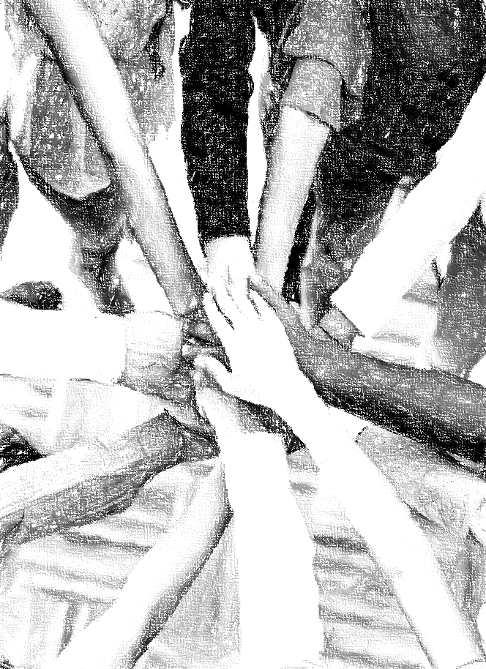
Acknowledgements
Background, Setting, Outlines, some Study Question answers, interpretative challenges, and some Summaries: Adapted from John MacArthur Study Bible at GTY.org.
Key verses, Practical Application, some Study Question answers, and some Summaries: Adapted from GotQuestions.org.
Inductive Bible Study Method: Adapted from Precept.org.
Creation – Consummation Icons: Adapted from AnswersInGenesis.org.
Definitions: Adapted from Websters 1828 Dictionary.

Slide 27
Study Leader Assistance
Sample Prayers
Study Question Answer Keys

Slide 28
Sample Opening Prayer Verse: Numbers
Numbers 6:24-26, "The LORD bless you and keep you;
The LORD make His face shine upon you,
and be gracious to you;
The LORD lift up His countenance upon you and give you peace.“
Sample Prayer: Dear Heavenly Father, thank you that you have made us holy through faith in the sacrifice of your One and Only Son, our Lord Jesus Christ. Keep us in Him. Help us to meditate on all you have done to rescue us out of darkness and condemnation and transfer us to the kingdom of your dear Son. We rejoice in knowing that it is your desire to make your face shine upon us and be gracious to us. Thank you for your favor, provisions, and protection. We know that each day with your peace and countenance lifted upon us is far more than we deserve. Help us to dwell on these things and to help others take hold of this truth. In Jesus’ name we pray. Amen.
Bless: 1) to consecrate, to make sacred/holy; 2) to praise or glorify, 3) to prosper, protect, endow with favor
Countenance: 1) expression toward another; 2) face as an indication of emotion
Gracious: 1) kindness; 2) merciful, compassionate
Peace: 1) a state of tranquility 2) freedom from disquieting or oppressive thoughts or emotions

Slide 29
Numbers: Study Question Answers
Read and reflect on Numbers 6:22-27 and Numbers 14:34 then answer the two questions below.
  How do these two passages provide insight into the attributes of God? Answer: The passage from Numbers 6 shows the Lord’s desire to bless and provide for his people. Our God desires to give us better than we deserve; He is gracious. And He seeks to give us the joy and peace that comes from truly knowing Him and knowing that He is for us (i.e., his countenance shines upon us). God does not desire to be against us. In Numbers 14:34 we see that God’s patience with our disbelief and rebellion has a limit, and He will not leave the guilty unpunished. Yet, his punishment is always conducted with a lesson to be learned for those who are willing to take instruction such as the children of those who experienced the wilderness consequences of their parents.
  How do the two passages from Numbers help you better understand Romans 11:21-22, 2 Peter 1:10-11, and Hebrews 10:38-39? Answer: These passages remind us of the Israelites who were quick to grumble against God in unbelief despite all the power and good care he had provided for them in bringing them out of Egypt and through the wilderness to the door of the Promised Land. We see again this warning regarding the limit on God’s patience and the severe consequences his judgments. Peter warns us to be diligent to confirm our calling and election from God by honestly looking at our lives to see if we are growing in our faith with virtue, knowledge, self-control, steadfastness, godliness, and affectionate love. If we examine ourselves and find we are not practicing these things but instead are grumbling and waddling in unbelief, we need to repent asking God to forgive, help our unbelief, give us eyes and thankful hearts that review all the good things he has done, and help us to lay hold of the power to supplement our faith by practicing the fruit of the Spirit. May our God fill our hearts with gratitude and hope in all the promises that are Yes in Christ Jesus (2 Corinthians 1:20).
Read Numbers 14:1-23 and answer the questions below.
  What are the most noticeable items about Moses’ intercessory prayer for Israel in Numbers 14:13-19? Answer: The first thing that stands out to me in Moses’ intercessory prayer is his concern for God’s glory among the nations who had seen or heard of how God brought the Israelites out of Egypt with the plagues and how He went with them in a visible presence in the cloud and fire. Moses prayed back to God his purposes (see Exodus 14:17-18). The second notable thing is how Moses prayed God’s own words back to Him regarding what God had proclaimed about Himself; that He is slow to anger and abounding in steadfast love. Lastly, Moses’ prayer demonstrated that God had given him a heart that truly cared about God’s glory but also the people. Moses prayed for God to once again pardon their rebellion.
  What does Numbers 14:20 teach us about how God responds to our intercessory prayers? Answer: God hears and responds to our prayers. He delights when we pray back to him the things He has taught us about himself, the things He has done, and the things He has promised. We can never be unfruitful praying God’s words back to Him for when we do this, we know we are truly praying in His Name and according to His will.
Read Numbers 14:36-38, What is the difference between the judgment God dispensed in this passage compared to the one He pronounced in Numbers 14:20-23? Answer: In Numbers 14:36-38, the death penalty was an immediate plague for the 10 men who had spied out the Promised Land and brought back a negative report to the congregation. Only Joshua and Caleb were spared for their obedient trust in the Lord. In Numbers 14:20-23, all the remaining men 20 years and up who had seen God’s glory in the wilderness and his signs against Egypt and had put God to the test ten times and still would not obey His voice were sentenced to die in the wilderness over the next 39 years. God described these men as those who despise Him or treated Him with contempt.

Slide 30
Sample Closing Prayer Verse
Numbers 12:6-8, "When a prophet of the LORD is among you, I reveal myself to him in visions, I speak to him in dreams. But this is not true of my servant Moses; he is faithful in all my house. With him I speak face to face, clearly and not in riddles; he sees the form of the LORD. Why then were you not afraid to speak against my servant Moses?"
Sample Prayer: Dear Heavenly Father, thank you for the servant leaders you have raised up throughout history to fulfill your plan of redemption. We know these men and women endured much hardship; yet by your Spirit they prevailed, and we are blessed by their works and writing. Accordingly, we also thank you for the servant leaders you have given us in our churches and ministries. Keep us from grumbling against those you have raised up to lead and shepherd us. Holy Spirit help us to be apart of encouraging them and bringing them joy as they serve in their roles. We ask these things in the name of Jesus Christ. Amen.

