Slide 1
EZEKIEL
Books 26
© 2026 RCI. All rights reserved.
To God Alone Be the Glory
1

Slide 2
What is the Holy Bible?
The Holy Bible is a collection of writings that includes 66 books in English editions. The Bible consists of two parts, the Old Testament and New Testament. The word testament means covenant. The Old Testament includes 39 books, and the New Testament includes 27 books.
These 66 books were written over approximately 1,400 years by 40 different authors in Hebrew, Aramaic, and Greek. The Old Testament writings were affirmed by Jewish leaders, and moreover, by Jesus Christ.¹ The New Testament writings were confirmed by early church leaders. The 66 books of the Bible are the inspired words of God that are used to make and mature disciples of the One true God through Jesus Christ, his Son (Matthew 28:18-20, 2 Timothy 3:16-17). The Bible was not created by mere human wisdom but was inspired by God (2 Peter 1:20-21), is interpreted by His Holy Spirit (John 16:13, Matthew 23:8-10), and will last forever (Matthew 24:35).²
If you do a phrase search on the Bible you will find the phrase "the word of the Lord" and "Thus says the Lord" more than 700 times.³ In addition, this book has given reasonable evidence to the claim of being God’s word by:​
  providing answers that conform with the reality we see around us.
  being a reliable collection of historical documents.
  containing eyewitness accounts that were written during the lifetimes of other eyewitnesses.
  recording supernatural events that took place in fulfillment of specific prophecies.⁴
Notes:
¹ See Matthew 4:4-7, 12:3-5, Mark 7:6-7, 12:26-27, and Luke 19:46 for examples.
^{2 “}What are the Books of the Bible”, GotQuestions.org
³ Blue Letter Bible
⁴ Paraphrased from Voddie Baucham

Slide 3
Our Goals in Studying the Bible
To better …..
Understand the Only true God; the Author of the Bible. (2 Timothy 3:16-17, 2 Peter 1:20-21, 1 John 5:20 , Jeremiah 9:23-24)
Learn How He works in the World and in our Lives. (Job 40:6-14, Isaiah 45:6-7, Isaiah 46:8-10, Philippians 2:12-13)
Understand Ourselves and the Hearts of Mankind. (Jeremiah 17:9, 2 Timothy 3:13, Ephesians 5:7-10)
Come to Know What Pleases and Grieves God. (1 Thessalonians 4:1, Ephesians 4:26-31, Hebrews 11:6, 1 Peter 1:14-19)
To be Transformed into Fruitful Doers of God’s Word and not just Hearers. (Romans 12:2, James 1:27, Matthew 3:8)
Tether Ourselves to God’s Word for Our Wisdom, Discernment, and Safety. (1 Corinthians 6:9-10, Matthew 24:24, Ephesians 4:11-14)
Jeremiah 9:23-24 “Thus says the Lord: "Let not the wise man boast in his wisdom, let not the mighty man boast in his might, let not the rich man boast in his riches, but let him who boasts boast in this, that he understands and knows me, that I am the Lord who practices steadfast love, justice, and righteousness in the earth. For in these things I delight, declares the Lord."

Slide 4
How to Study the Bible
#1. Observation: What does the text say?
Who?
What?
When?
Where?
How?
Why?
#2. Interpretation: What does the text mean in context with the passage, book, and whole counsel of God?
#3. Application: How is the Holy Spirit instructing me to apply this understanding at this time in my life?

Slide 5
Study Resources
Opening Prayer
Background and Setting
Book Outline
Geography Maps
Key Verses
Study Questions
Major Event Timeline
Book Summary
Application and Closing Prayer
Study Leader Support Slides
5

Slide 6

Ezekiel: Opening Prayer
Ezekiel 3:16-19, "And at the end of seven days, the word of the Lord came to me: "Son of man, I have made you a watchman for the house of Israel. Whenever you hear a word from my mouth, you shall give them warning from me. If I say to the wicked, ‘You shall surely die,’ and you give him no warning, nor speak to warn the wicked from his wicked way, in order to save his life, that wicked person shall die for his iniquity, but his blood I will require at your hand. But if you warn the wicked, and he does not turn from his wickedness, or from his wicked way, he shall die for his iniquity, but you will have delivered your soul."

Slide 7
Review of Lamentations
Learning Tip: For those studying the Bible in its table‑of‑contents order, this slide gives you a brief recap of the book you just completed. Studying in a different sequence? You can simply skip this slide or treat it as a gentle nudge to circle back when the time is right.
Brief Summary: The Book of Lamentations is divided into five chapters. Each chapter represents a separate poem. In the original Hebrew, the verses are acrostic, each verse starting with a succeeding letter of the Hebrew alphabet. The chief focus of Lamentations is on God’s judgment in response to Judah’s unrepentant sin and rebellion. This theme can be traced throughout the book.¹ The Prophet Jeremiah understands that the Babylonians were God’s tool for bringing judgment on Jerusalem and in the prophetic prequel titled by his name, Jeremiah mentions Babylon and her king, Nebuchadnezzar, more than 150 times.² However, in Lamentations he never once explicitly names Babylon or its king. Only the Lord is identified as the One who dealt with Judah’s sin. ³
A second theme that surfaces in Lamentations is the hope found in God’s compassion. Though the book deals with disgrace, it turns to God’s great faithfulness (Lamentations 3:22-25) ⁴ and closes with grace as Jeremiah moves from lamentation to consolation (Lamentations 5:19-22). Lamenting is appropriate in a time of distress, but it should quickly give way to contrition, repentance, and hope in the God who loves, forgives, and restores.⁵
Foreshadowings: Jeremiah was known as the “weeping prophet” for his deep and abiding passion for his people and their city.⁶ This same sorrow over the sins of the people and their rejection of God was expressed by Jesus as He approached Jerusalem and looked ahead to her destruction at the hands of the Romans (Luke 19:41-44). Because of the Jews’ rejection of their Messiah, God used the Roman siege to punish His people. But God takes no joy in having to punish His children (Lamentations 3:32-33), and His offer of Jesus Christ as a provision for sin shows His great compassion and abundant mercy. One day, because of Christ, God will wipe away all tears (Revelation 7:17).
Notes:
¹ Lamentations 1:5, 1:8-9, 1:18, 1:20; 3:42; 4:6, 4:13, 4:22; 5:16
² Jeremiah 20:4 - 52:34
³ Lamentations 1:12-15; 2:1-8; 4:11
⁴ Lamentations 3:22-25, 3:31-33; cf. Psalm 30:3-5
⁵ Lamentations 3:16-26 , Lamentations 3:40-42; 5:21-22
⁶ Lamentations 3:48-49

Slide 8
Old Testament Table of Contents (39 Books)
THE LAW - 5
GENESIS
EXODUS
LEVITICUS
NUMBERS
DEUTERONOMY
POETRY - 5
JOB
PSALMS
PROVERBS
ECCLESIASTES
SONG OF SOLOMON
MINOR PROPHETS – 12
HOSEA
JOEL
AMOS
OBADIAH
JONAH
MICAH
NAHUM
HABAKKUK
ZEPHANIAH
HAGGAI
ZECHARIAH
MALACHI
HISTORY – 12
JOSHUA
JUDGES
RUTH
1 SAMUEL
2 SAMUEL
1 KINGS
2 KINGS
1 CHRONICLES
2 CHRONICLES
EZRA
NEHEMIAH
ESTHER
MAJOR PROPHETS - 5
ISAIAH
JEREMIAH
LAMENTATIONS
EZEKIEL
DANIEL

Slide 9
Old Testament Books by Date Written
Historical Books
Wisdom Book and Prophetic Books
Genesis:
c. 1445-1400 B.C.
Exodus:
c. 1445-1400 B.C.
Leviticus:
c. 1445-1400 B.C.
Numbers:
c. 1405 B.C.
Deut:
c. 1405 B.C.
Joshua:
c. 1405-1385 B.C.
Judges:
c. 1043 B.C.
1 & 2 Samuel:
c. 960-722 B.C.
1 & 2 Kings:
c. 560-540 B.C.
Ezra:
c. 460-440 B.C
Esther:
c. 460-350 B.C..
1 & 2 Chron:
c. 450-425 B.C.
Nehemiah:
c. 445-420 B.C.
Ruth:
c. 1011-971 B.C.
Job:
c. 1440 – 950 B.C.
Psalms:
c. 1410-500 B.C.
Proverbs and Song of Solomon:
c. 965 B.C.
Ecclesiastes:
c. 930 B.C.
Obadiah:
c. 848-840 B.C.
Joel:
c. 835 – 796 B.C
Jonah:
c. 790 – 739 B.C.
Isaiah and Micah:
c. 739 – 681 B.C.
Nahum:
c. 663–612 B.C.
Habakkuk and Zephaniah:
c. 635-605 B.C
Jeremiah and Lamentations:
c. 630-575 B.C.
Ezekiel and Daniel:
c. 593 – 530 B.C.
Haggai and Zechariah:
c. 520-470 B.C.
Malachi:
c. 440 – 400 B.C.
Hosea and Amos:
c. 760 -725 B.C.
Amos 3:7 : “For the Lord GOD does nothing without revealing his secret to his servants the prophets.”

Slide 10
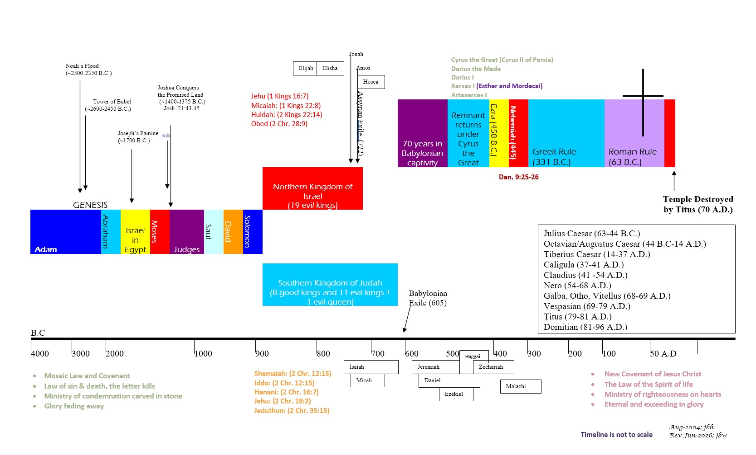
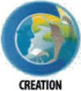

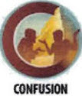



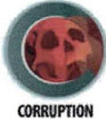
BIBLICAL CHRONOLOGICAL BACKGROUND
OT
NT
Prophets after Noah into the United Kingdom:
Abraham:
Moses:
Samuel:
Gad:
Nathan:
Ahijah
Asaph
(Gen. 20:7)
(Exo. 3:10)
(1 Sam. 3:20)
(1 Sam. 22:5)
(2 Sam. 7:2)
(1 Kings 11:29)
(2 Chr. 35:15)

Slide 11
GOD’s Prophetic Books
The Role of the Prophets
Time frames of God’s Prophetic Word
Speak
To speak God’s warnings with a goal to bring individuals and nations to repentance. Wording is often poetic and builds to a climax to make an impactful point.
Declare
To declare God’s imminent judgment and discipline for continued sinful behaviors.
Reveal
To reveal God’s future plans of judgment, deliverance, mercy, and grace.
God’s past actions and words in history (e.g., Creation – Confusion, Exodus from Egypt, fulfillment of God’s prophetic word, etc.). This is to remind the listeners/readers that God is always at work in the present fulfilling his word, and his past activity gives surety about future events God has declared.
God’s judgments that will impact the people of or near to the prophet’s generation as he speaks concerning specific nations or lands: (e.g., Judah’s exile to Babylon, the rise of Cyrus the Persian, the rebuilding of the temple in Jerusalem before it is even destroyed).
Events far into future generations that impact the whole earth: (e.g., the 1st coming of Jesus Christ, the 2nd coming of Jesus Christ, and the Millennial kingdom).
1 Peter 1:10-12: "Concerning this salvation, the prophets who prophesied about the grace that was to be yours searched and inquired carefully, inquiring what person or time the Spirit of Christ in them was indicating when he predicted the sufferings of Christ and the subsequent glories. It was revealed to them that they were serving not themselves but you, in the things that have now been announced to you through those who preached the good news to you by the Holy Spirit sent from heaven, things into which angels long to look.

Slide 12
Ezekiel
Author: Ezekiel, son of Buzi (a priest)
Date: c. 593-565 B.C.

Slide 13
About the Author and Book: Ezekiel
The book has always been named for its author, Ezekiel (Ezekiel 1:3; 24:24), who is nowhere else mentioned in Scripture. His name means “strengthened by God,” which, indeed, he was for the prophetic ministry to which God called him (Ezekiel 3:8-9). Ezekiel’s ministry began in 593/92 B.C., ~13 years after the first exiles were deported from Judah to Babylon in 605 B.C., and ~five years after King Jehoiachin’s captivity, which began in 597 B.C. (Ezekiel 1:1-3). His ministry extended at least 22 years until ~570 B.C.¹ God’s message through this book uses visions, prophecies, parables, signs, and symbols to proclaim and dramatize the word of the Lord to His exiled people.
Ezekiel was a contemporary of both Jeremiah, who was about 20 years older, and Daniel, who was the same age and already a well-known prophet as noted three times in the book.² Like Jeremiah and Zechariah, Ezekiel was both a prophet and a priest.³ Because of his priestly background, he was particularly interested in and familiar with the temple details; so, we can see why God would use him to write much about them.⁴
Ezekiel and his wife were among 10,000 Jews taken captive to Babylon in 597 B.C.⁵ They lived in Tel-abib (Ezekiel 3:14-15) on the bank of the Chebar River, probably southeast of Babylon. Ezekiel writes of his wife’s death in exile (Ezekiel 24:15-18), but the book does not mention Ezekiel’s death, which rabbinical tradition suggests occurred at the hands of an Israelite prince whose idolatry he rebuked around 560 B.C.
Ezekiel frequently dates his prophecies from 597 B.C., the year he was taken into captivity with Jehoiachin.⁶ He also dates the message in Ezekiel 40:1-2 as 573/72, the fourteenth year after the final fall of Jerusalem in 586 B.C. The last dated utterance of Ezekiel was in 571/70 B.C. (Ezekiel 29:17).
Prophecies in chapters 1–28 are in chronological order. In Ezekiel 29:1, the prophet regresses to a year earlier than in Ezekiel 26:1. But from chapter 30 on, he is close to being strictly chronological.⁷
DATE: c. 593 – 565 B.C
Notes:
¹ cf. Ezekiel 29:17
² Ezekiel 14:12-14, 14:19-20; 28:1-3
³ Jeremiah 1:1 , cf. Zechariah 1:1 with Nehemiah 12:16, Ezekiel. 1:3
⁴ Ezekiel 8:1–11:25; 40:1–47:12
⁵ Ezekiel 24:15–27, 2 Kings 24:11–18
⁶ Ezekiel 8:1; 20:1; 24:1; 26:1; 29:1; 30:20; 31:1; 32:1, 17; 33:21; 40:1
⁷ cf. Ezekiel 31:1; 32:1, 17

Slide 14
Ezekiel: Background and Setting
From the historical perspective, Israel’s united kingdom lasted more than 110 years (c. 1043–931 B.C.), through the reigns of Saul, David, and Solomon. Then the divided kingdom, Israel (north) and Judah (south), extended from 931 B.C. to ~722 B.C. until Israel in the north fell to Assyria leaving Judah, the surviving kingdom, for another 135 years. Judah fell to Babylon in 605–586 B.C. in three stages.
In the more immediate setting, several features were strategic. Politically, Assyria’s military crumbled after 626 B.C., and the capital, Nineveh, was destroyed in 612 B.C. by the Babylonians and Medes.¹ The neo-Babylonian empire had flexed its muscles since Nabopolassar took the throne in 625 B.C., and Egypt, under Pharaoh Neco II, was determined to conquer what she could. Babylon smashed Assyria in 612–605 B.C., and registered a decisive victory against Egypt in 605 B.C. at Carchemish, leaving, according to the Babylonian Chronicle, no survivors. Also in 605 B.C., Babylon, led by Nebuchadnezzar, began the conquest of Jerusalem and the deportation of captives, among them Daniel (Daniel 1:1-6).
In December, 598 B.C., Nebuchadnezzar again besieged Jerusalem, and on March 16, 597 B.C. took possession. This time, he took captive Jehoiachin and a group of 10,000, including Ezekiel.² The final destruction of Jerusalem and the conquest of Judah, including the third deportation, came in 586 B.C.
Religiously, King Josiah (c. 640–608 B.C.) had instituted reforms in Judah.³ Tragically, despite his effort, idolatry had so dulled the Judeans that their awakening was only “skin deep” overall. The Egyptian army killed Josiah as it crossed Israel in c. 608 B.C., and the Jews plunged on in sin toward judgment under Jehoahaz (c. 608 B.C.), Jehoiakim [Eliakim] (c. 608–597 B.C.), Jehoiachin (c. 597 B.C.), and Zedekiah (597–586 B.C.).
Domestically, Ezekiel and the 10,000 lived in exile in Babylon, more as colonists than captives, being permitted to farm tracts of land under somewhat favorable conditions. ⁴ Ezekiel even had his own house.⁵
Prophetically, false prophets deceived the exiles with assurances of a speedy return to Judah.⁶ From 593–585 B.C., Ezekiel warned that their beloved Jerusalem would be destroyed and their exile prolonged, so there was no hope of immediate return. In 585 B.C., an escapee from Jerusalem, who had evaded the Babylonians, reached Ezekiel with the first news that the city had fallen in 586 B.C., about six months earlier (Ezekiel 33:21). That dashed the false hopes of any immediate deliverance for the exiles, so the remainder of Ezekiel’s prophecies related to Israel’s future restoration to its homeland and the final blessings of the Messianic kingdom.
Notes:
¹ cf. Nahum
² 2 Kings 24:11–18
³ cf. 2 Chronicles 34
⁴ Jeremiah 29
⁵ Ezekiel 3:24; 20:1
⁶ Jeremiah 13:3, 16; Jeremiah 29:1

Slide 15
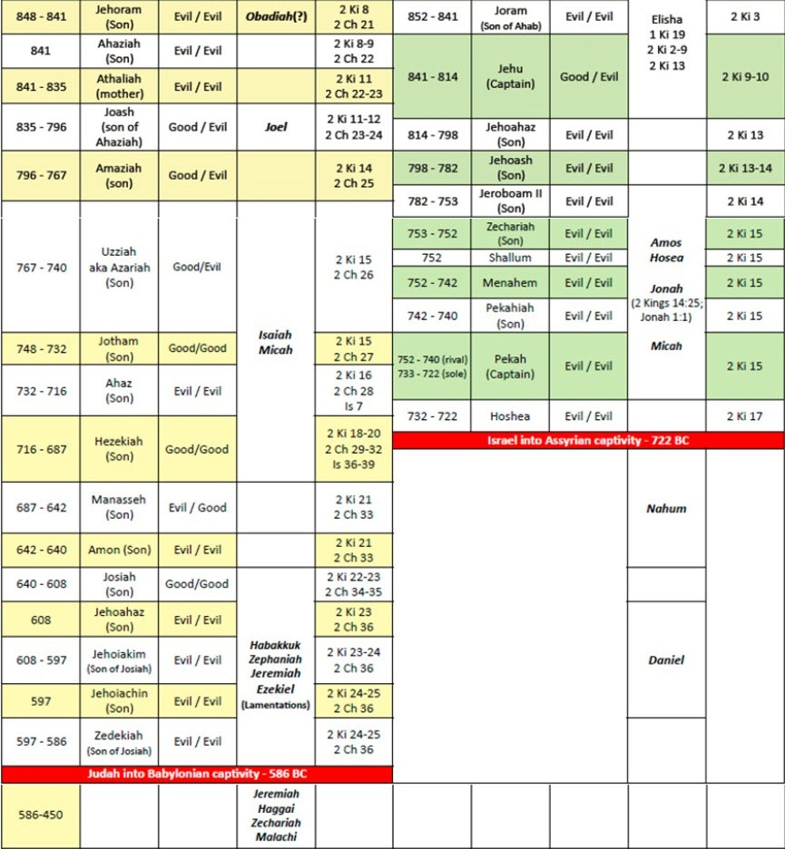
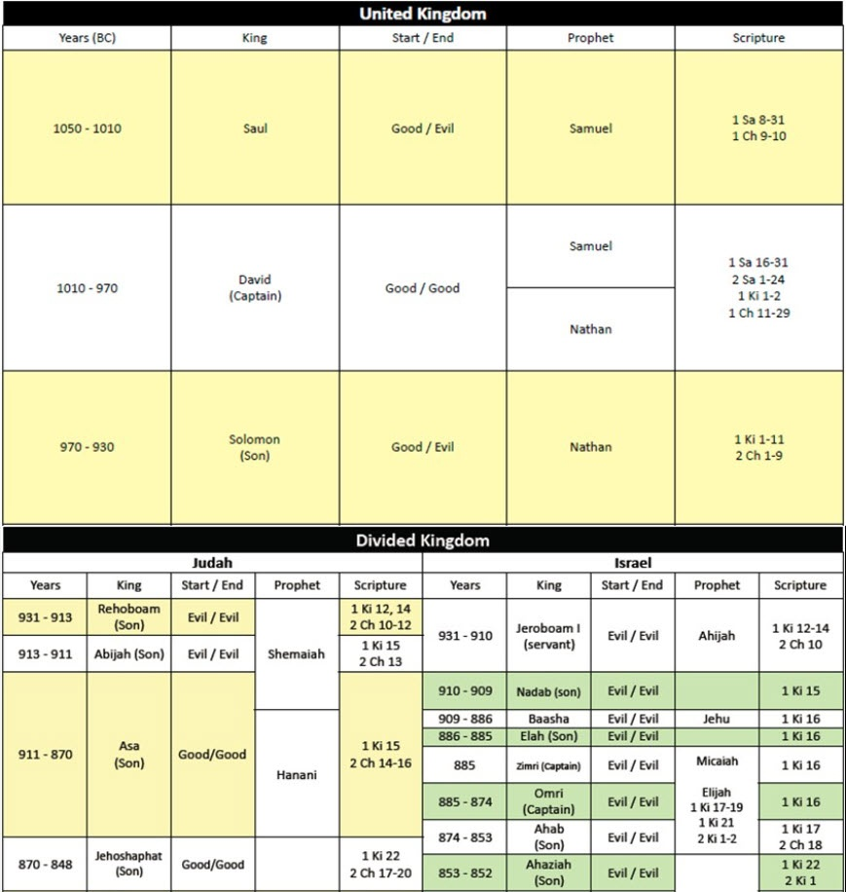
Israel’s Kings and Prophets¹
663-612 B.C.
¹ Biblegateway.com

Slide 16
Ezekiel: OUTLINE
Prophecies of Retribution to the Nations
Ammon, Moab, Edom
Philistia, Tyre, Sidon, Egypt
Prophecies of Israel’s Restoration
Regathering of Israel to the Land
Promise of a true Shepherd
Punishment of the nations
Removal of Israel’s Enemies from the Land
Reinstatement of True Worship in Israel
Redistribution of the Land in Israel
Ezekiel 1:1-24:27
Ezekiel 25:1-32:32
Ezekiel 33:1-33
Ezekiel 34:1-48:35
Prophecies of Jerusalem’s Ruin
Preparation and Commission of Ezekiel
Proclamation of Jerusalem’s Condemnation
Provisions for Israel’s Repentance
Repeated phrases in Ezekiel:
Of the ~107 uses of the phrase “son of man” in the Old Testament, 93 of these occur in Ezekiel’s 48 chapters.
“Son of man” appears 82 times in the New Testament with 80 of those references used to describe Jesus Christ.
Of the ~88 uses of the phrase “and you shall or will know that I am the LORD” in the Old Testament, 72 of these are in Ezekiel.

Slide 17
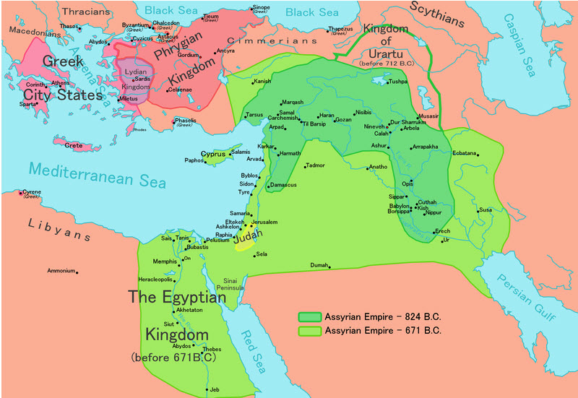
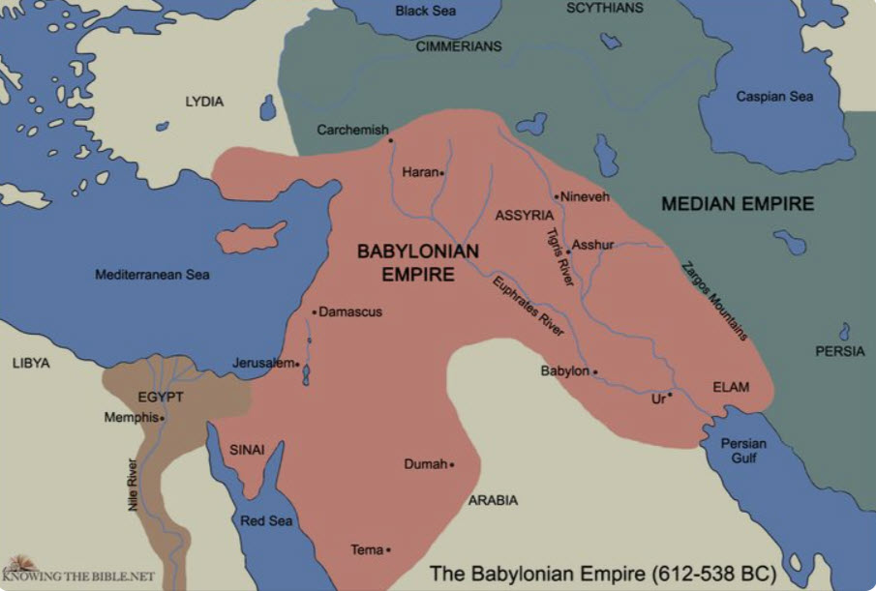
Key Geography of Ezekiel
Jeremiah 9:25-26, "Behold, the days are coming, declares the LORD, when I will punish all those who are circumcised merely in the flesh- Egypt, Judah, Edom, the sons of Ammon, Moab, and all who dwell in the desert who cut the corners of their hair, for all these nations are uncircumcised, and all the house of Israel are uncircumcised in heart."

Slide 18
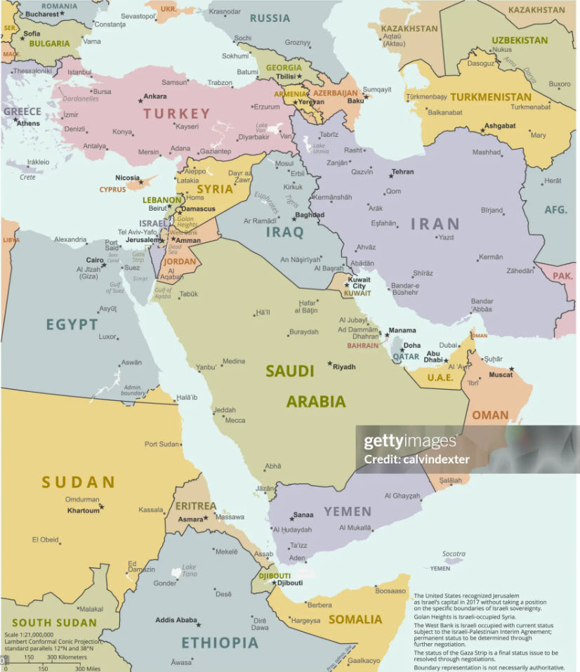
Key Geography of Ezekiel (PAST vs. PRESENT)
2017 A.D.
612 – 538 B.C.

Slide 19
Ezekiel: Key Verses
Ezekiel 1:1, “In the thirtieth year, in the fourth month, on the fifth day of the month, as I was among the exiles by the Chebar canal, the heavens were opened, and I saw visions of God.”
Ezekiel 1:28, “Like the appearance of the bow that is in the cloud on the day of rain, so was the appearance of the brightness all around. Such was the appearance of the likeness of the glory of the Lord. And when I saw it, I fell on my face, and I heard the voice of one speaking.”
Ezekiel 2:3-6, “And he said to me, ‘Son of man, I send you to the people of Israel, to nations of rebels, who have rebelled against me. They and their fathers have transgressed against me to this very day. The descendants also are impudent and stubborn: I send you to them, and you shall say to them, ‘Thus says the Lord God.’ And whether they hear or refuse to hear (for they are a rebellious house) they will know that a prophet has been among them. And you, son of man, be not afraid of them, nor be afraid of their words, though briers and thorns are with you and you sit on scorpions. Be not afraid of their words, nor be dismayed at their looks, for they are a rebellious house.’”
Ezekiel 3:16-19, “And at the end of seven days, the word of the Lord came to me: "Son of man, I have made you a watchman for the house of Israel. Whenever you hear a word from my mouth, you shall give them warning from me. If I say to the wicked, ‘You shall surely die,’ and you give him no warning, nor speak to warn the wicked from his wicked way, in order to save his life, that wicked person shall die for his iniquity, but his blood I will require at your hand. But if you warn the wicked, and he does not turn from his wickedness, or from his wicked way, he shall die for his iniquity, but you will have delivered your soul.”
Ezekiel 14:12-14, “And the word of the LORD came to me: ‘Son of man, when a land sins against me by acting faithlessly, and I stretch out my hand against it and break its supply of bread and send famine upon it, and cut off from it man and beast, even if these three men, Noah, Daniel, and Job, were in it, they would deliver but their own lives by their righteousness, declares the Lord GOD.’”
Ezekiel 18:4, “Behold, all souls are mine; the soul of the father as well as the soul of the son is mine: the soul who sins shall die.”
Ezekiel 28:12-14, “Son of man, raise a lamentation over the king of Tyre, and say to him, Thus says the Lord God: ‘You were the signet of perfection, full of wisdom and perfect in beauty. You were in Eden, the garden of God; every precious stone was your covering, sardius, topaz, and diamond, beryl, onyx, and jasper, sapphire, emerald, and carbuncle; and crafted in gold were your settings and your engravings. On the day that you were created they were prepared. You were an anointed guardian cherub. I placed you; you were on the holy mountain of God; in the midst of the stones of fire you walked.’”
Ezekiel 33:10-11, “And you, son of man, say to the house of Israel, Thus have you said: ‘Surely our transgressions and our sins are upon us, and we rot away because of them. How then can we live?’ Say to them, ‘As I live, declares the Lord God, I have no pleasure in the death of the wicked, but that the wicked turn from his way and live; turn back, turn back from your evil ways, for why will you die, O house of Israel?’”
Ezekiel 48:35, “The circumference of the city shall be 18,000 cubits. And the name of the city from that time on shall be, The Lord Is There.”
19

Slide 20
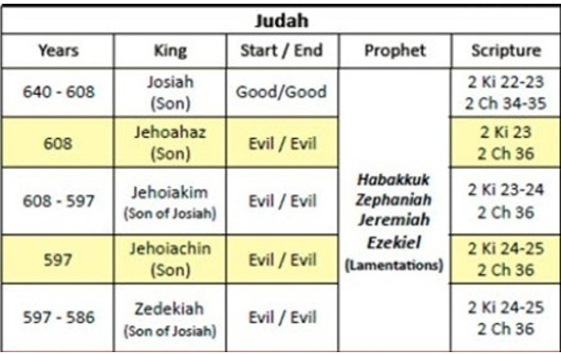
Ezekiel: Study Questions
Ezekiel 19 is a poetic lamentation about what happened to the southern kingdom of Israel (i.e., Judah) when God punished her for her sins. In this exercise as we read through the poetry, we will prayerfully seek to identify the historical figures the Holy Spirit is pointing to in three sections of the passage. God is the ultimate Poet, and as with all poetry, the figurative language and symbols point to definitive persons, places, events, etc., which correspond to reality. Let’s learn how to rightly identify these.
Read Ezekiel 19:1-4. Verse 1 of the passage tells us that this is a lament for the princes of Israel. Accordingly, who is the mother, the lioness among lions in verse 2 and who are her cubs and lions.
Compare 2 Chronicles 36:2-4 with Ezekiel 19:1-4. There are clues given in the poetical record of Ezekiel that coincide with the historical record of 2 Chronicles that enable us to identify this lion. What are those clues and what is the lion’s name?
To discover the identity of the second young lion spoken of in Ezekiel 19:5-9, read 2 Kings 24:6-15. List the information you were able to match between Ezekiel and the historical record of 2 Kings and give the name of the person referred to in this passage of Ezekiel.
The symbolic language in Ezekiel 19:10-14 changes from referring to Judah and her kings as a lioness with lions to calling Judah a vineyard and her kings branches. Read Jeremiah 39:1-8 and write about the historical events given concerning the branch that was torn off, withered; and from which fire went out from it.
20

Slide 21
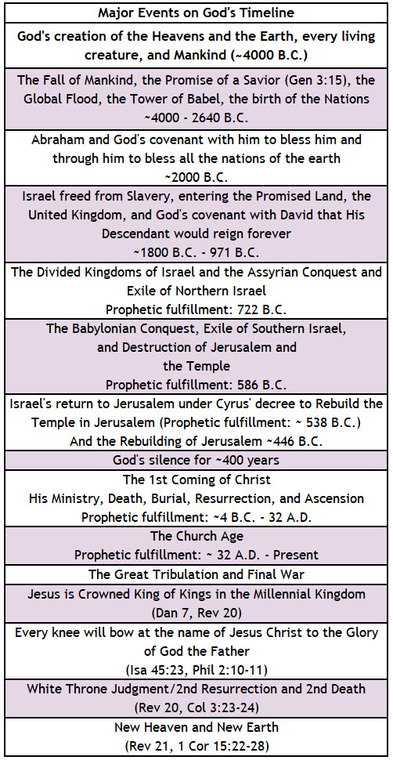
God’s Prophetic Timetable Events
Ezekiel
Ezekiel 11:16-20, "Therefore say, 'Thus says the Lord GOD: Though I removed them far off among the nations, and though I scattered them among the countries, yet I have been a sanctuary to them for a while in the countries where they have gone.' Therefore say, 'Thus says the Lord GOD: I will gather you from the peoples and assemble you out of the countries where you have been scattered, and I will give you the land of Israel.' And when they come there, they will remove from it all its detestable things and all its abominations. And I will give them one heart, and a new spirit I will put within them. I will remove the heart of stone from their flesh and give them a heart of flesh, that they may walk in my statutes and keep my rules and obey them. And they shall be my people, and I will be their God.“ (Emphasis added. See Jeremiah 29:10 and Daniel 9:1-3.)
Ezekiel 38:14-23, “Therefore, son of man, prophesy, and say to Gog, Thus says the Lord GOD: On that day when my people Israel are dwelling securely, will you not know it? You will come from your place out of the uttermost parts of the north, you and many peoples with you, all of them riding on horses, a great host, a mighty army. You will come up against my people Israel, like a cloud covering the land. In the latter days I will bring you against my land, that the nations may know me, when through you, O Gog, I vindicate my holiness before their eyes. Thus says the Lord GOD: Are you he of whom I spoke in former days by my servants the prophets of Israel, who in those days prophesied for years that I would bring you against them? But on that day, the day that Gog shall come against the land of Israel, declares the Lord GOD, my wrath will be roused in my anger. For in my jealousy and in my blazing wrath I declare, On that day there shall be a great earthquake in the land of Israel. The fish of the sea and the birds of the heavens and the beasts of the field and all creeping things that creep on the ground, and all the people who are on the face of the earth, shall quake at my presence. And the mountains shall be thrown down, and the cliffs shall fall, and every wall shall tumble to the ground. I will summon a sword against Gog on all my mountains, declares the Lord GOD. Every man’s sword will be against his brother. With pestilence and bloodshed I will enter into judgment with him, and I will rain upon him and his hordes and the many peoples who are with him torrential rains and hailstones, fire and sulfur. So, I will show my greatness and my holiness and make myself known in the eyes of many nations. Then they will know that I am the LORD.”
(Emphasis added. See also Rev 16:17-21, Rev 20:7-11).
Ezekiel 39:27-29, “When I have brought them back from the peoples and gathered them from their enemies' lands, and through them have vindicated my holiness in the sight of many nations. Then they shall know that I am the LORD their God, because I sent them into exile among the nations and then assembled them into their own land. I will leave none of them remaining among the nations anymore. And I will not hide my face anymore from them, when I pour out my Spirit upon the house of Israel, declares the Lord GOD."
(Emphasis added. See also Ezekiel 28:24-26, Acts 2:16-20, Romans 11:25-27)
21

Slide 22
Summary of Ezekiel
Brief Summary: Ezekiel and his wife along with 10,000 captives were among the second group from the southern kingdom of Israel (aka Judah) deported to Babylon. This occurred in c. 597 B.C. when King Jehoiachin surrendered to Babylon. Ezekiel’s ministry began c. 593 B.C., ~13 years after the first exiles from Judah were deported to Babylon in 605 B.C. (Ezekiel 1:1). The “glory of the Lord” is central to Ezekiel, appearing in six chapters.¹ The book includes graphic descriptions of the disobedience of Israel and Judah, despite God’s kindness.² It shows God’s desire for Israel to bear fruit which he can bless; however, selfish indulgence had left Judah ready for judgment, like a torched vine (Ezekiel 15). References are plentiful to Israel’s idolatry and its consequences, such as Pelatiah dropping dead (Ezekiel 11:13), a symbolic illustration of overall disaster for the people.
Many picturesque scenes illustrate spiritual principles. Among these are Ezekiel eating a scroll (Ezekiel 2); the faces on four angels representing aspects of creation over which God rules (Ezekiel 1:10); a “barbershop” scene (Ezekiel 5:1–4); graffiti on temple walls reminding readers of what God really wants in his dwelling place, namely holiness and not ugliness (Ezekiel 8:7-10); and sprinkled hot coals depicting judgment (Ezekiel 10:2, 10:7).
Chief among the theological themes are God’s holiness and sovereignty. These are conveyed by frequent contrast of his bright glory against the despicable backdrop of Judah’s sins.³ Closely related is God’s purpose of glorious triumph so that all may “know that I am the Lord.” This divine monogram, God’s signature authenticating his acts, is mentioned more than 60 times, usually with a judgment,⁴ but occasionally after the promised restoration.⁵ God is righteous and truthful, and thankfully, He will not allow men or angels to live forever believing lies about his character and rule.
Other subjects involve God’s angels carrying out his program behind the scenes,⁶ God’s holding each individual accountable for pursuing righteousness,⁷ and the sinfulness in Israel and other nations.⁸ Ezekiel addresses the necessity of God’s wrath to deal with sin, ⁹ God’s frustration over man’s devices to escape from besieged Jerusalem,¹⁰ God’s grace pledged in the Abrahamic Covenant to restore Abraham’s people to the land of the covenant, and also through Abraham, to bless all nations with the knowledge of God.^{11 ,12} God has promised to preserve a remnant of Israelites through whom he will fulfill his restoration promises and keep his inviolate word.
Foreshadowings: Ezekiel 34 is the chapter wherein God denounces the leaders of Israel as false shepherds for their poor care of His people. Instead of caring for the sheep of Israel, they cared for themselves. They ate well, were well-clothed, and well-cared for by the very people they had been placed over (Ezekiel 34:1-3). By contrast, Jesus is the Good Shepherd who lays down His life for the sheep and who protects them from the wolves who would destroy the flock (John 10:11-12). Verse 4 of chapter 34 describes people whom the shepherds failed to minister to as weak, sick, injured, and lost. Jesus is the Great Physician who heals our spiritual wounds (Isaiah 53:5) by His death on the cross. He is the one who seeks and saves that which is lost (Luke 19:10). Ezekiel also points to many events that will occur during the great tribulation, the day when all Israel will be saved, and the Millennial kingdom.¹³ Finally, Ezekiel gives precise measurements of a holy district in Jerusalem and another temple where the glory of God will fill it. ¹⁴ This could not be the heavenly temple since Ezekiel was taken to Israel to see it (Ezekiel 40:1-3). It could not be Zerubbabel’s temple since the glory of God was not present then.¹⁵ It could not be the eternal temple since the Lord and the Lamb are its temple.¹⁶ Therefore, it must be the earthly temple built before the great tribulation with all of the exquisite details that are yet to be outlined; an earthly temple that will serve a function during the millennial kingdom (Revelation 11:1-2).
Notes:
¹ Ezekiel 1:28; 3:12, 3:23; 10:4, 10:18; 11:23; 43:4–5; 44:4
² Ezekiel chapters 23; cf. chapter 16
³ Ezekiel 1:26–28; often in chapters. 8–11; and 43:1–7
⁴ Ezekiel 6:7; 7:4
⁵ Ezekiel 34:27; 36:11, 38; 39:28
⁶ Ezekiel 1:5–25; 10:1–22
⁷ Ezekiel 18:3–32
⁸ Ezekiel 2:3–7; 8:9–10, 25:1-32:32
⁹ Ezekiel 7:1–8; 15:8
¹⁰ Ezekiel 12:1–13; cf. Jer. 39:4–7
¹¹ Genesis 12:1–3
¹² Ezekiel 34; 36–48; cf. Gen. 12:1-7
¹³ Ezekiel 38:14-23, 11:16-20, Romans 11:25-27
¹⁴ Ezekiel 40-47
¹⁵ cf. Revelation 21:22
¹⁶ cf. Revelation 21:22

Slide 23
Ezekiel: Practical Application
Practical Application: The Book of Ezekiel calls us to join in a fresh and living encounter with the God of Abraham, Moses, and the prophets. Ezekiel challenges us to experience a life changing vision of God’s power, knowledge, eternal presence and holiness; to let God direct us in comprehending the depth of and commitment to evil that lodges in each human heart, and to recognize that God holds His servants responsible for warning wicked men of their peril. Those of us who have experienced new life through Jesus Christ are called to be overcomers and watchmen for others in the discernment, wisdom, and power provided to us by the Holy Spirit.
In addition, Ezekiel teaches us more about how God, at times, uses natural disasters and war to punish the sins of nations (cf. Ezekiel 7:1-16, Ezekiel 26:1-15) and to bring many to repentance and to the truth that He is the Lord and there is no other (Isaiah 45:6). When we hear of these things taking place in near or far away places, we can pray that many will heed the warnings God has given in his word to repent (Luke 13:1-7).
It is normal to hate war and desire peace, but we can better understand how God utilizes war for redemptive purposes. Combining what we learned about this in Ezekiel along with Judges 3:1-2, we see that God also uses times of war to instruct new generations in warfare. Lastly, 2 Chronicles 12:5-8 tells us that when a country’s citizens take their God-given freedom and prosperity for granted without reverence and thankfulness to Him; God may allow such a nation to see what it is truly like to serve under the harsh rule of sinful man rather than the freedom found under His rule.
As you prayerfully consider these lessons from Ezekiel, ask the Holy Spirit what application he is calling you to in this season of your life. Have you been neglectful in thanking God for his good benefits; have you been showing your love for Him by obeying his commands (cf. John 14:15)? Have you failed to give him reverence for his sovereign providence or to heed his command to be a warning watchman in your circle of influence? Whatever the Spirit is impressing upon you, confess it and ask for his help to obediently follow Christ.

Slide 24
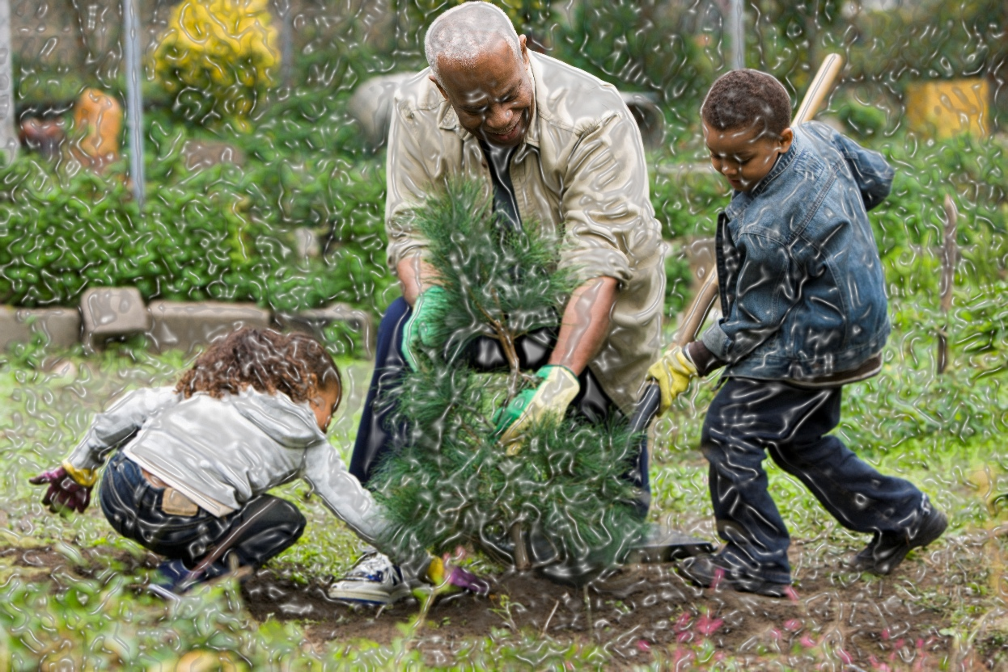
Closing Prayer: Ezekiel
Ezekiel 14:22-23, “But behold, some survivors will be left in it, sons and daughters who will be brought out; behold, when they come out to you, and you see their ways and their deeds, you will be consoled for the disaster that I have brought upon Jerusalem, for all that I have brought upon it. They will console you, when you see their ways and their deeds, and you shall know that I have not done without cause all that I have done in it, declares the Lord GOD."

Slide 25
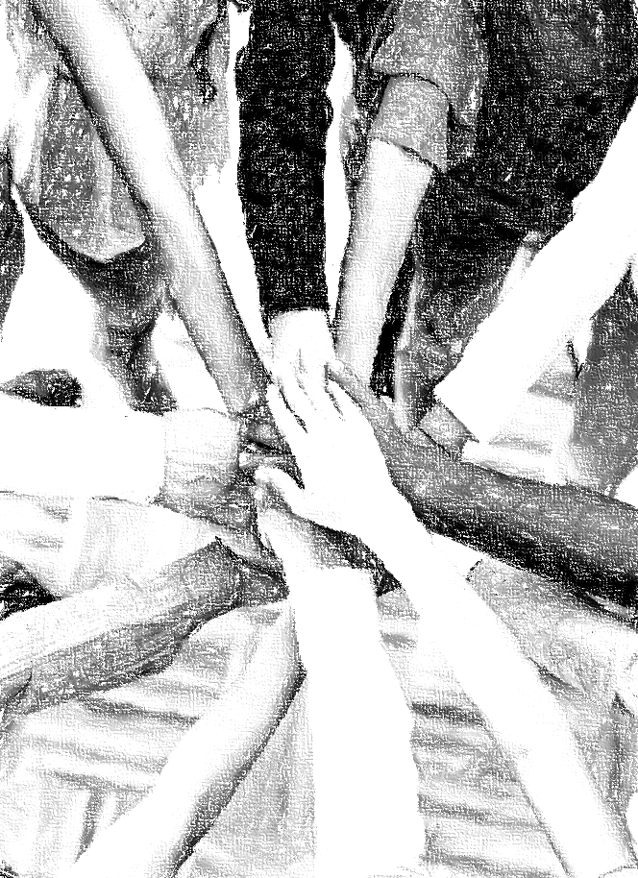
Acknowledgements
Background, Setting, Outlines, some Study Question answers, interpretative challenges, and some Summaries: Adapted from John MacArthur Study Bible at GTY.org.
Key verses, Practical Application, some Study Question answers, and some Summaries: Adapted from GotQuestions.org.
Inductive Bible Study Method: Adapted from Precept.org.
Creation – Consummation Icons: Adapted from AnswersInGenesis.org.
Definitions: Adapted from Websters 1828 Dictionary.
Bible Reference Software and Quotes: All Scripture quotations are taken from the Holy Bible using primarily the English Standard Version (ESV) or New American Standard Bible (NASB) translations. Links to Scripture references utilize BibleRef.com, which is a Got Questions Ministries’ website.

Slide 26
Study Leader Assistance
Sample Prayers
Study Question Answer Keys
26

Slide 27
Sample Ezekiel: Opening Prayer
Ezekiel 3:16-19, "And at the end of seven days, the word of the Lord came to me: "Son of man, I have made you a watchman for the house of Israel. Whenever you hear a word from my mouth, you shall give them warning from me. If I say to the wicked, ‘You shall surely die,’ and you give him no warning, nor speak to warn the wicked from his wicked way, in order to save his life, that wicked person shall die for his iniquity, but his blood I will require at your hand. But if you warn the wicked, and he does not turn from his wickedness, or from his wicked way, he shall die for his iniquity, but you will have delivered your soul."
Sample Prayer: Dear Heavenly Father, just as you made Ezekiel a watchman over Israel to warn the people to turn from their wicked ways and return to you, you have placed a similar calling upon all your people. You have made us ambassadors of Jesus Christ to prayerfully warn those in our circles of influence to repent and trust in the only name under heaven by which man can be saved. Thank you for so great a salvation and for reconciling us to yourself through Christ. Cause us to heed the warning you gave to Ezekiel and to take action to warn others of sin, judgment, and salvation through Jesus our Lord. In his name we pray. Amen.

Slide 28
Ezekiel: Study Question Answers
Ezekiel 19 is a poetic lamentation about what happened to the southern kingdom of Israel (i.e., Judah) when God punished her for her sins. In this exercise as we read through the poetry, we will prayerfully seek to identify the historical figures the Holy Spirit is pointing to in three sections of the passage. God is the ultimate Poet, and as with all poetry, the figurative language and symbols point to definitive persons, places, events, etc., which correspond to reality. Let’s learn how to rightly identify these.
Read Ezekiel 19:1-4. Verse 1 of the passage tells us that this is a lament for the princes of Israel. Accordingly, who is the mother, the lioness among lions in verse 2 and who are her cubs and lions. Answer: One of the basic rules of correctly understanding God’s word is that Scripture interprets Scripture. Verse 1 clearly tells us the lament is for the princes of Israel. In Ezekiel’s day, Israel only existed as the southern kingdom, also called Judah. Therefore, the mother and the lioness are one in the same; they refer to the nation of Judah, the southern kingdom of Israel. Her cubs are the princess of southern Israel, and the lions are the princes who became kings.
Compare 2 Chronicles 36:2-4 with Ezekiel 19:1-4. There are clues given in the poetical record of Ezekiel that coincide with the historical record of 2 Chronicles that enable us to identify this lion. What are those clues and what is the lion’s name? Answer: Ezekiel’s poem states that this lion was caught and brought with hooks to Egypt. The historical account in 2 Chronicles identifies Jehoahaz, son of Josiah, as the king who was deposed by the king of Egypt and carried into exile there. He reigned in Israel only three months before his exile.
To discover the identity of the second young lion spoken of in Ezekiel 19:5-9, read 2 Kings 24:6-15. List the information you were able to match between Ezekiel and the historical record of 2 Kings and give the name of the person referred to in this passage of Ezekiel. Answer: Ezekiel’s lamentation states that the nations were against this lion and he was taken with hooks to the king of Babylon and heard from no more in Israel. The historical account in 2 Kings identifies Jehoiachin as Judah’s king who surrendered himself and his household to Babylon when king Nebuchadnezzar’s servants laid siege to Jerusalem. This took place in c. 597 B.C. Nebuchadnezzar took Jehoiachin, his household, and all the king’s treasures to Babylon just as the Lord foretold (see Isaiah 39:1-7). Jehoiachin was later rewarded by the Lord for his obedient surrender (Jeremiah 52:31-34).
The symbolic language in Ezekiel 19:10-14 changes from referring to Judah and her kings as a lioness with lions to calling Judah a vineyard and her kings branches. Read Jeremiah 39:1-8 and write about the historical events given concerning the branch that was torn off, withered; and from which fire went out from it. Answer: This section of Ezekiel's lament describes the nation as being plucked up and consumed by fire. And from the stem, fire has gone out to consume its fruit so that no strong stem remains to rule. The historical account in Jeremiah records that this refers to King Zedekiah who rebelled against Nebuchadnezzar by ceasing to pay the required tribute to him. This led to the Babylonians laying its final siege on Jerusalem, capturing Zedekiah and his household, setting fire to the city, and destroying the temple in 586 B.C. Jeremiah had warned Zedekiah of all these things in Jeremiah 38:14-23, but he did not obey the voice of the Lord.
28

Slide 29
Sample Closing Prayer: Ezekiel
Ezekiel 14:22-23, “But behold, some survivors will be left in it, sons and daughters who will be brought out; behold, when they come out to you, and you see their ways and their deeds, you will be consoled for the disaster that I have brought upon Jerusalem, for all that I have brought upon it. They will console you, when you see their ways and their deeds, and you shall know that I have not done without cause all that I have done in it, declares the Lord GOD.“
Sample Prayer: Dear Heavenly Father, devastation from both nature and war are so difficult to face and resolve in our hearts and minds. So, we praise you that you have not left us in the dark groping to understand the truth about why such things come upon humans and your Creation. You have warned us plainly that the wage for our sin is death and then we are to face your judgment. Thank you that with this warning, you have provided a rescue for us in Jesus Christ. Just as Ezekiel’s soul was consoled when he witnessed the survivors in Israel and their repentance after the Babylonian invasion, we too are consoled and transformed when we receive your forgiveness and adoption through Christ. Thank you that you are a God who never afflicts without cause and that you always have redemption in your purpose. We love you Lord and lift this prayer in Jesus’ name. Amen.

