Slide 1

ACTS
Book 44

Slide 2
What is the Holy Bible?
The Holy Bible is a collection of writings that includes 66 books in English editions. The Bible consists of two parts, the Old Testament and New Testament. The word testament means covenant. The Old Testament includes 39 books, and the New Testament includes 27 books.
These 66 books were written over approximately 1,400 years by 40 different authors in Hebrew, Aramaic, and Greek. The Old Testament writings were affirmed by Jewish leaders, and moreover, by Jesus Christ.¹ The New Testament writings were confirmed by early church leaders. The 66 books of the Bible are the inspired words of God that are used to make and mature disciples of the One true God through Jesus Christ, his Son (Matthew 28:18-20, 2 Timothy 3:16-17). The Bible was not created by mere human wisdom but was inspired by God (2 Peter 1:20-21), is interpreted by His Holy Spirit (John 16:13, Matthew 23:8-10), and will last forever (Matthew 24:35).²
If you do a phrase search on the Bible you will find the phrase "the word of the Lord" and "Thus says the Lord" more than 700 times.³ In addition, this book has given reasonable evidence to the claim of being God’s word by:​
  providing answers that conform with the reality we see around us.
  being a reliable collection of historical documents.
  containing eyewitness accounts that were written during the lifetimes of other eyewitnesses.
  recording supernatural events that took place in fulfillment of specific prophecies.⁴
Notes:
¹ See Matthew 4:4-7, 12:3-5, Mark 7:6-7, 12:26-27, and Luke 19:46 for examples.
^{2 “}What are the Books of the Bible”, GotQuestions.org
³ Blue Letter Bible
⁴ Paraphrased from Voddie Baucham

Slide 3
Our Goals in Studying the Bible
To better …..
Understand the Only true God; the Author of the Bible. (2 Timothy 3:16-17, 2 Peter 1:20-21, 1 John 5:20 , Jeremiah 9:23-24)
Learn How He works in the World and in our Lives. (Job 40:6-14, Isaiah 45:6-7, Isaiah 46:8-10, Philippians 2:12-13)
Understand Ourselves and the Hearts of Mankind. (Jeremiah 17:9, 2 Timothy 3:13, Ephesians 5:7-10)
Come to Know What Pleases and Grieves God. (1 Thessalonians 4:1, Ephesians 4:26-31, Hebrews 11:6, 1 Peter 1:14-19)
To be Transformed into Fruitful Doers of God’s Word and not just Hearers. (Romans 12:2, James 1:27, Matthew 3:8)
Tether Ourselves to God’s Word for Our Wisdom, Discernment, and Safety. (1 Corinthians 6:9-10, Matthew 24:24, Ephesians 4:11-14)
Jeremiah 9:23-24 “Thus says the Lord: "Let not the wise man boast in his wisdom, let not the mighty man boast in his might, let not the rich man boast in his riches, but let him who boasts boast in this, that he understands and knows me, that I am the Lord who practices steadfast love, justice, and righteousness in the earth. For in these things I delight, declares the Lord."

Slide 4
How to Study the Bible
#1. Observation: What does the text say.
Who?
What?
When?
Where?
How?
Why?
#2. Interpretation: What does the text mean in context with the passage, book, and whole counsel of God?
#3. Application: How is the Holy Spirit instructing me to apply this understanding at this time in my life?

Slide 5
Study Resources
Opening Prayer
Background and Setting
Book Outline
Geography Maps
Key Verses
Study Questions
Major Event Timeline
Book Summary
Application and Closing Prayer
Study Leader Support Slides

Slide 6
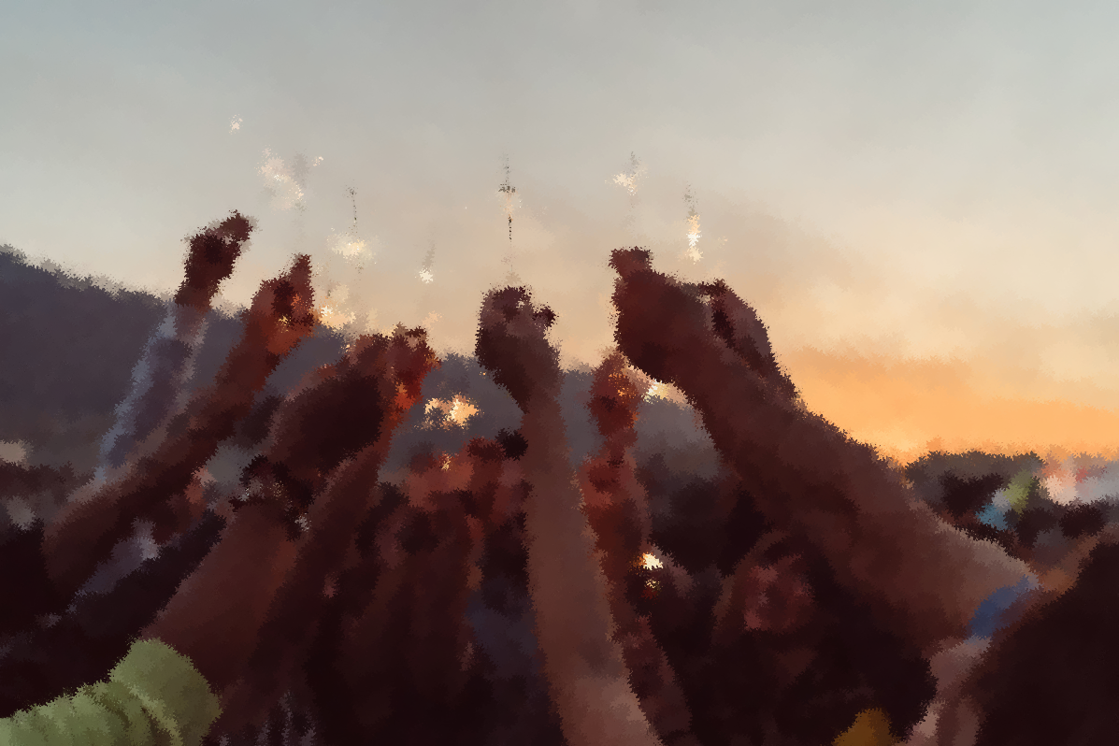
Opening Prayer Verse: Acts
Acts 2:37-41: "Now when they heard this they were cut to the heart, and said to Peter and the rest of the apostles, ‘Brothers, what shall we do?’ And Peter said to them, ‘Repent and be baptized every one of you in the name of Jesus Christ for the forgiveness of your sins, and you will receive the gift of the Holy Spirit. For the promise is for you and for your children and for all who are far off, everyone whom the Lord our God calls to himself.’ And with many other words he bore witness and continued to exhort them, saying, ‘Save yourselves from this crooked generation.’ So those who received his word were baptized, and there were added that day about three thousand souls."

Slide 7
Summary of John
Brief Summary: Whereas Matthew and Luke trace Jesus’ earthly heritage back to Abraham and Adam, respectively, and Mark opens with the beginning of Jesus’ earthly ministry; the gospel of John transports us back to the beginning before Creation. John tells us that “in the beginning was the Word, and the word was with God, and the Word was God.” All things came into being through Him, and in Him was life. The God from the Father’s side became flesh, was named Jesus, and dwelt among us full of glory, grace, and truth as the only begotten Son from the Father (John 1:1-18) in order that He might take away our sins as the spotless Lamb of God (John 1:29). John focused his text on the identity of Jesus beginning with the prologue and continuing with eight “I AM” statements from Jesus.
I AM the Bread of Life (John 6:22-71)
I AM the Light of the World (John 8:12-38)
Before Abraham was, I AM (John 8:39-59)
I AM the Door (John 10:1-10)
I AM the Good Shepherd (John 10:11-21)
I AM the Resurrection and the Life (John 11:17-44)
I AM the Way, the Truth, and the Life (John 14:1-14)
I AM the True Vine (John 15:1-17)
Likewise, John documented eight miracles as evidence to reinforce Jesus’ declarations.¹ Jesus taught you must be born again, born from above, born of the Spirit to be saved. He is the Way, the Truth, and the Life, and no one comes to the Father except through God’s Son. Once born from above by the Spirit through Jesus Christ, we are to express our love for Him by obeying his commands (John 14:15-21, 15:9-10). Jesus is the vine, we are the branches, and we must remain in Him to be fruitful in any endeavor that will have eternal impact. When we sin, we are slaves to sin, but when we are free in Jesus, we are free indeed with His power to overcome sin.
As with the other gospels, John records the plot of the Jewish leaders to kill Jesus, our Lord’s crucifixion, death, burial, and glorious resurrection on the third day. The Lord Jesus willingly died on the cross to pay in full the debt owed to God for the sins of all who place their trust in His work and righteousness. Jesus appeared to his disciples after his resurrection giving proof that He conquered the grave, he taught them and personally strengthened Peter by giving him three opportunities to again declare his love for the Lord and instructing Peter to feed his lambs and sheep.
Near the end of his book, John states his purpose: “these have been written so that you may believe that Jesus is the Christ, the Son of God; and that believing you may have life in His name” (John 20:30-31). For “those born of God, who receive Him and believe in His name, to them He gave the right to become children of God” (John 1:10-12).
Connections: The gospel of John’s portrayal of Jesus as the God of the Old Testament is seen most emphatically in the seven “I AM” statements of Jesus. He is the “Bread of life” (John 6:35), provided by God to feed the souls of His people. Just as He provided manna from heaven to feed the Israelites in the wilderness; Jesus now satisfies those who hunger and thirst for righteousness.² Jesus is the “Light of the world” (John 8:12), the same Light that God promised to His people in the Old Testament (Isaiah 30:26; 60:19-22) and which will find its culmination in the New Jerusalem when Christ the Lamb will be its Light (Revelation 21:23). Two of the “I AM” statements refer to Jesus as both the “Good Shepherd” and the “Door of the sheep.” Here are clear references to Jesus as the God of the Old Testament, the Shepherd of Israel (Psalm 23:1; 80:1; Jeremiah 31:10; Ezekiel 34:23) and, as the only Door into the sheepfold, the only way of salvation by which we escape God’s judgment.
Notes:
¹ see John chapters 2, 4-6, 9, 11, and 21
² See Exodus 16:11–36 and Matthew 5:6

Slide 8
Reviewing the Themes in Matthew - John
All four gospels record the earthly ministry of Jesus, the Lamb of God who willing died for our sins by crucifixion under Pontius Pilate, was buried, and rose from the dead on the third day. Yet, each gospel account also has a unique emphasis.
Matthew: Jesus Christ, the son of Abraham, son of David, and the Son of God of whom Moses and the Prophets wrote.
Mark: Jesus Christ, the Son of God, King of kings with all immediate authority and power.
Luke: Jesus Christ, the Son of Adam and the Son of God who fulfilled the Law and the Prophetic word and whose work is recorded so you may have certainty concerning the things you have been taught.
John: Eight “I AM” statements spoken and fulfilled by Jesus; written so that you may believe that Jesus is the Christ, the Son of God.

Slide 9
New Testament Table of Contents (27 Books)
THE GOSPELS & ACTS - 5
MATTHEW
MARK
LUKE
JOHN
ACTS
PAUL’S LETTERS TO CHURCHES - 9
ROMANS
1 CORINTHIANS
2 CORINTHIANS
GALATIANS
EPHESIANS
PHILIPPIANS
COLOSSIANS
1 THESSALONIANS
2 THESSALONIANS
PAUL’S LETTERS TO INDIVIDUALS - 4
1 TIMOTHY
2 TIMOTHY
TITUS
PHILEMON
LETTERS BY OTHERS – 9
HEBREWS
JAMES
1 PETER
2 PETER
1 JOHN
2 JOHN
3 JOHN
JUDE
REVELATION

Slide 10
New Testament Books by Date Written
James:
45-50 A.D.
Galatians:
49-55 A.D.
1 Thess:
51 A.D.
2 Thess:
52 A.D.
1 Cor:
53-55 A.D.
2 Cor:
55-56 A.D.
Mark:
55-60 A.D.
Matthew:
55-65 A.D.
Romans:
57-58 A.D.
Luke:
60 A.D.
1 & 2 Peter: 60-65 A.D.
Jude:
60-70 A.D.
Ephesians: 60-61 A.D.
Philippians: 60-61 A.D.
Colossians: 61 A.D.
Philemon:
61 A.D.
Titus:
62-67 A.D.
1 Timothy:
63-66 A.D.
Acts:
65 A.D.
Hebrews:
65 A.D.
2 Timothy:
67 A.D.
John:
85-90 A.D.
1, 2 & 3 John:
85-95 A.D.
Revelation: 90-95 A.D.

Slide 11


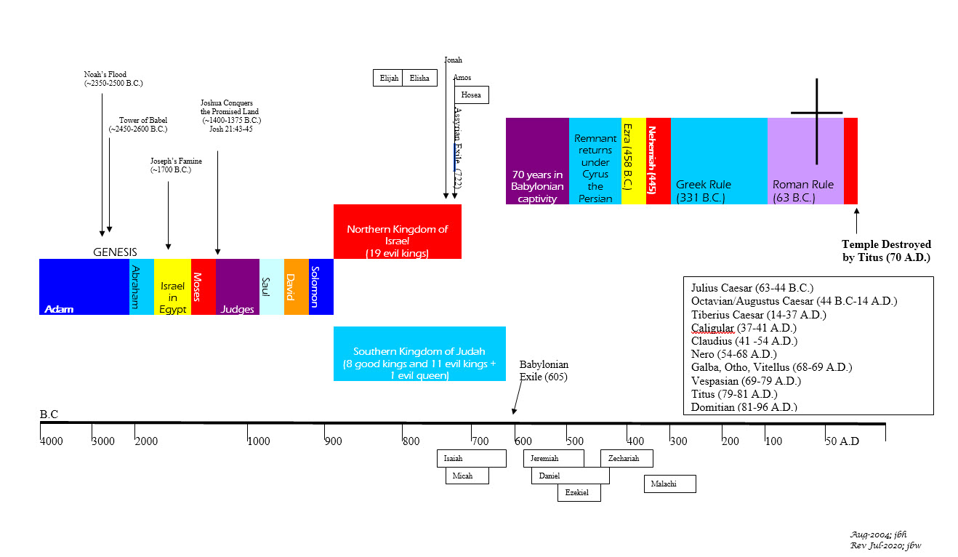





BIBLICAL CHRONOLOGICAL BACKGROUND
OT
Cyrus the Great (Cyrus II)
Darius the Mede
Darius I
Xerxes I (Esther and Mordecai)
Artaxerxes I
NT
Jehu (1 Kings 16:7)
Micaiah: (1 Kings 22:8)
Huldah: (2 Kings 22:14)
Obed (2 Chr 28:9)
Job
Daniel 9:25-26
Prophets after Noah into the United Kingdom:
Abraham:
Moses:
Samuel:
Gad:
Nathan:
Ahijah
Asaph
(Gen 20:7)
(Exo 3:10)
(1 Sam 3:20)
(1 Sam 22:5)
(2 Sam 7:2)
(1 Kings 11:29)
(2 Chron 35:15)
Haggai
Mosaic Law and Covenant
Law of sin & death, the letter kills
Ministry of condemnation carved in stone
Glory fading away
Shemaiah: (2 Chr 12:15)
Iddo: (2 Chr 12:15)
Hanani: (2 Chr 16:7)
Jehu: (2 Chr 19:2)
Jeduthun: (2 Chr 35:15)
New Covenant of Jesus Christ
The Law of the Spirit of life
Ministry of righteousness on hearts
Eternal and exceeding in glory
Timeline is not to scale

Slide 12
Acts
Author: Luke
Date of Writing: c. 60-65 A.D.

Slide 13
About this Book and Its Author - ACTS
As the second book Luke addressed to Theophilus (see Luke 1:3), Acts may originally have had no title. The Greek manuscripts title it “Acts”, and many add “of the Apostles.” The Greek word translated “Acts” (praxeis) was often used to describe the achievements of great men. Acts does feature the notable historical figures in the early years of the church, especially Peter (Acts 1–12) and Paul (Acts 13–28). But the book could more properly be called “The Acts of the Holy Spirit through the Apostles”, since his sovereign, superintending work was far more significant than that of any man. It was the Spirit’s directing, controlling, and empowering ministry that strengthened the church and caused it to grow in numbers, spiritual power, and influence.
Since this book is also addressed to Theophilus (Acts 1:1-2), it is logical to conclude that Luke is also the author of Acts, although he is not named in either the book of Luke or Acts. The writings of the early church Fathers such as Irenaeus, Clement of Alexandria, Tertullian, Origen, Eusebius, and Jerome affirm Luke’s authorship, and so does the Muratorian Canon (c 170 A.D.). Because he is a relatively obscure figure, mentioned only three times in the New Testament,¹ it is unlikely that anyone would have forged a work to make it appear to be Luke’s. A forger surely would have attributed his work to a more prominent person.
Luke was Paul’s close friend, traveling companion, and personal physician (Colossians 4:14). He was a careful researcher (Luke 1:1-4) and an accurate historian, displaying an intimate knowledge of Roman laws and customs, as well as the geography of Israel, Asia Minor, and Italy. In writing Acts, Luke drew on written sources,² and no doubt interviewed key figures such as Peter, John, and others in the Jerusalem church. Paul’s two-year imprisonment at Caesarea (Acts 24:27) gave Luke ample opportunity to interview Philip and his daughters (who were considered important sources of information on the early days of the church). Finally, Luke’s frequent use of the first-person plural pronouns “we” and “us”³ reveals that he was an eyewitness to many of the events recorded in Acts.
Some believe Luke wrote Acts after the fall of Jerusalem (70 A.D.; his death was probably in the mid-eighties). It is more likely, however, that he wrote much earlier, before the end of Paul’s first Roman imprisonment (c. 60–62 A.D.). That date is the most natural explanation for the abrupt ending of Acts—which leaves Paul awaiting trial before Caesar. Surely Luke, who devoted more than half of Acts to Paul’s ministry, would have given the outcome of that trial, and described Paul’s subsequent ministry, second imprisonment (cf. 2 Timothy 4:11), and death, if those events had happened before he wrote Acts. Luke’s silence about such notable events as the martyrdom of James, head of the Jerusalem church (62 A.D. according to the Jewish historian Josephus), the persecution under Nero (64 A.D.), and the fall of Jerusalem (70 A.D.) also suggests he wrote Acts before those events transpired.
Notes:
¹ Colossians 4:14; 2 Timothy 4:11, Philemon 24
² Acts 15:23-29; 23:26-30
³ Acts 16:10–17; 20:5–21:18; 27:1–28:16

Slide 14
Acts Background and Setting
As Luke makes clear in the prologue to his Gospel, he wrote to give Theophilus (and the others who would read his work) a “narrative of the things” (Luke 1:1) that Jesus had accomplished during his earthly ministry. Accordingly, Luke’s Gospel records those momentous events in a reasonably “consecutive order” (Luke 1:3). Acts continues that record, noting what the Holy Spirit of Jesus Christ accomplished through His church. Beginning with Jesus’ ascension, the empowering of this small assembly of believers on the day of Pentecost, on to the Acts of the Holy Spirit through the Apostles Peter and Paul, Acts chronicles the spread of the gospel and the growth of the church.¹ The book makes frequent use of the Old Testament connections² and records the mounting opposition to the gospel.³
Theophilus, whose name means “lover of God,” is unknown to history apart from his mention in Luke and Acts. Whether he was a believer whom Luke was instructing, or a pagan whom Luke sought to convert, is not known. Luke’s address of him as “most excellent Theophilus (Luke 1:3) suggests he was a Roman official of some importance.⁴
Notes:
¹ cf. Acts 1:15; 2:41, 2:47; 4:4; 5:14; 6:7; 9:31; 12:24; 13:49; 16:5; 19:20
² For examples, compare Acts 2:17–21 (Joel 2:28–32); Acts 7:49–50 (Isa. 66:1–2); Acts 8:32–33 (Isa. 53:7–8); Acts 28:26–27 (Isa. 6:9–10)
³ cf. Acts 2:13; 4:1-22; 5:17-42; 6:9-8:4; 12:1-5; 13:6-12, 13:45-50; 14:2-6, 14:19-20; 16:19-24; 17:5-9; 19:23-41; 21:27-36; 23:12-21; 28:24
⁴ cf. Acts 24:3; 26:25

Slide 15
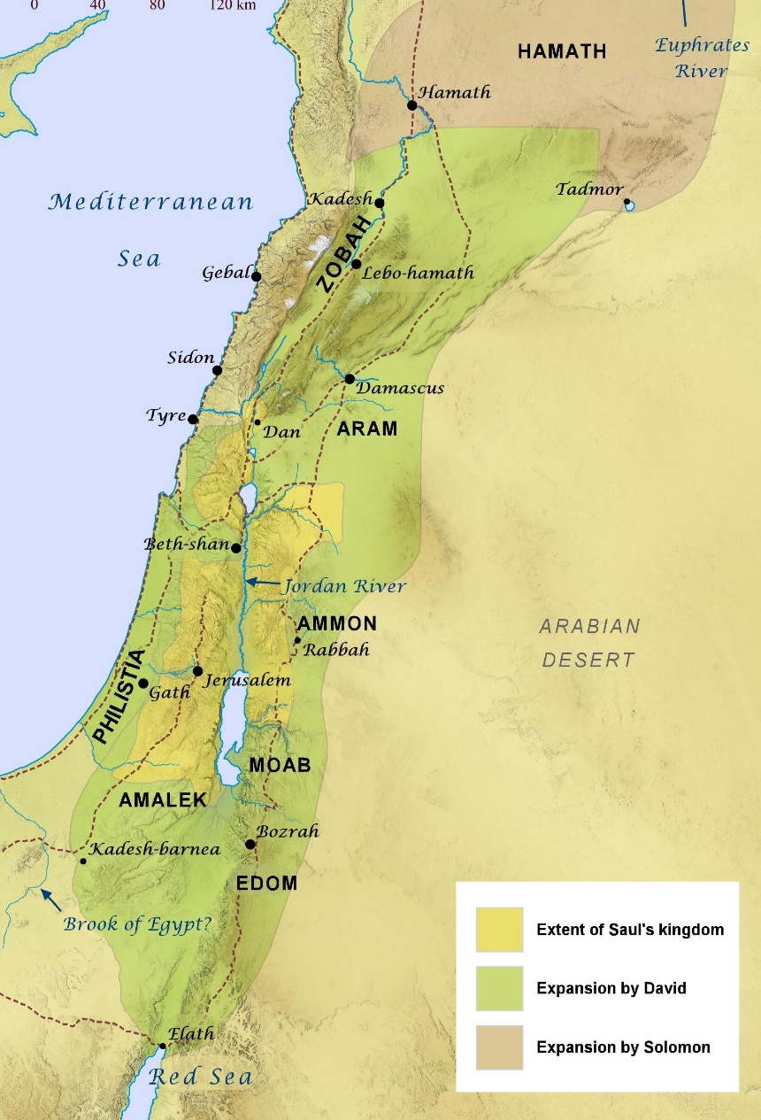
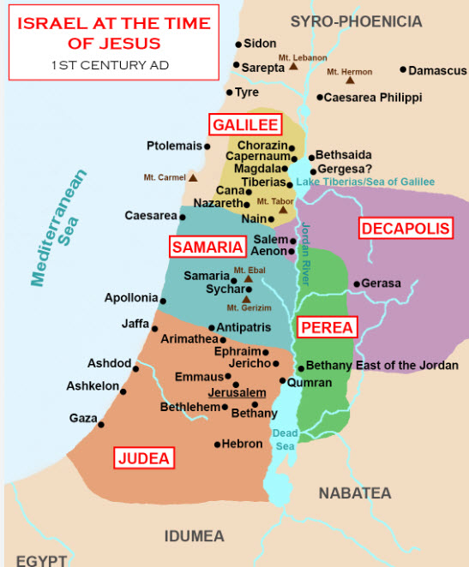
Geography of Israel in the Old and New Testaments

Slide 16
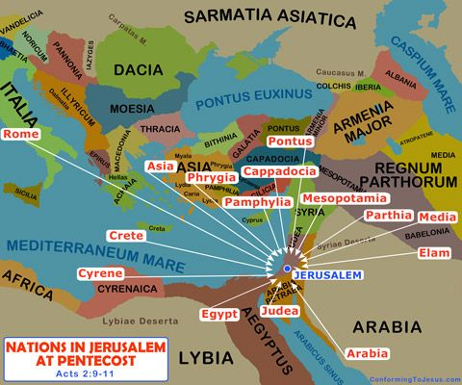
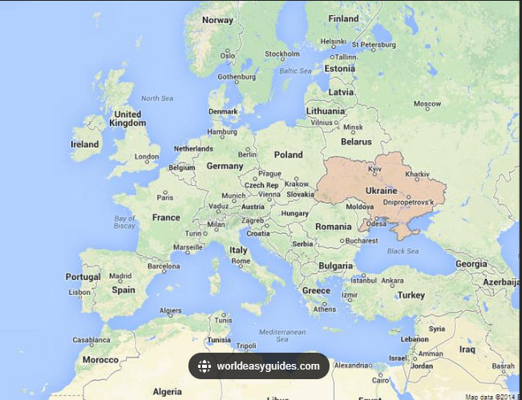
Geography at Pentecost ~33 A.D. vs. Present Day

Slide 17
Acts Outline
Prologue
The Witness to Jerusalem
The Witness to Judea and Samaria
The Witness to the Ends of the Earth
Acts 1:1–1:8
Acts 1:9–8:3
Acts 8:4–12:25
Acts13:1–28:31
Summary of first book to Theophilus
  Its content was about all Jesus began to do and teach.
  How Jesus left commands through the Holy Spirit for the apostles whom he had chosen.
  Jesus presented himself alive to them after his suffering by many convincing proofs.
Disciples asked if Jesus would now restore the kingdom to Israel
  It was not for them to know the times the Father has fixed.
  They would receive power when the Holy Spirit comes upon them to be Jesus’ witnesses.
The Anticipation of the Church
The Founding of the Church
The Growth of the Church
  Apostles: Preaching, healing, and enduring persecution
  Deacons: Praying, teaching, and enduring persecution
The Gospel to the Samaritans thru Philip, Peter, John
The Gospel to an Ethiopian Jew thru Philip
The Conversion of Saul
The Gospel to Judea thru Peter
The Gospel to a Gentile home in Caesarea thru Peter
The Persecution by Herod: James killed and Peter arrested
Paul’s First Missionary Journey
The Jerusalem Council
Paul’s Second Missionary Journey
Paul’s Third Missionary Journey
Paul’s Jerusalem and Caesarean Trials
Paul’s Journey to Rome (4th mission)

Slide 18
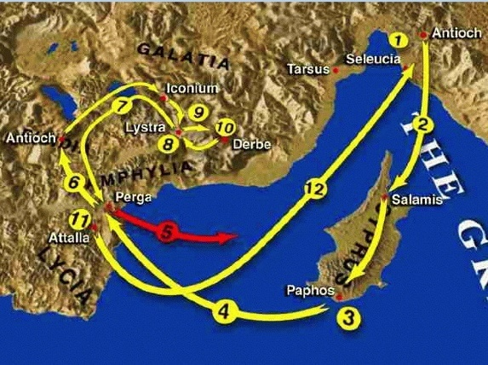
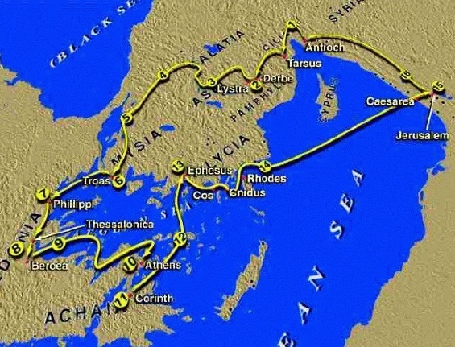
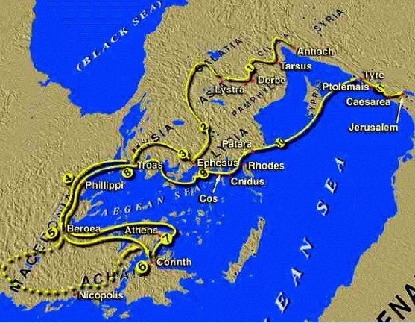
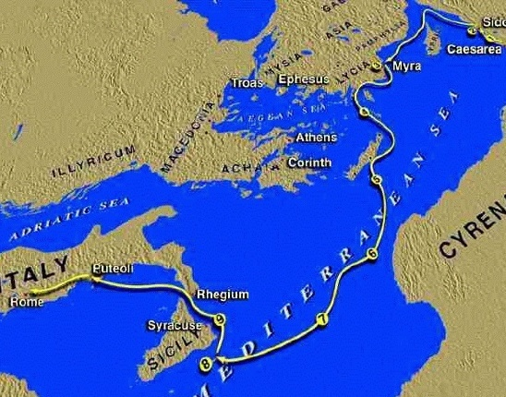
Paul’s 4th Missionary Journeys
1st Mission Journey
2nd Mission Journey
3rd Mission Journey
4th Mission Journey
Acts 13-14
Acts 15:36-18:22
Acts 18:23-20:38
Acts 23:11-28:31

Slide 19
Acts: Key Verses
Acts 1:1-3: “In the first book, O Theophilus, I have dealt with all that Jesus began to do and teach, until the day when he was taken up, after he had given commands through the Holy Spirit to the apostles whom he had chosen. He presented himself alive to them after his suffering by many proofs, appearing to them during forty days and speaking about the kingdom of God.”
Acts 1:6-8: “So when they had come together, they asked him, "Lord, will you at this time restore the kingdom to Israel?" He said to them, "It is not for you to know times or seasons that the Father has fixed by his own authority. But you will receive power when the Holy Spirit comes on you; and you will be my witnesses in Jerusalem, and in all Judea and Samaria, and to the ends of the earth.”
Acts 2:4-6: “And they were all filled with the Holy Spirit and began to speak in other tongues as the Spirit gave them utterance. Now there were dwelling in Jerusalem Jews, devout men from every nation under heaven. And at this sound the multitude came together, and they were bewildered, because each one was hearing them speak in his own language.”
Acts 4:10-12: “let it be known to all of you and to all the people of Israel that by the name of Jesus Christ of Nazareth, whom you crucified, whom God raised from the dead — by him this man is standing before you well. This Jesus is the stone that was rejected by you, the builders, which has become the cornerstone. And there is salvation in no one else, for there is no other name under heaven given among men by which we must be saved.”
Acts 4:19–20: “But Peter and John replied, ‘Judge for yourselves whether it is right in God’s sight to obey you rather than God. For we cannot help speaking about what we have seen and heard.’”
Acts 9:3–6: “As [Saul] neared Damascus on his journey, suddenly a light from heaven flashed around him. He fell to the ground and heard a voice say to him, ‘Saul, Saul, why do you persecute me?’ ‘Who are you, Lord?’ Saul asked. ‘I am Jesus, whom you are persecuting,’ he replied. ‘Now get up and go into the city, and you will be told what you must do.’”
Acts 11:9: “But [Peter explained] the voice answered a second time from heaven, ‘What God has made clean, do not call common.’”
Acts 11:18: “When they heard these things they fell silent. And they glorified God, saying, ‘Then to the Gentiles also God has granted repentance that leads to life.’"
Acts 16:30-31: “So they said, ‘Believe on the Lord Jesus Christ, and you will be saved.’ Then he brought them out and said, ‘Sirs, what must I do to be saved?’ And they said, ‘Believe in the Lord Jesus, and you will be saved, you and your household.’"

Slide 20
Acts: Study Questions
Read the passages below and write a couple of lines about the timing and events God used to declare Jesus’ message of salvation.
  Acts 1:1-11:
  Acts 2:1-13:
  Acts 2:37-41:
Refer to Peter’s sermon recorded in Acts 3:1-4:4 and answer the three questions below.
  What did Peter declare about God and his audience (Acts 3:12-15)?
  What did Peter testify concerning sin (Acts 3:14-18)?
  What did Peter say about judgment, salvation, and Jesus Christ (Acts 3:19-4:4)?
Who led the first Gentiles to faith in Jesus Christ and who became the primary minister to the Gentiles? (Need a hint? Look back at the slide on the book’s outline.)
Read Paul’s sermon recorded in Acts 17:22-34 and write a short bit of text on how he addresses topics similar to Peter’s sermon but to a Gentile audience in Athens.
  What did Paul affirm about God (Acts 17:22-25)?
  What did Paul say about God and mankind (Acts 17:26-28)?
  What did Paul declare about sin, judgment, and Jesus Christ (Acts 17:29-34)?

Slide 21
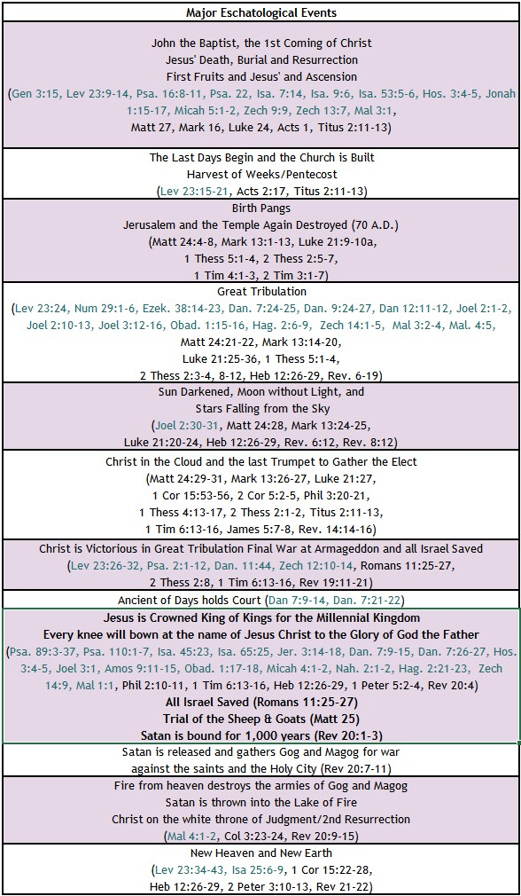


BIBLE ESCHATOLOGY
ACTS
Acts 1:1-3: “In the first book, O Theophilus, I have dealt with all that Jesus began to do and teach, until the day when he was taken up, after he had given commands through the Holy Spirit to the apostles whom he had chosen. He presented himself alive to them after his suffering by many proofs, appearing to them during forty days and speaking about the kingdom of God.”
Acts 2:4-6: “And they were all filled with the Holy Spirit and began to speak in other tongues as the Spirit gave them utterance. Now there were dwelling in Jerusalem Jews, devout men from every nation under heaven. And at this sound the multitude came together, and they were bewildered, because each one was hearing them speak in his own language.”
Acts 1:6-8: “So when they had come together, they asked him, "Lord, will you at this time restore the kingdom to Israel?" He said to them, "It is not for you to know times or seasons that the Father has fixed by his own authority. But you will receive power when the Holy Spirit comes on you; and you will be my witnesses in Jerusalem, and in all Judea and Samaria, and to the ends of the earth.”
Acts 2:37-41: "Now when they heard this they were cut to the heart, and said to Peter and the rest of the apostles, ‘Brothers, what shall we do?’ And Peter said to them, ‘Repent and be baptized every one of you in the name of Jesus Christ for the forgiveness of your sins, and you will receive the gift of the Holy Spirit. For the promise is for you and for your children and for all who are far off, everyone whom the Lord our God calls to himself.’ And with many other words he bore witness and continued to exhort them, saying, ‘Save yourselves from this crooked generation.’ So those who received his word were baptized, and there were added that day about three thousand souls."
Acts 1:10-11: “And as they were gazing intently into the sky while He was going, then behold, two men in white clothing stood beside them, 11and they said, 'Men of Galilee, why do you stand looking into the sky? This Jesus, who has been taken up from you into heaven, will come in the same way as you have watched Him go into heaven .”

Slide 22
Summary of Acts
Brief Summary: The book of Acts records the deeds of the Holy Spirit of Jesus Christ through his apostles, prophets, and disciples after his ascension to the Father’s right hand. It is the second account attributed to Luke, a physician and missionary companion of the apostle Paul, and addressed to a man called Theophilus. The opening of the book explains that after Jesus’ resurrection he spent 40 days appearing to his disciples with many convincing proofs, teaching them and giving them commands through the Holy Spirit. At the end of this period, the disciples reasonably asked Jesus if he would at this time restore the kingdom to Israel. Jesus answered it was not for them to know the appointed times the Father has set by His authority; instead, they were to be Jesus’ witnesses in Jerusalem, Judea, Samaria, and the remotest parts of the earth. After saying these things, Jesus was taken into heaven (Acts 1:1-11).
In fulfillment of Jesus’ last words to his beloved disciples, the Holy Spirit began his acts to empower and move in the disciples to take the good news of Jesus Christ through Jerusalem, Judea, Samaria, and to the ends of the earth. The first major event occurred on God’s holy festival known as the Harvest of Weeks when Jews from the surrounding provinces had returned to Jerusalem. This festival per God’s timetable occurred 50 days after Passover (i.e., Pentecost). On the Pentecost immediately following Jesus’ ascension into Heaven, the Holy Spirit gave the disciples the gift of multiple languages to draw the attention of Jews and proselytes who were there from these surrounding provinces, and Peter preached his first sermon through which God saved 3,000 souls (Acts 2:1-41). From this miraculous beginning the book of Acts records the Holy Spirit’s mighty deeds as He continued to increase and strengthen the assembly of God (aka the Church) and lay its foundations. Included among these crucial activities were:
  The martyrdom of Stephen (Acts 6:8-8:4) and the scattering of the disciples who preached to Jews in many nations (Acts 11:19) including Philip who first preached to those in Samaria and to an Ethiopian Jew (Acts 8:5-39).
  Peter’s sermon to Cornelius, the first Gentile, and the Holy Spirit authenticating the salvation of these Gentiles by visually manifesting His presence in them through the speaking of languages recognizable to the Jews who heard them exalting God (Acts 10:1-48).
  Jesus’ appearance to Saul of Tarsus, his conversion, and his ministry to the Gentiles (Acts 9:1-16). Saul, whose Greek name was Paul, empowered by the Spirit carried the gospel to Jews and Gentiles through four missionary journeys culminating in Jerusalem and then Rome. Through Paul’s ministry the Holy Spirit emphasized the pre-eminence of the baptism of Jesus Christ over the baptism of John (Acts 19:1-7) and eventually, inspired Paul to write thirteen epistles.
The work of the Holy Spirit of Jesus Christ continues to all generations as believers faithfully carry the gospel message transferred to us through the Holy Scriptures inspired and preserved by God through his Prophets and Apostles with Jesus as the chief cornerstone.
Connections: The disciples' question concerning the timing for the kingdom to be restored to Israel connects back to God's promise that the throne of David would be an everlasting one established under Messiah.¹ In addition, the disciples received power from the Holy Spirit on the Pentecost after Jesus' ascensions, which connects back to God's timetable in the Feast of Harvest (Leviticus 23:15-22, Acts 2:1-41). Acts records Old Testament quotes in Peter’s sermon and makes frequent use of the Old Testament.² Lastly, the salvation of the 3,000 souls at this Feast of Harvest sermon causes us to reflect on the 3,000 souls who were lost at Mount Sinai when Israel sinned against God with the golden calf (Exodus 32:28). God is indeed a Redeemer.
Notes:
¹ For examples see Isaiah 9:6-7, Daniel 7:9-15, Psalm 110, Mark 14:61-62, Acts 1:10-11
² For examples, compare Acts 2:17–21 (Joel 2:28–32); Acts 2:25–28 (Ps. 16:8–11), Acts 2:35 (Ps. 110:1); Acts 4:11(Ps. 118:22); Acts 4:25–26 (Ps. 2:1–2); Acts 7:49–50 (Isa. 66:1–2)

Slide 23
Acts: Practical Application
Practical Application: God does amazing things through ordinary people when He empowers them through the Holy Spirit of Jesus Christ. The book of Acts records the deeds of the Holy Spirit through Jesus’ disciples to carry the good news to Jerusalem, Judea, Samaria, and the ends of the known world of that time. This historical account gives us details about the sermons, miracles, and work of Peter, John, Stephen, Philip, Barnabas, Paul, and numerous others, through whom the Holy Spirit brought salvation to many. God used common place men and women and even a converted Christian-hating Pharisee named Saul to accomplish his will. God also worked through persecution as in the death of Stephen, for example, to scatter the believers and rapidly expand the borders of His Church.
Jesus promised he would build His Church, and the gates of Hades would not overpower it. This same power to be make disciples for Jesus Christ teaching them to obey all that He has commanded is available to us today. Our part is to prayerfully study God’s word and obediently submit to the leading of the Holy Spirit who is at work in us to will and to do for His good purpose (Philippians 2:13).
If we try to accomplish God’s work in the world in our own power, we will fail. Like the disciples in Acts 2, we must faithfully proclaim the gospel, trust God for the results, and devote ourselves “to the apostles’ teaching and to fellowship, to the breaking of bread and to prayer” (Acts 2:42).

Slide 24
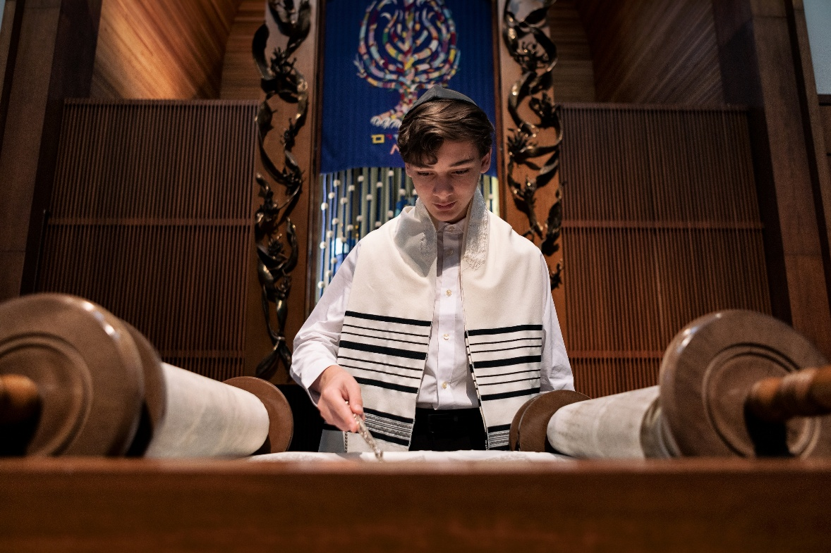
Closing Prayer Verse
Acts 17:10-11, “The brothers immediately sent Paul and Silas away by night to Berea, and when they arrived, they went into the Jewish synagogue. Now these Jews were more noble than those in Thessalonica; they received the word with all eagerness, examining the Scriptures daily to see if these things were so.”

Slide 25
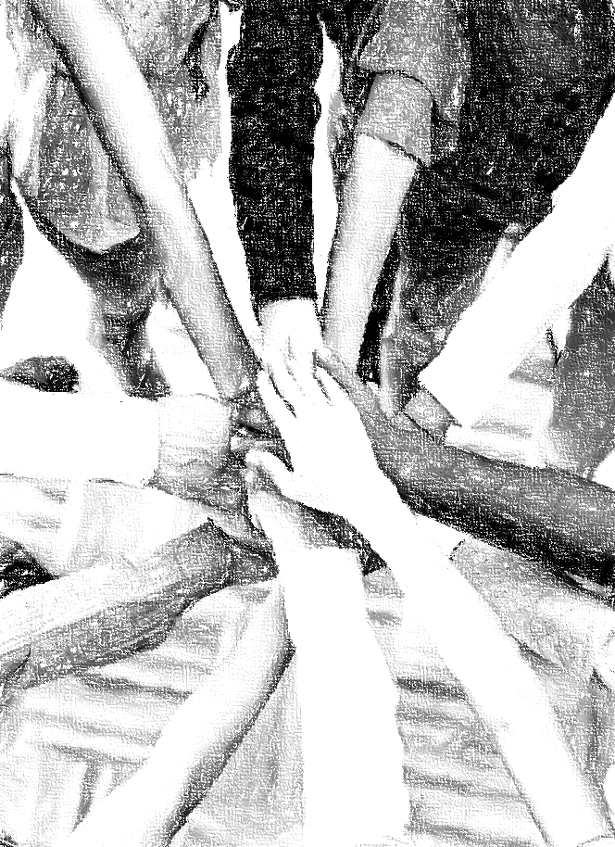
Acknowledgements
Background, Setting, Outlines, some Study Question answers, interpretative challenges, and some Summaries: Adapted from John MacArthur Study Bible at GTY.org.
Key verses, Practical Application, some Study Question answers, and some Summaries: Adapted from GotQuestions.org.
Inductive Bible Study Method: Adapted from Precept.org.
Creation – Consummation Icons: Adapted from AnswersInGenesis.org.
Definitions: Adapted from Websters 1828 Dictionary.

Slide 26
Study Leader Assistance
Sample Prayers
Study Question Answer Keys

Slide 27
Sample Opening Prayer Verse: Acts
Acts 2:37-41: "Now when they heard this they were cut to the heart, and said to Peter and the rest of the apostles, ‘Brothers, what shall we do?’ And Peter said to them, ‘Repent and be baptized every one of you in the name of Jesus Christ for the forgiveness of your sins, and you will receive the gift of the Holy Spirit. For the promise is for you and for your children and for all who are far off, everyone whom the Lord our God calls to himself.’ And with many other words he bore witness and continued to exhort them, saying, ‘Save yourselves from this crooked generation.’ So those who received his word were baptized, and there were added that day about three thousand souls."
Sample Prayer: Dear Heavenly Father, thank you for providing a Way for us to return to You and be forgiven our offenses against You through Jesus Christ, your Son. Thank you for the Holy Spirit who convicts us of our sins, grants us godly sorrow, causes us to be born again, and dwells within us. Teach us Father to hallow your name and to speak to our children and those you have put in our circles of influence about this great salvation so that they too are cut to the heart and want to know how to be forgiven. We ask this in Jesus’ name. Amen

Slide 28
Acts: Study Question Answers
Read the passages below and write a couple of lines about the timing and events God used to declare Jesus’ message of salvation.
  Acts 1:1-11: Answer: For forty days after Jesus’ resurrection he appeared to many discples with convincing proofs. He taught them and gave them commands through the Holy Spirit to enable them to be his witnesses. Then Jesus ascended into Heaven before their eyes. All these things connected back to the holy days God had established in the Old Testament around the feast of Unleavened Bread. Jesus was crucified on God’s Passover and raised from the dead on God’s Firstfruits holy day (see Luke 22:7, Lev 23:4-14, Matt 27:52-53, 1 Cor 15:23). Both Passover (Christ’s death) and Firstfruits (Christ’s resurrection) occurred during the week-long festival of Unleavened Bread. Today non-Jewish believers refer to the holy days of Passover and Firstfruits as Good Friday and Easter, respectively.
  Acts 2:1-13: Answer: Pentecost means fiftieth day. It was the time God had established among the Jewish holy days known as the Feast of Harvest. Thus, fifty days after Jesus’ resurrection (i.e., 10 days after his ascension), the disciples received power from the Holy Spirit to be Jesus’ witnesses and bring in a harvest (see Lev 23:15-22).
  Acts 2:37-41: Answer: At God’s Feast of Harvest (i.e., Pentecosst) after Jesus’ ascension, Peter, by the power of the Holy Spirit, preached a sermon to the Jews who had come to the festival from many surrounding nations. Through Peter’s preaching, God granted conviction and repentance reaping a salvation harvest of 3,000 souls.
Refer to Peter’s sermon recorded in Acts 3:1-4:4 and answer the three questions below.
  What did Peter declare about God and his audience (Acts 3:12-15)? Answer: Speaking to a Jewish audience who had the knowledge of the Old Testament, Peter stated that the “God of Abraham, Isaac, and Jacob” had glorified Jesus. Further he referred to Jesus as the Holy and Righteous One and the Author of Life. He said to the people that they were guilty of denying, disowning, and killing the Author of Life whom God raised from the dead.
  What did Peter testify concerning sin (Acts 3:14-18)? Answer: Though the people sinned by denying and disowning the Author of Life before Pilate, they acted in ignorance.
  What did Peter say about judgment, salvation, and Jesus Christ (Acts 3:19-4:4)? Answer: He told the people to repent and return to God that He may send Jesus, whom heaven has received until the period of restoration spoken of by the prophets. He told them God had raised up Jesus to bless them and turn them from their wickedness. And though some of the rulers had Peter and John arrested, God added 5,000 believers to their number that day.
Who led the first Gentiles to faith in Jesus Christ and who became the primary minister to the Gentiles? (Need a hint? Look back at the slide on the book’s outline.) Answer: The Apostle Peter was the first to present the gospel to Gentiles in the home of Cornelius in Caesarea. This led to some initial dissension in the Jerusalem church. But when the assembly realized this was God’s hand, they gave him glory (Acts 10:11-18). Saul, whose Greek name was Paul, later became the primary apostle to the Gentiles (Acts 9:10-16).
Read Paul’s sermon recorded in Acts 17:22-34 and write a short bit of text on how he addresses topics similar to Peter’s sermon but to a Gentile audience in Athens.
  What did Paul affirm about God (Acts 17:22-25)? Answer: Speaking to a Gentile audience with no knowledge of the Old Testament, Paul started from the beginning and proclaimed the God who made the world and everything in it; who needs nothing since he himself gives to all mankind life, and breath, and everything.
  What did Paul say about God and mankind (Acts 17:26-28)? Answer: Paul further explained that God made from one man every nation of mankind to live on all the face of the earth, having determined their allotted periods and the boundaries of their dwelling place that they should seek God; though they had not.
  What did Paul declare about sin, judgment, and Jesus Christ (Acts 17:29-34)? Answer: Paul stated that God had overlooked the times of ignorant idolatry, but now God commands all people everywhere to repent, because he has fixed a day on which he will judge the world in righteousness by a man whom he has appointed, Jesus Christ. Some mocked but others joined him and believed.

Slide 29
Sample Closing Prayer Verse
Acts 17:10-11, “The brothers immediately sent Paul and Silas away by night to Berea, and when they arrived, they went into the Jewish synagogue. Now these Jews were more noble than those in Thessalonica; they received the word with all eagerness, examining the Scriptures daily to see if these things were so.”
Sample Prayer: Dear Heavenly Father, thank you for all you have recorded for us in the book of Acts concerning how the Holy Spirit worked through Jesus’ disciples to carry the good news to Jerusalem, Judea, Samaria, and the known world of that time. Thank you for the example of the Jews in Berea who eagerly examined the Scriptures to see if the things the apostles were teaching them were true. Make us like these noble Bereans that we too would excitedly search your Word to know You and the things that please you. Cause us to be both hearers and doers of your Word. We ask these things in Jesus’ name. Amen.

