Slide 1
LUKE
Book 42

Slide 2
What is the Holy Bible?
The Holy Bible is a collection of writings that includes 66 books in English editions. The Bible consists of two parts, the Old Testament and New Testament. The word testament means covenant. The Old Testament includes 39 books, and the New Testament includes 27 books.
These 66 books were written over approximately 1,400 years by 40 different authors in Hebrew, Aramaic, and Greek. The Old Testament writings were affirmed by Jewish leaders, and moreover, by Jesus Christ.¹ The New Testament writings were confirmed by early church leaders. The 66 books of the Bible are the inspired words of God that are used to make and mature disciples of the One true God through Jesus Christ, his Son (Matthew 28:18-20, 2 Timothy 3:16-17). The Bible was not created by mere human wisdom but was inspired by God (2 Peter 1:20-21), is interpreted by His Holy Spirit (John 16:13, Matthew 23:8-10), and will last forever (Matthew 24:35).²
If you do a phrase search on the Bible you will find the phrase "the word of the Lord" and "Thus says the Lord" more than 700 times.³ In addition, this book has given reasonable evidence to the claim of being God’s word by:​
  providing answers that conform with the reality we see around us.
  being a reliable collection of historical documents.
  containing eyewitness accounts that were written during the lifetimes of other eyewitnesses.
  recording supernatural events that took place in fulfillment of specific prophecies.⁴
Notes:
¹ See Matthew 4:4-7, 12:3-5, Mark 7:6-7, 12:26-27, and Luke 19:46 for examples.
^{2 “}What are the Books of the Bible”, GotQuestions.org
³ Blue Letter Bible
⁴ Paraphrased from Voddie Baucham

Slide 3
Our Goals in Studying the Bible
To better …..
Understand the Only true God; the Author of the Bible. (2 Timothy 3:16-17, 2 Peter 1:20-21, 1 John 5:20 , Jeremiah 9:23-24)
Learn How He works in the World and in our Lives. (Job 40:6-14, Isaiah 45:6-7, Isaiah 46:8-10, Philippians 2:12-13)
Understand Ourselves and the Hearts of Mankind. (Jeremiah 17:9, 2 Timothy 3:13, Ephesians 5:7-10)
Come to Know What Pleases and Grieves God. (1 Thessalonians 4:1, Ephesians 4:26-31, Hebrews 11:6, 1 Peter 1:14-19)
To be Transformed into Fruitful Doers of God’s Word and not just Hearers. (Romans 12:2, James 1:27, Matthew 3:8)
Tether Ourselves to God’s Word for Our Wisdom, Discernment, and Safety. (1 Corinthians 6:9-10, Matthew 24:24, Ephesians 4:11-14)
Jeremiah 9:23-24 “Thus says the Lord: "Let not the wise man boast in his wisdom, let not the mighty man boast in his might, let not the rich man boast in his riches, but let him who boasts boast in this, that he understands and knows me, that I am the Lord who practices steadfast love, justice, and righteousness in the earth. For in these things I delight, declares the Lord."

Slide 4
How to Study the Bible
#1. Observation: What does the text say.
Who?
What?
When?
Where?
How?
Why?
#2. Interpretation: What does the text mean in context with the passage, book, and whole counsel of God?
#3. Application: How is the Holy Spirit instructing me to apply this understanding at this time in my life?

Slide 5
Study Resources
Opening Prayer
Background and Setting
Book Outline
Geography Maps
Key Verses
Study Questions
Major Event Timeline
Book Summary
Application and Closing Prayer
Study Leader Support Slides

Slide 6

Opening Prayer Verse: Luke
Luke 1:1-4, “Inasmuch as many have undertaken to compile a narrative of the things that have been accomplished among us, just as those who from the beginning were eyewitnesses and ministers of the word have delivered them to us, it seemed good to me also, having followed all things closely for some time past, to write an orderly account for you, most excellent Theophilus, that you may have certainty concerning the things you have been taught.”

Slide 7
Review of Mark
Brief Summary: The book of Mark opens with a proclamation of its content, “The beginning of the gospel of Jesus Christ, the Son of God.” Mark’s record starts at “the beginning” of Jesus’ ministry with his forerunner, John the Baptist. John prepared the way of the Lord by calling people to repentance and baptizing them with water in the wilderness (Mark 1:1-4). It was through John’s ministry, that our Lord Jesus was baptized and ordained by the Holy Spirit descending on him like a dove and the Father’s declaration from heaven (Mark 1:9-11).
After Jesus’ baptism and victory over the wilderness temptations, He began His public ministry in Galilee and called the first four of His disciples (Mark 1:17-20). As Jesus’ following grew, these four men along with eight others were named as his Apostles (Mark 3:13-19) from among his disciples. What follows is the record of Jesus’ ministry in Israel and various Gentile regions (Mark 1:14-10:52). He touched the lives of many people, but He left an enduring impact on His disciples. At the transfiguration (Mark 9:1-9) and the Olivet Discourse (Mark 13), Jesus gave the disciples a preview of His future return in power and glory.
While Mark’s gospel incudes information similar to Matthew about the same people, places, sermons and events, Mark’s focus is on the authority and power of Jesus Christ: the Son of God, the Son of Man, the Son of David, King of the Jews; to whom we are to listen in order to enter the Kingdom of God, do the will of God, and understand the things to come.¹ Mark uses the word immediately 37 times in conjunction with key events and the miraculous works of Jesus. For example, while God granted the power to Elijah and Elisha to even resurrect the dead, these miracles were not immediate, and the power that came was clearly not from within them (see 1 Kings 17 and 2 Kings 4:8-37). The miraculous works of Jesus, the Son of God, were immediate and from Power within Him. Mark highlights this immediate and sovereign power over nature, sickness, handicaps, death, and even more so, over the demonic world. Demons, unclean spirits and Satan are mentioned over 30 times in Mark’s writings demonstrating Jesus’ victorious power over them and their subjection to Him. The account tells us that those who witnessed the work of Jesus Christ were amazed and astonished.
However, most of the Jewish leaders (chief priests, scribes, and elders) opposed Jesus, and refused to repent of the sin He exposed in them. And after his Messianic entry into Jerusalem (Mark 11:1-11), they plotted to kill the Son of God and delivered him over to Pilate to be crucified (Mark 14:43-15:41). But what they meant for evil, our Lord planned for our good to give his life as a ransom for us (Mark 10:45). Victoriously, Jesus took up his life again from the grave on the third day with our ransom secured as he foretold (Mark 8:31, 9:31). His resurrection was proclaimed by the angels at the tomb, and he appeared to many witnesses with convincing proofs.²
Connections: Mark does not quote as frequently from the Old Testament as Matthew, who was writing primarily to the Jews. He does not begin with a genealogy to link Jesus with the Jewish patriarchs or to Adam, but begins instead with His baptism, the beginning of His earthly ministry. There Mark quotes from an Old Testament prophecy regarding the messenger—John the Baptist—who would exhort the people to “prepare the way for the Lord” (Mark 1:1-4; Isaiah 40:3, Malachi 3:1) as they awaited the coming of their Messiah. Mark also includes connections back to Isaiah and Psalms.³
Notes:
¹ Mark 1:1, 2:10, 2:28, 10:47-48, 15:2, 9:7
² Mark 16:1-8, John 20:11-29, Acts 1:3, 1 Corinthians 15:1-8
³ Compare Mark 4:11-12 with Isaiah 6:9-10; Compare Mark 7:6-7 with Isaiah 29:13, Compare Mark 12:10-11 with Psalm 118:22-23

Slide 8
New Testament Table of Contents (27 Books)
THE GOSPELS & ACTS - 5
MATTHEW
MARK
LUKE
JOHN
ACTS
PAUL’S LETTERS TO CHURCHES - 9
ROMANS
1 CORINTHIANS
2 CORINTHIANS
GALATIANS
EPHESIANS
PHILIPPIANS
COLOSSIANS
1 THESSALONIANS
2 THESSALONIANS
PAUL’S LETTERS TO INDIVIDUALS - 4
1 TIMOTHY
2 TIMOTHY
TITUS
PHILEMON
LETTERS BY OTHERS – 9
HEBREWS
JAMES
1 PETER
2 PETER
1 JOHN
2 JOHN
3 JOHN
JUDE
REVELATION

Slide 9
New Testament Books by Date Written
James:
45-50 A.D.
Galatians:
49-55 A.D.
1 Thess:
51 A.D.
2 Thess:
52 A.D.
1 Cor:
53-55 A.D.
2 Cor:
55-56 A.D.
Mark:
55-60 A.D.
Matthew:
55-65 A.D.
Romans:
57-58 A.D.
Luke:
60 A.D.
1 & 2 Peter: 60-65 A.D.
Jude:
60-70 A.D.
Ephesians: 60-61 A.D.
Philippians: 60-61 A.D.
Colossians: 61 A.D.
Philemon:
61 A.D.
Titus:
62-67 A.D.
1 Timothy:
63-66 A.D.
Acts:
65 A.D.
Hebrews:
65 A.D.
2 Timothy:
67 A.D.
John:
85-90 A.D.
1, 2 & 3 John:
85-95 A.D.
Revelation: 90-95 A.D.

Slide 10


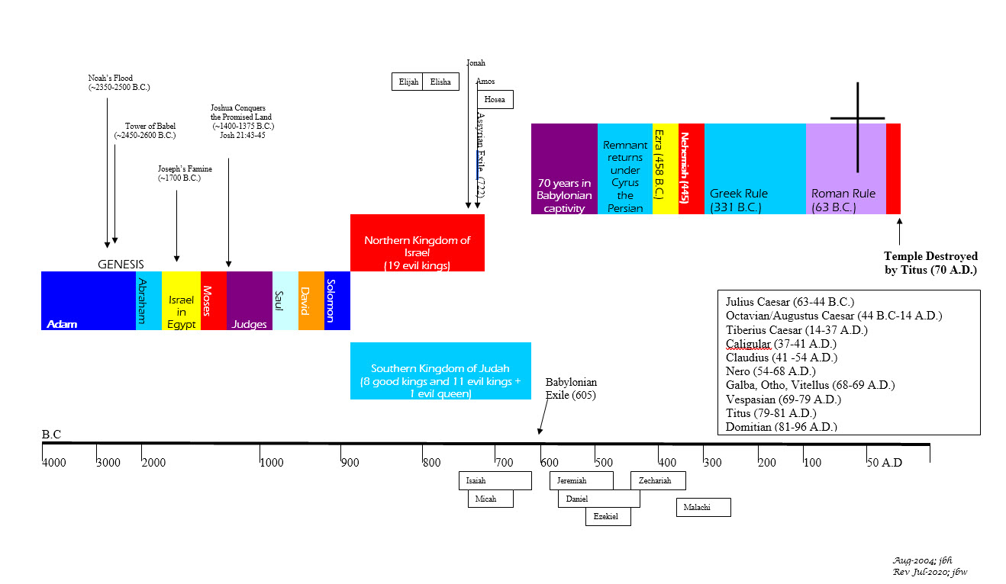





BIBLICAL CHRONOLOGICAL BACKGROUND
OT
Cyrus the Great (Cyrus II)
Darius the Mede
Darius I
Xerxes I (Esther and Mordecai)
Artaxerxes I
NT
Jehu (1 Kings 16:7)
Micaiah: (1 Kings 22:8)
Huldah: (2 Kings 22:14)
Obed (2 Chr 28:9)
Job
Daniel 9:25-26
Prophets after Noah into the United Kingdom:
Abraham:
Moses:
Samuel:
Gad:
Nathan:
Ahijah
Asaph
(Gen 20:7)
(Exo 3:10)
(1 Sam 3:20)
(1 Sam 22:5)
(2 Sam 7:2)
(1 Kings 11:29)
(2 Chron 35:15)
Haggai
Mosaic Law and Covenant
Law of sin & death, the letter kills
Ministry of condemnation carved in stone
Glory fading away
Shemaiah: (2 Chr 12:15)
Iddo: (2 Chr 12:15)
Hanani: (2 Chr 16:7)
Jehu: (2 Chr 19:2)
Jeduthun: (2 Chr 35:15)
New Covenant of Jesus Christ
The Law of the Spirit of life
Ministry of righteousness on hearts
Eternal and exceeding in glory
Timeline is not to scale

Slide 11
Luke
Author: Luke
Date of Writing: c. 60 A.D.

Slide 12
About this Gospel and Its Author - LUKE
As with the other three Gospels, the title is derived from the author’s name. According to tradition, Luke was a Gentile. The apostle Paul seems to confirm this, distinguishing Luke from those who were “of the circumcision” (Colossians 4:11-14). That would make Luke the only Gentile to pen any books of Scripture. He is responsible for a significant portion of the New Testament, having written both this Gospel and the book of Acts.
Very little is known about Luke. He almost never included personal details about himself, and nothing definite is known about his background or his conversion. Two early church leaders, Eusebius of Caesarea (c. 260 A.D.–c. 340 A.D.) and Jerome of Dalmatia (345 A.D.), identified Luke as a native of Antioch, which may explain why so much of the book of Acts centers on Antioch.¹
The Gospel of Luke and the book of Acts clearly were written by the same individual (cf. Luke 1:1-4; Acts 1:1). Although he never identified himself by name, it is clear from his use of “we” in many sections of Acts that he was a close companion of the apostle Paul.² Luke is the only person, among the colleagues Paul mentions in his own epistles, who fits the profile of the author of these books.³ That accords perfectly with the earliest tradition of the church, which unanimously attributed this Gospel to Luke.
Luke and Acts appear to have been written at about the same time—Luke first, then Acts. Combined, they make a two-volume work addressed to “Theophilus” (Luke 1:3; Acts 1:1) giving a sweeping history of the founding of Christianity, from the birth of Christ to Paul’s imprisonment under house arrest in Rome (Acts 28:30-31). Luke’s style is that of a scholarly, well-read author. He wrote as a meticulous historian, often giving details that helped identify the historical context of the events he described. ⁴
The book of Acts ends with Paul still in Rome, which leads to the conclusion that Luke wrote these books from Rome during Paul’s imprisonment there (c. 60–62 A.D.). Luke records Jesus’ prophecy of the destruction of Jerusalem in 70 A.D. but makes no mention of the fulfillment of that prophecy, either here or in Acts.⁵ Luke made it a point to record such prophetic fulfillments (cf. Acts 11:28), so it is extremely unlikely he wrote these books after the Roman invasion of Jerusalem. Acts also includes no mention of the great persecution that began under Nero in 64 A.D. In addition, many scholars set the date of James’ martyrdom at 62 A.D., and if that was before Luke completed his history, he certainly would have mentioned it. So, the most likely date for this Gospel is 60 or 61 A.D.
Notes:
¹ cf. Acts 11:19-27; 13:1-3; 14:26; 15:22-23, 15:30-35; 18:22-23
² Acts 16:10-17; 20:5-15; 21:1-18; 27:1-28:16
³ Colossians 4:14; 2 Timothy 4:11; Philemon 24
⁴ Luke 1:5; 2:1-2; 3:1–2; 13:1-4
⁵ Luke 19:42-44; Luke 21:20-24

Slide 13
Luke: Background and Setting
Luke dedicated his works to “most excellent Theophilus” (lit., “lover of God”—Luke 1:3; cf. Acts 1:1). This designation, which may be a nickname or a pseudonym, is accompanied by a formal address (“most excellent”)—possibly signifying that “Theophilus” was a well-known Roman dignitary, perhaps one of those who had turned to Christ in “Caesar’s household” (Philippians 4:22).
It is almost certain, however, that Luke envisioned a much broader audience for his work than this one man. The dedications at the outset of Luke and Acts are like the formal dedication in a modern book. They are not like the address of an epistle.
Luke expressly stated that his knowledge of the events recorded in his Gospel came from the reports of those who were eyewitnesses (Luke 1:1–2)—strongly implying that he himself was not an eyewitness. It is clear from his prologue that his aim was to give an ordered account of the events of Jesus’ life, but this does not mean he always followed a strict chronological order in all instances.
By acknowledging that he had compiled his account from various extant sources, Luke was not disclaiming divine inspiration for his work. The process of inspiration never bypasses or overrides the personalities, vocabularies, and styles of the human authors of Scripture. The unique traits of the human authors are always indelibly stamped on all the books of Scripture. Luke’s research is no exception to this rule. The research itself was orchestrated by divine providence. And in his writing, Luke was moved by the Spirit of God (2 Peter 1:21). Therefore, his account is infallibly true.

Slide 14
Luke: Outline
Prelude to Christ’s Ministry
The birth of Jesus
Annunciation to Zechariah
Announcement to Mary
The birth of the forerunner
The nativity
The Boyhood of Jesus
In Nazareth
In the temple
The Baptism of Jesus
John the Baptist
Heaven’s Testimony
Christ’s Genealogy
Christ’s Temptation
Journey to Jerusalem
Samaria
A village turns him away
He turns away the half-hearted
He sends out the seventy
The parable of the Good Samaritan
Bethany and Judea
Mary and Martha
The Lord’s prayer
The importance of persistence; the impossibility of neutrality
Woes upon Pharisees and scribes
Lessons on hypocrisy, materialism, worry
Perea
Testing/Teaching the Pharisees on the Sabbath and humility
Teaching to the multitudes on the cost of discipleship
Teachings in parables: lost sheep, coin, son, rich man and Lazarus
Lessons on forgiveness, faithfulness, thankfulness, readiness
Consummation of Christ’s Ministry
The Resurrection
The Road to Emmaus
The Ascension
Luke 1:1-4:13
Luke 4:14–9:50
Luke 9:51–19:27
Luke 19:28–23:56
Luke 24:1–53
Ministry in Galilee
The Ministry in Galilee
The Commencement of His Ministry
Nazareth and Capernaum
A demon cast out; Multitudes healed
The Calling of His Disciples
Forgiving sins
The gospel for sinners not the righteous
The Twelve
The Continuation of His Work
Beatitudes and Woes
Healing the sick; raising the dead
He stills the winds and waves
Delivers demoniacs; feeds the multitude
He predicts his crucifixion; unveils his glory
Passion Week
The triumphal entry and the temple
Jesus hailed as the King who comes in the name of the Lord
Christ weeps over the city and cleanses the temple
Teachings and Contentions
He teaches the Passover crowds
He contends with the Jewish rulers
He silences the rulers on paying taxes and the resurrection
A prophecy about the destruction of Jerusalem
Some signs of the times and His Second Coming
That Final Night
The Lord’s Supper and the New Covenant
The agony in the garden
Judas' betrayal, Jesus’ arrest, Peter's denial
Jesus mocked, beaten, put on trial, crucified and buried

Slide 15
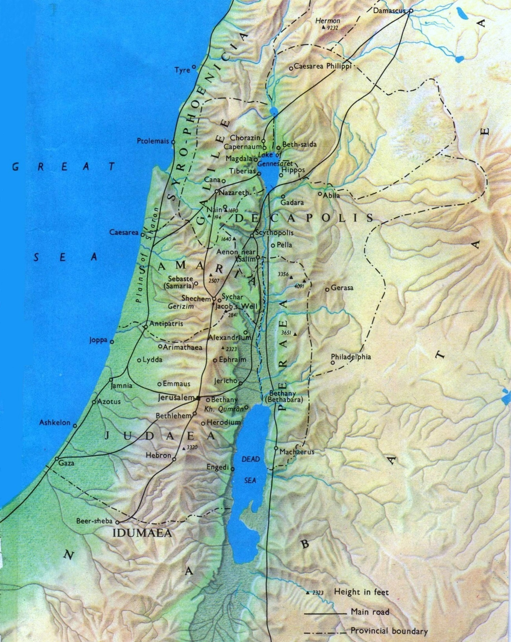
Geography for New Testament
Israel

Slide 16
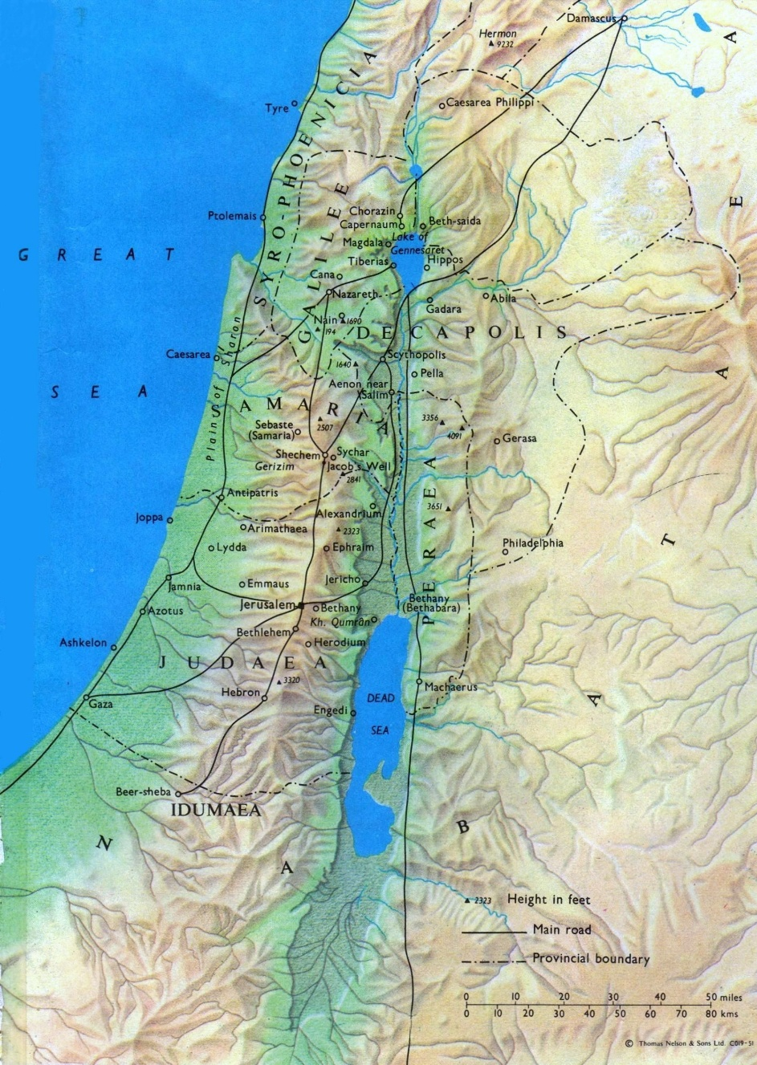
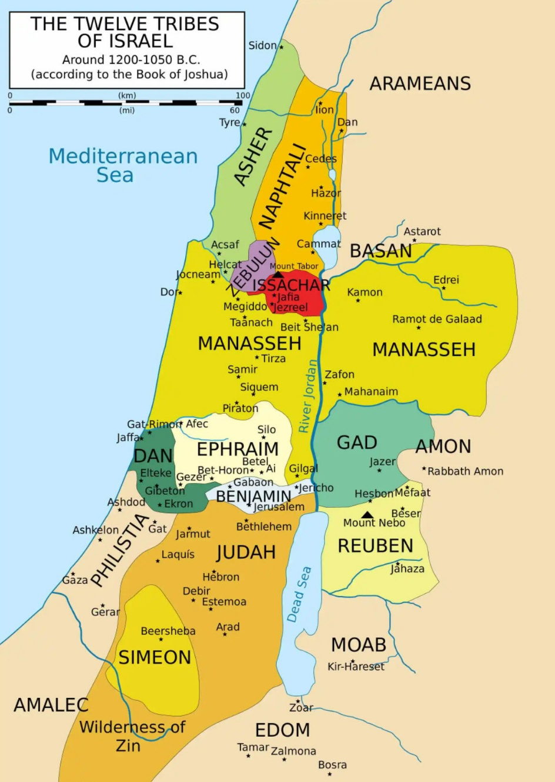
Comparison of Israel During Jesus’ and Joshua’s Lives
Israel During Jesus’ 1st Coming
Israel During Joshua’s Life

Slide 17
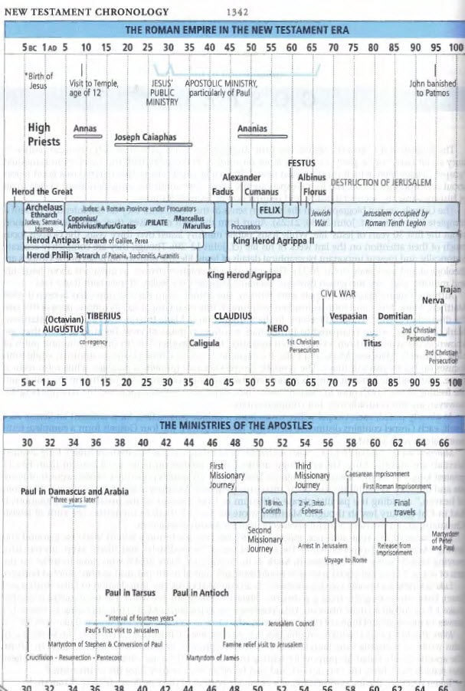
Luke’s Historical References

Slide 18
Luke: Key Verses
Luke 1:1-4: “Inasmuch as many have undertaken to compile a narrative of the things that have been accomplished among us, just as those who from the beginning were eyewitnesses and ministers of the word have delivered them to us, it seemed good to me also, having followed all things closely for some time past, to write an orderly account for you, most excellent Theophilus, that you may have certainty concerning the things you have been taught.”
Luke 2:4-7: “So Joseph also went up from the town of Nazareth in Galilee to Judea, to Bethlehem the town of David, because he belonged to the house and line of David. He went there to register with Mary, who was pledged to be married to him and was expecting a child. While they were there, the time came for the baby to be born, and she gave birth to her firstborn, a son. She wrapped him in cloths and placed him in a manger, because there was no room for them in the inn.”
Luke 3:16, 3:21-22, "John answered them all, 'I baptize you with water. But one more powerful than I will come, the thongs of whose sandals I am not worthy to untie. He will baptize you with the Holy Spirit and with fire.’ Now when all the people were baptized, and when Jesus also had been baptized and was praying, the heavens were opened, and the Holy Spirit descended on him in bodily form, like a dove; and a voice came from heaven, "You are my beloved Son; with you I am well 0pleased."
Luke 4:18-20: “‘The Spirit of the Lord is on me, because he has anointed me to preach good news to the poor. He has sent me to proclaim freedom for the prisoners and recovery of sight for the blind, to release the oppressed, to proclaim the year of the Lord’s favor.’ And he rolled up the scroll and gave it back to the attendant and sat down. And the eyes of all in the synagogue were fixed on him. Today this scripture is fulfilled in your hearing."
Luke 18:31-33: “Jesus took the Twelve aside and told them, ‘We are going up to Jerusalem, and everything that is written by the prophets about the Son of Man will be fulfilled. He will be handed over to the Gentiles. They will mock him, insult him, spit on him, flog him and kill him. On the third day he will rise again.’"
Luke 22:17-20: “And he took a cup, and when he had given thanks he said, ‘Take this, and divide it among yourselves. For I tell you that from now on I will not drink of the fruit of the vine until the kingdom of God comes.’ And he took bread, and when he had given thanks, he broke it and gave it to them, saying, ‘This is my body, which is given for you. Do this in remembrance of me.’ And likewise the cup after they had eaten, saying, ‘This cup that is poured out for you is the new covenant in my blood.’”
Luke 23:33-34: "When they came to the place called the Skull, there they crucified him, along with the criminals—one on his right, the other on his left. Jesus said, ‘Father, forgive them, for they do not know what they are doing.’"
Luke 24:1-7: "On the first day of the week, very early in the morning, the women took the spices they had prepared and went to the tomb. They found the stone rolled away from the tomb, but when they entered, they did not find the body of the Lord Jesus. While they were perplexed about this, behold, two men stood by them in dazzling apparel. And as they were frightened and bowed their faces to the ground, the men said to them, ‘Why do you seek the living among the dead? He is not here, but has risen. Remember how he told you, while he was still in Galilee, that the Son of Man must be delivered into the hands of sinful men and be crucified and on the third day rise.’”
Luke 24:50-53: “And he led them out as far as Bethany, and lifting up his hands he blessed them. While he blessed them, he parted from them and was carried up into heaven. And they worshiped him and returned to Jerusalem with great joy, and were continually in the temple blessing God.”

Slide 19
Luke: Study Questions
Luke records much about the work of the Holy Spirit, the third Person of the Godhead. Read each passage below and record what is taught about the Holy Spirit and His role.
  Luke 2:25-27:
  Luke 3:21:
  Luke 4:1:
  Luke 4:14-18:
  Luke 10:21:
  Luke 11:13:
In the gospel of Luke, the Holy Spirit gives prominence to several women in this historical account. In chapters 1 and 2 alone we read Elizabeth’s prophesy, the record of Mary’s visit by an angel who proclaims to her that she will carry and parent the Lord of the universe, Mary’s prayer of praise and prophesy, and Anna’s prophesy. Read the passage’s below and list other ways women were given prestige in this gospel account.
  Luke 7:37-50:
  Luke 8:1-3:
  Luke 8:43-48:
  Luke 23:49-24:9:
Read Luke 1:13-15 and Luke 1:39-45. What does God’s word definitively tell us about when human life begins?
The holy angels are rarely mentioned by name in the Scriptures, but in Luke 1:5-38 we learn of an angel who was referred to by name. What is the angel’s name and what had he come to do?

Slide 20
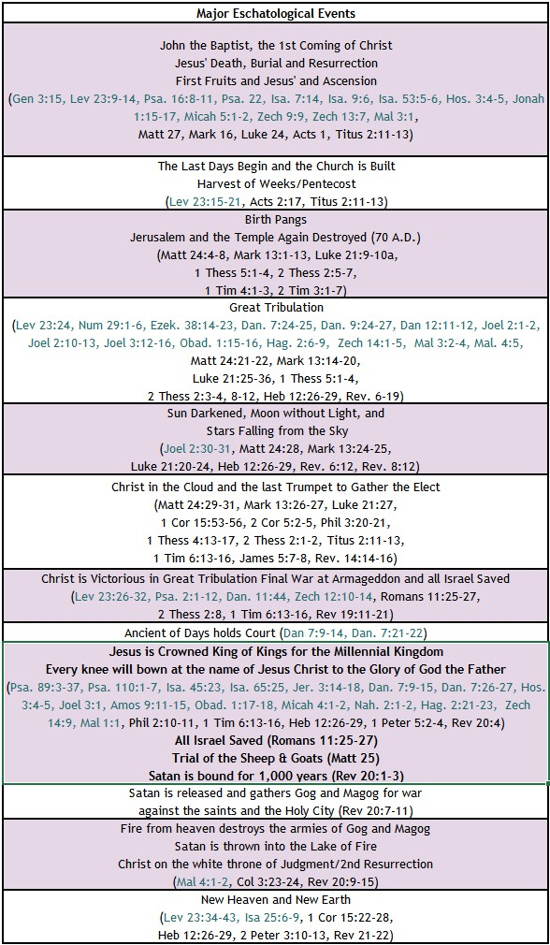


BIBLE ESCHATOLOGY
LUKE
Luke 21:9-10, "And when you hear of wars and tumults, do not be terrified, for these things must first take place, but the end will not be at once. Then he said to them, "Nation will rise against nation, and kingdom against kingdom.”
Luke 21:25-28, "And there will be signs in sun and moon and stars, and on the earth distress of nations in perplexity because of the roaring of the sea and the waves, people fainting with fear and with foreboding of what is coming on the world. For the powers of the heavens will be shaken. And then they will see the Son of Man coming in a cloud with power and great glory. Now when these things begin to take place, straighten up and raise your heads, because your redemption is drawing near."
Luke 21:20-24, "But when you see Jerusalem surrounded by armies, then know that its desolation has come near. Then let those who are in Judea flee to the mountains, and let those who are inside the city depart, and let not those who are out in the country enter it, for these are days of vengeance, to fulfill all that is written. Alas for women who are pregnant and for those who are nursing infants in those days! For there will be great distress upon the earth and wrath against this people. They will fall by the edge of the sword and be led captive among all nations, and Jerusalem will be trampled underfoot by the Gentiles, until the times of the Gentiles are fulfilled.”

Slide 21
Summary of Luke
Brief Summary: Luke opens his account disclosing his purpose for writing; his goal being an orderly account of the things that had been accomplished among them having followed all things closely so that his reader, Theophilus, could have certainty concerning the things he had been taught (Luke 1:1-4). In this gospel the authority of the Lord Jesus is corroborated over nature, demons, sickness, and death. In addition, Jesus’ righteousness, forgiveness¹ and compassion are on display. While Luke’s gospel incudes similar details regarding Jesus’ inauguration from heaven at his baptism, his ministry, final journey to Jerusalem, his betrayal, crucifixion, death, burial and resurrection, Luke also provides details and teachings that are not found in any of the other gospels.
Luke alone provides a genealogy for Jesus back to the first Adam in Genesis (Luke 3:23-38) and gives us a snippet of Jesus as a young boy (Luke 2:39-52). In addition, Luke alone records the accounts below.
  The angel Gabriel’s announcements to Zechariah and Mary (Luke 1:5-38).
  Jesus raising the only son of a widow (Luke 7:11-17)
  Jesus sending out 70 disciples with authority over demons and disease (Luke 10:1-24) .
  Jesus healing a woman disabled by a demonic spirit (Luke 13:10-17)
  Parables of the good Samaritan, the lost sheep, lost coin, the prodigal Son, and the rich man and Lazarus (Luke 10:25-37, Luke 15, Luke 16:19-31).
  Jesus’ cleansing of ten lepers with only one returning to give thanks (Luke 17:11-19).
  Jesus bringing salvation to Zacchaeus (Luke 19:1-10).
  The salvation of the thief on the cross (Luke 23:26-42).
Luke’s account also emphasizes the role of the Holy Spirit.² Luke ends his account explaining to us that after Jesus’ resurrection, He opened the minds of his disciples to understand the Scriptures and everything written about Him in the Law of Moses, the Prophets, and the Psalms. Jesus taught them that it was written, that the Christ should suffer and on the third day rise from the dead, “and that repentance for the forgiveness of sins should be proclaimed in his name to all nations, beginning from Jerusalem”. Lastly, when Jesus had led them out as far as Bethany, He blessed them and “parted from them and was carried into heaven” (Luke 24:44-53). This book is part one in a two-part series that was addressed to Theophilus concerning the things accomplished among them through Jesus Christ. Luke’s account recorded in the book of Acts is part 2.
Connections: Luke records the fulfillment of several Old Testament prophesies: 1) the birth of John the Baptist as the forerunner of Jesusª, 2) the birth of Jesus through a virgin ^{b}, 3) Jesus to be declared the Son of the Most High and God’s Salvation ^{c}, 4) Jesus preaching the good news to the poor, restoring sight to the blind, causing the lame to walk ^{d}, 5) Jesus’ triumphal entry into Jerusalem ^{e}, and 6) Jesus’ sufferings, crucifixion, and resurrection ^{f}. In addition, Luke records Jesus own prophetic words regarding his rejection, death, and resurrection (Luke 9:21-22), Peter’s denial (Luke 22:24-62), the impending destruction of Jerusalem (70 A.D.), and the signs of his return (Luke 21). In doing this Luke highlights that God is fulfilling his plan for all the peoples, Jew and Gentile, in his perfect timing (Mark 1:14-15, Galatians 4:4-5).
Notes:
¹ Luke 3:3; 5:20-25; 6:37; 7:41–50; 11:4; 12:10; 17:3-4; 23:34; 24:47
² Luke 1:15, 1:35, 1:41, 1:67; 2:25–27; 3:16, 3:22; 4:1, 4:14-18; 10:21; 11:13; 12:10-12
ª Compare Luke 1:11-17 with Malachi 4:5-6 and Isaiah 40:3
^{b} Compare Luke 1:25-38 with Isaiah 7:14, Matthew 1:22-23, and Isaiah 9:6-7
^{c} Compare Luke 1:32-35 and 2:22-38 with Psalm 89:35-37, Isaiah 49:6
^{d} Compare Luke 7:22-23 with Isaiah 35:5-6; 61:1
^{e} Compare Luke 19:28-40 with Daniel 9:24-26, Zechariah 9:9
^{f} Compare Luke 17:25 and Luke 24:26 with Isaiah 53:1-12, Psalm 22, Psalm 16:10

Slide 22
Luke: Practical Application
Practical Application: The Gospel of Luke gives us a beautiful portrait of our compassionate and powerful Savior, the work of the Holy Spirit, and the fulfillment of Jesus’ sufferings so that repentance for the forgiveness of sins could be proclaimed in his name to all nations.
Christians must follow the example of Jesus and through the power of the Holy Spirit show compassion to those in our circles of influence; proclaiming the gospel of repentance and forgiveness of sins through Christ Jesus our Lord. The kingdom of God is near, and the time grows shorter every day.

Slide 23

Closing Prayer Verse
Luke 24:50-53: “And he led them out as far as Bethany, and lifting up his hands he blessed them. While he blessed them, he parted from them and was carried up into heaven. And they worshiped him and returned to Jerusalem with great joy, and were continually in the temple blessing God.”

Slide 24
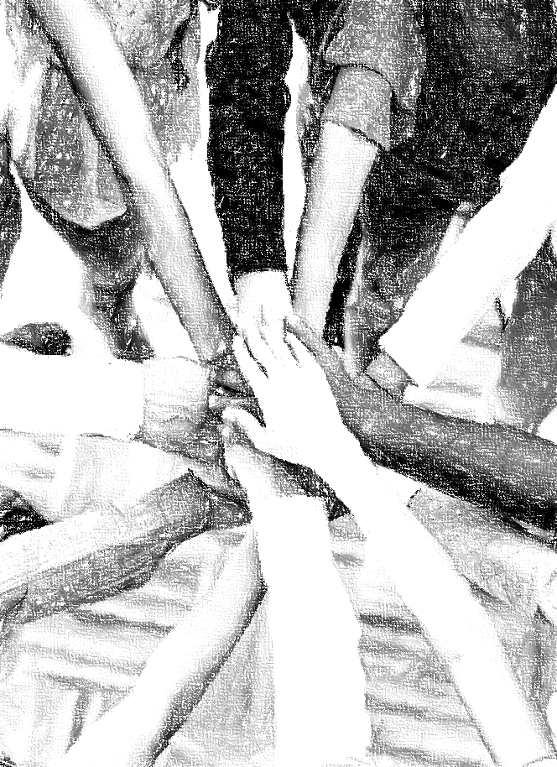
Acknowledgements
Background, Setting, Outlines, some Study Question answers, interpretative challenges, and some Summaries: Adapted from John MacArthur Study Bible at GTY.org.
Key verses, Practical Application, some Study Question answers, and some Summaries: Adapted from GotQuestions.org.
Inductive Bible Study Method: Adapted from Precept.org.
Creation – Consummation Icons: Adapted from AnswersInGenesis.org.
Definitions: Adapted from Websters 1828 Dictionary.

Slide 25
Study Leader Assistance
Sample Prayers
Study Question Answer Keys

Slide 26
Sample Opening Prayer Verse: Luke
Luke 1:1-4, “Inasmuch as many have undertaken to compile a narrative of the things that have been accomplished among us, just as those who from the beginning were eyewitnesses and ministers of the word have delivered them to us, it seemed good to me also, having followed all things closely for some time past, to write an orderly account for you, most excellent Theophilus, that you may have certainty concerning the things you have been taught.”
Sample Prayer: Dear Heavenly Father, thank you for the numerous eyewitness accounts of the first coming of our Lord Jesus Christ. Thank you for these men you chose to write down the Truth so that we can have certainty in the things we have been taught concerning You. We praise you that our sins are forgiven and we have eternal life in Jesus who took your wrath for our sins upon himself on the cross; who died, was buried and rose from the grave. Thank you for preserving your Word and how it coincides with history and the reality we see around us. It is Truth. We are blessed indeed; help us to bless others with your Word. In Jesus’ name we pray. Amen.

Slide 27
Luke: Study Question Answers
Luke records much about the work of the Holy Spirit, the third Person of the Godhead. Read each passage below and record what is taught about the Holy Spirit and His role.
  Luke 2:25-27: Answer: The Holy Spirit came upon a man name Simeon and revealed to him that he would not die before he saw the Lord’s Christ. And at just the right time the Spirit came upon this man so that he entered the temple while Joseph and Mary were there with Christ and Simeon spoke a word of prophecy over the baby Jesus. This teaches us that the Holy Spirit reveals truth to individuals and this truth is sometimes about future events; He directs the perfect timing of encounters and empowers individuals to speak the Truth.
  Luke 3:21-22: Answer: The Holy Spirit was a visible part of the inauguration of Jesus’ ministry allowing some who witnessed Jesus’ baptism to see Him descend upon Jesus in bodily form.
  Luke 4:1: Answer: The Holy Spirit filled Jesus Christ and led him into the wilderness where the devil tempted him. I believe this teaches that the Holy Spirit was with Jesus during these dreadful temptations. Jesus taught his disciples to pray “Lead us not into temptation”; a very wise prayer indeed. But if we find ourselves there, we can rely on the Holy Spirit to provide a way of escape.
  Luke 4:14-18: Answer: The Holy Spirit remained with Jesus during his ministry giving him Power to proclaim the good news to the poor, give sight to the blind and liberty to the oppressed. The Holy Spirit also empowers us as his people to do God’s work.
  Luke 10:21: Answer: Jesus rejoiced in the Holy Spirit resulting in prayer and praise to the Father. Likewise, when sincere thanksgiving, praise, and prayers for God’s glory rise out of us, this is the work of the Holy Spirit.
  Luke 11:13: Answer: The Heavenly Father gives the Holy Spirit to all who ask. Hallelujah!
In the gospel of Luke, the Holy Spirit gives prominence to several women in this historical account. In chapters 1 and 2 alone we read Elizabeth’s prophesy, the record of Mary’s visit by an angel who proclaims to her that she will carry and parent the Lord of the universe, Mary’s prayer of praise and prophesy, and Anna’s prophesy. Read the passage’s below and list other ways women were given prestige in this gospel account.
  Luke 7:37-50: Answer: Jesus utilized a woman of the city who was a sinner to teach the Pharisees a lesson on love and forgiveness. Unlike the Pharisees, this woman came to Jesus in a posture of humility, repentance, and love. The Lord responded by proclaiming her forgiveness before them all and teaching that she loved much because she understood she had been forgiven much.
  Luke 8:1-3: Answer: Women who had been healed from demons and sicknesses traveled with the Lord and the Apostles and provided for Jesus’ ministry out of their own funds.
  Luke 8:43-48: Answer: Jesus delayed his trip to the Synagogue ruler’s home to bless a woman who had suffered for as long as the ruler’s daughter had been alive. Jesus not only blessed this woman after her healing but referred to her as daughter. Being an outcast because of her hemorrhage likely meant she had not heard the word “daughter” for some time.
  Luke 23:49-24:9: Answer: Women were the first to discover Jesus’ empty tomb and to hear the testimony of the two angels that the Lord had risen. The women were dispatched to give this news to our Lord’s Apostles and other disciples.
Read Luke 1:13-15 and Luke 1:39-45. What does God’s word definitively tell us about when human life begins? Answer: Luke 1:13-15 teaches that the Holy Spirit can fill an individual even when he or she is in their mother’s womb. This alone teaches that human life begins at conception. Luke 1:39-45 takes it even further showing that the Holy Spirit can cause a human baby to be so aware of those around them that they can recognize the presence of others and rejoice over them. This is exactly what happened with John while he was in Elizabeth’s womb when Mary, the mother of our Lord, came into the room.
The holy angels are rarely mentioned by name in the Scriptures, but in Luke 1:5-38 we learn of an angel who was referred to by name. What is the angel’s name and what had he come to do? Answer: The angel’s name is Gabriel. He is a messenger who stands in the presence of God and is dispatched to tell humans of God’s plans. He was sent to tell Zechariah that God had heard his prayers and was going to give him and Elizabeth a son who would be great before the Lord and be filled with the Holy Spirit from the womb. He would fulfill God’s prophetic word by coming in the spirit of Elijah to prepare the way of our Lord Jesus (Malachi 3:1 and 4:5-6, Isaiah 40:3). Gabriel was also sent to give Mary the message that the Holy Spirit would come upon her so that she, a virgin, would give birth to the Son of God who would reign forever (Isaiah 7:14 and 9:6-7).

Slide 28
Sample Closing Prayer Verse
Luke 24:50-53: “And he led them out as far as Bethany, and lifting up his hands he blessed them. While he blessed them, he parted from them and was carried up into heaven. And they worshiped him and returned to Jerusalem with great joy, and were continually in the temple blessing God.”
Sample Prayer: Dear Heavenly Father, thank you for how Christ blessed these first disciples and continues to bless us today. Thank you for making it clear through passages like this one that Jesus Christ, your Son, is of the same essence as you and to be worshipped. The teaching that God is One, and exists in three persons: Father, Son, and Holy Spirit, can be difficult to grasp. But this is how you have more clearly revealed yourself in the new covenant Scriptures. And these Scriptures eloquently connect back to your Old Testament revelation. Grow our understanding Lord of you that we may marvel and worship you in spirit and truth. In Jesus’ name we pray. Amen

