Slide 1

2 Corinthians
Book 47
© 2026 RCI. All rights reserved.
To God Alone Be the Glory

Slide 2
What is the Holy Bible?
The Holy Bible is a collection of writings that includes 66 books in English editions. The Bible consists of two parts, the Old Testament and New Testament. The word testament means covenant. The Old Testament includes 39 books, and the New Testament includes 27 books.
These 66 books were written over approximately 1,400 years by 40 different authors in Hebrew, Aramaic, and Greek. The Old Testament writings were affirmed by Jewish leaders, and moreover, by Jesus Christ.¹ The New Testament writings were confirmed by early church leaders. The 66 books of the Bible are the inspired words of God that are used to make and mature disciples of the One true God through Jesus Christ, his Son (Matthew 28:18-20, 2 Timothy 3:16-17). The Bible was not created by mere human wisdom but was inspired by God (2 Peter 1:20-21), is interpreted by His Holy Spirit (John 16:13, Matthew 23:8-10), and will last forever (Matthew 24:35).²
If you do a phrase search on the Bible you will find the phrase "the word of the Lord" and "Thus says the Lord" more than 700 times.³ In addition, this book has given reasonable evidence to the claim of being God’s word by:​
  providing answers that conform with the reality we see around us.
  being a reliable collection of historical documents.
  containing eyewitness accounts that were written during the lifetimes of other eyewitnesses.
  recording supernatural events that took place in fulfillment of specific prophecies.⁴
Notes:
¹ See Matthew 4:4-7, 12:3-5, Mark 7:6-7, 12:26-27, and Luke 19:46 for examples.
^{2 “}What are the Books of the Bible”, GotQuestions.org
³ Blue Letter Bible
⁴ Paraphrased from Voddie Baucham

Slide 3
Our Goals in Studying the Bible
To better …..
Understand the Only true God; the Author of the Bible. (2 Timothy 3:16-17, 2 Peter 1:20-21, 1 John 5:20 , Jeremiah 9:23-24)
Learn How He works in the World and in our Lives. (Job 40:6-14, Isaiah 45:6-7, Isaiah 46:8-10, Philippians 2:12-13)
Understand Ourselves and the Hearts of Mankind. (Jeremiah 17:9, 2 Timothy 3:13, Ephesians 5:7-10)
Come to Know What Pleases and Grieves God. (1 Thessalonians 4:1, Ephesians 4:26-31, Hebrews 11:6, 1 Peter 1:14-19)
To be Transformed into Fruitful Doers of God’s Word and not just Hearers. (Romans 12:2, James 1:27, Matthew 3:8)
Tether Ourselves to God’s Word for Our Wisdom, Discernment, and Safety. (1 Corinthians 6:9-10, Matthew 24:24, Ephesians 4:11-14)
Jeremiah 9:23-24 “Thus says the Lord: "Let not the wise man boast in his wisdom, let not the mighty man boast in his might, let not the rich man boast in his riches, but let him who boasts boast in this, that he understands and knows me, that I am the Lord who practices steadfast love, justice, and righteousness in the earth. For in these things I delight, declares the Lord."

Slide 4
How to Study the Bible
#1. Observation: What does the text say?
Who?
What?
When?
Where?
How?
Why?
#2. Interpretation: What does the text mean in context with the passage, book, and whole counsel of God?
#3. Application: How is the Holy Spirit instructing me to apply this understanding at this time in my life?

Slide 5
Study Resources
Opening Prayer
Background and Setting
Book Outline
Geography Maps
Key Verses
Study Questions
Major Event Timeline
Book Summary
Application and Closing Prayer
Study Leader Support Slides

Slide 6

Opening Prayer Verse: 2 Corinthians
2 Corinthians 5:17-19: "Therefore, if anyone is in Christ, he is a new creation. The old has passed away; behold, the new has come. All this is from God, who through Christ reconciled us to himself and gave us the ministry of reconciliation; that is, in Christ God was reconciling the world to himself, not counting their trespasses against them, and entrusting to us the message of reconciliation."

Slide 7
Review of 1 Corinthians
Learning Tip: For those studying the Bible in its table‑of‑contents order, this slide gives you a brief recap of the book you just completed. Studying in a different sequence? You can simply skip this slide or treat it as a gentle nudge to circle back when the time is right.
Brief Summary: 1 Corinthians was written c. 55 A.D. from Ephesus while Paul was on his third missionary journey. Though this letter was written to correct various issues in the church at Corinth, Paul opens the letter by reminding the believers of their calling and many benefits in Christ Jesus. He tells them they have been set apart, called to be saints, and to receive grace and peace from God our Father and the Lord Jesus Christ. He reminds them that God has enriched them in Christ in all speech, knowledge, and fellowship and of God’s promise to sustain them and present them guiltless in the day of our Lord Jesus Christ (1 Corinthians 1:1-9).
After reminding the church of the benefits of their calling, Paul addresses the issues of the church. First, many believers in Corinth were dividing into groups loyal to certain spiritual leaders (1 Corinthians 1:12; 3:1-6) creating disunity in the church. Paul exhorted the Corinthian believers to not be foolishly arrogant, but to be united because of devotion to Christ who alone was crucified for their salvation (1 Corinthians 1:13-31, 3:21-23). Secondly, many in the church were essentially approving of a sexually immoral relationship (1 Corinthians 5:1-2). Paul commanded them to expel the wicked man from the church for the glory of Christ and the health of the flock (1 Corinthians 5:13).
Paul gave the Corinthian church instructions on settling disputes making it clear that conflicts should be settled within the church, and that it would be better to be taken advantage of than to damage one’s Christian testimony (1 Corinthians 6:3-8, Matthew 18:15-20). The apostle deals with marriage and celibacy in chapter 7 and then utilizes three chapters to address the issue of food sacrificed to idols and how to live out our Christian liberty in a way that glorifies God and seeks the good of others (chapters 8 -10). Chapters 12-14 address church worship including roles, the Lord’s communion table, the exercise of spiritual gifts, and how all should be done in love as God defines love (1 Corinthians 13).
Through Paul, the Holy Spirit begins the conclusion of the letter with the gospel, the crucial importance of Christ’s resurrection, and the promise of our resurrection through Him (1 Corinthians 15). In 1 Corinthians 10:6, Paul writes “Now these things took place as examples for us, that we might not desire evil as they did.” He wrote this after reminding the Corinthians about Israel’s sinful behavior in the wilderness. With this letter to the Corinthians, we now have this example two-fold, from both Israel and the Corinthians so that we will not crave evil things but instead live as saints of God.
Connections: In chapter 5 Paul takes us back to the Feast of Unleavened Bread and the Passover reminding the Church that Christ, our ultimate Passover Lamb, has been sacrificed, and we in turn, are to remove the leaven (i.e., sin) from our lives (Exodus 12:15-20, Leviticus 23:6-8). Then in chapter 10, Paul uses the story of the Israelites wilderness experience to illustrate to the Corinthian believers the folly of the misuse of freedom and the danger of overconfidence. The Israelites who, despite seeing God’s miracles and care for them—the parting of the Red Sea, the miraculous provision of manna from heaven and water from a rock—misused their freedom, and displeased God through their rebellion, grumbling, idolatry, and immorality (Numbers 11:4-6, 34, 25:1-9; Exodus 16:2, 17:2, 32:1-6). The Corinthian believers despite having the indwelling of the Holy Spirit and the benefits of grace, had fallen into these same sins. We too must take heed trusting God to enable us to endure; otherwise, we too will fall (1 Corinthians 10:11-13).

Slide 8
New Testament Table of Contents (27 Books)
THE GOSPELS & ACTS - 5
MATTHEW
MARK
LUKE
JOHN
ACTS
PAUL’S LETTERS TO CHURCHES - 9
ROMANS
1 CORINTHIANS
2 CORINTHIANS
GALATIANS
EPHESIANS
PHILIPPIANS
COLOSSIANS
1 THESSALONIANS
2 THESSALONIANS
PAUL’S LETTERS TO INDIVIDUALS - 4
1 TIMOTHY
2 TIMOTHY
TITUS
PHILEMON
LETTERS BY OTHERS – 9
HEBREWS
JAMES
1 PETER
2 PETER
1 JOHN
2 JOHN
3 JOHN
JUDE
REVELATION

Slide 9
New Testament Books by Date Written
James:
45-50 A.D.
Galatians:
49-55 A.D.
1 Thess:
51 A.D.
2 Thess:
52 A.D.
1 Cor:
53-55 A.D.
2 Cor:
55-56 A.D.
Mark:
55-60 A.D.
Matthew:
55-65 A.D.
Romans:
57-58 A.D.
Luke:
60 A.D.
1 Peter: 60-65 A.D.
Jude:
60-70 A.D.
2 Peter: 65-68 A.D.
Ephesians: 60-61 A.D
Philippians: 60-61 A.D.
Colossians: 61 A.D.
Philemon:
61 A.D.
Titus:
62-67 A.D.
1 Timothy:
63-66 A.D.
Acts:
65 A.D.
Hebrews:
65 A.D.
2 Timothy:
67 A.D.
John:
85-90 A.D.
1 John:
85-95 A.D.
2 & 3 John:
85-95 A.D.
Revelation: 90-95 A.D.

Slide 10
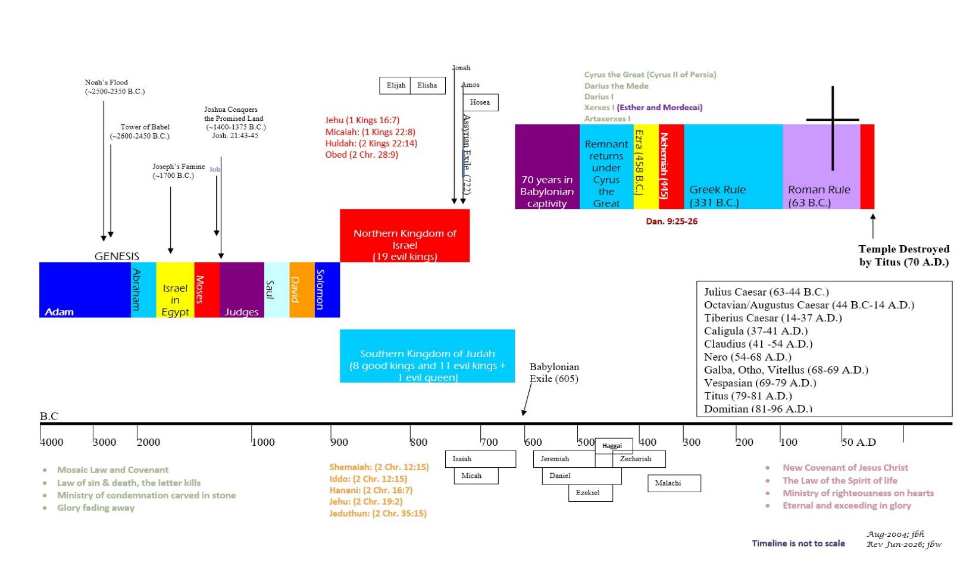







BIBLICAL CHRONOLOGICAL BACKGROUND
OT
NT
Prophets after Noah into the United Kingdom:
Abraham:
Moses:
Samuel:
Gad:
Nathan:
Ahijah
Asaph
(Gen. 20:7)
(Exo. 3:10)
(1 Sam. 3:20)
(1 Sam. 22:5)
(2 Sam. 7:2)
(1 Kings 11:29)
(2 Chr. 35:15)

Slide 11
2 Corinthians
Author: Paul
Date of Writing: c. 55 - 56 A.D.
11

Slide 12
About this Book and Its Author - Paul
This is the second preserved letter to the Christians in the city of Corinth. That the Apostle Paul wrote 2 Corinthians is uncontested; the lack of any motive for a forger to write this highly personal, biographical epistle has led even the most critical scholars to affirm Paul as its author.
Several considerations establish a feasible date for the writing of this letter. Extrabiblical sources indicate that July, A.D. 51 is the most likely date for the beginning of Gallio’s term as proconsul (cf. Acts 18:12-13). Paul’s trial before him at Corinth (Acts 18:12-17) probably took place shortly after Gallio assumed office. Leaving Corinth after this (likely in A.D. 52) Paul sailed for Syria (Acts 18:18), thus concluding his second missionary journey. Returning to Ephesus on his third missionary journey (probably in A.D. 52), Paul ministered there for about 2 1⁄2 years (Acts 19:1-10). The apostle wrote 1 Corinthians from Ephesus toward the close of that period (1 Corinthians 16:5-8), most likely in A.D. 55. Since Paul planned to stay in Ephesus until the following spring¹, and 2 Corinthians was written after he left Ephesus, the most likely date for 2 Corinthians is late A.D. 55 or very early A.D. 56.
Notes:
¹ cf. the reference to Pentecost in 1 Corinthians 16:8

Slide 13
2 Corinthians – Background and Setting
Paul’s association with the important commercial city of Corinth began on his second missionary journey when he spent 18 months ministering there (Acts 18:1-18). After leaving Corinth, Paul heard of immorality in the Corinthian church and wrote a letter (since lost) to confront that sin, referred to in 1 Corinthians 5:9. During his ministry in Ephesus, he received further reports of trouble in the Corinthian church in the form of divisions among them (1 Corinthians 1:11). In addition, the Corinthians wrote Paul a letter (1 Corinthians 7:1) asking for clarification on some issues. Paul responded by writing the letter known as 1 Corinthians. Planning to remain at Ephesus a little longer (1 Corinthians 16:8-9), Paul sent Timothy to Corinth.¹ Disturbing news reached the apostle (possibly from Timothy) of further difficulties at Corinth, including the arrival of self-styled false apostles (2 Corinthians 11:12-13).
To create the platform to teach their false gospel, they began by assaulting the character of Paul. They had to convince the people to turn from Paul to them if they were to succeed in preaching demon doctrine. Temporarily abandoning the work at Ephesus, Paul went immediately to Corinth. The visit known as the “painful visit” (2 Corinthians 2:1), was not a successful one from Paul’s perspective; someone in the Corinthian church (possibly one of the false apostles) even openly insulted him (2 Corinthians 10:10). Saddened by the Corinthians’ lack of loyalty to defend him, seeking to spare them further reproof (cf. 2 Corinthians 1:23), and perhaps hoping time would bring them to their senses, Paul returned to Ephesus. From Ephesus, Paul wrote what is known as the “severe letter” (2 Corinthians 2:1-4) and sent it with Titus to Corinth (2 Corinthians 7:5-16).
Leaving Ephesus after the riot sparked by Demetrius (Acts 19:23–20:1), Paul went to Troas to meet Titus (2 Corinthians 2:12-13). But Paul was so anxious for news of how the Corinthians had responded to the “severe letter” that he could not minister there though the Lord had opened the door (2 Corinthians 2:12).² So he left for Macedonia to look for Titus (2 Corinthians 2:12-13). To Paul’s immense relief and joy, Titus met him with the news that the majority of the Corinthians had repented of their rebellion against Paul (2 Corinthians 7:5-16). Wise enough to know that some rebellious attitudes still smoldered under the surface, and could erupt again, Paul wrote the Corinthians the letter called 2 Corinthians.³ In this letter, though the apostle expressed his relief and joy at their repentance (2 Corinthians 7:8-16), his main concern was to defend his apostleship (2 Corinthians 1–7), exhort the Corinthians to resume preparations for the collection for the poor at Jerusalem (2 Corinthians 8-9), and confront the false apostles head on (2 Corinthians 10-13). He then went to Corinth, as he had written (2 Corinthians 12:14; 13:1-2). The Corinthians’ participation in the Jerusalem offering (Romans 15:26-27) implies that Paul’s third visit to that church was successful.
Notes:
¹ 1 Corinthians 4:17; 16:10–11
² 2 Corinthians 2:12; cf. 7:5
³ possibly from Philippi, cf. 2 Corinthians 11:9 with Philippians 4:15; also, some early manuscripts list Philippi as the place of writing

Slide 14
2 Corinthians: Outline
Paul’s Greeting
  Paul, an apostle of Jesus Christ by God's will.
  Grace & peace from God our Father & the Lord Jesus
  To the saints in Corinth and all Achaia.
  Blessed be the God and Father of our Lord Jesus Christ.
  The Father of mercies who comforts us in affliction.
  He makes us rely not on ourselves but on God who raises the dead.
  On him we have set our hope that he will continue to deliver us.
  You also must help us by prayer for your reward.
Paul’s Collection
  The Patterns of Giving
    The Macedonians
    Jesus Christ
  The Purpose of Giving
  The Procedures of Giving
  The Promise of Giving
Paul’s Visit
  Paul’s Unselfishness
  Paul’s Warnings
  Paul’s Benediction
2 Corinthians 1:1–11
2 Corinthians 1:12–7:16
2 Corinthians 8:1–9:15
2 Corinthians 10:1–12:13
2 Corinthians 12:14–13:14
Paul’s Ministry
  Paul’s Plans
  The Offender’s Punishment
  Titus’ Absence
  The Ministry’s Nature
    It's triumph, permanence, commendation.
    It's basis and theme.
    It's trials and motivation.
    It's message and conduct.
  The Corinthians Exhorted
    To open their hearts.
    To separate themselves.
    To be assured of Paul’s love.
Paul’s Apostleship
  Apostolic Authority
  Apostolic Conduct
  Apostolic Suffering
  Apostolic Credentials

Slide 15
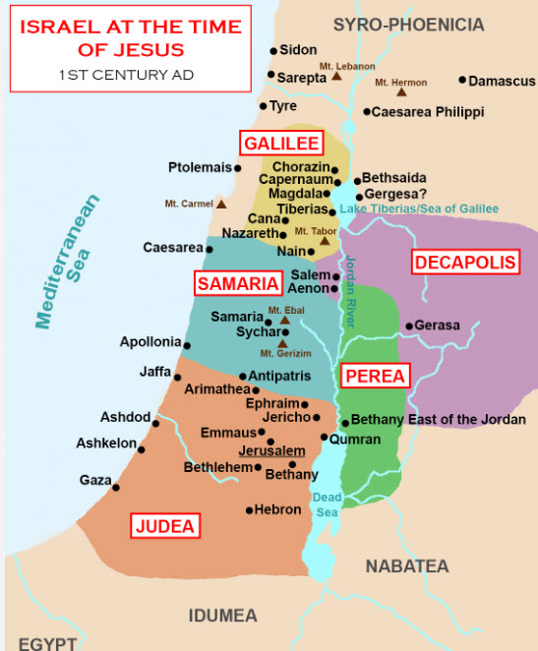
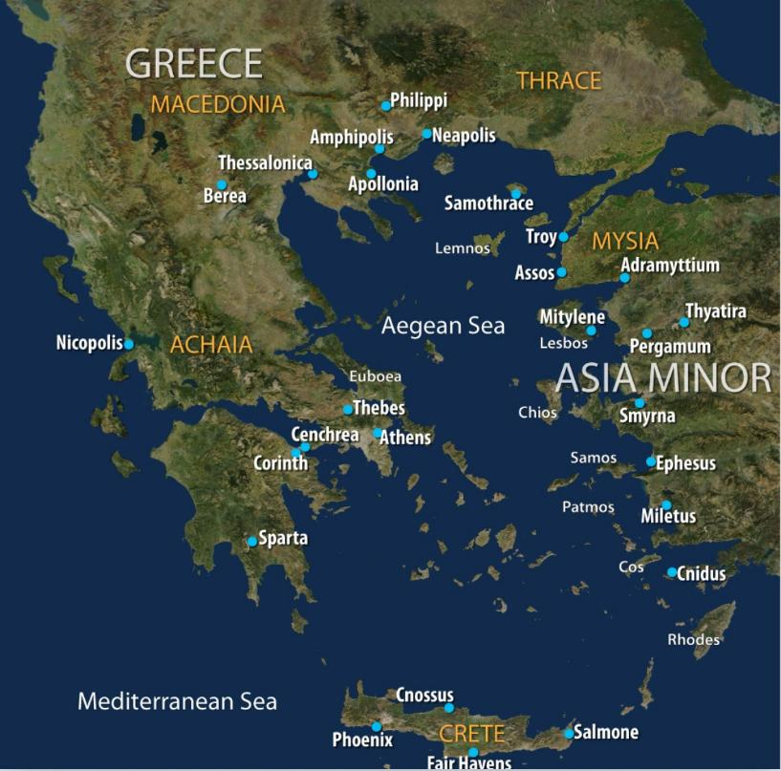
Geography for the New Testament

Slide 16
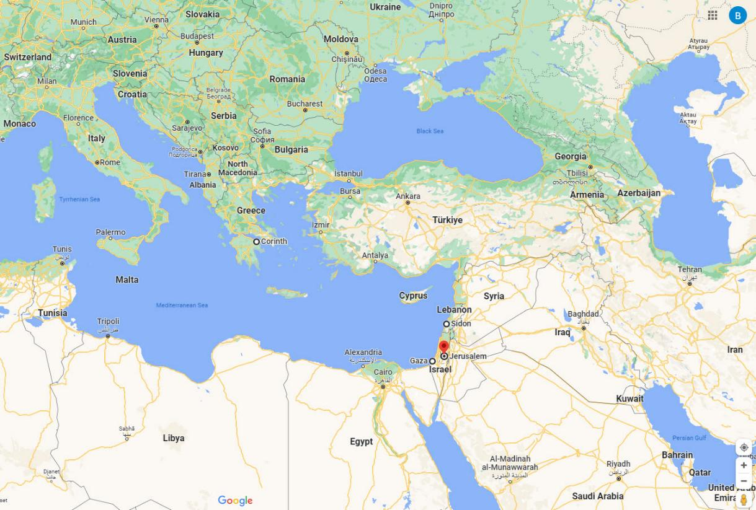
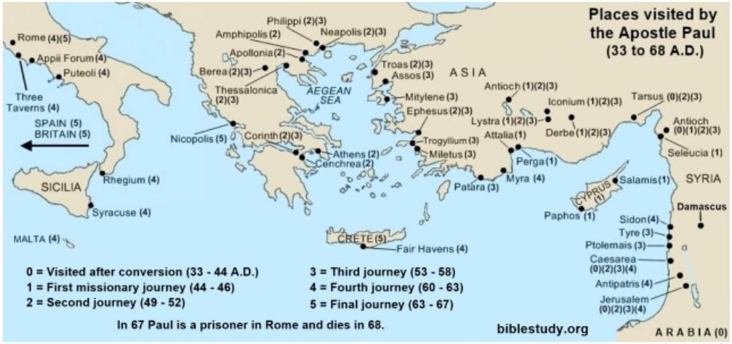
Ancient Corinth vs. Modern Day Borders

Slide 17
Struggles in the Corinthian Church
Immorality^{1,2}
Pride shown in Factions and Divisions²
Headship Roles in Marriage and Church²
Pride in Spiritual Gifts²
Chaotic Corporate Worship²
False “apostles” and a False gospel^{3,4}
Notes:
Paul’s 1st letter, which was not preserved (see reference in 1 Cor. 5:9) .
Paul’s 2nd letter, which we call 1 Corinthians.
Paul’s 3rd and most harsh letter, also not preserved (see 2 Cor. 2:3-4).
Paul’s 4th letter, which we call 2 Corinthians.

Slide 18
Paul’s Four Letters to the Corinthian Church
1st Letter:
Addressed immorality and excommunicating offenders.
2nd Letter:
Addressed: factions and divisions, more immorality, headship and women, pride in spiritual gifts, chaos in corporate worship.
3rd Letter:
The harsh letter dealing with false prophets and a false gospel.
4th Letter:
Letter of encouragement for their repentance and obedience, but also one that lists his credentials as an Apostle for their protection against false apostles.
Not Preserved
1 Corinthians
Not Preserved
2 Corinthians
See 1 Cor. 5:9
See 1 Cor. 1, 11, and 12-14
See 2 Cor. 2:1-4
See 2 Cor. 1, 6-7, and 11-12

Slide 19
2 Corinthians – Key Verses
2 Corinthians 1:20: “For all the promises of God find their Yes in him. That is why it is through him [Jesus] that we utter our Amen to God for his glory.”
2 Corinthians 2:14-16: “But thanks be to God, who in Christ always leads us in triumphal procession, and through us spreads the fragrance of the knowledge of him everywhere. For we are the aroma of Christ to God among those who are being saved and among those who are perishing, to one a fragrance from death to death, to the other a fragrance from life to life. Who is sufficient for these things?”
2 Corinthians 3:5-6: “Not that we are sufficient in ourselves to claim anything as coming from us, but our sufficiency is from God.”
2 Corinthians 3:18: “And we all, with unveiled face, beholding the glory of the Lord, are being transformed into the same image from one degree of glory to another. For this comes from the Lord who is the Spirit.”
2 Corinthians 5:17-19: "Therefore, if anyone is in Christ, he is a new creation. The old has passed away; behold, the new has come. All this is from God, who through Christ reconciled us to himself and gave us the ministry of reconciliation; that is, in Christ God was reconciling the world to himself, not counting their trespasses against them, and entrusting to us the message of reconciliation."
2 Corinthians 5:21: "For our sake he made him to be sin who knew no sin, so that in him we might become the righteousness of God.”
2 Corinthians 7:9-10: ”As it is, I rejoice, not because you were grieved, but because you were grieved into repenting. For you felt a godly grief, so that you suffered no loss through us. For godly grief produces a repentance that leads to salvation without regret, whereas worldly grief produces death.”
2 Corinthians 9:6-8: “The point is this: whoever sows sparingly will also reap sparingly, and whoever sows bountifully will also reap bountifully. Each one must give as he has decided in his heart, not reluctantly or under compulsion, for God loves a cheerful giver. And God is able to make all grace abound to you, so that having all sufficiency in all things at all times, you may abound in every good work.”
2 Corinthians 10:5: "We destroy arguments and every lofty opinion raised against the knowledge of God, and take every thought captive to obey Christ."
2 Corinthians 13:4-5: "For to be sure, he was crucified in weakness, yet he lives by God’s power. Likewise, we are weak in him, yet by God’s power we will live with him to serve you. Examine yourselves to see whether you are in the faith; test yourselves. Do you not realize that Christ Jesus is in you— unless, of course, you fail the test?"

Slide 20
2 Corinthians: Study Questions
In 2 Corinthians 2:5-11 we learn that a person the church had disciplined under Paul’s instruction had repented. Read the passage and answer the questions below.
  How does Paul now instruct the leaders of the church to behave toward this person and why?
  What do you think Paul meant in verses 2:10-11 when he stated that expressing forgiveness was a tool to prevent being outwitted by Satan?
In 2 Corinthians 3:7-18 Paul gives us a comparison between the “ministry of death” and the “ministry of the Spirit”. Read this passage and write a brief paragraph on what you learn about these two ministries.
Read 2 Corinthians 4:3-7 and answer the questions below.
  Who does the text describe as perishing and what reason does it give?
  Most people put their treasured possessions in a fire-proof metal container, safe, or vault. Why do you think the Holy Spirit describes us as jars of clay containing treasure?
Because false teachers had infiltrated the Corinthian church, Paul laid out his credentials as an Apostle called directly by Jesus Christ to draw the church away from the clutches of these evil men. Most of his credentials consisted of the hardships he had endured while spreading the gospel. But in 2 Corinthians 12:2-7 we get a glimpse into one of his mountain top experiences. Read this passage and answer the questions below.
  Paul noted he was caught up into the third heaven. Logic tells us that the first heaven is the sky we see above us (i.e., earth’s atmosphere). What are the second and third heavens? (See Genesis 1:16, Psalm 19:1-3, and Luke 23:43 for hints.)
  In 2 Corinthians 12:7 what was the reason the Apostle Paul gave for why God gave him a thorn in his flesh?

Slide 21
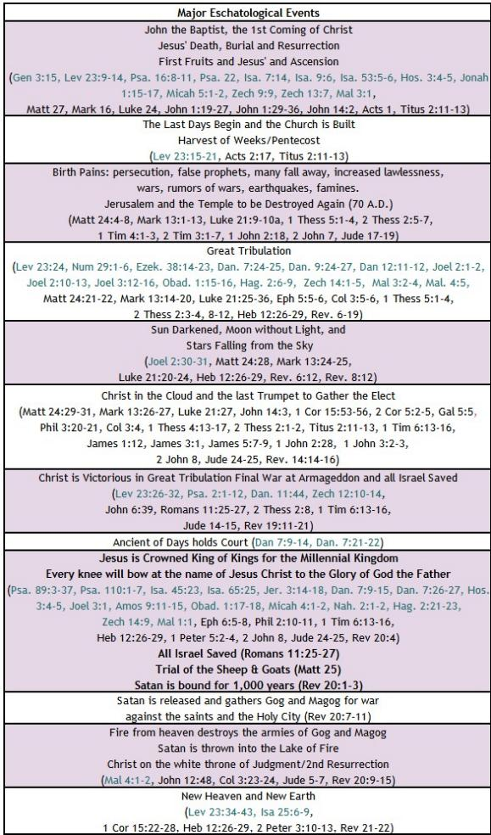


BIBLE ESCHATOLOGY
2 Corinthians
2 Corinthians 5:2-5, “For in this tent we groan, longing to put on our heavenly dwelling, if indeed by putting it on we may not be found naked. For while we are still in this tent, we groan, being burdened––not that we would be unclothed, but that we would be further clothed, so that what is mortal may be swallowed up by life. He who has prepared us for this very thing is God, who has given us the Spirit as a guarantee.”
2 Corinthians 5:9-10, “Therefore we also have as our ambition, whether at home or absent, to be pleasing to Him. For we must all appear before the judgment seat of Christ, so that each one may receive compensation for his deeds done through the body, in accordance with what he has done, whether good or bad.”
21

Slide 22
2 Corinthians – Summary
Brief Summary: Second Corinthians complements the historical record of Paul’s dealings with the Corinthian church as recorded in Acts 18 and 1 Corinthians. It also contains important biographical data on Paul throughout.
Although an intensely personal letter, written by the apostle in the heat of battle against those attacking his credibility, 2 Corinthians contains several important theological themes. In Paul’s greeting alone he touches on the following theological matters:
Paul’s apostleship in Jesus Christ by God’s will.
The God and Father of our Lord Jesus is the Father of mercies and all comfort.
He is the God who delivered the apostles out of their afflictions causing them to rely not on themselves but on God who raises the dead.
This is the God on whom the true apostles had set their hope for continued deliverance.
After explaining his reasons for not making an earlier visit to them and how the church was to handle a repentant offender, Paul begins his defense against the false teachers, peddlers of God’s word, who had infiltrated the church. He does this by first laying out the true gospel of Jesus Christ, the new covenant, in comparison to the old covenant. The text explains that the first covenant, the ministry of death, refers to the Law given to Moses, which God wrote on tablets of stone. It was glorious because the Law represents God's character, and Moses' face shone with this glory after being in God's presence. But this glory faded away, for the Law is condemning because it has no power to overcome sin. It is the Law of sin and death for us, the letter that kills, because we are sinners by birth and practice completely unable to be right before God. But the ministry of the Spirit is the new covenant that frees us from the Law of sin and death through Jesus Christ. God sent His only Son in human flesh to fulfill His Law and to be an offering for our sin. Through the Holy Spirit of Jesus Christ, the ministry of righteousness administers God’s mercy, grace and love and makes us new creations with God’s Law written upon our hearts. This is the permanent glory that will never fade and through which we are being transformed into the image of Jesus Christ (2 Corinthians 3).
Throughout the remainder of the letter Paul continues the defense of his ministry against the false apostles who were attempting to lead the Corinthians astray. He exhorts the Corinthians to open their hearts and be assured of his love for them and his apostolic authority. He calls himself a “fool” for having to reluctantly boast of his qualifications in conduct, suffering, and credentials including a vision of heaven (2 Cor. 11-12). Paul closes the letter with a warning for the Corinthians to examine themselves and ends with a benediction of love and peace.
Connections: Paul refers to the Mosaic law, comparing it with the surpassing greatness of the gospel of Jesus Christ and salvation by grace. The Law written on our hearts through Jesus Christ surpasses the Law written on tablets of stone (2 Corinthians 3:4-11, Exodus 24:12).

Slide 23
2 Corinthians
Practical Application
This letter while heavily personal and biographical still provides a wide array of applications for the Christian life. It helps us discern a true messenger of God; which will be one whose life is dedicated to prayerfully teaching, living out, and even suffering to deliver the Truth of God’s word. In addition, this ministry of reconciliation of sinners to God through Jesus Christ, has been handed down to all saints. We are to be ambassadors for Christ Jesus (2 Corinthians 5:18-20).
This epistle also provides examples of generosity to follow as Paul highlighted how the Macedonians gave both of themselves to the Lord and the apostles and of their worldly goods even in their own afflictions (2 Corinthians 8:1-6). Moreover, Paul writes that the ultimate example of sacrificial giving came from our Lord Jesus Christ who though he was rich became poor for our sakes (2 Corinthians 8:8-11). God loves a cheerful giver and promises that we will reap a benefit for everything we sow into His kingdom (2 Corinthians 9:6-8).
Other principles we find in this book include not being unequally yoked with unbelievers. Since we cannot expect unbelievers to desire to follow the ways of God (Romans 8:7), it is counterproductive to yoke ourselves in partnerships with them (i.e., business, deep friendships, marriage [unless already married; see 1 Corinthians 7:12-17]). The Holy Spirit, through Paul, asks a series of rhetorical questions after commanding us not to be unequally yoke to demonstrate that only regret and sorrow can come from such unions (2 Corinthians 6:14-18). Paul wraps up this epistle with an exhortation to each of us to examine ourselves to see whether we are in the faith (2 Corinthians 13:5). Are we obeying the Lord in the understanding He has given us? Are we exhibiting the fruit of the Holy Spirit (Galatians 5:22-23) and growing in the qualities of Christ Jesus (2 Peter 1:5-10)? Finally, Paul exhorts the believers to rejoice, comfort one another, agree with one another, and to live in peace.
As you read back through these possible applications, what is the Holy Spirit impressing upon your heart at this time in your life? Whatever it is, ask God to help you grow in that area.

Slide 24

Closing Prayer Verse
2 Corinthians 13:4-5, “For he was crucified in weakness, but lives by the power of God. For we also are weak in him, but in dealing with you we will live with him by the power of God. Examine yourselves, to see whether you are in the faith. Test yourselves. Or do you not realize this about yourselves, that Jesus Christ is in you? — unless indeed you fail to meet the test!”

Slide 25
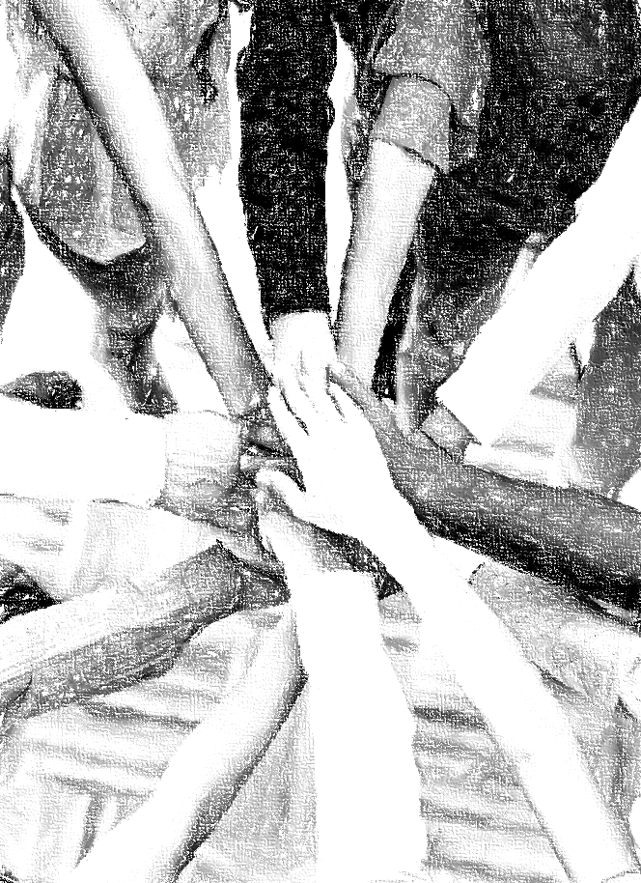
Acknowledgements
Background, Setting, Outlines, some Study Question answers, interpretative challenges, and some Summaries: Adapted from John MacArthur Study Bible at GTY.org.
Key verses, Practical Application, some Study Question answers, and some Summaries: Adapted from GotQuestions.org.
Inductive Bible Study Method: Adapted from Precept.org.
Creation – Consummation Icons: Adapted from AnswersInGenesis.org.
Definitions: Adapted from Websters 1828 Dictionary.
Bible Reference Software and Quotes: All Scripture quotations are taken from the Holy Bible using primarily the English Standard Version (ESV) or New American Standard Bible (NASB) translations. Links to Scripture references utilize BibleRef.com, which is a Got Questions Ministries’ website.

Slide 26
Study Leader Assistance
Sample Prayers
Study Question Answer Keys

Slide 27
Sample Opening Prayer Verse: 2 Corinthians
2 Corinthians 5:17-19: "Therefore, if anyone is in Christ, he is a new creation. The old has passed away; behold, the new has come. All this is from God, who through Christ reconciled us to himself and gave us the ministry of reconciliation; that is, in Christ God was reconciling the world to himself, not counting their trespasses against them, and entrusting to us the message of reconciliation."
Sample Prayer: Dear Heavenly Father, we would have never thought to ask to be made new creations. Thank you that you have caused our old sinful lives to pass away, and by your Spirit have caused us to be born again in Christ Jesus. Thank you for not holding our sins against us and making peace for us through Jesus’ sacrifice. Teach and empower us to carry this message of reconciliation to others so that they too may receive your forgiveness and abound in thanksgiving to you. We love you Lord and pray these things in Jesus’ name. Amen

Slide 28
2 Corinthians: Study Questions
In 2 Corinthians 2:5-11 we learn that a person the church had disciplined under Paul’s instruction had repented. Read the passage and answer the questions below.
  How does Paul now instruct the leaders of the church to behave toward this person and why? Answer: Paul tells them that the punishment was enough and now the church should forgive, comfort, and show their love toward the repentant sinner so that he would not be overcome with excessive sorrow.
  What do you think Paul meant in verses 2:10-11 when he stated that expressing forgiveness was a tool to prevent being outwitted by Satan? Answer: Christ clearly commanded us to forgive when a person repents (Luke 17:3-5), and we are also instructed not to allow bitterness to invade our hearts (Eph. 4:31). Bitterness in the heart is a desire that the offending party never repent but instead be condemned. It is a vengeful emotion that comes from Satan and not from God. When we are unwilling to pray for God to grant repentance to an offending party, we are showing bitterness and must seek God’s help to move past this to an open heart that is eager to see the person express godly grief that leads to repentance and life (2 Cor. 7:9-11). If we do not do this, we are disobeying our Lord Jesus, have given Satan a foothold in our own lives (see Eph. 4:26-27), and may cause a fellow Christian to be overwhelmed with sorrow and left in the clutches of the evil one.
In 2 Corinthians 3:7-18 Paul gives us a comparison between the “ministry of death” and the “ministry of the Spirit”. Read this passage and write a brief paragraph on what you learn about these two ministries. Answer: The ministry of death refers to the first covenant God made with Israel to keep the Law given to Moses, especially the Ten Commandments, which God wrote on tablets of stone. It was glorious because the Law represents God's character, and Moses' face shone with this glory after being in God's presence. But this glory faded away, and the Law is condemning because it has no power to overcome sin in our hearts. Thus, Paul explains that it is the Law of sin and death for us, the letter that kills, because we are sinners by birth and practice completely unable in ourselves to live right before God. But the ministry of the Spirit is the new covenant that frees us from the Law of sin and death through Jesus Christ. God sent His only Son in human flesh to fulfill His Law and to be an offering for our sin. As God in the flesh, Jesus, was the perfect righteous sacrifice able to accept God's wrath and pay for our sins (cf. John 1:1, 1:14, John 11:17-44, 1 Cor. 15:45-57, Eph. 2:5-7, Col. 1:13-17). God demonstrated the permanency of Jesus' sacrificial work by raising him from the dead (cf. John 10:17-18, Acts 2:24, Rom. 8:10-11). Through the Holy Spirit of Jesus Christ, the ministry of righteousness causes us to be born again. God grants his new creations godly sorrow that leads to repentance, the gift of faith in Christ's work, writes His Law upon our hearts, justifies us in His sight, and seals us with the deposit of His Holy Spirit. This is the permanent glory that will never fade and through which we are being transformed bit by bit into the image of Jesus Christ, the life-giving spirit.
Read 2 Corinthians 4:3-7 and answer the questions below.
  Who does the text describe as perishing and what reason does it give? Answer: The people who are perishing are those to whom the gospel of Jesus Christ is veiled . The god of this world (i.e., Satan) is blinding unbelievers to the truth of the good news and glory of Jesus Christ. This veil is analogous to the veil in the temple that separated the holy place from the holy of holies. When Jesus paid our penalty on the cross, God tore the veil in the temple from top to bottom signifying that the Way to him had been made through Christ Jesus. Without Jesus the veil remains over a person’s heart and mind, and he or she cannot get to God. They have no payment for their sins.
  Most people put their treasured possessions in a fire-proof metal container, safe, or vault. Why do you think the Holy Spirit describes us as jars of clay containing treasure? Answer: Human life is fragile and easily taken by sickness, accident, or violence. Moreover, as humans we tend to be fearful, lack courage, and our confidence is often shaky and dependent on what others think. Like jars of clay, we are easily destroyed. God, who cannot lie but always demonstrates the Truth, has put his treasure into fragile humans so that it will be plain to all that the power belongs to Him and not to us.
Because false teachers had infiltrated the Corinthian church, Paul laid out his credentials as an Apostle called directly by Jesus Christ to draw the church away from the clutches of these evil men. Most of his credentials consisted of the hardships he had endured while spreading the gospel. But in 2 Corinthians 12:2-7 we get a glimpse into one of his mountain top experiences. Read this passage and answer the questions below.
  Paul noted he was caught up into the third heaven. Logic tells us that the first heaven is the sky we see above us (i.e., earth’s atmosphere). What are the second and third heavens? (See Genesis 1:16, Psalm 19:1-3, and Luke 23:43 for hints.) Answer: The second heaven would be what we refer to as outer space (i.e., stars, sun, moon, galaxies). The third heaven would be Paradise, or the place where God lives.
  In 2 Corinthians 12:7 what was the reason the Apostle Paul gave for why God gave him a thorn in his flesh? Answer: Paul states that to keep him from becoming conceited and exalting himself after such a superior revelation from God, God gave Paul what he refers to as a thorn in his flesh; a messenger of Satan.

Slide 29
Sample Closing Prayer Verse
2 Corinthians 13:5, “Examine yourselves, to see whether you are in the faith. Test yourselves. Or do you not realize this about yourselves, that Jesus Christ is in you? — unless indeed you fail to meet the test!”
Sample Prayer: Dear Heavenly Father, help us to examine ourselves against your word. Search us, O God, and know our hearts. Try our thoughts and show us if there is any hurtful way in us that we may confess our sins and restore fellowship with you. Enable us to overcome quarreling, jealousy, hostility, gossip, and conceit. Do not allow us to hide our impurity but lead us in the way everlasting. We are weak but Christ Jesus, in whose name we pray, is strong. Amen.

