Slide 1
1 Corinthians
Book 46
© 2026 RCI. All rights reserved.
To God Alone Be the Glory
1

Slide 2
What is the Holy Bible?
The Holy Bible is a collection of writings that includes 66 books in English editions. The Bible consists of two parts, the Old Testament and New Testament. The word testament means covenant. The Old Testament includes 39 books, and the New Testament includes 27 books.
These 66 books were written over approximately 1,400 years by 40 different authors in Hebrew, Aramaic, and Greek. The Old Testament writings were affirmed by Jewish leaders, and moreover, by Jesus Christ.¹ The New Testament writings were confirmed by early church leaders. The 66 books of the Bible are the inspired words of God that are used to make and mature disciples of the One true God through Jesus Christ, his Son (Matthew 28:18-20, 2 Timothy 3:16-17). The Bible was not created by mere human wisdom but was inspired by God (2 Peter 1:20-21), is interpreted by His Holy Spirit (John 16:13, Matthew 23:8-10), and will last forever (Matthew 24:35).²
If you do a phrase search on the Bible you will find the phrase "the word of the Lord" and "Thus says the Lord" more than 700 times.³ In addition, this book has given reasonable evidence to the claim of being God’s word by:​
  providing answers that conform with the reality we see around us.
  being a reliable collection of historical documents.
  containing eyewitness accounts that were written during the lifetimes of other eyewitnesses.
  recording supernatural events that took place in fulfillment of specific prophecies.⁴
Notes:
¹ See Matthew 4:4-7, 12:3-5, Mark 7:6-7, 12:26-27, and Luke 19:46 for examples.
^{2 “}What are the Books of the Bible”, GotQuestions.org
³ Blue Letter Bible
⁴ Paraphrased from Voddie Baucham

Slide 3
Our Goals in Studying the Bible
To better …..
Understand the Only true God; the Author of the Bible. (2 Timothy 3:16-17, 2 Peter 1:20-21, 1 John 5:20 , Jeremiah 9:23-24)
Learn How He works in the World and in our Lives. (Job 40:6-14, Isaiah 45:6-7, Isaiah 46:8-10, Philippians 2:12-13)
Understand Ourselves and the Hearts of Mankind. (Jeremiah 17:9, 2 Timothy 3:13, Ephesians 5:7-10)
Come to Know What Pleases and Grieves God. (1 Thessalonians 4:1, Ephesians 4:26-31, Hebrews 11:6, 1 Peter 1:14-19)
To be Transformed into Fruitful Doers of God’s Word and not just Hearers. (Romans 12:2, James 1:27, Matthew 3:8)
Tether Ourselves to God’s Word for Our Wisdom, Discernment, and Safety. (1 Corinthians 6:9-10, Matthew 24:24, Ephesians 4:11-14)
Jeremiah 9:23-24 “Thus says the Lord: "Let not the wise man boast in his wisdom, let not the mighty man boast in his might, let not the rich man boast in his riches, but let him who boasts boast in this, that he understands and knows me, that I am the Lord who practices steadfast love, justice, and righteousness in the earth. For in these things I delight, declares the Lord."

Slide 4
How to Study the Bible
#1. Observation: What does the text say?
Who?
What?
When?
Where?
How?
Why?
#2. Interpretation: What does the text mean in context with the passage, book, and whole counsel of God?
#3. Application: How is the Holy Spirit instructing me to apply this understanding at this time in my life?

Slide 5
Study Resources
Opening Prayer
Background and Setting
Book Outline
Geography Maps
Key Verses
Study Questions
Major Event Timeline
Book Summary
Application and Closing Prayer
Study Leader Support Slides

Slide 6

Opening Prayer Verse: 1 Corinthians
1 Corinthians 1:2-9, “To the church of God that is in Corinth, to those sanctified in Christ Jesus, called to be saints together with all those who in every place call upon the name of our Lord Jesus Christ, both their Lord and ours: Grace to you and peace from God our Father and the Lord Jesus Christ. I give thanks to my God always for you because of the grace of God that was given you in Christ Jesus, that in every way you were enriched in him in all speech and all knowledge — even as the testimony about Christ was confirmed among you — so that you are not lacking in any gift, as you wait for the revealing of our Lord Jesus Christ, who will sustain you to the end, guiltless in the day of our Lord Jesus Christ. God is faithful, by whom you were called into the fellowship of his Son, Jesus Christ our Lord.

Slide 7
REVIEW OF ROMANS
Learning Tip: For those studying the Bible in its table‑of‑contents order, this slide gives you a brief recap of the book you just completed. Studying in a different sequence? You can simply skip this slide or treat it as a gentle nudge to circle back when the time is right.
Brief Summary: Guided by the Holy Spirit, Paul writes the letter to the Romans from Corinth while staying in the home of a believer named Gaius (Romans 16:23). The timing of this letter is just prior to Paul’s trip to Jerusalem to deliver the alms that had been given for the poor there. Paul also states that having fulfilled his ministry to the Gentiles from Jerusalem all the way to Illyricum, which was north of Italy, he now hoped to visit the church in Rome as he passed through on his way to Spain (Romans 15:17-26). However, based on what we can glean from Scriptures and reliable outside historical sources, his plans were interrupted when he was arrested in Jerusalem. He would eventually go to Rome as a prisoner.
In Romans, Paul unpacks Old Testament Scriptures to teach several primary Christian doctrines.
All human beings are unrighteous and under God’s judgment. When we continue to live unrighteous lives we suppress the truth about God, which God has made plain to us. Thus, we are without excuse. (Romans 1:19-25, 3:9-18)
The gospel of Jesus Christ is the power of God for salvation to everyone who believes. Since we have all rebelled against God and are guilty before Him, righteousness in the court of the Infinitely Holy One is impossible for us (Matthew 19:25-26). As finite creatures we can not pay off our sin debt against God. We can only be justified by God’s mercy through faith in the redemptive work of Jesus Christ. Jesus, the Infinitely Righteous Son of God, alone could appease God’s wrath providing the Way for God to be just and justifier of his people. While we were still sinners Christ died on a cross for our sins. (Rom 3:19-26, 5:8)
Since salvation is a gift that relies on God’s grace and not on our own unrighteous and wavering lives, the promise of eternal life is guaranteed. God has granted us the righteousness that comes through faith in His salvation, and He works all things for our good. Nothing can separate us from the love of God in Christ Jesus. (Romans 4:16, 8:28, 8:35-39)
The law, while good, was powerless to save; instead, it was given to expose sin and rebellion and show us our need for God’s mercy. (Romans 7:7)
Because mercy and faith are gifts by God’s grace; there is no room for boasting. Therefore, salvation does not depend on one’s works but on God’s sovereign choice to give mercy. As it is written “I will have mercy on whom I have mercy.” (Romans 9:8-16)
The mystery of God hidden in the Old Testament is that Abraham is the father of all who live by faith: Jew and Gentile. And a partial hardening of Israel has occurred until the Gentiles are brought in. Israel’s rejection meant reconciliation of the world; their acceptance will mean life from the dead. When Jesus Christ returns Israel will be saved. (Romans 4:16-25, 11:25-29, Leviticus 23:15-21, Acts 11:18)
Forgiven sinners are called to offer our bodies as living sacrifices as our worship to God. This means that by the Holy Spirit who lives in us, we are to combat our prideful tendencies by showing honor to others, serving with our gifts, loving the saints, caring for the weak, blessing our enemies, and obeying the authorities God has placed over us (Romans 12:1-13:8). The only wise God will strengthen us to do these things (Romans 16:25-27).
Connections: Paul uses several Old Testament people and events as illustrations of the glorious truths in the Book of Romans. Abraham believed God and righteousness was imputed to him by his faith, not by his works (Romans 4:1-5). In Romans 4:6-9, Paul refers to David who reiterated the same truth: “Blessed are they whose transgressions are forgiven, whose sins are covered. Blessed is the man whose sin the Lord will never count against him." Paul uses Adam to explain the doctrine of inherited sin, and he uses the story of Sarah and Isaac, the child of promise, to illustrate the principle of Christians being the children of the promise by the divine grace of God through Christ. In chapters 9–11, Paul recounts the history of the nation of Israel and declares that God has not completely and finally rejected Israel (Romans 11:11-12) but has allowed them to “stumble” only until the full number of the Gentiles will be brought to salvation (Romans 11:25-29).

Slide 8
New Testament Table of Contents (27 Books)
THE GOSPELS & ACTS - 5
MATTHEW
MARK
LUKE
JOHN
ACTS
PAUL’S LETTERS TO CHURCHES - 9
ROMANS
1 CORINTHIANS
2 CORINTHIANS
GALATIANS
EPHESIANS
PHILIPPIANS
COLOSSIANS
1 THESSALONIANS
2 THESSALONIANS
PAUL’S LETTERS TO INDIVIDUALS - 4
1 TIMOTHY
2 TIMOTHY
TITUS
PHILEMON
LETTERS BY OTHERS – 9
HEBREWS
JAMES
1 PETER
2 PETER
1 JOHN
2 JOHN
3 JOHN
JUDE
REVELATION

Slide 9
New Testament Books by Date Written
James:
45-50 A.D.
Galatians:
49-55 A.D.
1 Thess:
51 A.D.
2 Thess:
52 A.D.
1 Cor:
53-55 A.D.
2 Cor:
55-56 A.D.
Mark:
55-60 A.D.
Matthew:
55-65 A.D.
Romans:
57-58 A.D.
Luke:
60 A.D.
1 Peter: 60-65 A.D.
Jude:
60-70 A.D.
2 Peter: 65-68 A.D.
Ephesians: 60-61 A.D
Philippians: 60-61 A.D.
Colossians: 61 A.D.
Philemon:
61 A.D.
Titus:
62-67 A.D.
1 Timothy:
63-66 A.D.
Acts:
65 A.D.
Hebrews:
65 A.D.
2 Timothy:
67 A.D.
John:
85-90 A.D.
1 John:
85-95 A.D.
2 & 3 John:
85-95 A.D.
Revelation: 90-95 A.D.

Slide 10
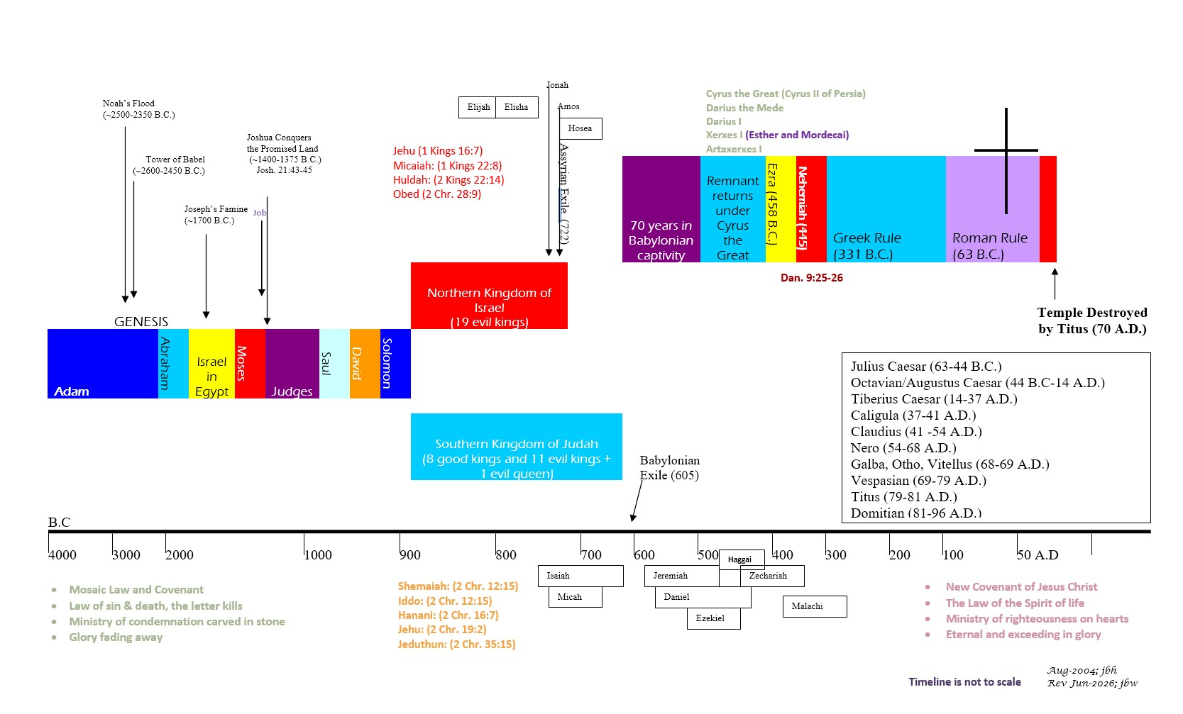
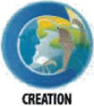

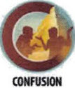



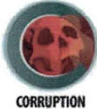
BIBLICAL CHRONOLOGICAL BACKGROUND
OT
NT
Prophets after Noah into the United Kingdom:
Abraham:
Moses:
Samuel:
Gad:
Nathan:
Ahijah
Asaph
(Gen. 20:7)
(Exo. 3:10)
(1 Sam. 3:20)
(1 Sam. 22:5)
(2 Sam. 7:2)
(1 Kings 11:29)
(2 Chr. 35:15)

Slide 11
1 Corinthians
Author: Paul
Date of Writing: c. 53 - 55 A.D.
11

Slide 12
About this Book and Its Author - Paul
The letter is named for the city of Corinth, where the church to whom it was written was located. With the exception of personal epistles addressed to Timothy, Titus, and Philemon, all Paul’s letters bear the name of the city where the church addressed existed.
As indicated in the first verse, the epistle was written by the apostle Paul, whose authorship cannot be seriously questioned. Pauline authorship has been universally accepted by the church since the first century, when 1 Corinthians was penned. Internally, the apostle claimed to have written the epistle (1 Corinthians 1:1-2).¹ Externally, this correspondence has been acknowledged as genuine since 95 A.D. by Clement of Rome, who was writing to the Corinthian church. Other early Christian leaders who authenticated Paul as author include Ignatius (c. 110 A.D.), Polycarp (c. 135 A.D.), and Tertullian (c. 200 A.D.).
This epistle was most likely written in the first half of 55 A.D. from Ephesus (1 Corinthians 16:8-9) ² while Paul was on his third missionary journey. The apostle intended to remain on at Ephesus to complete his three-year stay (Acts 20:17-31) until Pentecost (May/June) 55 A.D. Then he hoped to winter (55–56 A.D.) at Corinth (1 Corinthians 16:6).³ His departure for Corinth was anticipated even as he wrote (1 Corinthians 4:19).⁴
Notes:
¹ 1 Corinthians 1:13; 3:4–6; 4:15; 16:21
² 1 Corinthians 16:19
³ Acts 20:2
⁴ 1 Corinthians 11:34; 16:8

Slide 13
1 Corinthians – Background and Setting
The city of Corinth was located in southern Greece, in what was the Roman province of Achaia, c. 45 miles west of Athens. This lower part, the Peloponnesus, is connected to the rest of Greece by a 4-mile-wide isthmus, which is bounded on the east by the Saronic Gulf and on the west by the Gulf of Corinth. Corinth is near the middle of the isthmus and is prominently situated on a high plateau. For many centuries, all north-south land traffic in that area had to pass through or near this ancient city. Since travel by sea around the Peloponnesus involved a 250-mile voyage that was dangerous and obviously time consuming, most captains carried their ships on skids or rollers across the isthmus directly past Corinth. Corinth understandably prospered as a major trade city, not only for most of Greece but for much of the Mediterranean area, including North Africa, Italy, and Asia Minor. A canal across the isthmus was begun by the emperor Nero during the first century A.D. but was not completed until near the end of the nineteenth century.
The Isthmian games, one of the two most famous athletic events of that day (the other being the Olympian games), was hosted by Corinth, causing more people-traffic. Even by the pagan standards of its own culture, Corinth became so morally corrupt that its very name became synonymous with debauchery and moral depravity. To “corinthianize” came to represent gross immorality and drunken debauchery. In 1 Corinthians 6:9-10, Paul lists some of the specific sins for which the city was noted and which formerly had characterized many believers in the church there. Tragically, some of the worst sins were still found among some church members. One of those sins, incest, was condemned even by most pagan Gentiles (1 Corinthians 5:1).
Like most ancient Greek cities, Corinth had an acropolis (literally “a high city”), which rose 2,000 feet and was used both for defense and for worship. The most prominent edifice on the acropolis was a temple to Aphrodite, the Greek goddess of love. Some 1,000 priestesses, who were “religious” prostitutes, lived and worked there and came down into the city in the evening to offer their services to male citizens and foreign visitors.
The church in Corinth was founded by Paul on his second missionary journey. As usual, his ministry began in the synagogue, where he was assisted by two Jewish believers, Priscilla and Aquila, with whom he lived for a while and who were fellow tradesmen. Soon after, Silas and Timothy joined them, and Paul began preaching even more intensely in the synagogue. When most of the Jews resisted the gospel, he left the synagogue, but not before Crispus, the leader of the synagogue, his family, and many other Corinthians were converted (Acts 18:1–8).
After ministering in Corinth for over a year and a half (Acts 18:8-11), Paul was brought before a Roman tribunal by some of the Jewish leaders. Because the charges were strictly religious and not civil, the proconsul, Gallio, dismissed the case. Shortly thereafter, Paul took Priscilla and Aquila with him to Ephesus and from there he returned to strengthen the churches in the regions of Galatia and Phrygia. (Acts 18:18-23).
Unable to fully break with the culture from which it came, the church at Corinth was exceptionally factional, showing its carnality and immaturity. After the gifted Apollos had ministered in the church for some time, a group of his admirers established a clique and had little to do with the rest of the church. Another group developed that was loyal to Paul, another claimed special allegiance to Peter (Cephas), and still another to Christ alone (see 1 Corinthians 1:10-13; 3:1-9).
The most serious problem of the Corinthian church was worldliness, an unwillingness to divorce the culture around them. Most of the believers could not consistently separate themselves from their old, selfish, immoral, and pagan ways. It became necessary for Paul to write to correct this, as well as to command the faithful Christians not only to break fellowship with the disobedient and unrepentant members, but to put those members out of the church (1 Corinthians 5:9-13).
Before he wrote this inspired letter, Paul had written the church another correspondence (1 Corinthians 5:9), which was also corrective in nature. Because a copy of that letter has never been discovered, it has been referred to as “the lost epistle.” There was another non-canonical letter after 1 Corinthians, usually called “the severe letter” (2 Corinthians 2:4).

Slide 14
1 Corinthians: Outline
The Calling and Benefits of Sainthood
  Paul
  Called by the will of God to be an apostle
  Church of God in Corinth
  Called to be saints with all who call upon the name of our Lord Jesus Christ
  Enriched in Jesus with all knowledge
  Sustained by Jesus to be guiltless at His Coming
Immorality in the Church
Should result in mourning not arrogance
Requires action for cleansing to protect the flock, not passivity
Our bodies are the Lord’s; temples of the Holy Spirit
Liberty in the Church
  Use your freedom in Christ Jesus for the good of others
  Whether then, you eat or drink or whatever you do, do all to the glory of God
The Hope of the Church: Resurrection
  The gospel of Jesus Christ
  The importance of His Resurrection
  The resurrection of those in Christ at the last trumpet
1 Cor. 1:1–9
1 Cor. 1:10–4:21
1 Cor. 5:1–6:20
1 Cor. 7:1–40
1 Cor. 8:1–11:1
1 Cor. 11:2–14:40
1 Cor. 15:1–58
1 Cor. 16:1–24
Disunity in the Church
  The need for unity in Christ
  The need for humility before God
  The need for maturing in Christ
Marriage in the Church
Balancing service to the Lord and a spouse
Singleness
Divorce and remarriage
Worship in the Church
  Roles of men and women in the Church
  The Lord’s Supper
  Faith, hope, and love
  Spiritual gifts
A Charge to the Church
    Stewardship
    Personal plans and greetings.

Slide 15
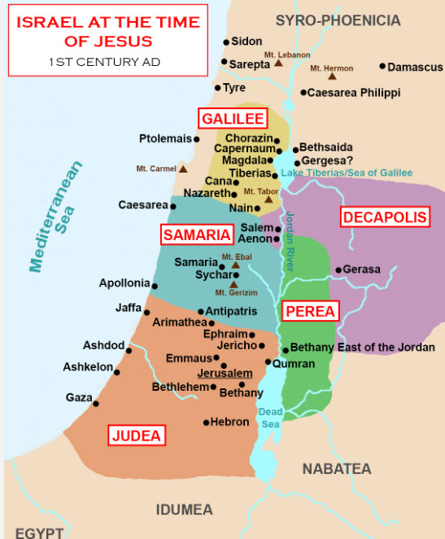
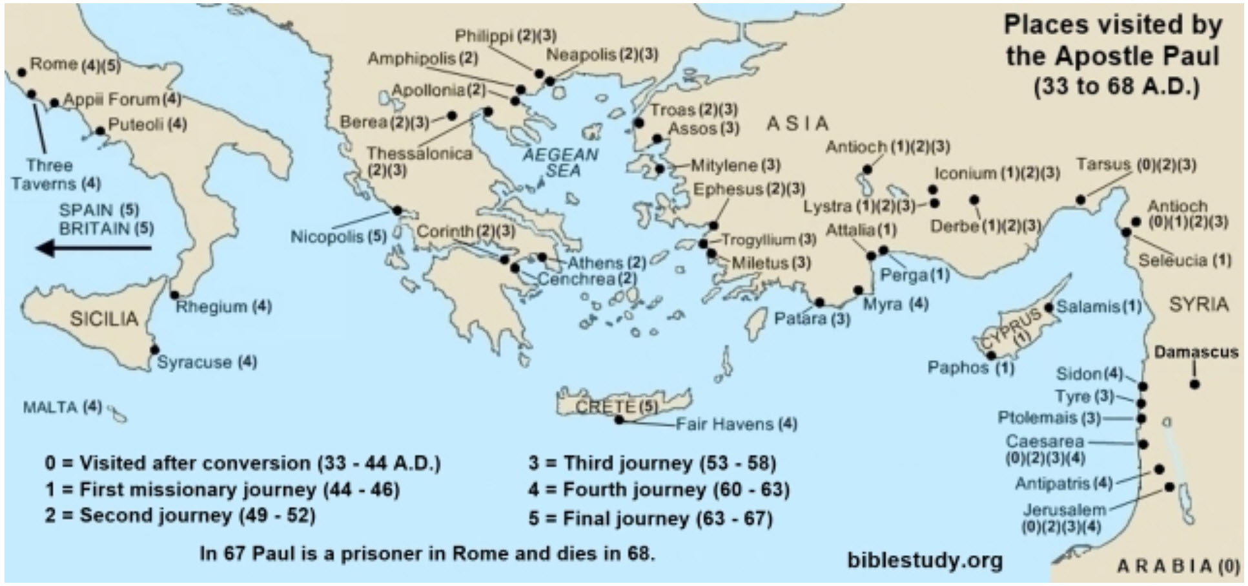
Geography for 1 Corinthians

Slide 16
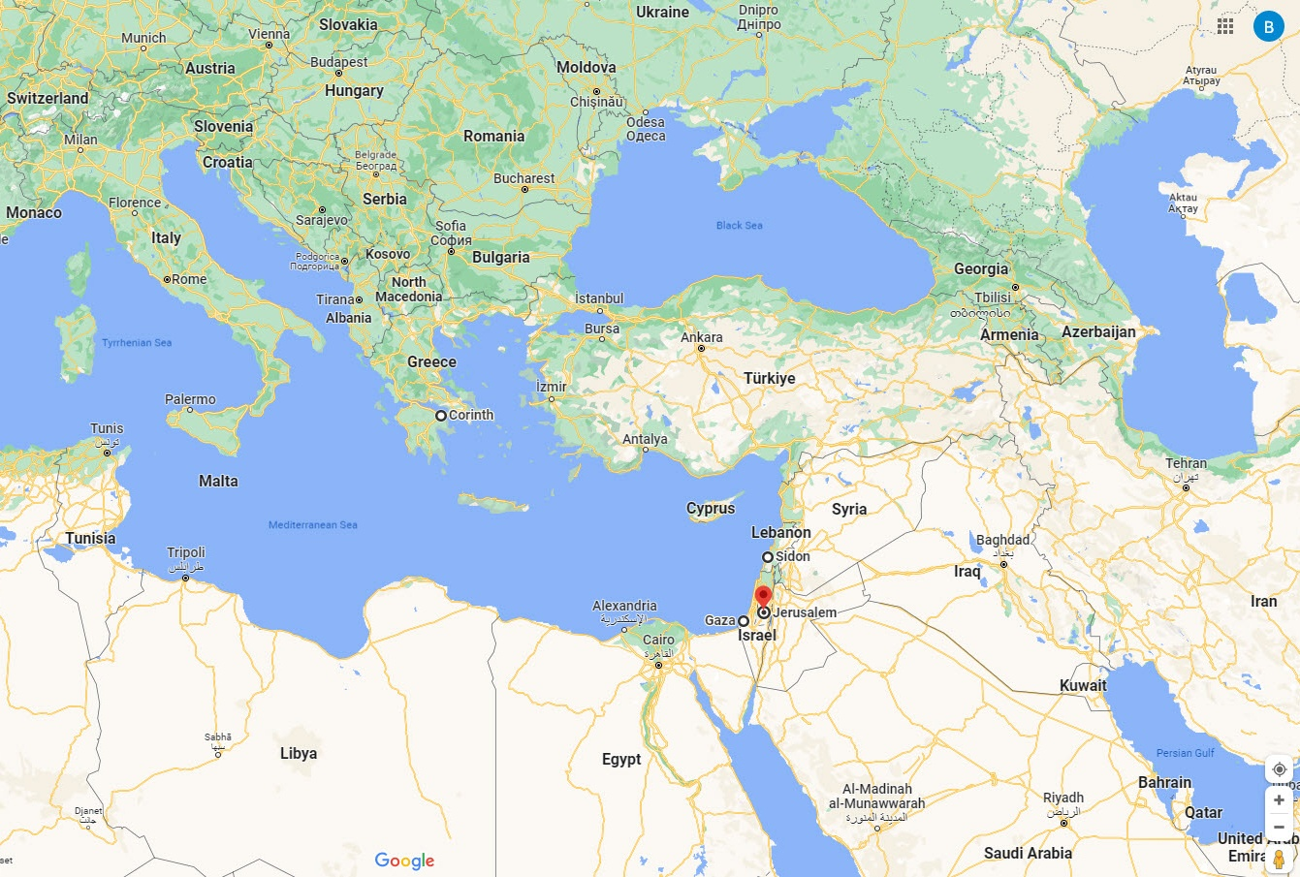
Ancient vs. Modern Day Borders

Slide 17
1 Corinthians – Key Verses
1 Corinthians 1:1-2: Paul, called by the will of God to be an apostle of Christ Jesus, and our brother Sosthenes, To the church of God that is in Corinth, to those sanctified in Christ Jesus, called to be saints together with all those who in every place call upon the name of our Lord Jesus Christ, both their Lord and ours:
1 Corinthians 1:10-13: I appeal to you, brothers, by the name of our Lord Jesus Christ, that all of you agree, and that there be no divisions among you, but that you be united in the same mind and the same judgment. For it has been reported to me by Chloe 's people that there is quarreling among you, my brothers. What I mean is that each one of you says, "I follow Paul," or "I follow Apollos," or "I follow Cephas," or "I follow Christ." Is Christ divided? Was Paul crucified for you? Or were you baptized in the name of Paul?
1 Corinthians 1:26-29: “For consider your calling, brothers: not many of you were wise according to worldly standards, not many were powerful, not many were of noble birth. But God chose what is foolish in the world to shame the wise; God chose what is weak in the world to shame the strong; God chose what is low and despised in the world, even things that are not, to bring to nothing things that are, so that no human being might boast in the presence of God.”
1 Corinthians 3:3: “You are still worldly. For since there is jealousy and quarreling among you, are you not worldly? Are you not acting like mere men?”
1 Corinthians 4:6-7: I have applied all these things to myself and Apollos for your benefit, brothers, that you may learn by us not to go beyond what is written, that none of you may be puffed up in favor of one against another. For who sees anything different in you? What do you have that you did not receive? If then you received it, why do you boast as if you did not receive it?
1 Corinthians 5:1: “It is actually reported that there is sexual immorality among you, and of a kind that is not tolerated even among pagans, for a man has his father 's wife.”
1 Corinthians 6:19-20: “Do you not know that your body is a temple of the Holy Spirit, who is in you, whom you have received from God? You are not your own; you were bought at a price. Therefore honor God with your body.”
1 Corinthians 10:13:“No temptation has overtaken you that is not common to man. God is faithful, and he will not let you be tempted beyond your ability, but with the temptation he will also provide the way of escape, that you may be able to endure it.”
1 Corinthians 10:19-22: “What do I imply then? That food offered to idols is anything, or that an idol is anything? No, I imply that what pagans sacrifice they offer to demons and not to God. I do not want you to be participants with demons. You cannot drink the cup of the Lord and the cup of demons. You cannot partake of the table of the Lord and the table of demons. Shall we provoke the Lord to jealousy? Are we stronger than he?”
1 Corinthians 10:31: “So whether you eat or drink or whatever you do, do it all for the glory of God.”
1 Corinthians 12:7: “Now to each one the manifestation of the Spirit is given for the common good.”
1 Corinthians 13:4-7: “Love is patient, love is kind. It does not envy, it does not boast, it is not proud. It is not rude, it is not self-seeking, it is not easily angered, it keeps no record of wrongs. Love does not delight in evil but rejoices with the truth. It always protects, always trusts, always hopes, always perseveres.”
1 Corinthians 15:3-4: “For what I received I passed on to you as of first importance: that Christ died for our sins according to the Scriptures, that he was buried, that he was raised on the third day according to the Scriptures.”
1 Corinthians 15:51-52: “Behold! I tell you a mystery. We shall not all sleep, but we shall all be changed, in a moment, in the twinkling of an eye, at the last trumpet. For the trumpet will sound, and the dead will be raised imperishable, and we shall be changed.”
1 Corinthians 15:58: “Therefore, my beloved brothers, be steadfast, immovable, always abounding in the work of the Lord, knowing that in the Lord your labor is not in vain.”

Slide 18
1 Corinthians: Study Questions
Read 1 Corinthians 1:1-9 and list the description and benefits to those in Christ Jesus?
In the letter to the Corinthians, the apostle Paul addresses timeless church issues including disunity, sexual immorality, church accountability, disputes between Christians, marriage, singleness, idols, roles in the church, the communion table, love, and spiritual gifts. Through this letter the Holy Spirit has provided clear and practical guidance to the Church on how to properly understand and address these things in our personal and corporate lives. Let’s explore the first two items here.
  According 1 Corinthians 1:10-13, what was causing the factions and disunity in the Corinthian church and what was the answer to this issue (see v13)?
  What was the sin being addressed in 1 Corinthians 5, and how was church leadership commanded to address the issue?
  1 Corinthians 6:1-8 addresses civil suits between believers and admonishes both church leadership and individuals for taking their disputes outside the church. What are the admonishments given to leadership and to the disputing individuals?
In Corinth and many places, it was typical for meat to be sold in the marketplace that had been sacrificed to idols. The Gentile churches had received the earlier letter of instruction to abstain from food sacrificed to idols which was given to Paul and Barnabas from the Jerusalem church council during Paul’s second missionary journey (Acts 15:22-29). Still there were issues in the Corinthian church on how to live this out in a manner pleasing to God. Whether we realize it or not, we too likely face this issue when we eat in restaurants that are owned by those who serve other gods. How should we respond when we enter a restaurant that displays an idol? Perhaps we see where food has even been laid out for the idol. Let’s look at some key passages in this section of the letter that provide instruction.
  First, what key things did Paul teach concerning idols in 1 Corinthians 8:4-6?
  In 1 Corinthians 8:10-11 Paul addresses whether it is right to dine in a pagan temple, and thereby, being certain that you are eating food that was sacrificed to idols. He wraps up his argument in 1 Corinthians 10:19-33. List the key points and direction the Holy Spirit gives us in Paul’s final instructions regarding this matter.
What does 1 Corinthians 11:23-31 teach us about how we are to treat the Lord’s communion table?
In chapters 12-14 of 1 Corinthians, we are given instruction concerning spiritual gifts. Write a brief summary using 1 Corinthians 12:1-11 and 1 Corinthians 13:8-13.

Slide 19
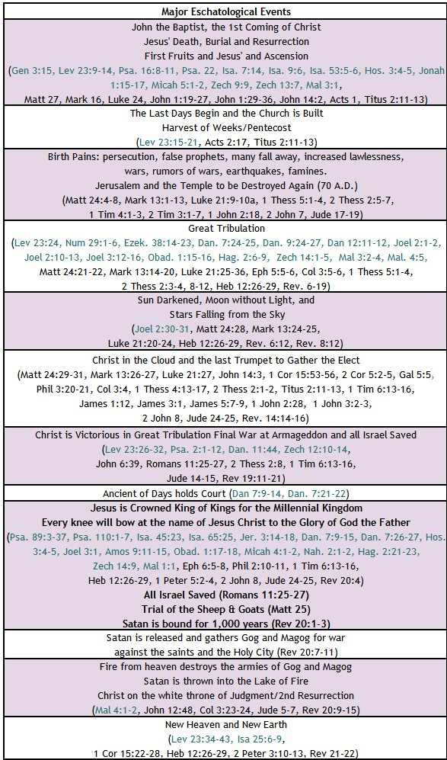

BIBLE ESCHATOLOGY
1 Corinthians
1 Corinthians 15:3-7, “For I delivered to you as of first importance what I also received: that Christ died for our sins in accordance with the Scriptures, that he was buried, that he was raised on the third day in accordance with the Scriptures, and that he appeared to Cephas, then to the twelve. Then he appeared to more than five hundred brothers at one time, most of whom are still alive, though some have fallen asleep. Then he appeared to James, then to all the apostles.”
1 Corinthians 15:22-28, “For as in Adam all die, so also in Christ shall all be made alive. But each in his own order: Christ the firstfruits, then at his coming those who belong to Christ. Then comes the end, when he delivers the kingdom to God the Father after destroying every rule and every authority and power. For he must reign until he has put all his enemies under his feet. The last enemy to be destroyed is death. For “God has put all things in subjection under his feet.” But when it says, “all things are put in subjection,” it is plain that he is excepted who put all things in subjection under him. When all things are subjected to him, then the Son himself will also be subjected to him who put all things in subjection under him, that God may be all in all.”
1 Corinthians 15:53-56, “For this perishable body must put on the imperishable, and this mortal body must put on immortality. When the perishable puts on the imperishable, and the mortal puts on immortality, then shall come to pass the saying that is written: “Death is swallowed up in victory.” “O death, where is your victory? O death, where is your sting?” The sting of death is sin, and the power of sin is the law.”
19

Slide 20
1 Corinthians – Summary
Brief Summary: 1 Corinthians was written c. 55 A.D. from Ephesus while Paul was on his third missionary journey. Though this letter was written to correct various issues in the church at Corinth, Paul opens the letter by reminding the believers of their calling and many benefits in Christ Jesus. He tells them they have been set apart, called to be saints, and to receive grace and peace from God our Father and the Lord Jesus Christ. He reminds them that God has enriched them in Christ in all speech, knowledge, and fellowship and of God’s promise to sustain them and present them guiltless in the day of our Lord Jesus Christ (1 Corinthians 1:1-9).
After reminding the church of the benefits of their calling, Paul addresses the issues of the church. First, many believers in Corinth were dividing into groups loyal to certain spiritual leaders (1 Corinthians 1:12; 3:1-6) creating disunity in the church. Paul exhorted the Corinthian believers to not be foolishly arrogant, but to be united because of devotion to Christ who alone was crucified for their salvation (1 Corinthians 1:13-31, 3:21-23). Secondly, many in the church were essentially approving of a sexually immoral relationship (1 Corinthians 5:1-2). Paul commanded them to expel the wicked man from the church for the glory of Christ and the health of the flock (1 Corinthians 5:13).
Paul gave the Corinthian church instructions on settling disputes making it clear that conflicts should be settled within the church, and that it would be better to be taken advantage of than to damage one’s Christian testimony (1 Corinthians 6:3-8, Matthew 18:15-20). The apostle deals with marriage and celibacy in chapter 7 and then utilizes three chapters to address the issue of food sacrificed to idols and how to live out our Christian liberty in a way that glorifies God and seeks the good of others (chapters 8 -10). Chapters 12-14 address church worship including roles, the Lord’s communion table, the exercise of spiritual gifts, and how all should be done in love as God defines love (1 Corinthians 13).
Through Paul, the Holy Spirit begins the conclusion of the letter with the gospel, the crucial importance of Christ’s resurrection, and the promise of our resurrection through Him (1 Corinthians 15). In 1 Corinthians 10:6, Paul writes “Now these things took place as examples for us, that we might not desire evil as they did.” He wrote this after reminding the Corinthians about Israel’s sinful behavior in the wilderness. With this letter to the Corinthians, we now have this example two-fold, from both Israel and the Corinthians so that we will not crave evil things but instead live as saints of God.
Connections: In chapter 5 Paul takes us back to the Feast of Unleavened Bread and the Passover reminding the Church that Christ, our ultimate Passover Lamb, has been sacrificed, and we in turn, are to remove the leaven (i.e., sin) from our lives (Exodus 12:15-20, Leviticus 23:6-8). Then in chapter 10, Paul uses the story of the Israelites wilderness experience to illustrate to the Corinthian believers the folly of the misuse of freedom and the danger of overconfidence. The Israelites who, despite seeing God’s miracles and care for them—the parting of the Red Sea, the miraculous provision of manna from heaven and water from a rock—misused their freedom, and displeased God through their rebellion, grumbling, idolatry, and immorality (Numbers 11:4-6, 34, 25:1-9; Exodus 16:2, 17:2, 32:1-6). The Corinthian believers despite having the indwelling of the Holy Spirit and the benefits of grace, had fallen into these same sins. We too must take heed trusting God to enable us to endure; otherwise, we too will fall (1 Corinthians 10:11-13).

Slide 21
1 Corinthians: Practical Application
Practical Application: Many of the problems and questions the Corinthian church was dealing with are still present in the church today. Churches today still struggle with divisions, with immorality, and with the use of spiritual gifts. The Book of 1 Corinthians very well could have been written to the church today, and we would do well to heed Paul’s warnings and apply them to ourselves. Despite all the rebukes and corrections, 1 Corinthians brings our focus back to where it should be—on Christ. Genuine Christian love is the answer to most problems (1 Corinthians 13). A proper understanding of our God, the resurrection of Christ, our own promised resurrection, and the proper application of God’s wisdom as we rely on his Holy Spirit will enable us to walk in God’s love and be victorious over those things that seek to divide and defeat us (1 Corinthians 15 , 1 Corinthians 10:13).
21

Slide 22
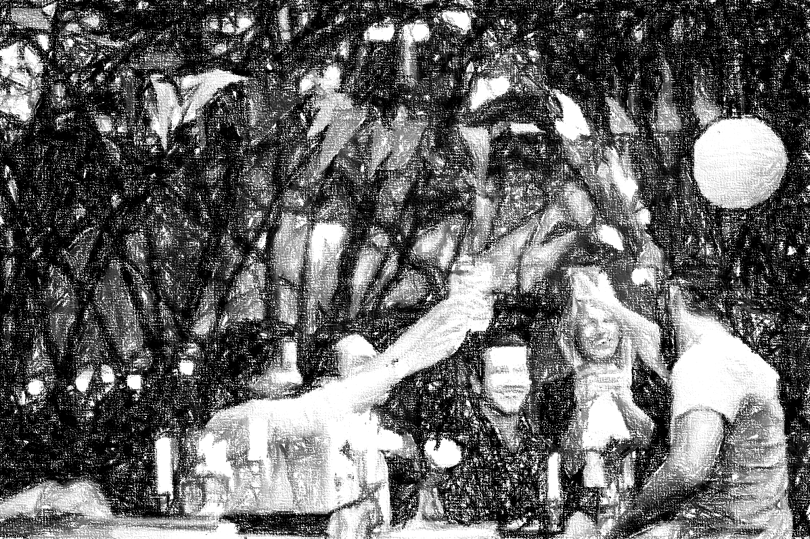
Closing Prayer Verse
1 Corinthians 10:6-11, “Now these things took place as examples for us, that we might not desire evil as they did. Do not be idolaters as some of them were; as it is written, "The people sat down to eat and drink and rose up to play." We must not indulge in sexual immorality as some of them did, and twenty-three thousand fell in a single day. We must not put Christ to the test, as some of them did and were destroyed by serpents, nor grumble, as some of them did and were destroyed by the Destroyer. Now these things happened to them as an example, but they were written down for our instruction, on whom the end of the ages has come.”

Slide 23
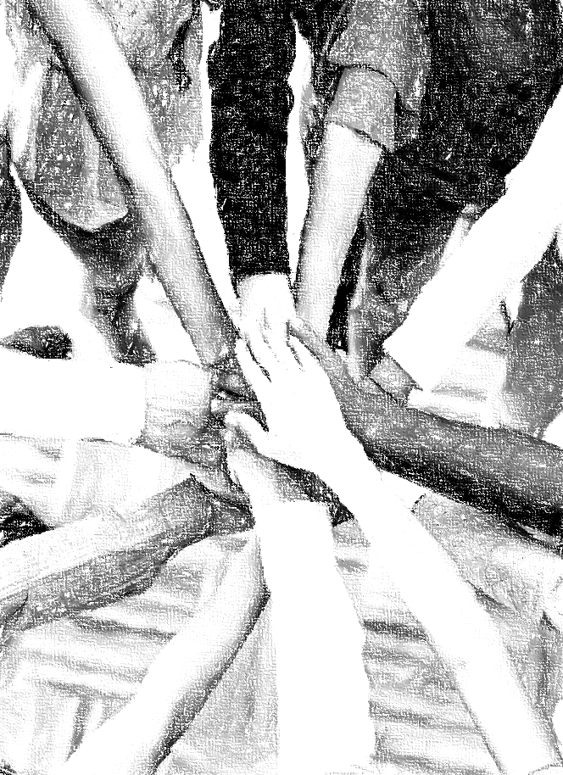
Acknowledgements
Background, Setting, Outlines, some Study Question answers, interpretative challenges, and some Summaries: Adapted from John MacArthur Study Bible at GTY.org.
Key verses, Practical Application, some Study Question answers, and some Summaries: Adapted from GotQuestions.org.
Inductive Bible Study Method: Adapted from Precept.org.
Creation – Consummation Icons: Adapted from AnswersInGenesis.org.
Definitions: Adapted from Websters 1828 Dictionary.
Bible Reference Software and Quotes: All Scripture quotations are taken from the Holy Bible using primarily the English Standard Version (ESV) or New American Standard Bible (NASB) translations. Links to Scripture references utilize BibleRef.com, which is a Got Questions Ministries’ website.

Slide 24
Study Leader Assistance
Sample Prayers
Study Question Answer Keys

Slide 25
Sample Opening Prayer Verse: 1 Corinthians
1 Corinthians 1:2-9, “To the church of God that is in Corinth, to those sanctified in Christ Jesus, called to be saints together with all those who in every place call upon the name of our Lord Jesus Christ, both their Lord and ours: Grace to you and peace from God our Father and the Lord Jesus Christ. I give thanks to my God always for you because of the grace of God that was given you in Christ Jesus, that in every way you were enriched in him in all speech and all knowledge — even as the testimony about Christ was confirmed among you — so that you are not lacking in any gift, as you wait for the revealing of our Lord Jesus Christ, who will sustain you to the end, guiltless in the day of our Lord Jesus Christ. God is faithful, by whom you were called into the fellowship of his Son, Jesus Christ our Lord.
Sample Prayer: Dear Heavenly Father, we are amazed that you call us saints and have set us apart in Christ Jesus. Thank you for the grace and peace you continually provide to us and for growing us in speech and knowledge through your word so that we are not lacking in any gift. We ask that you stir us to use our gifts to build each other up. Thank you for your faithful promise to sustain us to the end guiltless in the day of our Lord Jesus Christ. We love you, Father. In Jesus’ name we pray. Amen.

Slide 26
1 Corinthians: Study Question ANSWERS
Read 1 Corinthians 1:1-9 and list the description and benefits to those in Christ Jesus? Answer: We are set apart in Christ Jesus, called to be saints, and receive grace and peace from God our Father and the Lord Jesus Christ. God enriches us in Christ in all speech and knowledge so that we do not lack any gift. And, God has promised to sustain us and present us guiltless in the day of our Lord Jesus Christ in whom we have been called into fellowship.
In the letter to the Corinthians, the apostle Paul addresses timeless church issues including disunity, sexual immorality, church accountability, disputes between Christians, marriage, singleness, idols, roles in the church, the communion table, love, and spiritual gifts. Through this letter the Holy Spirit has provided clear and practical guidance to the Church on how to properly understand and address these things in our personal and corporate lives. Let’s explore the first two items here.
  According 1 Corinthians 1:10-13, what was causing the factions and disunity in the Corinthian church and what was the answer to this issue (see v13)? Answer: Groups had set themselves against one another claiming discipleship to Paul, Peter, Apollos, or Christ. In essence, these groups had begun to “idolize” their favorite messenger and were arrogant in their “so-called” knowledge. The answer to this disunity was given in verse 13. It is Christ who was crucified for us and into whom we have been immersed for salvation. Christ is not divided. Paul, Peter, and Apollos were mortal men called by God and unified in preaching Christ alone. Therefore, we are to be unified in following Christ alone.
  What was the sin being addressed in 1 Corinthians 5, and how was church leadership commanded to address the issue? Answer: A man had taken his father’s wife, which means the woman was his stepmother since Paul did not say the man had taken his mother. (If you previously studied Genesis, you may remember that Jacob’s firstborn son, Reuben, did a similar thing and lost his position as firstborn [see Genesis 35:22, Genesis 49:4)]). Paul commanded church leadership to put the unrepentant sinners out of the church out of reverence to God and to protect the flock. Later when the man repents, he is re-instated into the church body (2 Corinthians 2:5-11).
  1 Corinthians 6:1-8 addresses civil suits between believers and admonishes both church leadership and individuals for taking their disputes outside the church. What are the admonishments given to leadership and to the disputing individuals? Answer: Church leadership is admonished for not having a system in place where those wise enough to settle disputes are available. Paul tells them that the world and angels will be judged by the saints; thus, there should be within the church those who are competent to try trivial cases between brothers (v. 2-5). He says to the individuals that the lawsuits demonstrate their immaturity in Christ. Individual saints should be developing hearts that are unwilling to defraud others and would rather suffer wrong for Christ’s sake (v. 6-8).
In Corinth and many places, it was typical for meat to be sold in the marketplace that had been sacrificed to idols. The Gentile churches had received the earlier letter of instruction to abstain from food sacrificed to idols which was given to Paul and Barnabas from the Jerusalem church council during Paul’s second missionary journey (Acts 15:22-29). Still there were issues in the Corinthian church on how to live this out in a manner pleasing to God. Whether we realize it or not, we too likely face this issue when we eat in restaurants that are owned by those who serve other gods. How should we respond when we enter a restaurant that displays an idol? Perhaps we see where food has even been laid out for the idol. Let’s look at some key passages in this section of the letter that provide instruction.
  First, what key things did Paul teach concerning idols in 1 Corinthians 8:4-6? Answer: An idol has no real existence and that there is no God but one. For even though there are so-called "gods" and "lords", there is one God, the Father, from whom are all things and for whom we exist, and one Lord, Jesus Christ, through whom are all things and through whom we exist.”
  In 1 Corinthians 8:10-11 Paul addresses whether it is right to dine in a pagan temple, and thereby, being certain that you are eating food that was sacrificed to idols. He wraps up his argument in 1 Corinthians 10:19-33. List the key points and direction the Holy Spirit gives us in Paul’s final instructions regarding this matter. Answer: Even though an idol is made by human hands, the false religion behind the idol is demonic. Thus, what pagans sacrifice they offer to demons and not to God. We cannot partake of the table of the Lord and the table of demons; doing so provokes God to jealousy and communicates the wrong teaching to Christians who are younger in the faith. Thus, we are to avoid pagan temples but buy in the marketplace and eat whatever is set before us with thanksgiving without raising the question. The market would include a restaurant; yet if I were with a Christian who was uncomfortable in a restaurant that displayed an idol, I would suggest that we leave for their conscience sake (1 Cor. 8:12). In reality, the earth is the Lord's. So, whether we eat or drink, or whatever we do, we are to do all to the glory of God. And the glory of God includes the good of our fellow Christians.
What does 1 Corinthians 11:23-31 teach us about how we are to treat the Lord’s communion table? Answer: The Lord's communion table symbolizes the sacrifice of his body and blood to redeem us and fulfill the New Covenant, which cleanses us and reconciles us to God. We are to do to approach it in reverent remembrance of Jesus; thereby proclaiming his death until He returns. We are commanded to examine our lives and if we have unrepentant sin in our lives ,we are to abstain from the Lord's table so that we do not dishonor him. When we fail to do this, we bring judgment upon ourselves that can lead to sickness and even death.
In chapters 12-14 of 1 Corinthians, we are given instruction concerning spiritual gifts. Write a brief summary using 1 Corinthians 12:1-11 and 1 Corinthians 13:8-13. Answer: The Holy Spirit gives a variety of gifts to the Church body of Jesus Christ for the common good of the whole assembly. The list includes wisdom, knowledge, faith, miracles, prophecy, discernment, foreign languages and the interpretation of languages. All these gifts are empowered by one and the same Spirit, who apportions to each one individually as he wills. And the gifts, which are received, are to be applied in humility and love for the good of others and the glory of God.

Slide 27
Sample Closing Prayer Verse
1 Corinthians 10:6-11, “Now these things took place as examples for us, that we might not desire evil as they did. Do not be idolaters as some of them were; as it is written, "The people sat down to eat and drink and rose up to play." We must not indulge in sexual immorality as some of them did, and twenty-three thousand fell in a single day. We must not put Christ to the test, as some of them did and were destroyed by serpents, nor grumble, as some of them did and were destroyed by the Destroyer. Now these things happened to them as an example, but they were written down for our instruction, on whom the end of the ages has come.”
Sample Prayer: Dear Heavenly Father, thank you for having these historical events written down and preserved for us so that we can learn from these examples and be certain about the things that displease you. We ask that you keep us from idolatry, immorality, and grumbling against you. Enable us to come to our senses and find joy and contentment in being the beloved children of the Creator of the universe. Work in us to use the liberty you have given us in our Lord Jesus to bring you glory and good to others. In His name we pray. Amen.

