Slide 1
Exodus
Book 2

Slide 2
What is the Holy Bible?
The Holy Bible is a collection of writings that includes 66 books in English editions. The Bible consists of two parts, the Old Testament and New Testament. The word testament means covenant. The Old Testament includes 39 books, and the New Testament includes 27 books.
These 66 books were written over approximately 1,400 years by 40 different authors in Hebrew, Aramaic, and Greek. The Old Testament writings were affirmed by Jewish leaders, and moreover, by Jesus Christ.¹ The New Testament writings were confirmed by early church leaders. The 66 books of the Bible are the inspired words of God that are used to make and mature disciples of the One true God through Jesus Christ, his Son (Matthew 28:18-20, 2 Timothy 3:16-17). The Bible was not created by mere human wisdom but was inspired by God (2 Peter 1:20-21), is interpreted by His Holy Spirit (John 16:13, Matthew 23:8-10), and will last forever (Matthew 24:35).²
If you do a phrase search on the Bible you will find the phrase "the word of the Lord" and "Thus says the Lord" more than 700 times.³ In addition, this book has given reasonable evidence to the claim of being God’s word by:​
  providing answers that conform with the reality we see around us.
  being a reliable collection of historical documents.
  containing eyewitness accounts that were written during the lifetimes of other eyewitnesses.
  recording supernatural events that took place in fulfillment of specific prophecies.⁴
Notes:
¹ See Matthew 4:4-7, 12:3-5, Mark 7:6-7, 12:26-27, and Luke 19:46 for examples.
^{2 “}What are the Books of the Bible”, GotQuestions.org
³ Blue Letter Bible
⁴ Paraphrased from Voddie Baucham

Slide 3
Our Goals in Studying the Bible
To better …..
Understand the Only true God; the Author of the Bible. (2 Timothy 3:16-17, 2 Peter 1:20-21, 1 John 5:20 , Jeremiah 9:23-24)
Learn How He works in the World and in our Lives. (Job 40:6-14, Isaiah 45:6-7, Isaiah 46:8-10, Philippians 2:12-13)
Understand Ourselves and the Hearts of Mankind. (Jeremiah 17:9, 2 Timothy 3:13, Ephesians 5:7-10)
Come to Know What Pleases and Grieves God. (1 Thessalonians 4:1, Ephesians 4:26-31, Hebrews 11:6, 1 Peter 1:14-19)
To be Transformed into Fruitful Doers of God’s Word and not just Hearers. (Romans 12:2, James 1:27, Matthew 3:8)
Tether Ourselves to God’s Word for Our Wisdom, Discernment, and Safety. (1 Corinthians 6:9-10, Matthew 24:24, Ephesians 4:11-14)
Jeremiah 9:23-24 “Thus says the Lord: "Let not the wise man boast in his wisdom, let not the mighty man boast in his might, let not the rich man boast in his riches, but let him who boasts boast in this, that he understands and knows me, that I am the Lord who practices steadfast love, justice, and righteousness in the earth. For in these things I delight, declares the Lord."

Slide 4
How to Study the Bible
#1. Observation: What does the text say.
Who?
What?
When?
Where?
How?
Why?
#2. Interpretation: What does the text mean in context with the passage, book, and whole counsel of God?
#3. Application: How is the Holy Spirit instructing me to apply this understanding at this time in my life?

Slide 5
Study Resources
Opening Prayer
Background and Setting
Book Outline
Geography Maps
Key Verses
Study Questions
Major Event Timeline
Book Summary
Application and Closing Prayer
Study Leader Support Slides

Slide 6

Opening Prayer Verse: Exodus
Exodus 34:5-8, “The LORD, the LORD God, compassionate and gracious, slow to anger, and abounding in lovingkindness and truth; who keeps lovingkindness for thousands, who forgives iniquity, transgression and sin; yet He will by no means leave the guilty unpunished, visiting the iniquity of fathers on the children and on the grandchildren to the third and fourth generations."

Slide 7
Review of Genesis
Brief Summary: The Book of Genesis was written c. 1445-1400 B.C. by Moses as affirmed by Jesus Christ (see Mark 12:24-27, Luke 20:34-38). This is the book of the beginnings, which provides the historical account of the universe God created. In the beginning God created the earth for habitation (Isaiah 45:18), the universe to declare his glory (Psalm 19:1-3), and all living creatures after their own kinds in six days and rested on the seventh day (Genesis 1:1-31); establishing our work week (Exodus 20:8-11). He made mankind, male and female, specifically, Adam and Eve, in his own image to have communion with Him, be the original parents of all human beings, and to have dominion over all other living creatures. God gave them only one commandment to obey; and everything was very good. But then man believed the evil one, mistrusted God’s words, and disobeyed God. This brought God's punishment of death into the world, pain in childbirth, and burdensome toil in bringing food from the ground. Yet God in His mercy also promised a Seed of the woman who would bruise the head of the serpent (Genesis 3:1-24). In Genesis God lays the foundation for us to understand who He is, who we are, where we came from, why we are here, why we wear clothes, why we marry and have families, and how sin, hardship, and death entered his perfect world. In the sequence of accounts that make up these chapters of Scripture, a pattern emerges that reveals God’s abundant grace as he responded to the repeated willful disobedience of mankind.
Genesis can be divided into two sections: Primitive History (Genesis 1-11) and Patriarchal History (Genesis 12-50). Primitive history records (1) Creation, (2) Corruption (the Fall of man), (3) Catastrophe (the Flood), and (4) Confusion (God’s confounding of the languages that resulted in the nations). Patriarchal history records the lives of four great men: (1) Abraham, (2) Isaac, (3) Jacob, and (4) Joseph. God chose Abraham through whom He would create a chosen people and eventually bring the promised Messiah. This covenant promise was passed on to Abraham’s son Isaac, and then to Isaac’s son Jacob. God changed Jacob’s name to Israel, and his twelve sons became the ancestors of the twelve tribes of Israel. In His sovereignty, God allowed Jacob’s son Joseph to be sent to Egypt by the vile actions of Joseph’s brothers. This act, intended for evil by the brothers, was meant for good by God. Through God’s providence Joseph rose to power in Egypt, and his actions saved many lives from a devastating famine including the lives of Jacob, his brothers, and their families. Before Jacob’s death he bestowed prophetic blessings upon his sons. God ends this book with a message of hope as we read that when Joseph was near death, he requested that his bones be taken to the Promised Land as he was looking forward to when God would fulfill his pledge to Abraham to give his descendants the land.
Foreshadowings: Many New Testament themes have their roots in Genesis. Jesus Christ is the Seed of the woman who will destroy Satan’s power (Genesis 3:15, John 3:16). As with Joseph, the evil men did in crucifying Jesus Christ, God used for the good of mankind offering His Son as a sacrifice for our sins (Acts 2:22-24). Noah and his family are the first of many remnants pictured in the Bible (Genesis 6-9). Despite overwhelming odds and difficult circumstances, God always preserves a remnant of the faithful for Himself. God told Elijah he had preserved 7,000 in Israel who had not turned to idolatry (1 Kings 19:13-18) and saved 100 prophets from Jezebel’s murderous rampage (1 Kings 18:3-4). A remnant of Israelites returned to Jerusalem after the Babylonian captivity and destruction of Jerusalem (Ezra 1). God has preserved a remnant of faithful Jews through history (Acts 1-9, Jews for Jesus). Moreover, God promises that a remnant generation of all Israel will one day embrace their true Messiah (Romans 11:25-27). The faith displayed by Abraham would be the gift of God and the basis of salvation for both Jew and Gentile (Ephesians 2:8-9; Hebrews 11).

Slide 8
Old Testament Table of Contents (39 Books)
THE LAW - 5
GENESIS
EXODUS
LEVITICUS
NUMBERS
DEUTERONOMY
POETRY - 5
JOB
PSALMS
PROVERBS
ECCLESIASTES
SONG OF SOLOMON
MINOR PROPHETS – 12
HOSEA
JOEL
AMOS
OBADIAH
JONAH
MICAH
NAHUM
HABAKKUK
ZEPHANIAH
HAGGAI
ZECHARIAH
MALACHI
HISTORY – 12
JOSHUA
JUDGES
RUTH
1 SAMUEL
2 SAMUEL
1 KINGS
2 KINGS
1 CHRONICLES
2 CHRONICLES
EZRA
NEHEMIAH
ESTHER
MAJOR PROPHETS - 5
ISAIAH
JEREMIAH
LAMENTATIONS
EZEKIEL
DANIEL

Slide 9
Old Testament Books by Date Written
Historical Books
Wisdom Book and Prophetic Books
Genesis:
c. 1445-1400 B.C.
Exodus:
c. 1445-1400 B.C.
Leviticus:
c. 1445-1400 B.C.
Numbers:
c. 1405 B.C.
Deut:
c. 1405 B.C.
Joshua:
c. 1405-1385 B.C.
Judges:
c. 1043 B.C.
1 & 2 Samuel:
c. 960-722 B.C.
1 & 2 Kings:
c. 560-540 B.C.
Ezra:
c. 460-440 B.C
Esther:
c. 460-350 B.C..
1 & 2 Chron:
c. 450-425 B.C.
Nehemiah:
c. 445-420 B.C.
Ruth
c. 1011-971 B.C.
Job:
c. 1440 – 950 B.C.
Psalms:
c. 1410-500 B.C.
Proverbs and Song of Solomon:
c. 965 B.C.
Ecclesiastes:
c. 930 B.C.
Obadiah:
c. 848-840 B.C.
Joel:
c. 835 – 796 B.C
Jonah
c. 790 – 739 B.C.
Isaiah and Micah:
c. 739 – 681 B.C.
Nahum:
c. 663–612 B.C.
Habakkuk and Zephaniah:
c. 635-605 B.C
Jeremiah and Lamentations
c. 630-575 B.C.
Ezekiel and Daniel:
c. 593 – 530 B.C.
Haggai and Zechariah
c. 520-470 B.C.
Malachi
c. 440 – 400 B.C.
Hosea and Amos:
c. 760 -725 B.C.
Amos 3:7 : “For the Lord GOD does nothing without revealing his secret to his servants the prophets.”

Slide 10


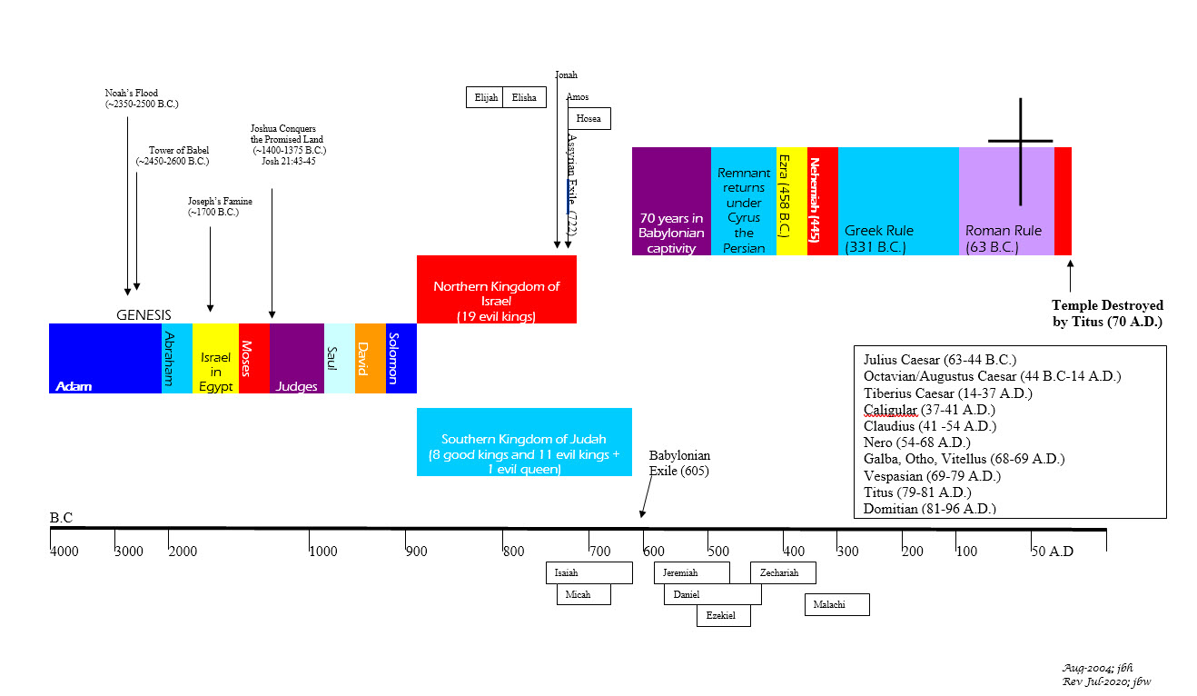

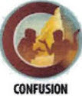



BIBLICAL CHRONOLOGICAL BACKGROUND
OT
Cyrus the Great (Cyrus II)
Darius the Mede
Darius I
Xerxes I (Esther and Mordecai)
Artaxerxes I
NT
Jehu (1 Kings 16:7)
Micaiah: (1 Kings 22:8)
Huldah: (2 Kings 22:14)
Obed (2 Chr 28:9)
Job
Daniel 9:25-26
Prophets after Noah into the United Kingdom:
Abraham:
Moses:
Samuel:
Gad:
Nathan:
Ahijah
Asaph
(Gen 20:7)
(Exo 3:10)
(1 Sam 3:20)
(1 Sam 22:5)
(2 Sam 7:2)
(1 Kings 11:29)
(2 Chron 35:15)
Haggai
Mosaic Law and Covenant
Law of sin & death, the letter kills
Ministry of condemnation carved in stone
Glory fading away
Shemaiah: (2 Chr 12:15)
Iddo: (2 Chr 12:15)
Hanani: (2 Chr 16:7)
Jehu: (2 Chr 19:2)
Jeduthun: (2 Chr 35:15)
New Covenant of Jesus Christ
The Law of the Spirit of life
Ministry of righteousness on hearts
Eternal and exceeding in glory
Timeline is not to scale

Slide 11
Exodus
Author: Moses
Date of Writing: c.1445 – 1400 B.C.

Slide 12
About Exodus and its Author: Moses
The Greek Septuagint (LXX) and the Latin Vulgate versions of the Old Testament (OT) assigned the title “Exodus” to this second book of Moses, because the departure of Israel from Egypt is the dominant historical fact in the book (Exodus 19:1). In the Hebrew Bible, the opening words, “And (or Now) these are the names,” served as the title of the book (Exodus 1:1 NASB). The opening “And” or “Now” in the Hebrew title suggests that this book was to be accepted as the obvious sequel to Genesis, the first book of Moses. Hebrews 11:22 commends the faith of Joseph who, while on his deathbed (c. 1589 B.C.)¹, spoke of the “Exodus” of the sons of Israel, looking ahead over 140 years to the Exodus (c. 1445 B.C.).
Mosaic authorship of Exodus is unhesitatingly affirmed. Moses followed God’s instructions and “wrote down all the words of the Lord” (Exodus 24:4), which included at the least the record of the battle with Amalek (Exodus 17:14), the Ten Commandments (Exodus 34:4, Exodus 34:27–29), and the Book of the Covenant (Exodus 20:22–23:33). Similar assertions of Mosaic writing occur elsewhere in the Pentateuch: Moses is identified as the one who recorded “their stages according to their starting places” (Numbers 33:2) and who “wrote this law” (Deuteronomy 31:9).
Other OT books also corroborate Mosaic authorship of the portions mentioned above. ² The New Testament concurs by citing Exodus 3:6 as part of “the book of Moses” (Mark 12:26), by assigning Exodus 13:2 to “the law of Moses,” which is also referred to as “the Law of the Lord” (Luke 2:22–23), by Jesus’ specifically declaring that Moses had written of him (John 5:46–47), and various other references.³
At some time during his 40-year tenure as Israel’s leader, beginning at 80 years of age and ending at 120,⁴ Moses wrote down this second of his five books. More specifically, it would have been after the Exodus and obviously before his death on Mount Nebo in the plains of Moab. The date of the Exodus (c. 1445 B.C.) dictates the date of the writing in the fifteenth century B.C.
Scripture dates Solomon’s fourth year of reign, when he began to build the temple (c. 966/65 B.C.), as being 480 years after the Exodus (1 Kings 6:1), establishing the early date of 1445 B.C.
Scripture also teaches us that the law came 430 years after God made his covenant promise to Abraham (Galatians 3:16-17). Abraham received the promise at age 75 year, and using the Bible’s genealogies, Abraham was born c. 1950 B.C., and received the call from God c. 1875 B.C. Thus, the 1875 – 430 years also coincides with the accepted date of the Exodus as c. 1445 B.C. One interpretative challenge is Exodus 12:40-41, which states that the time the people of Israel lived in Egypt was 430 years. Since 1 Kings 6:1 and Galatians 3:16-17 so clearly point to the c. 1445 B.C. date for the Exodus, the only reasonable interpretation that this writer can conclude is that Abraham’s time in Egypt is also counted in this 430 years (Genesis 12:10-20).
Using the dates above and the corrected Egyptian chronology from Answers in Genesis (AIG) ^{1,2}, we can conclude Joseph went to Egypt under Pharaoh Sesostris I. Sesostris III would have been the pharaoh who oppressed the Israelites into further slavery, and Sobekneferu, the daughter of Amenemhet III, was the princess who rescued Moses from the Nile. Lastly, Neferhotep I was the pharaoh who refused to let the Israelites go and who subsequently drowned in the Red Sea with his army.
DATE: c. 1445 – 1400 B.C.
Notes:
¹Corrected Chronology ,Pharaohs of the Bible
² Joshua 1:7–8; 8:31–32; 1 Kings 2:3; 2 Kings 14:6; Neh. 13:1; Dan. 9:11–13; and Mal. 4:4
³ Exodus 20:12, Exodus 21:17, Mark 7:10, John 7:19; Romans 10:5
⁴ Exodus 7:7; Deuteronomy 34:7

Slide 13
AIG Chronology from Joseph – Exodus¹
Exodus
Background and Setting
Biblical Events & Reference | Biblical Reference | c. Dates (B.C.) | Egyptian Dynasties
Abram responds to God’s call and promise | Genesis 12:1-5 | 1875 | Dynasty 4
 |  | 1703 | Dynasty 12 Amenemhet I
Joseph sold into slavery in Egypt at age 17 | Genesis 37:2 | 1682
 |  | 1673 | Sesostris I
Joseph as prime minister in Egypt at age 30 | Genesis 41:46 | 1668
Jacob migrated to Egypt, age 130 years | Genesis 47:9 | 1660
 |  | 1628 | Amenemhet II
 |  | 1592 | Sesostris II
Joseph died (110-30-5=75) | Genesis 50:26, 41:46, 45:11 | 1589
Oppression |  | 1572 | Sesostris III
 |  | 1531 | Amenemhet III
Moses born 80 years before Exodus | Exodus 7:7 | 1525
Moses fled to Midian, age 40 years | Acts 7:23 | 1485
 |  | 1483 | Sobekneferu
 |  | 1479 | Dynasty 13
 |  | 1456 | Neferhotep I
 |  | 1445
Exodus | 1 Kings 6:1, Exodus 7:7 Exodus 12:40-41, Galatians 3:16–17
40 years later | Numbers 14:34, Deuteronomy 34:7 | 1405
As the sequel to Genesis, Exodus begins by listing the names of the sons of Israel who came to Egypt to escape the famine after Joseph had risen to power. After Joseph’s death another ruler rose to power who did not know Joseph and set his mind to deal shrewdly with the Israelites by oppressing them into slavery and even murdering their newborn boys. But Moses’ mother hid him and when she could do so no longer, she placed him in a small ark and put the child in the Nile. Moses was rescued from the Nile by princess Sobekneferu, the daughter of Amenemhet III,¹ and became “instructed in all the wisdom of the Egyptians” while growing up in Pharaoh’s court his first 40 years (Acts 7:22-23). Later he fled to Midian where he lived for another 40 years (Exodus 2:11-15, Acts 7:30), and returned at God’s direction to be Israel’s leader early in the reign of Neferhotep I, ¹ the pharaoh of the Exodus. God used both the educational system of Egypt and his exile in Midian to prepare Moses to represent his people before a powerful pharaoh and to guide his people through the wilderness of the Sinai peninsula during his final 40 years (Acts 7:36).
There is difficulty and uncertainty in assigning dates and rulers to the more ancient Egyptian dynasties. Before the 1st Dynasty of Egypt, most scholars place a pre-historic period, and then a pre-dynastic period of about 2,000 years.¹ The former is dependent on the macro-evolutionary period to which is attributed millions of years and is based on unsubstantiated speculation. Therefore, Assyrian chronology is far more reliable than the current Egyptian chronology and should be used as the basis for chronological calculations. ¹ Further, as biblical chronology is very specific and is consistent with Assyrian chronology, the Bible also can be used as a reliable source. Using this Assyrian technique to assign dates and rulers, places Joseph into slavery at age 17 in c 1682 B.C. under Amenenmhet I. He became prime minister at age 30 in c. 1668 B.C. under Pharaoh Sesostris I. The oppression of the Israelites would have begun under Sesostris III followed by Moses birth in c. 1525 B.C. during the reign of Amenemhet III. Finally, Neferhotep I would have been the Pharaoh who pursued the Israelites into the Red Sea during the Exodus and not Amenhotep II as proposed by the evolutionary chronology. ¹
Notes: ¹ Answers in Genesis Biblical Chronology, Pharaohs of the Bible

Slide 14
Exodus Outline
Israel in Egypt
Population Explosion
The Oppression
The Maturation of a Deliverer
The Confrontation with Pharaoh
The Preparation for Departure
Israel Encamped at Sinai
The Law of God Prescribed
The Tabernacle of God Described
The Worship of God Defiled
The Presence of God Confirmed
The Tabernacle of God Constructed
Exodus 1:1–12:36
Exodus 12:37–18:27
Exodus 19:1–40:38
Israel on the Road to Sinai
Exiting Egypt and Panicking
Crossing the Red Sea and Rejoicing
Traveling to Sinai and Grumbling
Meeting with Jethro and Learning

Slide 15
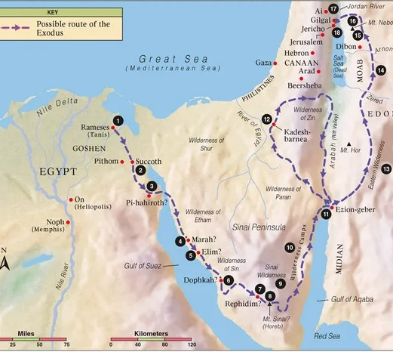
Exodus: Geography

Slide 16
Exodus: Key Verses
Exodus 1:8-11, "Now there arose a new king over Egypt, who did not know Joseph. And he said to his people, "Behold, the people of Israel are too many and too mighty for us. Come, let us deal shrewdly with them, lest they multiply, and, if war breaks out, they join our enemies and fight against us and escape from the land." Therefore, they set taskmasters over them to afflict them with heavy burdens. They built for Pharaoh store cities, Pithom and Raamses."
Exodus 2:24-25, "God heard their groaning and he remembered his covenant with Abraham, with Isaac and with Jacob. So, God looked on the Israelites and was concerned about them.”
Exodus 3:1-6, "Now Moses was keeping the flock of his father-in-law, Jethro, the priest of Midian, and he led his flock to the west side of the wilderness and came to Horeb, the mountain of God. And the angel of the Lord appeared to him in a flame of fire out of the midst of a bush. He looked, and behold, the bush was burning, yet it was not consumed. And Moses said, "I will turn aside to see this great sight, why the bush is not burned." When the Lord saw that he turned aside to see, God called to him out of the bush, "Moses, Moses!" And he said, "Here I am." Then he said, "Do not come near; take your sandals off your feet, for the place on which you are standing is holy ground." And he said, "I am the God of your father, the God of Abraham, the God of Isaac, and the God of Jacob." And Moses hid his face, for he was afraid to look at God."
Exodus 4:21-23, "And the Lord said to Moses, "When you go back to Egypt, see that you do before Pharaoh all the miracles that I have put in your power. But I will harden his heart, so that he will not let the people go. Then you shall say to Pharaoh, ‘Thus says the Lord, Israel is my firstborn son, and I say to you, "Let my son go that he may serve me." If you refuse to let him go, behold, I will kill your firstborn son.’“
Exodus 12:27, "'It is the Passover sacrifice to the LORD, who passed over the houses of the Israelites in Egypt and spared our homes when he struck down the Egyptians.' Then the people bowed down and worshiped.“
Exodus 14:21-28, "Then Moses stretched out his hand over the sea, and the Lord drove the sea back by a strong east wind all night and made the sea dry land, and the waters were divided. And the people of Israel went into the midst of the sea on dry ground, the waters being a wall to them on their right hand and on their left. The Egyptians pursued and went in after them into the midst of the sea, all Pharaoh's horses, his chariots, and his horsemen. And in the morning watch the Lord in the pillar of fire and of cloud looked down on the Egyptian forces and threw the Egyptian forces into a panic, clogging their chariot wheels so that they drove heavily. And the Egyptians said, "Let us flee from before Israel, for the Lord fights for them against the Egyptians." Then the Lord said to Moses, "Stretch out your hand over the sea, that the water may come back upon the Egyptians, upon their chariots, and upon their horsemen." So, Moses stretched out his hand over the sea, and the sea returned to its normal course when the morning appeared. And as the Egyptians fled into it, the Lord threw the Egyptians into the midst of the sea. The waters returned and covered the chariots and the horsemen; of all the host of Pharaoh that had followed them into the sea, not one of them remained.
Exodus 16:4, "Then the Lord said to Moses, "Behold, I am about to rain bread from heaven for you, and the people shall go out and gather a day 's portion every day, that I may test them, whether they will walk in my law or not."
Exodus 17:5-6, "And the Lord said to Moses, "Pass on before the people, taking with you some of the elders of Israel, and take in your hand the staff with which you struck the Nile, and go. Behold, I will stand before you there on the rock at Horeb, and you shall strike the rock, and water shall come out of it, and the people will drink." And Moses did so, in the sight of the elders of Israel."
Exodus 20:2-3, "I am the LORD your God, who brought you out of Egypt, out of the land of slavery. You shall have no other gods before me."

Slide 17
Exodus: Study Questions
According to Exodus 1:8-20 what did the new king in Egypt who did not know Joseph do to the Israelites?
In Exodus 3:1-4:18 we read about the interaction between God and Moses when God calls him to return to Egypt as Israel’s leader. The encounter certainly reveals a great deal about human nature, our fears and excuses, and our need for God to make us overcomers. Even more importantly, the encounter enables us to discover much about our God’s. List the things you learn about God from reading this exchange.
Exodus 12:21-30 describes the Lord’s Passover and its purpose. What was the purpose of the Passover lamb and how did this foreshadow Jesus Christ? (See also John 1:26-29, Luke 22:14-20, 1 Corinthians 5:6-8, Hebrews 9:11-15.)
Read Exodus 19:3-6 and 1 Peter 2:9-10. How does God’s description of Israel in Exodus foreshadow his promise to all believers?
Read Exodus 7:14-21 and Revelation 11:3-6. What foreshadow do you see from Moses and Aaron?

Slide 18
Foreshadows from Exodus
Exodus | Exodus Description | Foreshadowed Fulfillments | Passage Addresses
2:1-4:1-17, 32:31-33:17 | Moses: deliverer, prophet and mediator | Jesus Christ: our Deliver, Prophet and Mediator | Acts 3:18-23, 1 Timothy 2:5-6
7:14-11:10, 12:29-32 | God uses Moses and Aaron to bring 10 plagues upon Egypt that they may know he is God and to deliver His people | God will use two witnesses to bring plagues upon the whole earth for the same purposes | Revelation 11:3-6, Revelation 5-16
8:15, 8:32, 9:34, 9:12, 10:20, 10:27, 11:10 | Pharaoh hardens his heart and will not repent; then God hardens Pharoah’s heart so that he cannot repent | The world does not repent under God’s end time plagues | Revelation 9:20-21, Revelation 16:9-11
12:1-51 | Passover lamb | Jesus Christ our Passover Lamb | John 1:29-36, 1 Corinthians 5:7-8
14:1-31 | God parts the Red Sea | At His Return Christ will part the Mt. of Olives | Zechariah 14:4-5
16:1-36 | Manna from Heaven | Christ Jesus is the Bread from Heaven | John 6:33-40
17:1-7 | Water from the rock that was struck | Jesus is the Rock who was struck once for all and gives Living Water to His people | 1 Corinthians 10:1-5
19:3-6 | Israel a kingdom of priests and a holy nation | Believers in Jesus are called a royal priesthood and holy nation | 1 Peter 2:9-10
25:1-31:18, 40:1-33 | Items in the Tabernacle/Sanctuary made to specifications and consecrated with blood | Jesus entered the more perfect tabernacle in heaven through his own blood having obtained our eternal redemption | Hebrews 9:1-15
34:1-28 | Moses: 40 days/nights without food or water | Jesus in the wilderness 40 days/nights without food or water | Matthew 4:1-2
40:34-39 | God’s presence filling the Sanctuary | The Holy Spirit indwells every forgiven and cleansed believer. We are God’s temple. | 1 Corinthians 3:16, 6:19, Ephesians 2:22

Slide 19
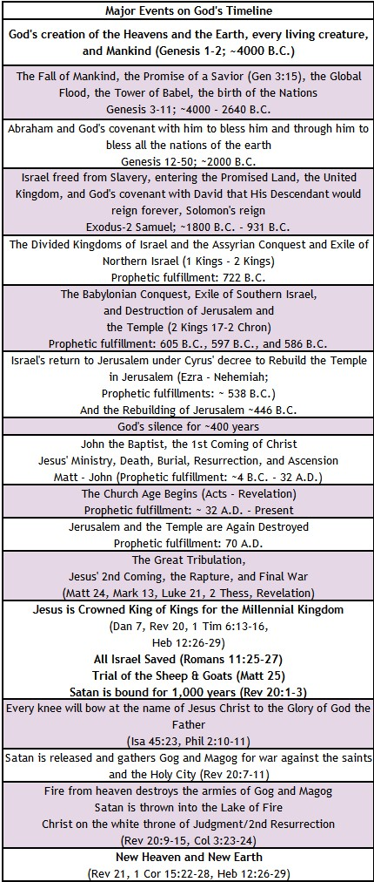
KEY EVENTS
Exodus: GOD’s TIMELINE
Exodus 12:40-42, "The time that the people of Israel lived in Egypt was 430 years. At the end of 430 years, on that very day, all the hosts of the Lord went out from the land of Egypt. It was a night of watching by the Lord, to bring them out of the land of Egypt; so, this same night is a night of watching kept to the Lord by all the people of Israel throughout their generations."

Slide 20
Exodus: Summary Theme
Brief Summary: Exodus begins where Genesis leaves off as God continues to fulfill his covenant promises made to Abraham, Isaac and Jacob. It traces the events from the time Israel entered Egypt as guests of Joseph, who was powerful in Egypt, until they were eventually delivered from the cruel bondage of slavery into which they had been brought by a new king who did not know Joseph (Exodus 1:8). By God’s self-revelation in the book of Exodus, we are instructed in God’s sovereignty, majesty, goodness, holiness, mercy, and grace. He reveals Himself as the one and only God of heaven and earth.
Chapter 1 through 12:37 describe the conditions of the oppression of the Israelites under the new Pharaoh, the miraculous rescue of Moses as an infant, God’s commission of Moses as Israel’s deliverer, and the plagues God brought upon Egypt through Moses and Aaron for Pharaoh's refusal to submit to Him. God’s sovereign and powerful hand is seen in the miracles of the ten plagues, which end with the deaths of the Egyptian’s firstborn. It is on the eve of this tenth plague that God institutes the first Passover and brings about the release of His people from Egypt. It is also in this section that we read of God’s response to Moses’ prayer to see God’s glory. God proclaims of himself: "The Lord, the Lord God, compassionate and merciful, slow to anger, and abounding in faithfulness and truth; who keeps faithfulness for thousands, who forgives wrongdoing, violation of His Law, and sin; yet He will by no means leave the guilty unpunished, inflicting the punishment of fathers on the children and on the grandchildren to the third and fourth generations.” (Exodus 34:6-7).
The end of chapter 12 through chapter 18 record Israel on the road to Sinai. We learn about God’s parting of the Red Sea, the destruction of the Egyptian army, and God’s continuous presence with his people to guide their journey in the form of a cloud by day, shielding them from the sun, and fire by night to give them light. Unfortunately, we also read of the grumblings of the people against God and his servant Moses. Yet, God gave them bread from heaven, sweet water from bitter, and water from the rock to sustain them on their journey and to help them learn more about their God.
Lastly, chapters 19-40 document Israel’s time encamped at Mount Sinai. Regrettably while Moses was on the mountain receiving the gift of God’s Law written on tablets of stone by God’s own hand, the people in the camp below began a rebellion against God with the idolatrous golden calf (Exodus 32:1-10). Through Moses’ intercession for the people God did not destroy them, but there were grave consequences (Exodus 32:11-28). Moses returned to the mountain top to again receive the Law from God and his instructions for the Tabernacle. When Moses returned to the people, he told them all the Lord had commanded (Exodus 34:29-33), and the people whose hearts were stirred by the Lord (Exodus 35:21-29) gave contributions to build the Tabernacle. The last portion of the book describes the construction of the Ark of the Covenant, the anointing of the Aaronic priesthood, the completion of the Tabernacle, and God’s acceptance of the finished work by the cloud of His glory (Exodus 40:34-38).
Foreshadowings: The numerous sacrifices required of the Israelites were a picture of the ultimate sacrifice, the Passover Lamb of God, Jesus Christ. The night of the last plague on Egypt, an unblemished lamb was killed and its blood applied to the doorposts of the houses of God’s people, protecting them from the angel of death. This foreshadowed Jesus, the Lamb of God without spot or blemish (1 Peter 1:17-21), whose blood applied to us ensures eternal life (Revelation 5:6-10). Among the symbolic presentations of Christ in the book of Exodus is the story of the water from the rock in Exodus 17:1-6. Just as Moses struck the rock to provide life-giving water for the people to drink, so did God strike the Rock of our salvation, crucifying Him for our sin, and from the Rock came the gift of living water (John 4:10-14). The provision of manna in the wilderness is a perfect picture of Christ, the Bread of Life (John 6:48-51), provided by God to give us life. Also, through the tabernacle of the Exodus and its filling with God’s glory, we see the foreshadow of the ultimate consecration of God’s people through Jesus Christ and our being filled with the Holy Spirit (See Exodus 40:34-38, Hebrews 9:15-28, 1 Corinthians 3:16, 1 Corinthians 6:19, Ephesians 2:22).

Slide 21
Exodus: Practical Application
Practical Application: The book of Exodus is filled with passages that help us see the attributes of our self-existing God, the great I AM. We see his power and fierceness in rescuing His people and his compassion, patience, and mercy toward them. Likewise, Israel’s grumbling, idolatry, and failure to trust in the Maker of heaven and earth, serve as examples we are not to follow (1 Corinthians 10:1-12).
The Mosaic Law was given in part to show mankind that we are incapable of keeping it. We are unable to please God by law-keeping; therefore, Paul exhorts us to “put our faith in Christ Jesus that we may be justified by faith in Christ and not by observing the law, because by observing the law no one will be justified” (Galatians 2:16). Without faith it is impossible to please God (Hebrews 11:6). But with faith and the gift of the Holy Spirit we can practice righteousness and walk in a manner worthy of our Lord Jesus Christ (Colossians 1:10, 1 Thessalonians 2:12).
God’s provision for the Israelites, from deliverance from captivity to the manna and water in the wilderness, are clear indications of His gracious provision for His people. God has promised to supply all our needs. “God, who has called us into fellowship with his Son Jesus Christ our Lord, is faithful” (1 Corinthians 1:9).
Exodus also teaches us that God listens and responds to our intercessory prayers for others (Exodus 32:11-14, James 5:16), and it is God who stirs our hearts to do good (Exodus 35:21-29, Philippians 2:12-13).
We are to trust in the Lord, for He can deliver us from anything and transform us by His Holy Spirit. But God does not allow sin to go unpunished forever. As a result, we can trust Him in His retribution and justice. When God removes us from a bad situation, we should not seek to go back. When God makes demands of us, He expects us to comply, but at the same time He provides grace and mercy through His Spirit because He knows that, on our own, we are unable to fully obey.

Slide 22

Closing Prayer Verse
Exodus 20:1-7
"And God spoke all these words, saying,
"I am the Lord your God, who brought you out of the land of Egypt, out of the house of slavery. You shall have no other gods before me.
You shall not make for yourself a carved image, or any likeness of anything that is in heaven above, or that is in the earth beneath, or that is in the water under the earth. You shall not bow down to them or serve them, for I the Lord your God am a jealous God, visiting the iniquity of the fathers on the children to the third and fourth generation of those who hate me, but showing steadfast love to thousands of those who love me and keep my commandments.
You shall not take the name of the Lord your God in vain, for the Lord will not hold him guiltless who takes his name in vain."

Slide 23
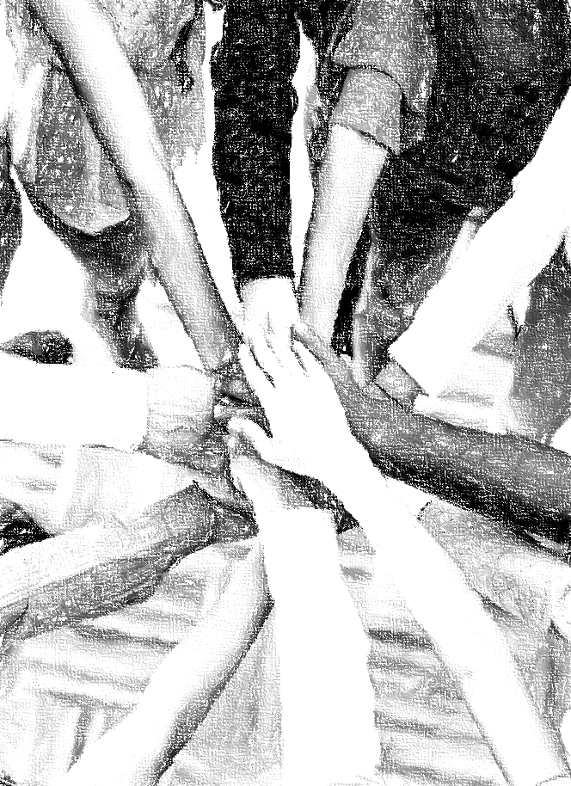
Acknowledgements
Background, Setting, Outlines, some Study Question answers, interpretative challenges, and some Summaries: Adapted from John MacArthur Study Bible at GTY.org.
Key verses, Practical Application, some Study Question answers, and some Summaries: Adapted from GotQuestions.org.
Inductive Bible Study Method: Adapted from Precept.org.
Creation – Consummation Icons: Adapted from AnswersInGenesis.org.
Definitions: Adapted from Websters 1828 Dictionary.

Slide 24
Study Leader Assistance
Sample Opening Prayer
Study Question Answer Keys
Sample Closing Prayer

Slide 25

Sample Opening Prayer: Exodus
Exodus 34:5-8, “The LORD, the LORD God, compassionate and gracious, slow to anger, and abounding in lovingkindness and truth; who keeps lovingkindness for thousands, who forgives iniquity, transgression and sin; yet He will by no means leave the guilty unpunished, visiting the iniquity of fathers on the children and on the grandchildren to the third and fourth generations.“
Sample Prayer: Dear Heavenly Father, thank you for making yourself known to us. Thank you for giving us the Scriptures and the Holy Spirit as our teacher. We rejoice knowing that you are a God who is compassionate, gracious, slow to anger and abounding in love. We are grateful for your patience toward us through Jesus Christ our Lord. We are blessed with the knowledge that you are a just and holy Judge who will not allow sin to go unpunished. Father, thank you for the forgiveness and love we have received through Jesus. Work in us so that we never take your generous gift of your Son for granted but instead demonstrate with our lives that we hold him in the highest place or honor. In Jesus’ name we pray. Amen.

Slide 26
Exodus: Study Question Answers
According to Exodus 1:8-20 what did the new king in Egypt who did not know Joseph do to the Israelites? Answer: He afflicted the Israelites with slavery and heavy burdens. The Egyptians ruthlessly made their lives bitter with hard service in mortar and brick and all kinds of field work. This Pharaoh also attempted to diminish their population by having every newborn male murdered by drowning them in the Nile. He did not want his slave work force to leave Egypt or to be strong enough to rise against him if Egypt was invaded.
In Exodus 3:1-4:18 we read about the interaction between God and Moses when God calls him to return to Egypt as Israel’s leader. The encounter certainly reveals a great deal about human nature, our fears and excuses, and our need for God to make us overcomers. Even more importantly, the encounter enables us to discover much about our God. List the things you learn about God from reading this exchange. Answer: 1) Through the bush that was on fire but not consumed, God demonstrates his power over his creation and his ability to protect us even through fire. 2) God demonstrates he is a God who sees and cares about the suffering of his people, and he declares his power to rescue them (3:7-9). 3) God demonstrates his great patience as He addresses all of Moses’ objections to this commission: a) God promised to be with Moses, b) God introduced himself as I AM, the self existent One, and as the God of Abraham, Isaac, and Jacob , c) God shared his entire plan against Pharaoh with Moses (3:19-22), d) God gave Moses the miracles of his staff and his leprous hand, e) God declared he made man's mouth and would instruct him what to say, and f) God demonstrated his great empathy toward Moses’ fears; for even in his anger God gave Aaron to Moses as his initial spokesperson.
Exodus 12:21-30 describes the Lord’s Passover and its purpose. What was the purpose of the Passover lamb and how did this foreshadow Jesus Christ? (See also John 1:26-29, Luke 22:14-20, 1 Corinthians 5:6-8, Hebrews 9:11-15.) Answer: The families were instructed to select lambs for themselves, kill the Passover lamb, and then apply its blood to the lintel and two doorposts of their homes. The Lord would then pass through to strike the Egyptians but would Passover any house who had faithfully obeyed His Passover instructions. This is a foreshadow of our Lord Jesus who is the true Passover Lamb who through the eternal Spirit offered himself without blemish to God to purify us from our sins. Jesus, our High Priest, entered into the holy places of Heaven by his own blood securing our eternal redemption as the mediator of a new covenant.
Read Exodus 19:3-6 and 1 Peter 2:9-10. How does God’s description of Israel in Exodus foreshadow his promise to all believers? Answer: In Exodus God said that the people of Israel were to obey His voice, keep covenant with Him, and they would be God’s treasured possession, a kingdom of priests, and a holy nation. In 1 Peter 2:9-10 the Holy Spirit uses this same language to describe all of us who have been born again out of darkness and brought into God’s marvelous light receiving his mercy through Christ Jesus our Lord.
Read Exodus 7:14-21 and Revelation 11:3-6. What foreshadow do you see from Moses and Aaron? Answer: As Moses and Aaron stood before Pharaoh and delivered God’s plagues in judgment against Egypt, God has revealed to us that there will also be two witnesses in the future who will deliver His plagues against the Antichrist and the whole earth during the Great Tribulation when God cleanses His Earth of all wickedness.

Slide 27
Sample Closing Prayer
Exodus 20:1-7
"And God spoke all these words, saying,
"I am the Lord your God, who brought you out of the land of Egypt, out of the house of slavery. You shall have no other gods before me.
You shall not make for yourself a carved image, or any likeness of anything that is in heaven above, or that is in the earth beneath, or that is in the water under the earth. You shall not bow down to them or serve them, for I the Lord your God am a jealous God, visiting the iniquity of the fathers on the children to the third and fourth generation of those who hate me, but showing steadfast love to thousands of those who love me and keep my commandments.
You shall not take the name of the Lord your God in vain, for the Lord will not hold him guiltless who takes his name in vain.“
Sample Prayer: Dear Heavenly Father, we praise you for your mighty works in delivering the Israelites out of the hands of their enemies in Egypt. Likewise, you have delivered us from the clutches of our sinful lives and have foreshadowed how you will again display your mighty works during the Great Tribulation to rescue your people from the hands of the evil one who has power over the whole world. Father, keep us from idolatry, and may your name and the name of your Son, Jesus Christ, only be on our lips in praise and prayer. In His name we pray. Amen.

