Slide 1

Galatians
Book 48
© 2026 RCI. All rights reserved.
To God Alone Be the Glory
1

Slide 2
What is the Holy Bible?
The Holy Bible is a collection of writings that includes 66 books in English editions. The Bible consists of two parts, the Old Testament and New Testament. The word testament means covenant. The Old Testament includes 39 books, and the New Testament includes 27 books.
These 66 books were written over approximately 1,400 years by 40 different authors in Hebrew, Aramaic, and Greek. The Old Testament writings were affirmed by Jewish leaders, and moreover, by Jesus Christ.¹ The New Testament writings were confirmed by early church leaders. The 66 books of the Bible are the inspired words of God that are used to make and mature disciples of the One true God through Jesus Christ, his Son (Matthew 28:18-20, 2 Timothy 3:16-17). The Bible was not created by mere human wisdom but was inspired by God (2 Peter 1:20-21), is interpreted by His Holy Spirit (John 16:13, Matthew 23:8-10), and will last forever (Matthew 24:35).²
If you do a phrase search on the Bible you will find the phrase "the word of the Lord" and "Thus says the Lord" more than 700 times.³ In addition, this book has given reasonable evidence to the claim of being God’s word by:​
  providing answers that conform with the reality we see around us.
  being a reliable collection of historical documents.
  containing eyewitness accounts that were written during the lifetimes of other eyewitnesses.
  recording supernatural events that took place in fulfillment of specific prophecies.⁴
Notes:
¹ See Matthew 4:4-7, 12:3-5, Mark 7:6-7, 12:26-27, and Luke 19:46 for examples.
^{2 “}What are the Books of the Bible”, GotQuestions.org
³ Blue Letter Bible
⁴ Paraphrased from Voddie Baucham

Slide 3
Our Goals in Studying the Bible
To better …..
Understand the Only true God; the Author of the Bible. (2 Timothy 3:16-17, 2 Peter 1:20-21, 1 John 5:20 , Jeremiah 9:23-24)
Learn How He works in the World and in our Lives. (Job 40:6-14, Isaiah 45:6-7, Isaiah 46:8-10, Philippians 2:12-13)
Understand Ourselves and the Hearts of Mankind. (Jeremiah 17:9, 2 Timothy 3:13, Ephesians 5:7-10)
Come to Know What Pleases and Grieves God. (1 Thessalonians 4:1, Ephesians 4:26-31, Hebrews 11:6, 1 Peter 1:14-19)
To be Transformed into Fruitful Doers of God’s Word and not just Hearers. (Romans 12:2, James 1:27, Matthew 3:8)
Tether Ourselves to God’s Word for Our Wisdom, Discernment, and Safety. (1 Corinthians 6:9-10, Matthew 24:24, Ephesians 4:11-14)
Jeremiah 9:23-24 “Thus says the Lord: "Let not the wise man boast in his wisdom, let not the mighty man boast in his might, let not the rich man boast in his riches, but let him who boasts boast in this, that he understands and knows me, that I am the Lord who practices steadfast love, justice, and righteousness in the earth. For in these things I delight, declares the Lord."

Slide 4
How to Study the Bible
#1. Observation: What does the text say?
Who?
What?
When?
Where?
How?
Why?
#2. Interpretation: What does the text mean in context with the passage, book, and whole counsel of God?
#3. Application: How is the Holy Spirit instructing me to apply this understanding at this time in my life?

Slide 5
Study Resources
Opening Prayer
Background and Setting
Book Outline
Geography Maps
Key Verses
Study Questions
Major Event Timeline
Book Summary
Application and Closing Prayer
Study Leader Support Slides

Slide 6

Opening Prayer Verse: Galatians
Galatians 3:27-29: “For as many of you as were baptized into Christ have put on Christ. There is neither Jew nor Greek, there is neither slave nor free, there is no male and female, for you are all one in Christ Jesus. And if you are Christ's, then you are Abraham's offspring, heirs according to promise.”

Slide 7
Review of 2 Corinthians
Learning Tip: For those studying the Bible in its table‑of‑contents order, this slide gives you a brief recap of the book you just completed. Studying in a different sequence? You can simply skip this slide or treat it as a gentle nudge to circle back when the time is right.
Brief Summary: Second Corinthians complements the historical record of Paul’s dealings with the Corinthian church as recorded in Acts 18 and 1 Corinthians. It also contains important biographical data on Paul throughout.
Although an intensely personal letter, written by the apostle in the heat of battle against those attacking his credibility, 2 Corinthians contains several important theological themes. In Paul’s greeting alone he touches on the following theological matters:
Paul’s apostleship in Jesus Christ by God’s will.
The God and Father of our Lord Jesus is the Father of mercies and all comfort.
He is the God who delivered the apostles out of their afflictions causing them to rely not on themselves but on God who raises the dead.
This is the God on whom the true apostles had set their hope for continued deliverance.
After explaining his reasons for not making an earlier visit to them and how the church was to handle a repentant offender, Paul begins his defense against the false teachers, peddlers of God’s word, who had infiltrated the church. He does this by first laying out the true gospel of Jesus Christ, the new covenant, in comparison to the old covenant. The text explains that the first covenant, the ministry of death, refers to the Law given to Moses, which God wrote on tablets of stone. It was glorious because the Law represents God's character, and Moses' face shone with this glory after being in God's presence. But this glory faded away, for the Law is condemning because it has no power to overcome sin. It is the Law of sin and death for us, the letter that kills, because we are sinners by birth and practice; completely unable to be right before God. But the ministry of the Spirit is the new covenant that frees us from the Law of sin and death through Jesus Christ. God sent His only Son in human flesh to fulfill His Law and to be an offering for our sin. Through the Holy Spirit of Jesus Christ, the ministry of righteousness administers God’s mercy, grace and love and makes us new creations with God’s Law written upon our hearts. This is the permanent glory that will never fade and through which we are being transformed into the image of Jesus Christ (2 Corinthians 3).
Throughout the remainder of the letter Paul continues the defense of his ministry against the false apostles who were attempting to lead the Corinthians astray. He exhorts the Corinthians to open their hearts and be assured of his love for them and his apostolic authority. He calls himself a “fool” for having to reluctantly boast of his qualifications in conduct, suffering, and credentials including a vision of heaven (2 Corinthians 11-12). Paul closes the letter with a warning for the Corinthians to examine themselves and ends with a benediction of love and peace.
Connections: Paul refers to the Mosaic law, comparing it with the surpassing greatness of the gospel of Jesus Christ and salvation by grace. The Law written on our hearts through Jesus Christ surpasses the Law written on tablets of stone (2 Corinthians 3:4-11, Exodus 24:12)

Slide 8
New Testament Table of Contents (27 Books)
THE GOSPELS & ACTS - 5
MATTHEW
MARK
LUKE
JOHN
ACTS
PAUL’S LETTERS TO CHURCHES - 9
ROMANS
1 CORINTHIANS
2 CORINTHIANS
GALATIANS
EPHESIANS
PHILIPPIANS
COLOSSIANS
1 THESSALONIANS
2 THESSALONIANS
PAUL’S LETTERS TO INDIVIDUALS - 4
1 TIMOTHY
2 TIMOTHY
TITUS
PHILEMON
LETTERS BY OTHERS – 9
HEBREWS
JAMES
1 PETER
2 PETER
1 JOHN
2 JOHN
3 JOHN
JUDE
REVELATION

Slide 9
New Testament Books by Date Written
James:
45-50 A.D.
Galatians:
49-55 A.D.
1 Thess:
51 A.D.
2 Thess:
52 A.D.
1 Cor:
53-55 A.D.
2 Cor:
55-56 A.D.
Mark:
55-60 A.D.
Matthew:
55-65 A.D.
Romans:
57-58 A.D.
Luke:
60 A.D.
1 Peter: 60-65 A.D.
Jude:
60-70 A.D.
2 Peter: 65-68 A.D.
Ephesians: 60-61 A.D
Philippians: 60-61 A.D.
Colossians: 61 A.D.
Philemon:
61 A.D.
Titus:
62-67 A.D.
1 Timothy:
63-66 A.D.
Acts:
65 A.D.
Hebrews:
65 A.D.
2 Timothy:
67 A.D.
John:
85-90 A.D.
1 John:
85-95 A.D.
2 & 3 John:
85-95 A.D.
Revelation: 90-95 A.D.

Slide 10
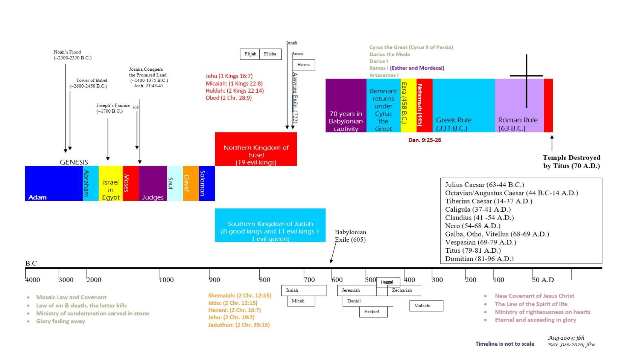







BIBLICAL CHRONOLOGICAL BACKGROUND
OT
NT
Prophets after Noah into the United Kingdom:
Abraham:
Moses:
Samuel:
Gad:
Nathan:
Ahijah
Asaph
(Gen. 20:7)
(Exo. 3:10)
(1 Sam. 3:20)
(1 Sam. 22:5)
(2 Sam. 7:2)
(1 Kings 11:29)
(2 Chr. 35:15)

Slide 11
Galatians
Author: Apostle Paul
Date: Likely written c. 49-55 A.D.
11

Slide 12
Galatians: About this Book and Its Author
Galatians derives its title (pros Galatas) from the region in Asia Minor (modern Turkey) where the churches addressed were located. It is the only one of Paul’s epistles specifically addressed to churches in more than one city.¹
There is no reason to question the internal claims that the apostle Paul wrote Galatians (Galatians 1:1-2; 5:2-3). Paul was born in Tarsus, a city in the province of Cilicia, not far from Galatia. Under the famous rabbi, Gamaliel, Paul received a thorough training in the Old Testament Scriptures and in the rabbinic traditions at Jerusalem (Acts 22:3). A member of the ultraorthodox sect of the Pharisees (Acts 23:6), he was one of first-century Judaism’s rising stars.²
The course of Paul’s life took a sudden and startling turn when, on his way to Damascus from Jerusalem to persecute Christians, he was confronted by the risen, glorified Christ (Acts 9). That dramatic encounter turned Paul from Christianity’s chief persecutor to its greatest missionary. The Holy Spirit utilized Paul’s three missionary journeys and his final trip to Rome to move Christianity from a faith that included only a small group of Jewish believers into an Empire-wide mercy extended also to Gentiles. Galatians is one of 13 inspired letters Paul addressed to Gentile congregations or his fellow workers.
In Galatians 2, Paul described his visit to the Jerusalem Council of Acts 15, so he must have written Galatians after that event. Since most scholars date the Jerusalem Council about A.D. 49, the most likely date for Galatians is shortly thereafter.
Notes:
¹ Galatians 1:2; cf. Galatians 3:1; 1 Corinthians 16:1
² Galatians 1:14; cf. Philippians 3:5-6

Slide 13
Galatians: Background and Setting
In Paul’s day, the word Galatia had two distinct meanings. In a strict ethnic sense, Galatia was the region of central Asia Minor inhabited by a Celtic people who had migrated to that region from Gaul (modern France) in the third century B.C. The Romans conquered the Galatians in 189 B.C. but allowed them to have some measure of independence until 25 B.C. when Galatia became a Roman province, incorporating some regions not inhabited by ethnic Galatians (e.g., parts of Lycaonia, Phrygia, and Pisidia). In a political sense, Galatia came to describe the entire Roman province, not merely the region inhabited by the ethnic Galatians who had migrated from the area of modern-day France.
Paul founded churches in the southern Galatian cities of Antioch, Iconium, Lystra, and Derbe (Acts 13:14-14:23). These cities, although within the Roman province of Galatia, were not in the ethnic Galatian region. Although the apostle apparently crossed the border into the fringes of ethnic Galatia on at least two occasions (Acts 16:6-8; 18:22-23), there is no record of Paul’s founding churches in that northern, less populated region.
These two uses of the word Galatia (ethnic and regional) make it more difficult to determine who the original recipients of the epistle were. Scripture tells us that the word of Christ Jesus reached further north into Pontus and Bithynia as recorded in Acts 2:5-11, 18:1-3, and 1 Peter 1:1-2. However, because neither Acts nor Galatians credits Paul with founding churches or engaging in evangelistic ministry in cities from northern (ethnic) Galatia, it is reasonable to believe that Paul originally addressed this epistle to churches located in the southern part of the Roman province.
Acts records the apostle’s founding of such churches at Pisidian Antioch (Acts 13:14-50), Iconium (Acts 13:51-14:7; cf. 16:1-2), Lystra (Acts 14:8-19; cf. 16:1-2), and Derbe (Acts 14:20-21; cf. 16:1-2). In addition, the churches Paul addressed had apparently been established before the Jerusalem Council (see Acts 15:1-35). The churches of southern Galatia fit that criterion, having been founded during Paul’s first missionary journey before the Council met. Paul did not visit northern (ethnic) Galatia until after the Jerusalem Council (Acts 16:6-8).
Paul wrote Galatians to counter Judaizing false teachers who were undermining the central New Testament doctrine of justification by faith. They spread their dangerous teaching that Gentiles must first become Jewish proselytes and submit to all the Mosaic law before they could be saved (Galatians 1:6-7, 2:1-10; 5:2-12; 6:12-13). Shocked by the Galatians’ openness to this damning heresy, Paul wrote this letter to defend justification by faith and warn these churches of the dire consequences of abandoning that essential doctrine. Galatians is the only epistle Paul wrote that does not contain a commendation for its readers—that obvious omission reflects how urgently he felt about confronting the defection and defending the essential doctrine of justification.

Slide 14
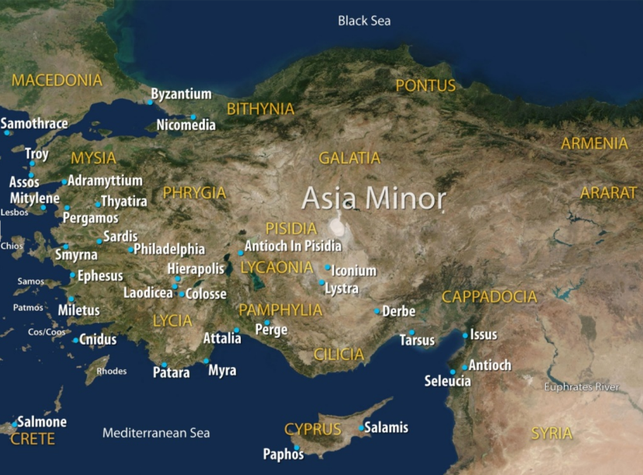
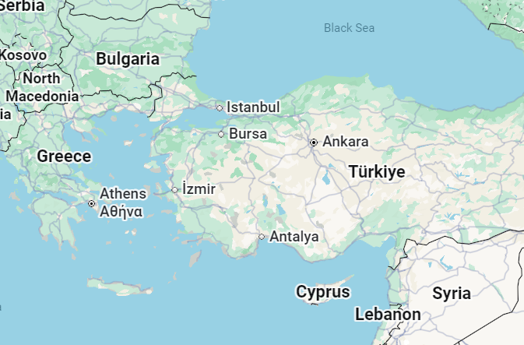
Ancient Galatia vs. Modern Day Borders
Mediterranean Sea

Slide 15
Galatians Outline
Personal
Doctrinal
Practical
Galatians 1:1–2:21
Galatians 3:1–4:31
Galatians 5:1–6:18
The Preacher of Justification in Christ
  Apostolic Chastening
  Apostolic Credentials
  Apostolic Confidence
The Principles of Justification in Christ
The Holy Spirit and Faith
The Blessing of Abraham
The Curse of the Law
The Promise of the Covenant
The Purpose of the Law
The Sonship of Believers
The Futility of Ritualism to Obtain Salvation
The Illustration from Scripture
The Privileges of Justification in Christ
Freedom from Ritual
Freedom from Legalists
Freedom in the Holy Spirit
Freedom from Spiritual Bondage with the Holy Spirit’s power to love and serve
Conclusion

Slide 16
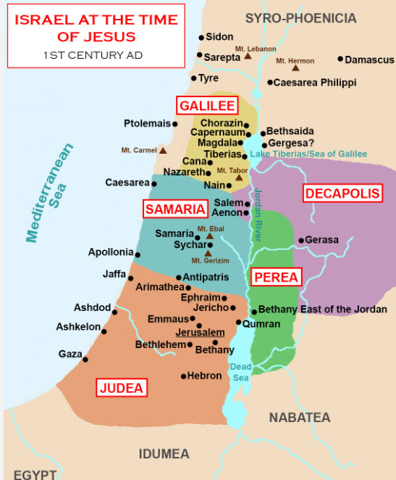
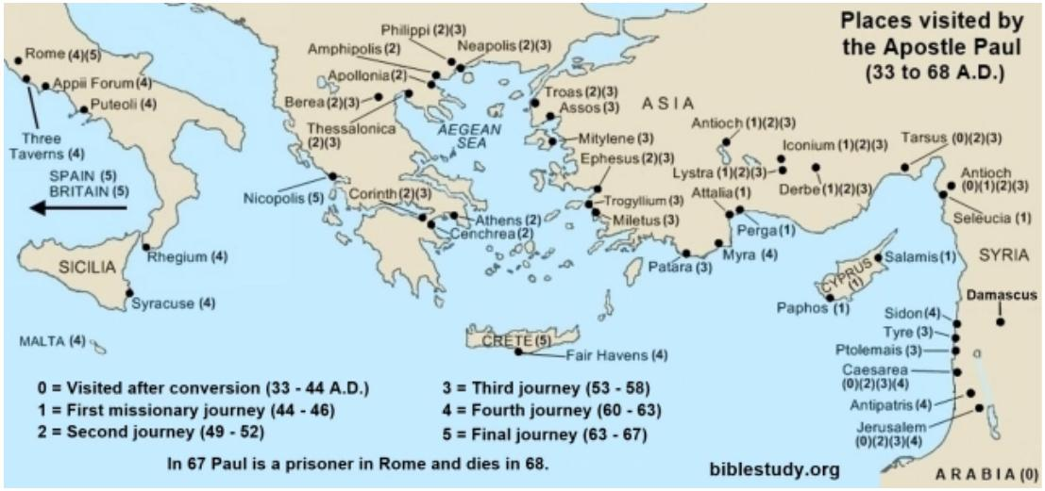
Geography of New Testament Israel and Paul’s Journeys

Slide 17
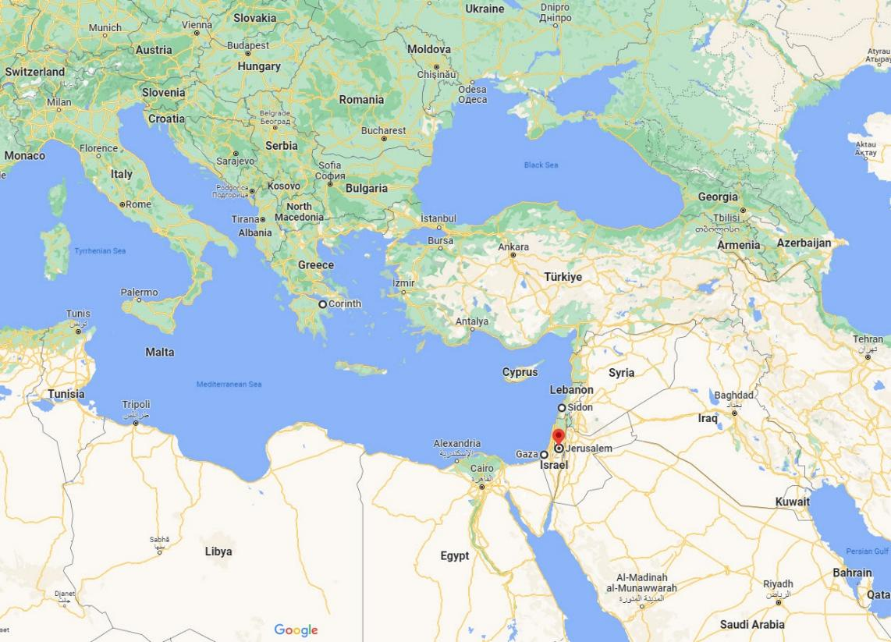

Ancient Galatia with Extended Modern Day Borders

Slide 18
Galatians – Key Verses
Galatians 1:1-2: “Paul, an apostle — not from men nor through man, but through Jesus Christ and God the Father, who raised him from the dead — and all the brothers who are with me, To the churches of Galatia:”
Galatians 1:8: “But even if we or an angel from heaven should preach to you a gospel contrary to the one we preached to you, let him be accursed.”
Galatians 2:16: “yet we know that a person is not justified by works of the law but through faith in Jesus Christ, so we also have believed in Christ Jesus, in order to be justified by faith in Christ and not by works of the law, because by works of the law no one will be justified.”
Galatians 2:20: “I have been crucified with Christ and I no longer live, but Christ lives in me. The life I live in the body, I live by faith in the Son of God, who loved me and gave himself for me.”
Galatians 3:11: “Now it is evident that no one is justified before God by the law, for ‘The righteous shall live by faith.’”
Galatians 3:22: “But the Scripture has shut up everyone under sin, so that the promise by faith in Jesus Christ might be given to those who believe.”
Galatians 3:27-29: “For as many of you as were baptized into Christ have put on Christ. There is neither Jew nor Greek, there is neither slave nor free, there is no male and female, for you are all one in Christ Jesus. And if you are Christ's, then you are Abraham's offspring, heirs according to promise.”
Galatians 4:4-6: “But when the fullness of time had come, God sent forth his Son, born of woman, born under the law, to redeem those under law, that we might receive the full rights of sons. Because you are sons, God sent the Spirit of his Son into our hearts, the Spirit who calls out, ‘Abba, Father.’”
Galatians 5:2-6: “Look: I, Paul, say to you that if you accept circumcision, Christ will be of no advantage to you. I testify again to every man who accepts circumcision that he is obligated to keep the whole law. You are severed from Christ, you who would be justified by the law; you have fallen away from grace. For through the Spirit, by faith, we ourselves eagerly wait for the hope of righteousness. For in Christ Jesus neither circumcision nor uncircumcision counts for anything, but only faith working through love.”
Galatians 5:22-23: “But the fruit of the Spirit is love, joy, peace, patience, kindness, goodness, faithfulness, gentleness and self-control. Against such things there is no law.”
Galatians 6:7: “Do not be deceived: God is not mocked, for whatever one sows, that will he also reap”
Galatians 6:14: “But far be it from me to boast except in the cross of our Lord Jesus Christ, by which the world has been crucified to me, and I to the world.”

Slide 19
Galatians at a Glance
True Gospel = born of the Spirit
False Gospel = severed from Christ
Claims we are justified before God by keeping His laws + faith in Christ.
We are new creations justified before God thru the gift of faith in God’s provision thru Jesus Christ.
Our freedom in Christ is given so we can live to love God and others.
The person born of the Holy Spirit and led by Him will bear the fruit of the Spirit, which is love, joy, peace, patience, kindness, goodness, faithfulness, gentleness, and self-control.
Or claims you can be a Christian and still practice evil: (e.g., immorality, idolatry, sorcery, jealousy, dissensions, envying, drunkenness).
Or claims our freedom in Christ means we can indulge our sinful behaviors.
Galatians 1 – 5:12: Rebuke and Correction Concerning the Gospel of Jesus Christ
Galatians 5:13-6:18: Encouragement and Christian Living

Slide 20
GALATIANS: Study Questions
Read Galatians 1:1-2 and Galatians 1:10-2:14 and answer the two questions below.
  Where did Paul claim he received his apostolic authority for the Christian faith? (See also Acts 9:1-22.)
  Why did Paul make the point of the origin of his apostolic authority? (See also Galatians 1:6-9.)
In Galatians 3:3-7 why does Paul call the Galatians foolish? What does it mean to begin with the Spirit (see also John 3:3-8)? What are the benefits of having our beginnings in the Spirit (see also Ephesians 2:8-9 and Romans 9:8-9)?
The Holy Spirit is mentioned more than 15 times in Galatians. This number is only exceeded by references to Jesus Christ, God, the law, and faith. Match the verses on the left below with the interpretations on the right to deepen your understanding of the Holy Spirit who dwells in us.
Read Galatians 5:1-6 and answer the two questions below.
  Why does Paul say in Galatians 5:1-6 that someone who tries to be justified by circumcision or keeping the law is severed from Christ?
  How can you correctly reconcile Paul’s warning in Galatians 5:1-6 concerning salvation with Paul’s warnings in Galatians 5:19-21 and 6:8 concerning how we live?
  Galatians 3:3
  Galatians 4:6 (see also Acts 16:7, Philippians 1:19)
  Galatians 5:5
  Galatians 5:16-18, 5:25
  Galatians 4:29, 6:15 (see also John 3:3-8)
  Galatians 5:19-21, 6:8
  Galatians 3:2, 3:5, 3:14
  _____________ We are born of the Holy Spirit; He makes us new creations.
  _____________ We begin with the Spirit.
  _____________ The Holy Spirit is the Spirit of Jesus Christ enabling us to fellowship with God as our Father.
  _____________ Without obedience to the Spirit we are endanger of corruption. Led by Him we gain his fruit & life.
  _____________ God provides his Holy Spirit to us by hearing his Word with faith.
  _____________ Walking by or being led by the Holy Spirit requires our obedient cooperation.
  _____________ The Spirit causes us to wait by faith for the hope of righteousness.

Slide 21
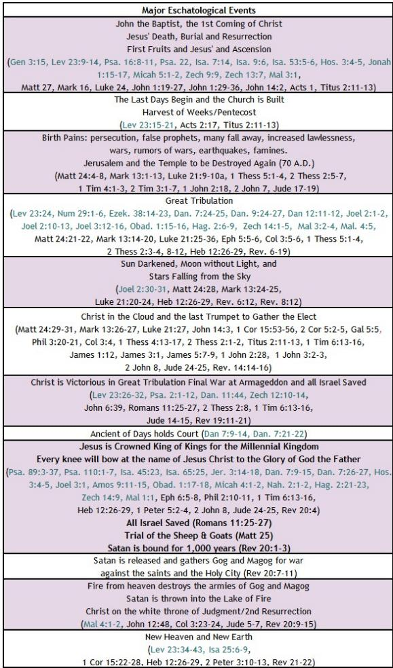


BIBLE ESCHATOLOGY
GALATIANS
Galatians 4:4-6: “But when the fullness of time had come, God sent forth his Son, born of woman, born under the law, to redeem those under law, that we might receive the full rights of sons. Because you are sons, God sent the Spirit of his Son into our hearts, the Spirit who calls out, ‘Abba, Father.’”
Galatians 5:5, “For through the Spirit, by faith, we ourselves eagerly wait for the hope of righteousness.”
21

Slide 22
Galatians – Summary
Brief Summary: Galatians is one of the earliest of 13 inspired letters Paul addressed to Gentile congregations or his fellow workers. Paul founded churches in the southern Galatian cities of Pisidian Antioch, Iconium, Lystra, and Derbe (Acts 13:14-14:23). He wrote Galatians to counter Judaizing false teachers who were undermining the central New Testament doctrine of justification by faith. They spread their dangerous teaching that in addition to faith in the death, burial, and resurrection of Jesus Christ to pay our sin debt, Gentiles also needed to submit to all the Mosaic law to truly be righteous before God. Shocked by the Galatians’ openness to this damning heresy, Paul, an apostle who received his authority directly from Jesus Christ and God the Father, wrote this letter to defend justification (our right standing before God) by faith alone in Jesus Christ alone (Galatians 1:11-2:14) .
Throughout Paul’s epistle to the Galatians, saving grace—the gift of God—is juxtaposed against the Law of Moses, which cannot save, but was our guardian while we were children until faith in Christ had come (Galatians 3:24-25). The Judaizers urged a return to the Mosaic Law as an additional source of justification, and they were prominent in the early church. Even Peter was temporarily drawn into their web of deceit (Galatians 2:11–13). Paul reminded his readers that their new lives in Christ Jesus began with a work of the Holy Spirit when they heard the word of God. It was the Holy Spirit who worked the miracle to cause them to be born again into new creations and gave them the gift of faith to trust in the death and resurrection of Christ for the forgiveness of sins. And it was God who supplied them with the gift of the Holy Spirit of His Son to dwell in them. Paul called them foolish to believe they could achieve perfection before God with their deeds having begun with the miracles of the Spirit (Galatians 3:3-7, John 3:3). In doing so they were not only accepting a yoke of futile slavery but also being severed from Christ through whom is our only hope of being made righteous before God (Galatians 5:1-6). Truly it is beyond irrational to think we can add anything to the perfect work of Jesus Christ.
After having clearly stated that the righteous live by faith believing on the one whom God has sent (Galatians 2:16, 3:11, John 6:29), Paul moves to ensure that his readers do not misunderstand this free gift of salvation. Christians are set free not to gratify our sin natures; but to live by the Holy Spirit using our freedom as an opportunity to love one another (Galatians 5:13; 6:7–10) and glorify God. The Christian is to live obediently led by the Spirit in the power of the Spirit, not the flesh (Galatians 5:16–18). The Holy Spirit will bear His fruit in and through the believer (Galatians 5:22–23, Philippians 2:12-13); thereby demonstrating externally the new lives we possess internally in Christ.
Connections: The themes connecting Galatians to the Old Testament center on Law vs. grace: the inability of the Law to justify (Galatians 2:16); Abraham’s justification by faith (Galatians 3:6); the Law’s bringing not God’s salvation but His wrath (Galatians 3:10); the supremacy of the Abrahamic covenant over the Mosaic covenant (Galatians 3:16-18) because the former is linked to Abraham’s seed, Jesus Christ, who fulfilled the eternal covenant. Believers are the spiritual children of Sarah, not Hagar—that is, we are children of the freewoman, not children of the slave; we have more in common with Isaac, the son of promise, than with Ishmael, the son of human effort (Galatians 4:21-31). Lastly, children of God are to freely live before God serving one another in love as the fulfillment of the Law (Galatians 5:14).
The books of Galatians and James deal with two complementary aspects of Christianity. Galatians highlights the gospel of grace that produces righteous living (Galatians 3:13-14). James highlights the righteous living that proves faith. There is no conflict; James, too, emphasizes the new birth through the gospel (James 1:18), and Galatians spends its final two chapters applying the doctrine of sola gratia to practical Christian living.

Slide 23
Galatians
Practical Application
Practical Application: One of the main themes of the book of Galatians is found in 3:11: “The righteous shall live by faith.” We must stand firm in this truth. Any compromise with legalism or the mixture of human effort and the grace of God for salvation leads to heresy and results in being severed from Christ. If we could be saved through the keeping of the Law, then Jesus did not need to die (Galatians 2:21). Trying to save ourselves nullifies grace and leaves us condemned.
Not only are we saved by faith (John 3:16; Ephesians 2:8-9), but the life of the believer in Christ—day by day, moment by moment—is lived by and through that faith (Galatians 2:20). Not that faith is something we conjure up on our own—it is the gift of God, not of works (see Ephesians 2:8-9)—but it is our responsibility and joy to exhibit our faith through the power of the Holy Spirit so that others will see the work of Christ in us. We grow in our faith by the application of spiritual disciplines (Bible study, prayer, obedience, etc.).
Jesus said we would be known by the fruit of our lives (Matthew 7:16), which should give evidence of the faith within us. This fruit produced by the Holy Spirit is clearly stated in Galatians 5:22-23. All Christians should be diligent in striving to mature the new life given us by the Holy Spirit and to build upon the saving faith within us so that our lives will reflect Christ and cause others to glorify our Father who is in heaven” (Matthew 5:16).

Slide 24

Closing Prayer Verse
Galatians 4:4-6: “But when the fullness of time had come, God sent forth his Son, born of woman, born under the law, to redeem those under law, that we might receive the full rights of sons. Because you are sons, God sent the Spirit of his Son into our hearts, the Spirit who calls out, ‘Abba, Father.’”

Slide 25
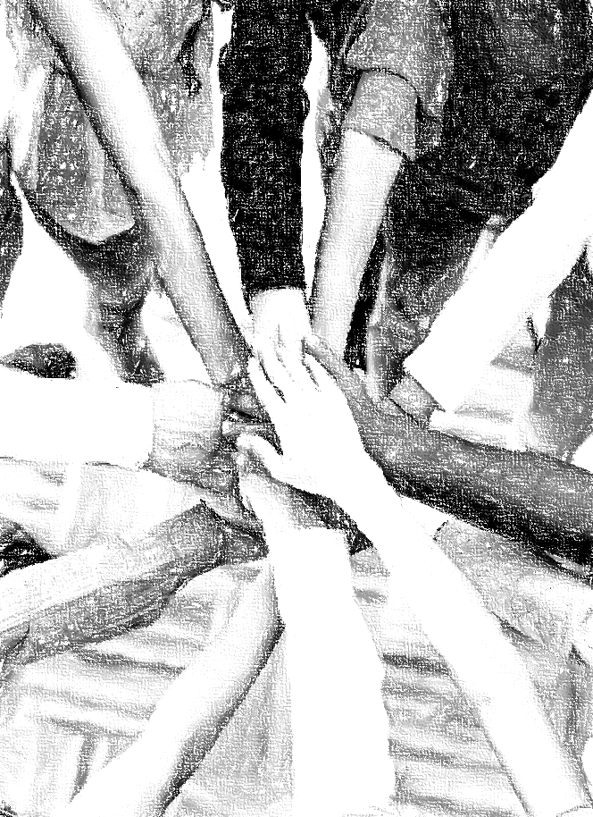
Acknowledgements
Background, Setting, Outlines, some Study Question answers, interpretative challenges, and some Summaries: Adapted from John MacArthur Study Bible at GTY.org.
Key verses, Practical Application, some Study Question answers, and some Summaries: Adapted from GotQuestions.org.
Inductive Bible Study Method: Adapted from Precept.org.
Creation – Consummation Icons: Adapted from AnswersInGenesis.org.
Definitions: Adapted from Websters 1828 Dictionary.
Bible Reference Software and Quotes: All Scripture quotations are taken from the Holy Bible using primarily the English Standard Version (ESV) or New American Standard Bible (NASB) translations. Links to Scripture references utilize BibleRef.com, which is a Got Questions Ministries’ website.

Slide 26
Study Leader Assistance
Sample Prayers
Study Question Answer Keys

Slide 27
Sample Opening Prayer Verse: Galatians
Galatians 3:27-29: “For as many of you as were baptized into Christ have put on Christ. There is neither Jew nor Greek, there is neither slave nor free, there is no male and female, for you are all one in Christ Jesus. And if you are Christ's, then you are Abraham's offspring, heirs according to promise.”
Sample Prayer: Dear Heavenly Father, thank you for the unbreakable promise you made to Abraham that through him all the nations of the earth would be blessed. Thank you for Christ Jesus, your Son, the seed of Abraham through whom you are fulfilling this promise. Through Jesus you have broken down every dividing wall: ethnic, gender and social, and made us one in Him. Our hearts are overwhelmed that you would declare us all Abraham’s offspring and heirs through the covenant promise you made to him long ago. Keep us in the true faith and enable us to walk as people who have put on Christ Jesus. In his name we pray. Amen.

Slide 28
GALATIANS: Study Question ANSWERs
Read Galatians 1:1-2 and Galatians 1:10-2:14 and answer the two questions below.
  Where did Paul claim he received his apostolic authority for the Christian faith? (See also Acts 9:1-22.) Answer: Paul stated he received his Christian apostolic authority directly from Jesus Christ and God the Father, who raised Jesus from the dead and not from men though he was affirmed by the other apostles later in his ministry.
  Why did Paul make the point of the origin of his apostolic authority? (See also Galatians 1:6-9.) Answer: Paul needed the readers to understand that there is only one true gospel through which we can obtain salvation, and this is in the grace of Christ. This gospel was passed to him directly from Jesus Christ. Everything else is a false gospel that will lead to destruction. This is why Paul strongly proclaims that there is no other gospel and even if the apostles or an angel from heaven should preach a gospel contrary to our being justified by any other means except the righteous life, death, and resurrection of Jesus Christ, the Son of God, they should be accursed. A statement as strong as this needed a foundation that came directly from God.
In Galatians 3:3-7 why does Paul call the Galatians foolish? What does it mean to begin with the Spirit (see also John 3:3-8)? What are the benefits of having our beginnings in the Spirit (see also Ephesians 2:8-9 and Romans 9:8-9)? Answer: Paul calls the Galatians foolish because their new lives in Christ Jesus began with a work of the Holy Spirit when they heard the word of God. The Scriptures teach that it is the Holy Spirit who causes us to be born again into new creations making us alive and giving us the gift of faith to trust in the death and resurrection of Christ for the pardon of our sins. It is pure foolishness to begin with the Spirit and then return to relying on our own abilities to gain a righteous standing before the God of heaven; as if we could add any thing to the infinitely perfect work of Jesus Christ. God has supplied us with the Holy Spirit who worked the miracle of our new birth. In Jesus we have salvation, the gift of the Holy Spirit, and are counted as children of God.
The Holy Spirit is mentioned more than 15 times in Galatians. This number is only exceeded by references to Jesus Christ, God, the law, and faith. Match the verses on the left below with the interpretations on the right to deepen your understanding of the Holy Spirit who dwells in us.
Read Galatians 5:1-6 and answer the two questions below.
  Why does Paul say in Galatians 5:1-6 that someone who tries to be justified by circumcision or keeping the law is severed from Christ? Answer: Forgiveness for sins is a gracious act of God through the gift of faith in the work of Jesus Christ so that no man can boast (Eph. 2:8-9). If we try to earn and justify ourselves before God by our deeds, we are no longer trusting in Christ and have been separated from Him. He alone is the Way, the Truth, and the Life (John 14:6).
  How can you correctly reconcile Paul’s warning in Galatians 5:1-6 concerning salvation with Paul’s warnings in Galatians 5:19-21 and 6:8 concerning how we live? Answer: Gal. 5:1-6 is teaching that our righteous standing before God comes directly from the gift of faith in the work of Jesus Christ. This not of ourselves but the Spirit who makes us alive when we hear God’s word. To believe you can be justified before God any other way is to be severed from Christ and without hope. In Gal. 5:19-21 and 6:8 we are being taught that the evidence of a new birth by the Spirit will result in a life that sows to the Spirit not to fleshly desires. The new life will reflect the Spirit’s fruit.
  Galatians 3:3
  Galatians 4:6 (see also Acts 16:7, Philippians 1:19)
  Galatians 5:5
  Galatians 5:16-18, 5:25
  Galatians 4:29, 6:15 (see also John 3:3-8)
  Galatians 5:19-21, 6:8
  Galatians 3:2, 3:5, 3:14
  E. Gal. 4:29, 6:15 We are born of the Holy Spirit; He makes us new creations.
  A. Gal. 3:3 We begin with the Spirit.
  B. Gal. 4:6 The Holy Spirit is the Spirit of Jesus Christ enabling us to fellowship with God as our Father.
  F. Gal. 5:19-22,6:8 Without obedience to the Spirit we are endanger of corruption. Led by Him we gain his fruit & life.
  G. Gal. 3:2, 5, 14 God provides his Holy Spirit to us by hearing his Word with faith.
  D. Gal. 5:16-18, 25 Walking by or being led by the Holy Spirit requires our obedient cooperation.
  C. Gal. 5:5 The Spirit causes us to wait by faith for the hope of righteousness.

Slide 29
Sample Closing Prayer Verse
Galatians 4:4-6: “But when the fullness of time had come, God sent forth his Son, born of woman, born under the law, to redeem those under law, that we might receive the full rights of sons. Because you are sons, God sent the Spirit of his Son into our hearts, the Spirit who calls out, ‘Abba, Father.’”
Sample Prayer: Dear Heavenly Father, you who did not spare your Only Son, but sent Him from heaven to take on human form and provide our redemption, thank you for the forgiveness of sins we have received in Him. We are so grateful for the One who loved us and gave himself for us, and joyfully praise the name of Jesus, your Son. It would have been enough to be forgiven and rescued from hell, but you have made us your children and given us the Holy Spirit to dwell in us and confirm in our hearts that You are our Abba, Father. We love you Lord and pray that your Holy Spirit will work in us so that we demonstrate our love and trust through obedient lives. In Jesus’ name we pray. Amen

Slide 30
The Books of the New Testament
The Gospels:
Historical records of specific eyewitness events in the life of Jesus Christ, His Death, Burial, Resurrection, and Great Commission.
The Church:
Historical records of specific eyewitness events of Jesus Christ laying the Foundation of His Church through His Apostles.
The Epistles:
The Lord Jesus’ instructions to the church through the Apostles on how to live lives worthy of the mercy and grace extended to us by God.
Prophecy:
The revelation of Jesus Christ, which God gave him to show his servants the things which must soon take place.
(Revelation 1:1)
Matthew - John
Acts
Romans - Jude
Revelation
c. 50 – 90 A.D.
c. 60 – 65 A.D.
c. 47 – 95 A.D.
c. 90 – 96 A.D.

