Slide 1
JOSHUA
Book 6
© 2026 RCI. All rights reserved.
To God Alone Be the Glory

Slide 2
What is the Holy Bible?
The Holy Bible is a collection of writings that includes 66 books in English editions. The Bible consists of two parts, the Old Testament and New Testament. The word testament means covenant. The Old Testament includes 39 books, and the New Testament includes 27 books.
These 66 books were written over approximately 1,400 years by 40 different authors in Hebrew, Aramaic, and Greek. The Old Testament writings were affirmed by Jewish leaders, and moreover, by Jesus Christ.¹ The New Testament writings were confirmed by early church leaders. The 66 books of the Bible are the inspired words of God that are used to make and mature disciples of the One true God through Jesus Christ, his Son (Matthew 28:18-20, 2 Timothy 3:16-17). The Bible was not created by mere human wisdom but was inspired by God (2 Peter 1:20-21), is interpreted by His Holy Spirit (John 16:13, Matthew 23:8-10), and will last forever (Matthew 24:35).²
If you do a phrase search on the Bible you will find the phrase "the word of the Lord" and "Thus says the Lord" more than 700 times.³ In addition, this book has given reasonable evidence to the claim of being God’s word by:​
  providing answers that conform with the reality we see around us.
  being a reliable collection of historical documents.
  containing eyewitness accounts that were written during the lifetimes of other eyewitnesses.
  recording supernatural events that took place in fulfillment of specific prophecies.⁴
Notes:
¹ See Matthew 4:4-7, 12:3-5, Mark 7:6-7, 12:26-27, and Luke 19:46 for examples.
^{2 “}What are the Books of the Bible”, GotQuestions.org
³ Blue Letter Bible
⁴ Paraphrased from Voddie Baucham

Slide 3
Our Goals in Studying the Bible
To better …..
Understand the Only true God; the Author of the Bible. (2 Timothy 3:16-17, 2 Peter 1:20-21, 1 John 5:20 , Jeremiah 9:23-24)
Learn How He works in the World and in our Lives. (Job 40:6-14, Isaiah 45:6-7, Isaiah 46:8-10, Philippians 2:12-13)
Understand Ourselves and the Hearts of Mankind. (Jeremiah 17:9, 2 Timothy 3:13, Ephesians 5:7-10)
Come to Know What Pleases and Grieves God. (1 Thessalonians 4:1, Ephesians 4:26-31, Hebrews 11:6, 1 Peter 1:14-19)
To be Transformed into Fruitful Doers of God’s Word and not just Hearers. (Romans 12:2, James 1:27, Matthew 3:8)
Tether Ourselves to God’s Word for Our Wisdom, Discernment, and Safety. (1 Corinthians 6:9-10, Matthew 24:24, Ephesians 4:11-14)
Jeremiah 9:23-24 “Thus says the Lord: "Let not the wise man boast in his wisdom, let not the mighty man boast in his might, let not the rich man boast in his riches, but let him who boasts boast in this, that he understands and knows me, that I am the Lord who practices steadfast love, justice, and righteousness in the earth. For in these things I delight, declares the Lord."

Slide 4
How to Study the Bible
#1. Observation: What does the text say?
Who?
What?
When?
Where?
How?
Why?
#2. Interpretation: What does the text mean in context with the passage, book, and whole counsel of God?
#3. Application: How is the Holy Spirit instructing me to apply this understanding at this time in my life?

Slide 5
Study Resources
Opening Prayer
Background and Setting
Book Outline
Geography Maps
Key Verses
Study Questions
Major Event Timeline
Book Summary
Application and Closing Prayer
Study Leader Support Slides

Slide 6
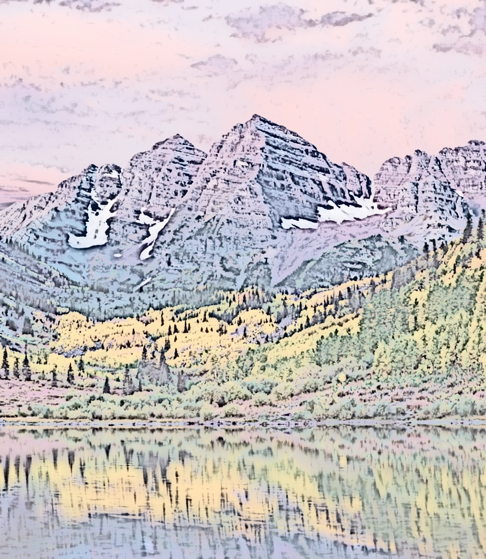
Opening Prayer: Joshua
Joshua 1:1 and 1:5-7, "After the death of Moses the servant of the Lord, the Lord said to Joshua the son of Nun, Moses' assistant…No man shall be able to stand before you all the days of your life. Just as I was with Moses, so I will be with you. I will not leave you or forsake you. Be strong and courageous, for you shall cause this people to inherit the land that I swore to their fathers to give them. Only be strong and very courageous, being careful to do according to all the law that Moses my servant commanded you. Do not turn from it to the right hand or to the left, that you may have good success wherever you go.”

Slide 7
Review of Deuteronomy
Learning Tip: For those studying the Bible in its table‑of‑contents order, this slide gives you a brief recap of the book you just completed. Studying in a different sequence? You can simply skip this slide or treat it as a gentle nudge to circle back when the time is right.
Brief Summary: The events of Deuteronomy take place in the plains of Moab east of the Jordan River across from Jericho over a period of approximately one month before the new generation of Israelite warriors were to begin the conquest of the Promised Land (c. 1405 B.C).¹ The book can be divided into three communications from Moses to the people followed by some concluding historical events.
The first discourse of Moses consisted of a historical recounting of God’s grace and power toward Israel and an exhortation for the people’s obedience (Deuteronomy 1-4).
Moses’s second discourse reminded this new generation of the basic elements of their relationship with the Lord and the statues for life in the new Land. It is here we find a second account of the Ten Commandments (Deuteronomy 5-28).
In Moses’ final address he calls the people to make a covenant with the Living God to worship and serve him alone and to keep their hearts from foreign gods. The people are exhorted to “choose life” and God’s blessings rather than death and God’s curses (Deuteronomy 29-30).
The final chapters of the book highlight the change of leadership from Moses to Joshua, Moses’ song and his encouragement to the people, and the final events of Moses’ life and death at 120 years old (Deuteronomy 31-34).
In the Promised Land the nation of Israel was to be set apart from the surrounding nations through the wisdom of God shown in His statutes and righteous judgments (Deuteronomy 4:7-8). Israel was to fear and love the Lord their God, to demonstrate that love by obeying his commands, and to remember the Lord who kept his covenant with their fathers and brought them out of Egyptian slavery with great power and signs. Obedience to the Lord was for their good, life and blessing; disobedience would result in God’s curses and death. The phrase “the Lord Your God” is used over 200 times in Deuteronomy making God’s election of his people personal; and it is in this book where the Lord God further emphasizes his personal love and affection for his people (Deuteronomy 7:1-26), not because of their righteousness but because of God’s faithfulness to his covenant with Abraham, Isaac, and Jacob (Deuteronomy 9:1-29).
Foreshadowings: Many New Testament themes are present in the Book of Deuteronomy. Jesus Christ is foreshadowed again in the sacrifices and prescribed feasts (Deuteronomy 16:1-17:7) and as the ultimate Prophet like Moses who God would later send (Deuteronomy 18:15-22). God emphasizes the necessity of keeping perfectly the Mosaic Law and the impossibility of doing so; for we like Israel continually transgressed the Law. But thanks be to God for Christ who is our “once for all” atoning sacrifice (Hebrews 10:10). Through Him we are cleansed from our unrighteousness and sealed with the Holy Spirit who empowers us to live for God. In the New Testament Moses continues to be an example of God’s gracious and complete forgiveness as Matthew 17:1-3 records his appearance in the Promised Land with Christ on the Mount of Transfiguration; the land from which he was previously forbidden to enter.² Lastly, God’s choosing of the Israelites as His special people foreshadows His choosing of all those who would believe in Christ (1 Peter 2:9).
Notes:
¹ Deuteronomy 1:1-4
² Deuteronomy 34:1-8

Slide 8
Old Testament Table of Contents (39 Books)
THE LAW - 5
GENESIS
EXODUS
LEVITICUS
NUMBERS
DEUTERONOMY
POETRY - 5
JOB
PSALMS
PROVERBS
ECCLESIASTES
SONG OF SOLOMON
MINOR PROPHETS – 12
HOSEA
JOEL
AMOS
OBADIAH
JONAH
MICAH
NAHUM
HABAKKUK
ZEPHANIAH
HAGGAI
ZECHARIAH
MALACHI
HISTORY – 12
JOSHUA
JUDGES
RUTH
1 SAMUEL
2 SAMUEL
1 KINGS
2 KINGS
1 CHRONICLES
2 CHRONICLES
EZRA
NEHEMIAH
ESTHER
MAJOR PROPHETS - 5
ISAIAH
JEREMIAH
LAMENTATIONS
EZEKIEL
DANIEL

Slide 9
Old Testament Books by Date Written
Historical Books
Wisdom Book and Prophetic Books
Genesis:
c. 1445-1400 B.C.
Exodus:
c. 1445-1400 B.C.
Leviticus:
c. 1445-1400 B.C.
Numbers:
c. 1405 B.C.
Deut:
c. 1405 B.C.
Joshua:
c. 1405-1385 B.C.
Judges:
c. 1043 B.C.
1 & 2 Samuel:
c. 960-722 B.C.
1 & 2 Kings:
c. 560-540 B.C.
Ezra:
c. 460-440 B.C
Esther:
c. 460-350 B.C..
1 & 2 Chron:
c. 450-425 B.C.
Nehemiah:
c. 445-420 B.C.
Ruth:
c. 1011-971 B.C.
Job:
c. 1440 – 950 B.C.
Psalms:
c. 1410-500 B.C.
Proverbs and Song of Solomon:
c. 965 B.C.
Ecclesiastes:
c. 930 B.C.
Obadiah:
c. 848-840 B.C.
Joel:
c. 835 – 796 B.C
Jonah:
c. 790 – 739 B.C.
Isaiah and Micah:
c. 739 – 681 B.C.
Nahum:
c. 663–612 B.C.
Habakkuk and Zephaniah:
c. 635-605 B.C
Jeremiah and Lamentations:
c. 630-575 B.C.
Ezekiel and Daniel:
c. 593 – 530 B.C.
Haggai and Zechariah:
c. 520-470 B.C.
Malachi:
c. 440 – 400 B.C.
Hosea and Amos:
c. 760 -725 B.C.
Amos 3:7 : “For the Lord GOD does nothing without revealing his secret to his servants the prophets.”

Slide 10
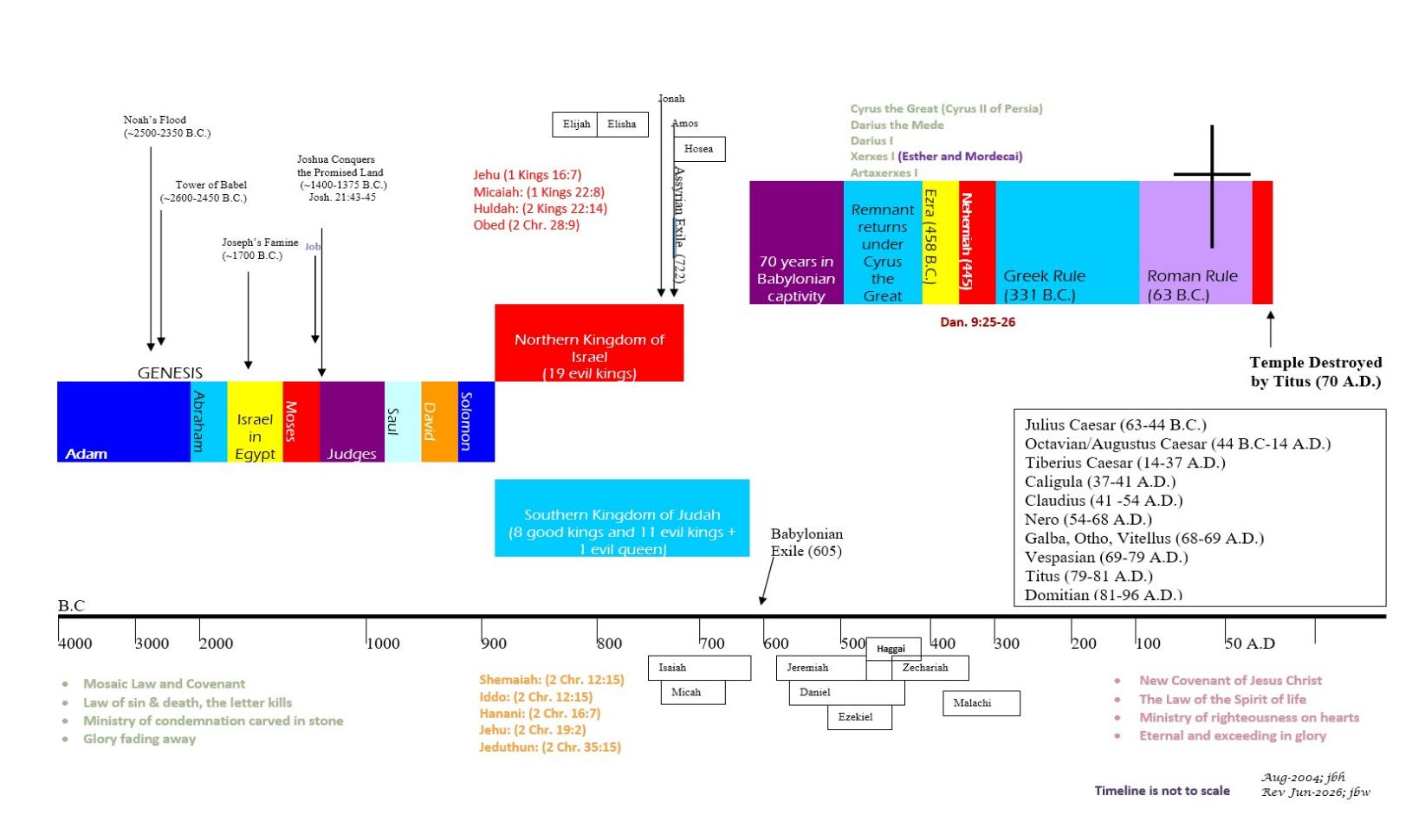







BIBLICAL CHRONOLOGICAL BACKGROUND
OT
NT
Prophets after Noah into the United Kingdom:
Abraham:
Moses:
Samuel:
Gad:
Nathan:
Ahijah
Asaph
(Gen. 20:7)
(Exo. 3:10)
(1 Sam. 3:20)
(1 Sam. 22:5)
(2 Sam. 7:2)
(1 Kings 11:29)
(2 Chr. 35:15)

Slide 11
Joshua
Date: c. 1405-1385 B.C.
Author:
Joshua, son of Nun

Slide 12
JOSHUA: ABOUT THE Author and book
DATE: 1405-1385 B.C
This is the first of the 12 books grouped as historical. The first five books of the Bible are also history books but have been traditionally grouped together under the heading of “The Law”. The book of Joshua gained its name from the exploits of Joshua, the understudy whom Moses prayed for and commissioned as a leader in Israel (Numbers 27:12-23). “Joshua” means “Jehovah saves,” or “the Lord is salvation,” and corresponds to the New Testament name “Jesus.” God delivered Israel in Joshua’s day when he was personally present as the saving Commander who fought on Israel’s behalf.¹
Although the author is not named, the most probable candidate is Joshua, who was the key eyewitness to the events recorded (cf. Joshua 18:8-10; 24:26). An assistant whom Joshua groomed could have finished the book by attaching such comments as those concerning Joshua’s death (Joshua 24:29-33). Some have even suggested that this section was written by the high priest Eleazar, or his son, Phinehas. Rahab was still living at the time Joshua 6:25 was penned. The book was completed before David’s reign.² The most likely writing period is c. 1405–1385 B.C.
Joshua was born in Egyptian slavery, trained under Moses, and by God’s choice rose to his key position of leading Israel into Canaan. Distinguishing features of his life include:
service (Exodus 17:10) ³
soldiering (Exodus 17:9-13)
scouting (Numbers 13-14)
supplication by Moses (Numbers 27:15-18)
the sovereignty of God (Numbers 27:18)
the Spirit’s presence (Numbers 27:18; Deuteronomy 34:9)
set apart by the Lord through Moses (Numbers 27:18-23)⁴
The Lord described Joshua as a man in whom was the Spirit, and his character was marked by wholly following the Lord and challenging others to do likewise (Numbers 32:10-12, Joshua 24:15, Judges 2:7-9).
Notes:
¹ Joshua 5:14-6:2; 10:42; 23:3, Acts 7:45
² Joshua 15:63; cf. 2 Samuel 5:5-9
³ Exodus 24:13; 33:11; Numbers 11:28
⁴ Deuteronomy 31:7-8, Deuteronomy 13-15

Slide 13
Joshua Background and Setting
When Moses passed the baton of leadership on to Joshua before he died (Deuteronomy 34), Israel was at the end of its 40-year wilderness wandering period c. 1405 B.C. Joshua was approaching 90 years of age when he became Israel’s leader.
Poised on the plains of Moab, east of the Jordan River and the land that God had promised (Genesis 12:7; 15:18-21), the Israelites awaited God’s direction to conquer the land. They faced peoples on the western side of the Jordan who had become so steeped in iniquity that God would cause the land, so to speak, to spew out these inhabitants (Leviticus 18:20-25).
God would give Israel the land by conquest, primarily to fulfill the covenant he had pledged to Abraham and his descendants, but also to pass just judgment on the sinful inhabitants (cf. Genesis 15:16). Long possession of different parts of the land by various peoples had predated even Abraham’s day (Genesis 10:15-19; 12:6; 13:7). Its inhabitants had continued on a moral decline in the worship of many gods up to Joshua’s time.

Slide 14
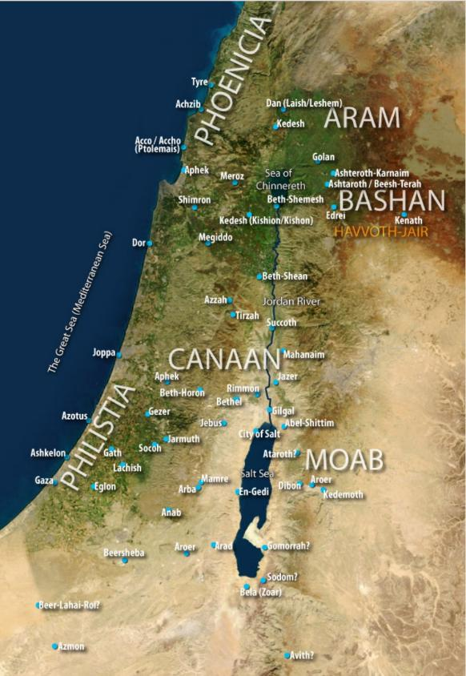
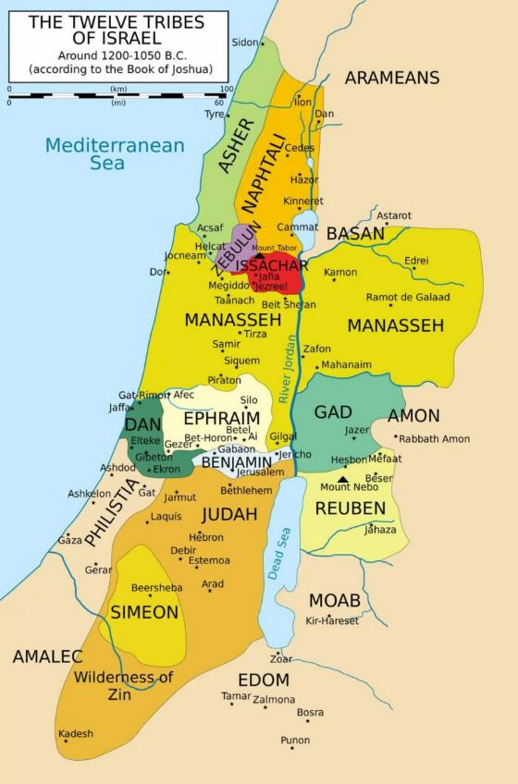
Geography of Joshua
Canaan Prior to Joshua’s Conquests
Israel After Joshua’s Conquests

Slide 15
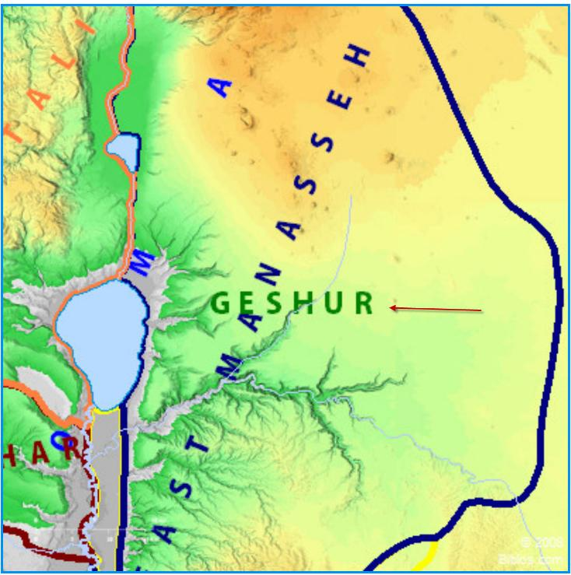
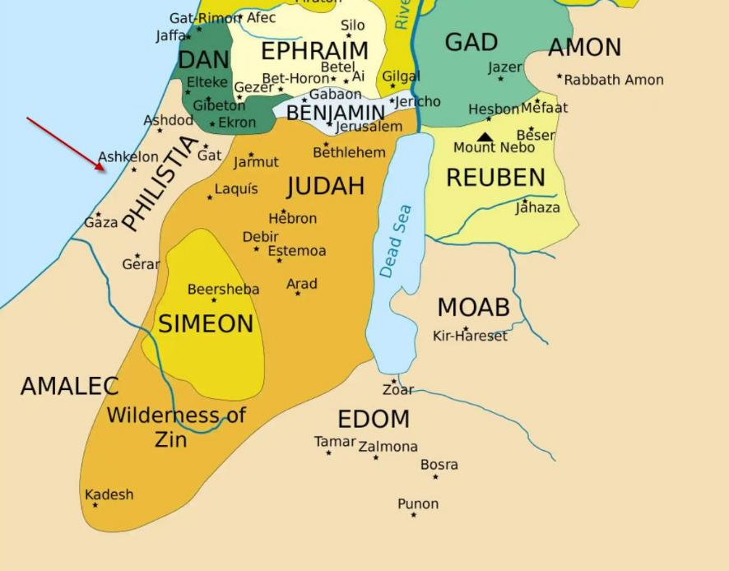
Lands God Also Declared as Canaanite
Exodus 23:27-31, Joshua 13:1-7
Philistia
Geshurites

Slide 16
Joshua: Outline
Entering the Promised Land
  God Commissions Joshua
  Joshua Assumes Command
  Rahab Hides the Spies
  Israel Crosses the Jordan
  The New Generation Circumcised
  The First Passover in Canaan
  Joshua meets the Commander of the Lord’s Army and Worships Him
Distributing Portions in the Promised Land
  Additional Land to be Counted as Canaanite
  Inheritance East of the Jordan River
  Inheritance West of the Jordan
  Cities of Refuge
  Cities and Pasturelands of the Levites
  Joshua’s Charge to Israel’s Leaders
  Eastern Tribes Return Home
Postscript
  Joshua Dies at 110 Years of Age
  The Israelites Bury Joseph’s Bones in Shechem
  Eleazar Dies and is Buried in Ephraim
Joshua 1:1–5:15
Joshua 6:1–12:24
Joshua 13:1–22:34
Joshua 23:1–24:28
Joshua 24:29–33
Conquering the Promised Land
  The Central Campaign
  The Fall of Jericho
  Israel Defeated at Ai (Sin of Achan)
  Covenant Renewed, Ai defeated
  The Southern Campaign
  The Gibeonite Deception
  The Supernatural Defeat of the Amorites
  The Northern Campaign
  The Summary of Conquests
Retaining the Promised Land
  Joshua’s First Speech
  Charge to Take the Additional Land
  Warning not to Mix with Those Who Serve Other gods or Territory Would be Lost
  Joshua’s Second Speech
  Covenant Renewal at Shechem
  Choose Whom You Will Serve
  “As for me and my house, we will serve the Lord”

Slide 17
Joshua: Key Verses
Joshua 1:1-5, “After the death of Moses the servant of the Lord, the Lord said to Joshua the son of Nun, Moses' assistant, "Moses my servant is dead. Now therefore arise, go over this Jordan, you and all this people, into the land that I am giving to them, to the people of Israel. Every place that the sole of your foot will tread upon I have given to you, just as I promised to Moses. From the wilderness and this Lebanon as far as the great river, the river Euphrates, all the land of the Hittites to the Great Sea toward the going down of the sun shall be your territory. No man shall be able to stand before you all the days of your life. Just as I was with Moses, so I will be with you. I will not leave you or forsake you.”
Joshua 1:6-9, "Be strong and courageous, because you will lead these people to inherit the land I swore to their forefathers to give them. Be strong and very courageous. Be careful to obey all the law my servant Moses gave you; do not turn from it to the right or to the left, that you may be successful wherever you go. Do not let this Book of the Law depart from your mouth; meditate on it day and night, so that you may be careful to do everything written in it. Then you will be prosperous and successful. Have I not commanded you? Be strong and courageous. Do not be terrified; do not be discouraged, for the LORD your God will be with you wherever you go."
Joshua 5:13-15, “When Joshua was by Jericho, he lifted up his eyes and looked, and behold, a man was standing before him with his drawn sword in his hand. And Joshua went to him and said to him, "Are you for us, or for our adversaries?" And he said, "No; but I am the commander of the army of the Lord. Now I have come." And Joshua fell on his face to the earth and worshiped and said to him, "What does my lord say to his servant?" And the commander of the Lord 's army said to Joshua, "Take off your sandals from your feet, for the place where you are standing is holy." And Joshua did so.
Joshua 6:25, “But Rahab the prostitute and her father 's household and all who belonged to her, Joshua saved alive. And she has lived in Israel to this day, because she hid the messengers whom Joshua sent to spy out Jericho.”
Joshua 10:11, “And as they fled before Israel, while they were going down the ascent of Beth-horon, the Lord threw down large stones from heaven on them as far as Azekah, and they died. There were more who died because of the hailstones than the sons of Israel killed with the sword.”
Joshua 13:1-3a, “Now Joshua was old and advanced in years, and the Lord said to him, "You are old and advanced in years, and there remains yet very much land to possess. This is the land that yet remains: all the regions of the Philistines, and all those of the Geshurites (from the Shihor, which is east of Egypt, northward to the boundary of Ekron, it is counted as Canaanite;”
Joshua 21:43-45, “Thus the Lord gave to Israel all the land that he swore to give to their fathers. And they took possession of it, and they settled there. And the Lord gave them rest on every side just as he had sworn to their fathers. Not one of all their enemies had withstood them, for the Lord had given all their enemies into their hands. Not one word of all the good promises that the Lord had made to the house of Israel had failed; all came to pass.”
Joshua 24:14-15, [Joshua said] "Now fear the LORD and serve him with all faithfulness. Throw away the gods your forefathers worshiped beyond the River and in Egypt, and serve the LORD. But if serving the LORD seems undesirable to you, then choose for yourselves this day whom you will serve, whether the gods your forefathers served beyond the River, or the gods of the Amorites, in whose land you are living. But as for me and my household, we will serve the LORD.”
Joshua 24:31-32, “Israel served the Lord all the days of Joshua, and all the days of the elders who outlived Joshua and had known all the work that the Lord did for Israel.
As for the bones of Joseph, which the people of Israel brought up from Egypt, they buried them at Shechem, in the piece of land that Jacob bought from the sons of Hamor the father of Shechem for a hundred pieces of money. It became an inheritance of the descendants of Joseph.”

Slide 18
Repeated Words and/or Phrases in the Book of Joshua
Word/Phrase | Approx. No. | Comments
Land | 84 | Either the description of the Promised Land to be possessed or as conquered as promised, the allotment of land to the various tribes of Israel, or remaining land that God was also counting as Canaanite (i.e., Philistine and Geshurite – Joshua 13:1-7).
Give/giving/gave | 58 | Predominantly used to remind Israel that it was the Lord who was giving them the land or the Lord giving their enemies into their hands. Also used for the allotments assigned by Moses or Joshua.
Command/Commanding | 44 | Instructions from the Lord or Joshua to the people.
“The Lord Your God”/ “The Lord Our God” | 32 | Speaks to God’s personal relationship with his chosen people.
Against | 31 | Either rebellion against God, God's anger against Israel, or battles against an enemy.
Struck | 23 | Regarding battles or the people, animals and other things God had devoted to destruction.
Kings | 22
Covenant | 21 | Either the Ark of the Covenant or reference to keeping covenant with God.
You can use the Blue Letter Bible to check for repeated word counts

Slide 19
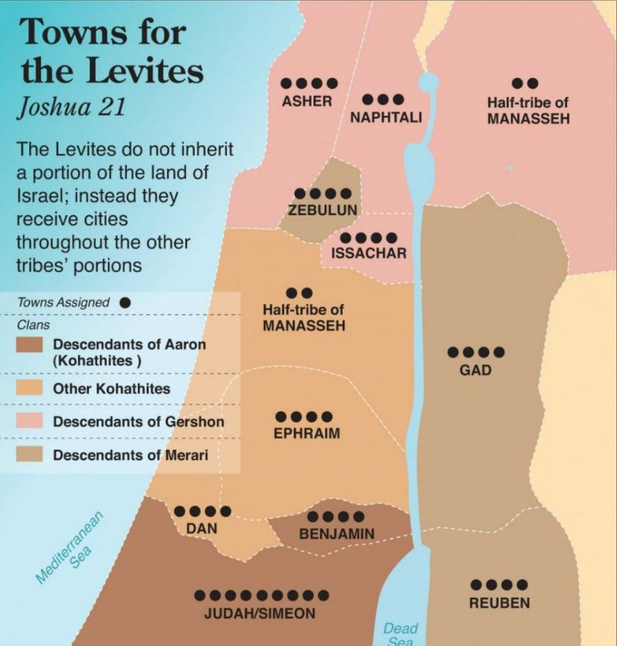
Towns of the Levites
God chose the Levites for special service instead of choosing the firstborn from among all the tribes (see Numbers 3:9-12).
The Levites were given to the Levitical priests (Aaron’s line) to assist them in serving the nation (see Numbers 8:18-19).
Their duties included service for the tabernacle, settling disputes within each city along with the elders according to God’s statutes and ordinances thereby teaching the people to obey God’s word (Deuteronomy 21:5). Accordingly, they were given cities and pasturelands within each tribe rather than having a single inheritance of their own.

Slide 20
Joshua: Study Questions
In Joshua 2 we read how Rahab was given faith and understanding concerning the God of heaven and earth. Her faith was active in that she hid the spies Joshua had sent into Jericho and sought mercy for herself and her family. In Joshua 6:23-25 we read how God granted her the mercy she requested. Read Matthew 1:1-5 and Hebrews 11:30--31 and list the additional blessings God gave to Rahab; blessings she did not know how to ask or think.
Joshua 7 records the events of how one man’s disobedience brought tragic consequences to the nation, himself, and his family. Read the sections below and answer the questions.
  What happened in Joshua 7:1-9 and what reason did God give in Joshua 7:10-15 for Israel’s situation?
  In addition to the tragic outcome in Joshua 7:1-9, what is revealed in Joshua 7:20-25 concerning the crimes and consequences?
What insights into Joshua’s war victories do Joshua 10:5-11 and 24:11-13 give us?
In Deuteronomy 20:10-18 God gave Israel instructions on how they were to approach war. The Israelites were to offer terms of peace to each city before going to war. If the city chose war over peace, God allowed the Israelites to claim the war spoils from far away cities, but the cities in the Promised Land were devoted to destruction for their sins. When we understand that the news of all God had done to the Egyptians had reached the Promised Land (Joshua 2:8-11), it is difficult to fathom why only the Gibeonites were wise enough to seek peace with Israel. How does Joshua 11:18-20 help us comprehend this?
What deeper understanding about faith in God’s promises can you glean from the actions recorded in Genesis 50:25, Exodus 13:19, Joshua 24:32, and Hebrews 11:22?

Slide 21
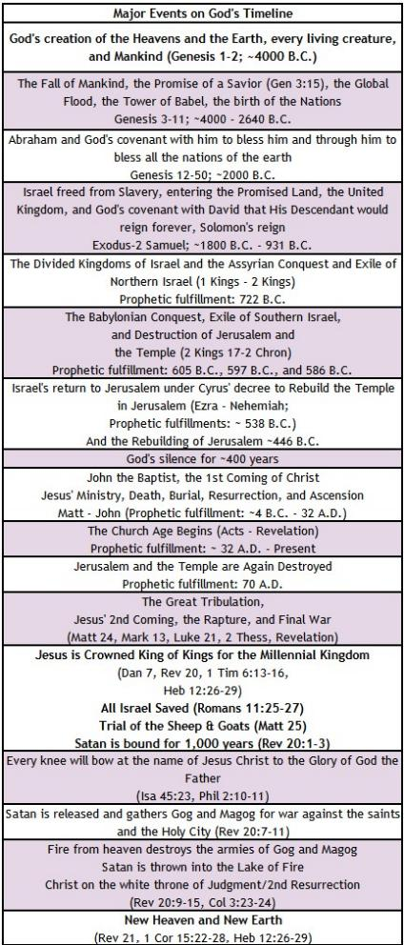
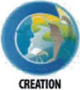

God’s Prophetic Timetable Events
JOSHUA
Joshua 21:43-45, “Thus the Lord gave to Israel all the land that he swore to give to their fathers. And they took possession of it, and they settled there. And the Lord gave them rest on every side just as he had sworn to their fathers. Not one of all their enemies had withstood them, for the Lord had given all their enemies into their hands. Not one word of all the good promises that the Lord had made to the house of Israel had failed; all came to pass.”
Joshua 24:31-32, “As for the bones of Joseph, which the people of Israel brought up from Egypt, they buried them at Shechem, in the piece of land that Jacob bought from the sons of Hamor the father of Shechem for a hundred pieces of money. It became an inheritance of the descendants of Joseph.”
Joshua 23:12-13, "For if you turn back and cling to the remnant of these nations remaining among you and make marriages with them, so that you associate with them and they with you, know for certain that the Lord your God will no longer drive out these nations before you, but they shall be a snare and a trap for you, a whip on your sides and thorns in your eyes, until you perish from off this good ground that the Lord your God has given you."

Slide 22
Summary of Joshua
Brief Summary: The book of Joshua begins with the death of Moses and the Lord calling upon Joshua to be strong and courageous, to not let the Book of the Law depart from him, and to take command of the people of Israel. The historical timing was ~1400 B.C. at the end of Israel’s 40 years of wandering in the wilderness until only a new generation of fighting men were alive along with Joshua and Caleb. God promised to never leave nor forsake Joshua, and when they set out to cross the Jordan River into the Promised Land, God demonstrated he was with Joshua by parting the Jordan as he had done for Moses with the Red Sea (Joshua 3, Exodus 14:10-22). After Israel crossed the Jordan, the Lord commanded that the new generation of males be circumcised, and Israel celebrated their first Passover in the Promised Land. God miraculously protected Israel from the surrounding enemies while all the men recovered from their circumcision (Joshua 5:1-12).
Just prior to taking Jericho, Joshua meets the Commander of the Lord’s army. We know this is the preincarnate Christ Jesus and not an angel because he receives worship from Joshua (Joshua 5:13-15). Afterwards God miraculously gives Israel the land of seven nations (see Joshua 3:10) through various battles beginning with Jericho. Israel conquered the Promised Land via three major campaigns beginning with the central locations, then in battles with the southern kings, and finally defeating the northern kings. The Lord their God fought against their enemies and struck down more soldiers with panic, confusion, hailstones, and hornets than Israel did with the sword (cf. Joshua 10:11, 24:12). God kept the covenant he made with their fathers, Abraham, Isaac, and Jacob and not one of his promises failed as Joshua took the entire land (Joshua 11:23, 21:45). Joshua obeyed the Lord when they came into the land having all the words of the Law read before the leaders and the people (Joshua 23-24). And with Joshua’s challenge to choose whom they would serve; the people renewed their covenant with the Lord God (Joshua 24:14-18).
The Book of Joshua can be summarized as follows:
Chapters 1-12: Entering and conquering the Promised Land.
Chapters 13-22: Distributing Portions in the Promised Land.
Chapters 23-24: Retaining the Promised Land (Joshua’s farewell addresses).
The book closes with a postscript recording the death of our beloved Joshua, the burying of Joseph’s bones, and the death of Eleazar. And we are told that Israel served the Lord all the days of Joshua and the elders who outlived Joshua who had known all the work of the Lord (Joshua 24:31).
Foreshadowings: The story of Rahab the harlot and her great faith in the God of the Israelites gives her a place with those honored for their faith in Hebrews 11:31. Hers is a story of God’s grace to sinners and salvation by faith alone. Most importantly, by God’s grace she was in the Messianic line (Matthew 1:5) of Jesus Christ.
One of the ceremonial rituals of Joshua 5 finds its perfect fulfillment in the New Testament. Verses 1-9 describe God’s commandment that the men who were born in the wilderness were to be circumcised when they came into the Promised Land. By so doing, God “rolled away the reproach of Egypt” from them, meaning that He cleansed them from the sins of their former lives. Colossians 2:10-12 describes believers as having been circumcised in their hearts by Christ Himself, by whom we have put off the sinful nature of our former lives without Christ.
God established cities of refuge so that those who accidentally killed someone could live there without fear of retribution. Christ is our refuge to whom we “have fled to take hold of the hope offered to us” (Hebrews 6:18). Lastly, the Book of Joshua has an overriding theological theme of rest. The Israelites, after wandering in the wilderness for 40 years, finally entered the rest God had prepared for them in the land of Canaan. The writer of Hebrews uses this incident as a warning to us not to let unbelief keep us from entering into God’s rest in Christ (Hebrews 3:7-12).

Slide 23
Joshua: Practical application
One of the key verses of the Book of Joshua is Joshua 1:8a: “This Book of the Law shall not depart from your mouth, but you shall meditate on it day and night, so that you may be careful to do according to all that is written in it.” The Old Testament is replete with historical accounts of how the people forgot God and His Word and suffered terrible consequences. For the Christian, the Word of God is our lifeblood. If we neglect it, our lives will suffer accordingly. But if we take to heart the principle of Joshua 1:8, we will be complete and able to be of use in God’s kingdom (2 Timothy 3:16-17), and we will find that God’s promises in Joshua 1:8 will be ours as well.
Joshua is a prime example of the benefits of having a godly older man to disciple us in the counsel of the Lord (see also Titus 2:1-8). For years Joshua remained close to Moses. He watched Moses as he followed God in an almost flawless manner. He learned to pray in a personal way from Moses. He learned how to obey through the example of Moses. Joshua apparently also learned from the negative example that cost Moses the joy of entering the Promised Land. If you are alive, you are an example. Someone, somewhere, is watching you. Some younger person or someone that you are influencing is seeing how you live and how you react. Someone is learning from you. Someone will follow your example. Making disciples for Jesus Christ must be done with words, deeds, and prayerful dependence on the Holy Spirit. Our entire lives are on display before God and a watching world; a very sobering thought indeed. But in the power of God’s Spirit we can bear fruit that will last throughout eternity.

Slide 24
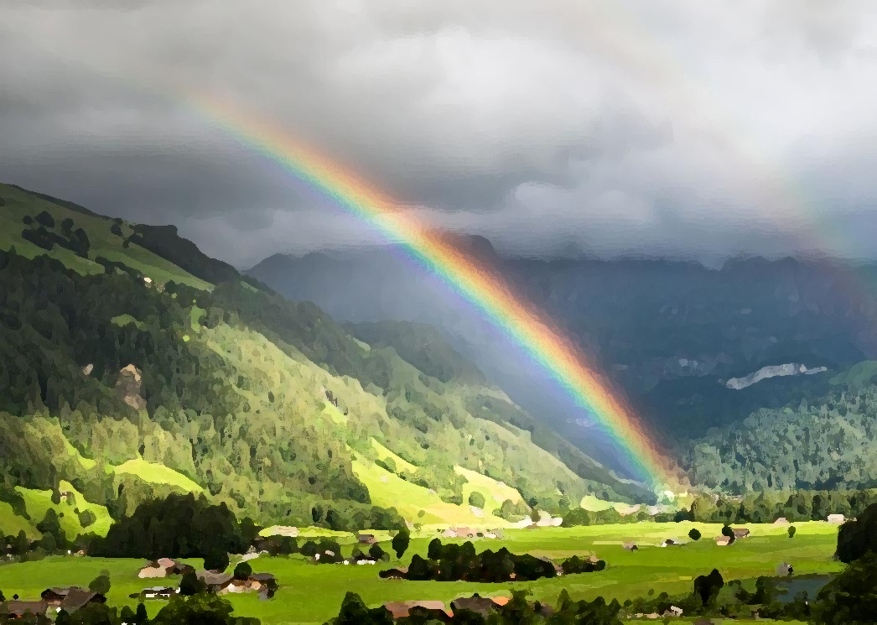
Closing Prayer Verse
Joshua 21:43-45, “Thus the Lord gave to Israel all the land that he swore to give to their fathers. And they took possession of it, and they settled there. And the Lord gave them rest on every side just as he had sworn to their fathers. Not one of all their enemies had withstood them, for the Lord had given all their enemies into their hands. Not one word of all the good promises that the Lord had made to the house of Israel had failed; all came to pass.”

Slide 25
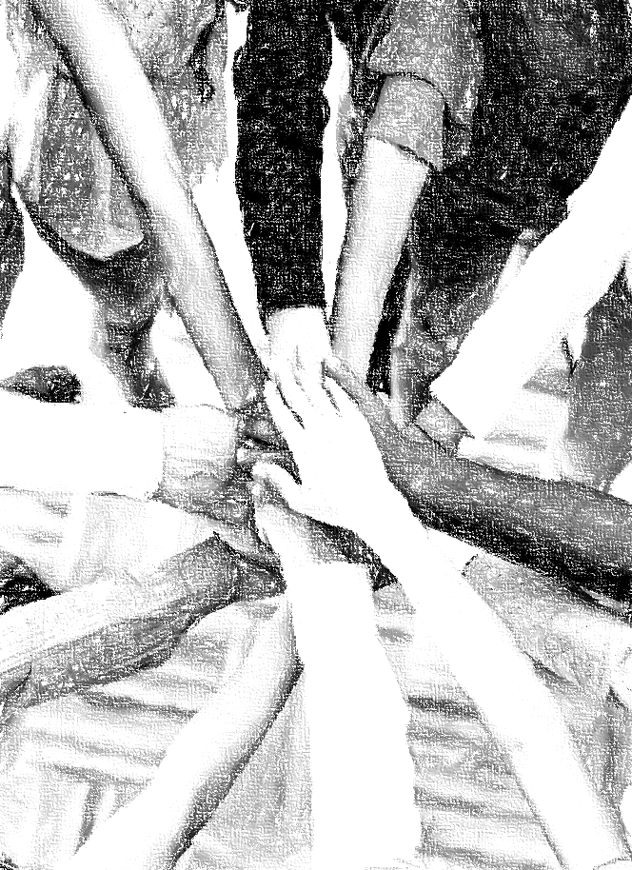
Acknowledgements
Background, Setting, Outlines, some Study Question answers, interpretative challenges, and some Summaries: Adapted from John MacArthur Study Bible at GTY.org.
Key verses, Practical Application, some Study Question answers, and some Summaries: Adapted from GotQuestions.org.
Inductive Bible Study Method: Adapted from Precept.org.
Creation – Consummation Icons: Adapted from AnswersInGenesis.org.
Definitions: Adapted from Websters 1828 Dictionary.
Bible Reference Software and Quotes: All Scripture quotations are taken from the Holy Bible using primarily the English Standard Version (ESV) or New American Standard Bible (NASB) translations. Links to Scripture references utilize BibleRef.com, which is a Got Questions Ministries’ website.

Slide 26
Study Leader Assistance
Sample Prayers
Study Question Answer Keys

Slide 27
Sample Opening Prayer: Joshua
Joshua 1:1 and 1:5-7, "After the death of Moses the servant of the Lord, the Lord said to Joshua the son of Nun, Moses' assistant…No man shall be able to stand before you all the days of your life. Just as I was with Moses, so I will be with you. I will not leave you or forsake you. Be strong and courageous, for you shall cause this people to inherit the land that I swore to their fathers to give them. Only be strong and very courageous, being careful to do according to all the law that Moses my servant commanded you. Do not turn from it to the right hand or to the left, that you may have good success wherever you go.”
Sample Prayer: Dear Heavenly Father, we ask that these promises you made to Joshua will be ours also. Be with us as you were with Joshua and Moses never leaving or forsaking us. Enable us, we pray, to be strong and courageous. Work in us so that we may be used to enable others to inherit your rest. Keep us in your Word so that we do not depart from it or from you all our days and cause us to inherit all you have promised through Jesus Christ our Lord. In his name we pray. Amen.

Slide 28
Joshua: Study Questions
In Joshua 2 we read how Rahab was given faith and understanding concerning the God of heaven and earth. Her faith was active in that she hid the spies Joshua had sent into Jericho and sought mercy for herself and her family. In Joshua 6:23-25 we read how God granted her the mercy she requested. Read Matthew 1:1-5 and Hebrews 11:30--31 and list the additional blessings God gave to Rahab; blessings she did not know how to ask or think. Answer: In addition to saving Rahab and her household, God had Rahab’s faithful actions recorded in His word that will never pass away. He also graciously placed her into the line of David and the lineage of His Son our Lord and Savior, Jesus Christ. And the Holy Spirit likewise commends Rahab in His “Hall of Faith”, which is listed in the book of Hebrews.
Joshua 7 records the events of how one man’s disobedience brought tragic consequences to the nation, himself, and his family. Read the sections below and answer the questions.
  What happened in Joshua 7:1-9 and what reason did God give in Joshua 7:10-15 for Israel’s situation? Answer: After a man named Achan, of the tribe of Judah, secretly broke faith with God by disobeying His instructions concerning items devoted to destruction, Israel was defeated by Ai and lost 36 men in the battle. When Joshua cried out to the Lord, God told him that the people had stolen and hidden some of the devoted things among their belongings and this was why Israel was unable to stand before their enemies.
  In addition to the tragic outcome in Joshua 7:1-9, what is revealed in Joshua 7:20-25 concerning the crimes and consequences? Answer: Achan had coveted and stolen a robe, some silver and gold that God had directed Israel to destroy. Achan’s actions broke covenant with God and resulted in the death of 36 soldiers. God’s punishment was death for Achan, his family, and all they owned by stoning and fire. As the devoted things were to be destroyed by fire; so were Achan and his household. It was not something God or Joshua took pleasure in doing (see Ezekiel 33:11) but was a “cancer” that had to be removed from Israel before it could spread further.
What insights into Joshua’s war victories do Joshua 10:5-11 and 24:11-13 give us? Answer: It was God who gave Joshua the courage and strength that He commanded from him. And it was the Lord God who fought Israel’s battles and gave them the land promised to Abraham, Isaac, and Jacob. The Lord used confusion, panic, hailstones, and hornets against Israel’s enemies and thereby secured Israel’s victories (see Deuteronomy 7:22-26). Our Heavenly Father did this also in Egypt when he brought Israel out of slavery, and He will do it again in all the earth as described in the book of Revelation when Christ Jesus comes again.
In Deuteronomy 20:10-18 God gave Israel instructions on how they were to approach war. The Israelites were to offer terms of peace to each city before going to war. If the city chose war over peace, God allowed the Israelites to claim the war spoils from far away cities, but the cities in the Promised Land were devoted to destruction for their sins. When we understand that the news of all God had done to the Egyptians had reached the Promised Land (Joshua 2:8-11), it is difficult to fathom why only the Gibeonites were wise enough to seek peace with Israel. How does Joshua 11:18-20 help us comprehend this? Answer: The Lord harden the hearts of the inhabitants so that they would come against Israel in battle and not receive mercy but be destroyed. This is similar to the hardening of Pharoah’s heart that made the Egyptian army pursue the Israelites into the Red Sea when it should have been obvious the Lord of heaven and earth was fighting on Israel’s behalf. These examples emphasize that man can only have true intelligence and wisdom when given to him by God.
What deeper understanding about faith in God’s promises can you glean from the actions recorded in Genesis 50:25, Exodus 13:19, Joshua 24:32, and Hebrews 11:22? Answer: Joseph demonstrated his complete trust in God’s covenant with Abraham to give his descendants the Promised Land. Moreover, I see Joseph’s expectation in a future resurrection and a desire to have that resurrection from the grave in the Promised Land. Moses demonstrated faith in the same promises by taking up Joseph’s bones as they left Egypt. And faithful Israelites demonstrated this confidence by fulfilling Joseph’s request to bury his bones in the Land.

Slide 29
Sample Closing Prayer Verse
Joshua 21:43-45, “Thus the Lord gave to Israel all the land that he swore to give to their fathers. And they took possession of it, and they settled there. And the Lord gave them rest on every side just as he had sworn to their fathers. Not one of all their enemies had withstood them, for the Lord had given all their enemies into their hands. Not one word of all the good promises that the Lord had made to the house of Israel had failed; all came to pass.”
Sample Prayer: Dear Heavenly Father, we praise you that you are a God who keeps all your promises and that you have demonstrated this over and over in your written word and in our own lives. We ask that you will not allow any of our enemies to defeat us and that we will receive the ultimate rest you have promised to those who are in Christ Jesus. Holy Spirit actively work in our circumstances and hearts so that we may direct others to Christ to enjoy You now and forever. We love you Lord and pray these things in Jesus’ name. Amen.

