Slide 1

LEVITICUS
Book 3

Slide 2
What is the Holy Bible?
The Holy Bible is a collection of writings that includes 66 books in English editions. The Bible consists of two parts, the Old Testament and New Testament. The word testament means covenant. The Old Testament includes 39 books, and the New Testament includes 27 books.
These 66 books were written over approximately 1,400 years by 40 different authors in Hebrew, Aramaic, and Greek. The Old Testament writings were affirmed by Jewish leaders, and moreover, by Jesus Christ.¹ The New Testament writings were confirmed by early church leaders. The 66 books of the Bible are the inspired words of God that are used to make and mature disciples of the One true God through Jesus Christ, his Son (Matthew 28:18-20, 2 Timothy 3:16-17). The Bible was not created by mere human wisdom but was inspired by God (2 Peter 1:20-21), is interpreted by His Holy Spirit (John 16:13, Matthew 23:8-10), and will last forever (Matthew 24:35).²
If you do a phrase search on the Bible you will find the phrase "the word of the Lord" and "Thus says the Lord" more than 700 times.³ In addition, this book has given reasonable evidence to the claim of being God’s word by:​
  providing answers that conform with the reality we see around us.
  being a reliable collection of historical documents.
  containing eyewitness accounts that were written during the lifetimes of other eyewitnesses.
  recording supernatural events that took place in fulfillment of specific prophecies.⁴
Notes:
¹ See Matthew 4:4-7, 12:3-5, Mark 7:6-7, 12:26-27, and Luke 19:46 for examples.
^{2 “}What are the Books of the Bible”, GotQuestions.org
³ Blue Letter Bible
⁴ Paraphrased from Voddie Baucham

Slide 3
Our Goals in Studying the Bible
To better …..
Understand the Only true God; the Author of the Bible. (2 Timothy 3:16-17, 2 Peter 1:20-21, 1 John 5:20 , Jeremiah 9:23-24)
Learn How He works in the World and in our Lives. (Job 40:6-14, Isaiah 45:6-7, Isaiah 46:8-10, Philippians 2:12-13)
Understand Ourselves and the Hearts of Mankind. (Jeremiah 17:9, 2 Timothy 3:13, Ephesians 5:7-10)
Come to Know What Pleases and Grieves God. (1 Thessalonians 4:1, Ephesians 4:26-31, Hebrews 11:6, 1 Peter 1:14-19)
To be Transformed into Fruitful Doers of God’s Word and not just Hearers. (Romans 12:2, James 1:27, Matthew 3:8)
Tether Ourselves to God’s Word for Our Wisdom, Discernment, and Safety. (1 Corinthians 6:9-10, Matthew 24:24, Ephesians 4:11-14)
Jeremiah 9:23-24 “Thus says the Lord: "Let not the wise man boast in his wisdom, let not the mighty man boast in his might, let not the rich man boast in his riches, but let him who boasts boast in this, that he understands and knows me, that I am the Lord who practices steadfast love, justice, and righteousness in the earth. For in these things I delight, declares the Lord."

Slide 4
How to Study the Bible
#1. Observation: What does the text say.
Who?
What?
When?
Where?
How?
Why?
#2. Interpretation: What does the text mean in context with the passage, book, and whole counsel of God?
#3. Application: How is the Holy Spirit instructing me to apply this understanding at this time in my life?

Slide 5
Study Resources
Opening Prayer
Background and Setting
Book Outline
Geography Maps
Key Verses
Study Questions
Major Event Timeline
Book Summary
Application and Closing Prayer
Study Leader Support Slides

Slide 6
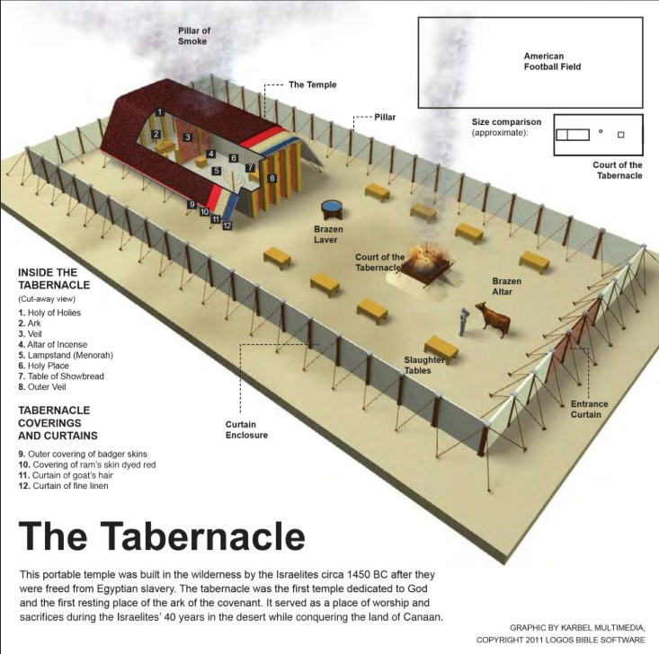
Opening Prayer Verse: Leviticus
Leviticus 4:13-14, "If the whole congregation of Israel sins unintentionally and the thing is hidden from the eyes of the assembly, and they do any one of the things that by the Lord's commandments ought not to be done, and they realize their guilt, when the sin which they have committed becomes known, the assembly shall offer a bull from the herd for a sin offering and bring it in front of the tent of meeting."

Slide 7
Review of Exodus
Brief Summary: Exodus, written c. 1445-1400 B.C., begins where Genesis leaves off as God continues to fulfill his covenant promises made to Abraham, Isaac and Jacob. It traces the events from the time Israel entered Egypt as guests of Joseph, who was powerful in Egypt, until they were eventually delivered from the cruel bondage of slavery into which they had been brought by a new king who did not know Joseph (Exodus 1:8). By God’s self-revelation in the book of Exodus, we are instructed in God’s sovereignty, majesty, goodness, holiness, mercy, and grace. He reveals Himself as the one and only God of heaven and earth.
Chapter 1 through 12:37 describe the conditions of the oppression of the Israelites under the new Pharaoh, the miraculous rescue of Moses as an infant, God’s commission of Moses as Israel’s deliverer, and the plagues God brought upon Egypt through Moses and Aaron for Pharaoh's refusal to submit to Him. God’s sovereign and powerful hand is seen in the miracles of the ten plagues, which end with the deaths of the Egyptian’s firstborn. It is on the eve of this tenth plague that God institutes the first Passover and brings about the release of His people from Egypt. It is also in this section that we read of God’s response to Moses’ prayer to see God’s glory. God proclaims of himself: "The Lord, the Lord God, compassionate and merciful, slow to anger, and abounding in faithfulness and truth; who keeps faithfulness for thousands, who forgives wrongdoing, violation of His Law, and sin; yet He will by no means leave the guilty unpunished, inflicting the punishment of fathers on the children and on the grandchildren to the third and fourth generations.” (Exodus 34:6-7).
The end of chapter 12 through chapter 18 record Israel on the road to Sinai. We learn about God’s parting of the Red Sea, the destruction of the Egyptian army, and God’s continuous presence with his people to guide their journey in the form of a cloud by day, shielding them from the sun, and fire by night to give them light. Unfortunately, we also read of the grumblings of the people against God and his servant Moses. Yet, God gave them bread from heaven, sweet water from bitter, and water from the rock to sustain them on their journey and to help them learn more about their God.
Lastly, chapters 19-40 document Israel’s time encamped at Mount Sinai. Regrettably while Moses was on the mountain receiving the gift of God’s Law written on tablets of stone by God’s own hand, the people in the camp below began a rebellion against God with the idolatrous golden calf (Exodus 32:1-10). Through Moses’ intercession for the people God did not destroy them, but there were grave consequences (Exodus 32:11-28). Moses returned to the mountain top to again receive the Law from God and his instructions for the Tabernacle. When Moses returned to the people, he told them all the Lord had commanded (Exodus 34:29-33), and the people whose hearts were stirred by the Lord (Exodus 35:21-29) gave contributions to build the Tabernacle. The last portion of the book describes the construction of the Ark of the Covenant, the anointing of the Aaronic priesthood, the completion of the Tabernacle, and God’s acceptance of the finished work by the cloud of His glory (Exodus 40:34-38).
Foreshadowings: The numerous sacrifices required of the Israelites were a picture of the ultimate sacrifice, the Passover Lamb of God, Jesus Christ. The night of the last plague on Egypt, an unblemished lamb was killed and its blood applied to the doorposts of the houses of God’s people, protecting them from the angel of death. This foreshadowed Jesus, the Lamb of God without spot or blemish (1 Peter 1:17-21), whose blood applied to us ensures eternal life (Revelation 5:6-10). Among the symbolic presentations of Christ in the book of Exodus is the story of the water from the rock in Exodus 17:1-6. Just as Moses struck the rock to provide life-giving water for the people to drink, so did God strike the Rock of our salvation, crucifying Him for our sin, and from the Rock came the gift of living water (John 4:10-14). The provision of manna in the wilderness is a perfect picture of Christ, the Bread of Life (John 6:48-51), provided by God to give us life. Also, through the tabernacle of the Exodus and its filling with God’s glory, we see the foreshadow of the ultimate consecration of God’s people through Jesus Christ and our being filled with the Holy Spirit (See Exodus 40:34-38, Hebrews 9:15-28, 1 Corinthians 3:16, 1 Corinthians 6:19, Ephesians 2:22).

Slide 8
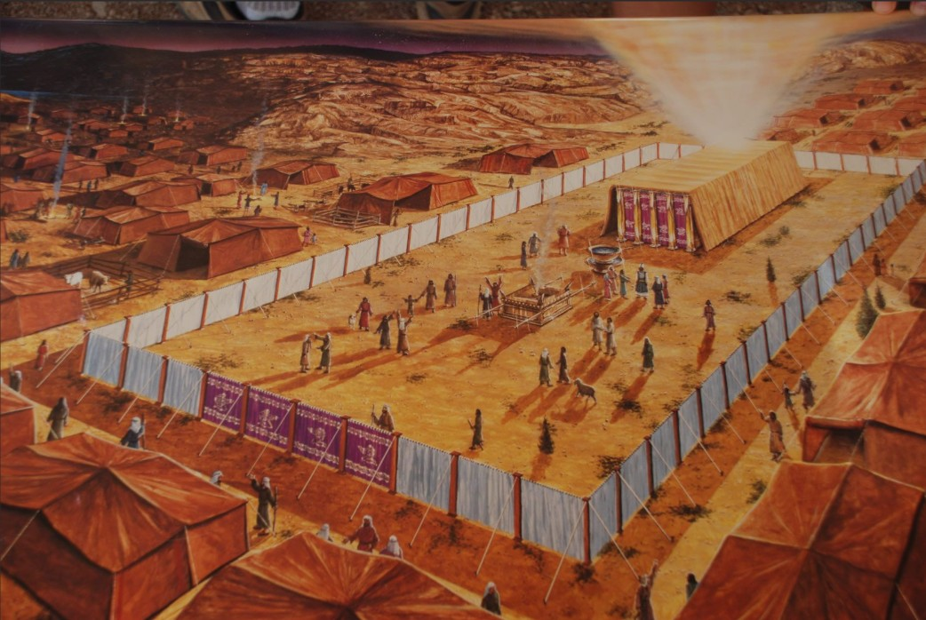
The Tabernacle: Exodus 40

Slide 9
Old Testament Table of Contents (39 Books)
THE LAW - 5
GENESIS
EXODUS
LEVITICUS
NUMBERS
DEUTERONOMY
POETRY - 5
JOB
PSALMS
PROVERBS
ECCLESIASTES
SONG OF SOLOMON
MINOR PROPHETS – 12
HOSEA
JOEL
AMOS
OBADIAH
JONAH
MICAH
NAHUM
HABAKKUK
ZEPHANIAH
HAGGAI
ZECHARIAH
MALACHI
HISTORY – 12
JOSHUA
JUDGES
RUTH
1 SAMUEL
2 SAMUEL
1 KINGS
2 KINGS
1 CHRONICLES
2 CHRONICLES
EZRA
NEHEMIAH
ESTHER
MAJOR PROPHETS - 5
ISAIAH
JEREMIAH
LAMENTATIONS
EZEKIEL
DANIEL

Slide 10
Old Testament Books by Date Written
Historical Books
Wisdom Book and Prophetic Books
Genesis:
c. 1445-1400 B.C.
Exodus:
c. 1445-1400 B.C.
Leviticus:
c. 1445-1400 B.C.
Numbers:
c. 1405 B.C.
Deut:
c. 1405 B.C.
Joshua:
c. 1405-1385 B.C.
Judges:
c. 1043 B.C.
1 & 2 Samuel:
c. 960-722 B.C.
1 & 2 Kings:
c. 560-540 B.C.
Ezra:
c. 460-440 B.C
Esther:
c. 460-350 B.C..
1 & 2 Chron:
c. 450-425 B.C.
Nehemiah:
c. 445-420 B.C.
Ruth
c. 1011-971 B.C.
Job:
c. 1440 – 950 B.C.
Psalms:
c. 1410-500 B.C.
Proverbs and Song of Solomon:
c. 965 B.C.
Ecclesiastes:
c. 930 B.C.
Obadiah:
c. 848-840 B.C.
Joel:
c. 835 – 796 B.C
Jonah
c. 790 – 739 B.C.
Isaiah and Micah:
c. 739 – 681 B.C.
Nahum:
c. 663–612 B.C.
Habakkuk and Zephaniah:
c. 635-605 B.C
Jeremiah and Lamentations
c. 630-575 B.C.
Ezekiel and Daniel:
c. 593 – 530 B.C.
Haggai and Zechariah
c. 520-470 B.C.
Malachi
c. 440 – 400 B.C.
Hosea and Amos:
c. 760 -725 B.C.
Amos 3:7 : “For the Lord GOD does nothing without revealing his secret to his servants the prophets.”

Slide 11


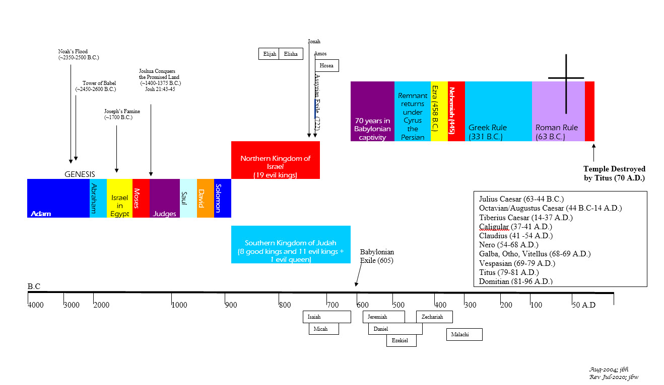
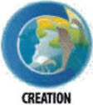
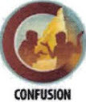
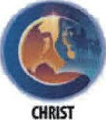
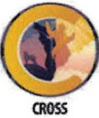
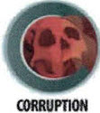
BIBLICAL CHRONOLOGICAL BACKGROUND
OT
Cyrus the Great (Cyrus II)
Darius the Mede
Darius I
Xerxes I (Esther and Mordecai)
Artaxerxes I
NT
Jehu (1 Kings 16:7)
Micaiah: (1 Kings 22:8)
Huldah: (2 Kings 22:14)
Obed (2 Chr 28:9)
Job
Daniel 9:25-26
Prophets after Noah into the United Kingdom:
Abraham:
Moses:
Samuel:
Gad:
Nathan:
Ahijah
Asaph
(Gen 20:7)
(Exo 3:10)
(1 Sam 3:20)
(1 Sam 22:5)
(2 Sam 7:2)
(1 Kings 11:29)
(2 Chron 35:15)
Haggai
Mosaic Law and Covenant
Law of sin & death, the letter kills
Ministry of condemnation carved in stone
Glory fading away
Shemaiah: (2 Chr 12:15)
Iddo: (2 Chr 12:15)
Hanani: (2 Chr 16:7)
Jehu: (2 Chr 19:2)
Jeduthun: (2 Chr 35:15)
New Covenant of Jesus Christ
The Law of the Spirit of life
Ministry of righteousness on hearts
Eternal and exceeding in glory
Timeline is not to scale

Slide 12
Leviticus
Author: Moses
Date of Writing: c.1445 – 1400 B.C.

Slide 13
About Leviticus and its Author: Moses
The original Hebrew title of this third book of the law is taken from the first word, translated as “And he called.” Several Old Testament (OT) books derive their Hebrew names in the same manner (e.g., Genesis, “In the beginning”; Exodus, “Now these are the names”). The title “Leviticus” comes from the Latin Vulgate version of the Greek OT (LXX) Leuitikon, meaning “matters of the Levites”. While the book addresses issues of the Levites’ responsibilities, much more significantly, all the priests are instructed in how they are to assist the people in worship, and the people are informed about how to live a holy life. New Testament writers quote the book of Leviticus over 15 times.
Authorship and date issues are resolved by the concluding verse of the book, “These are the commandments that the Lord commanded Moses for the people of Israel on Mount Sinai” (Leviticus 27:34).¹ The fact that God gave these laws to Moses appears 56 times in the 27 chapters of Leviticus. In addition to recording detailed prescriptions, the book chronicles several historical accounts relating to the laws.² The exodus occurred in 1445 B.C. and the tabernacle was finished one year later (Exodus 40:17). Leviticus picks up the record at that point, likely revealed in the first month (Abib/Nisan) of the second year after the exodus. The book of Numbers begins after that in the second month (Ziv).³
DATE: c. 1445 – 1400 B.C.
Notes:
¹ See also Leviticus 7:37-38; 25:1; 26:46
² Leviticus 8–10; Leviticus 24:10-23
³ Numbers 1:1

Slide 14
Leviticus Background and Setting
Leviticus continues God’s preparation of his people in the wilderness at Mount Sinai. Before the year that Israel camped at Mount Sinai:
  the presence of God’s glory had never formally resided among the Israelites;
  a central place of worship, like the tabernacle, had never existed;
  a structured and regulated set of sacrifices and feasts had not been given; and
  a high priest, a formal priesthood, and a cadre of tabernacle workers had not been appointed.
As Exodus concluded, features one and two had been accomplished, thereby requiring that elements three and four be inaugurated, which is where Leviticus fits in. Exodus 19:6 called Israel to be “a kingdom of priests and a holy nation.” Leviticus in turn is God’s instruction for his newly redeemed people, teaching them how to worship and obey him.
Israel had, up to that point, only the historical records of the patriarchs from which to gain their knowledge of how to worship and live before their God. Having been slaves for centuries in Egypt, the land of a seemingly infinite number of gods, they had a concept of worship and the godly life that was severely distorted. Their tendency to hold on to polytheism and pagan ritual is witnessed in the wilderness wanderings, for example, when they worshiped the golden calf (Exodus 32). God would not permit them to worship in the ways of their Egyptian neighbors, nor would he tolerate Egyptian ideas about morality and sin. With the instructions in Leviticus, the priests could lead Israel in worship appropriate to the Lord.
Even though the book contains a great deal of law, it is presented in a historical format. Immediately after Moses supervised the construction of the tabernacle, God came in glory to dwell there; this marked the close of the book of Exodus (40:34–38). Leviticus begins with God calling Moses from the tabernacle and ends with God’s commands to Moses in the form of binding legislation. Israel’s King had occupied his palace (the tabernacle), instituted his law, and declared himself a covenant partner with his subjects.
No geographical movement occurs in this book. The people of Israel stay at the foot of Sinai, the mountain where God came down to give his law (Leviticus 25:1; 26:46; 27:34). They were still there one month later when the record of Numbers began (Numbers 1:1).

Slide 15
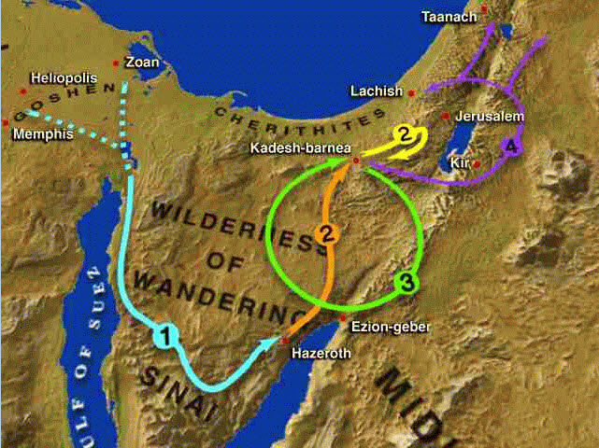
Leviticus Geography
Israel camped at Mount Sinai

Slide 16
Leviticus Outline
Laws Pertaining to Sacrifice
Beginnings of the Priesthood
Prescriptions for Uncleanness
Guidelines for Practical Holiness
Leviticus 1:1–7:38
Leviticus 8:1–10:20
Leviticus 11:1–16:34
Leviticus 17:1–27:34
Legislation for the Laity
  Burnt offerings
  Grain offerings
  Peace offerings
  Sin offerings
  Guilt offerings
Legislation for the Priesthood
  Burnt offerings
  Grain offerings
  Sin offerings
  Guilt offerings
  Peace offerings
Ordination of Aaron and His Sons
First Sacrifices
Execution of Nadab and Abihu for irreverently offering unprescribed fire to God
Unclean Animals
Uncleanness of Childbirth
Unclean Diseases
Cleansing of Diseases
Unclean Discharges
Purification of the Tent of Meeting from Uncleanness
Sacrifice and Food
Proper Sexual Behavior
Neighborliness
Capital/Grave Crimes
Instructions for Priests
Religious Festivals
The Tabernacle
An Account of Blasphemy
Sabbatical and Jubilee Years
Exhortation to Obey the Law: Blessings and Curses
Redemption of Votive Gifts

Slide 17
Jesus Christ in the Offerings¹
Leviticus Passages | Offering | Christ’s Provision | Christ’s Character
Lev. 1:3-17, 6:8-13 | Burnt Offering | Atonement | Jesus Christ’s sinless nature.
Lev. 2:1-16, 6:14-23 | Grain Offering | Dedication, Consecration | Jesus was wholly devoted to the Father’s purposes.
Lev. 3:1-17, 7:11-36 | Peace Offering | Reconciliation, Fellowship | Christ was at peace with God.
Lev. 4:1-5; 4:13-14, 6:24-30 | Sin Offering | Propitiation | Jesus Christ’s substitutionary death.
Lev. 5:14-6; 7:1-10 | Guilt Offering | Repentance | Christ paid it all for redemption.
Atonement: Satisfaction or reparation made by giving an equivalent for an injury, or by doing or suffering that which is received in satisfaction for an offense or injury
Propitiation: To conciliate; to appease one offended and render him favorable
¹MacArthur Study Bible (ESV) page 156

Slide 18
Leviticus: Key Verses
Leviticus 1:4, "He is to lay his hand on the head of the burnt offering, and it will be accepted on his behalf to make atonement for him.”
Leviticus 9:7, “Then Moses said to Aaron, 'Draw near to the altar and offer your sin offering and your burnt offering and make atonement for yourself and for the people, and bring the offering of the people and make atonement for them, as the Lord has commanded. '"
Leviticus 10:10-11, “You are to distinguish between the holy and the common, and between the unclean and the clean, and you are to teach the people of Israel all the statutes that the Lord has spoken to them by Moses."
Leviticus 17:11, "For the life of a creature is in the blood, and I have given it to you to make atonement for yourselves on the altar; it is the blood that makes atonement for one’s life.”
Leviticus 18:24-25, "Do not make yourselves unclean by any of these things, for by all these the nations I am driving out before you have become unclean, and the land became unclean, so that I punished its iniquity, and the land vomited out its inhabitants.”
Leviticus 19:1-2, “And the Lord spoke to Moses, saying, 'Speak to all the congregation of the people of Israel and say to them, You shall be holy, for I the Lord your God am holy. '”
Leviticus 19:18, “'Do not seek revenge or bear a grudge against one of your people, but love your neighbor as yourself. I am the LORD. ‘”
Leviticus 26:44-45, “Yet for all that, when they are in the land of their enemies, I will not spurn them, neither will I abhor them so as to destroy them utterly and break my covenant with them, for I am the Lord their God. But I will for their sake remember the covenant with their forefathers, whom I brought out of the land of Egypt in the sight of the nations, that I might be their God: I am the Lord."

Slide 19
LEVITICUS REPEATED WORDS OR PHRASES DEFINED
Word/Phrase | # Repeats¹ | Definitions² | Comments
Offering/Offerings | 226 | That which is presented to God as an atonement for sin or as a return of thanks for His lovingkindness.
Unclean | 85 | Not free from whatever is injurious or offensive. Guilty, impure, or foul.
Holy | 76 | Properly, whole, entire or perfect, in a moral sense. Hence, pure in heart, temper or dispositions; free from sin and sinful affections. | God is holy and calls his people to be holy as he is. We are called to be pure in heart, dispositions, and free from sin and sinful affections.
Atonement | 45 | Satisfaction or reparation made by giving an equivalent for an injury, or by doing or suffering that which is received in satisfaction for an offense or injury. | Associated with the burnt, sin, and guilt offerings
Seven (days, years, times or seven-fold) | 42 | Signifies completion in the Scriptures: (e.g., creation days, pillars of wisdom, spirits before God's throne). | Genesis 1, Exodus 20:8-11, Proverbs 9, Revelation 1:4
Clean | 39 | Free from whatever is injurious or offensive. Innocent, holy.
Pleasing aroma | 16 | Satisfying fragrance | Associated with the burnt, sin, and guilt offerings.
Notes:
¹Blue Letter Bible
²Webster’s 1828 Dictionary

Slide 20
Jesus Christ in the Feasts
Feast of | Month on Jewish Calendar | Corresponding Month | Foreshadow/Fulfillment
Passover | Nisan 14 | March/April | Lev. 23:5; Exo. 12:1-14; Matt. 26:17-26, Luke 22:7, 1 Cor. 5:7-8
Unleavened Bread | Nisan 15-21 | March/April | Lev. 23:6-8; Exo. 12:15-20, 1 Cor. 5:6-8
First fruits | Nisan 16 or Sivan 6 | March/April | Lev. 23:9-14, 1 Cor .15:23, Matt. 27:52-53
Harvest of Weeks (Pentecost) 50 days after First fruits | Sivan 6 | May/June | Lev. 23:15-21 (two loaves baked with leaven); Deut 16:9-12; Acts 1:3, Acts 2:1-6
Trumpets | Tishri 1,2 | September/October | Lev. 23:24, Num. 29:1-6, 1 Thes. 4:16-17, 1 Cor. 15:51-52
Day of Atonement | Tishri 10 | September/October | Lev. 23:26-32; Heb. 9:7, Hebrews 9:11-15, Zech. 12:10-14, Zech. 13:1, Zech. 6
Booths | Tishri 15-21 | September/October | Lev. 23:34-43; Neh. 8:13, John 7:2, Zech. 14:16-19
¹MacArthur Study Bible (ESV) page 184 and “The Seven Feasts of Israel” by Zola Levitt

Slide 21
Old Covenant the New Covenant¹
Leviticus Provision | Christ’s Provision | New Testament Passage
Old Covenant (temporary) | New Covenant (eternal/permanent) | Hebrews 7:22; 8:6-13, 10:20
Obsolete promises | Better promises | Hebrews 8:6-13
A shadow | The reality | Hebrews 8:5; 9:23-24, 10:1
Aaronic priesthood (many) | Melchizedekian priesthood (one = Christ) | Hebrews 6:19-7:25
Sinful Priesthood | Sinless priest | Hebrews 7:26-27, 9:7
Limited-by-death priesthood | Forever priest | Hebrews 7:16-17,23-24
Daily sacrifices | Once-for-all sacrifice | Hebrews 7:27; 9:12,9:25-26; 10:9-12
Animal sacrifices | Sacrifice of God’s Son | Hebrews 9:11-15,9:26; 10:4-19
Ongoing sacrifices | Sacrifices no longer needed | Hebrews 10:11-14, 10:18
One year atonement | Eternal atonement and propitiation | Hebrews 7:25; 9:12-15; 10:1-4, 10:12
¹MacArthur Study Bible (ESV) page 158

Slide 22
Leviticus: Study Questions
Read Leviticus 5:17-19 and Leviticus 7:1-5 and answer the following questions.
  What was the purpose of the guilt offering?
  Since we know that God is the Creator of all things, gives to all, and has need of nothing (Acts 17:24-25), what reasonable conclusions can you interpret about the offerings being described as “a food offering to the Lord”?
  Along those same lines why do you think the God who created us and knows what is best for us commanded that all the fat, kidneys, and liver be burned in this offering, but other portions of this offering were given to the priests as food?
Refer back to Leviticus 23 and the Scriptures provided in the chart on how Jesus Christ is foreshadowed in the OT feasts to answer the questions below.
  How does the work of Jesus Christ fulfill the Passover feast described in Leviticus 23:5?
  Leviticus 23:15-21 describes the feast of the Harvest of Weeks also known as Pentecost because it occurs 50 days after the feast of First fruits. The New Testament describes the resurrection of Jesus Christ as the first fruits from the grave (1 Corinthians 15:20-24) and records the empowering of his disciples by the Holy Spirit as occurring on the Pentecost after Jesus’ resurrection (Acts 1:8,Acts 2:1-6). Reflecting on the Great Commission that Jesus gave to his all Jewish followers to go and make disciples of all nations, how can we best interpret the two leavened loaves that the priest was to wave before the Lord in this passage?
In Leviticus 25 we read about the Sabbath year for the land (Leviticus 25:1-7), the year of Jubilee for those who have fallen on hard times (Leviticus 25:8-12), and how we are to treat those who fall upon hard times (Leviticus 25:35-38). Review these passages and answer the following questions.
  What does Scripture communicate to us about our God that He has provided a weekly Sabbath rest for us, a Sabbath for the land, and a Jubilee for those in need?
  What does the passage teach about how we are to respond to those in our circle of influence who find themselves in need?

Slide 23
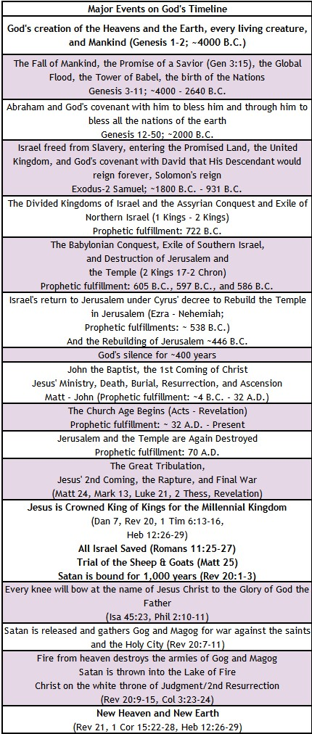
KEY EVENTS
LEVITICUS: GOD’s TIMELINE
Leviticus 26:44-45, “Yet for all that, when they are in the land of their enemies, I will not spurn them, neither will I abhor them so as to destroy them utterly and break my covenant with them, for I am the Lord their God. But I will for their sake remember the covenant with their forefathers, whom I brought out of the land of Egypt in the sight of the nations, that I might be their God: I am the Lord."

Slide 24
Leviticus: Summary Theme
Brief Summary: The entire book of Leviticus occurs at Mount Sinai where God has the Israelites camp after He miraculously rescued them from Egypt. The book of Exodus ends with God demonstrating his acceptance of the consecrated Tabernacle and priesthood established under Moses’ leadership per God’s instructions with the cloud of his glory filling the tent. God had given the Israelites a central place of worship and consecrated a priestly line from Aaron. Now in Leviticus we see God explaining what was necessary for a sinful and unholy people to be cleansed and live in fellowship with a holy God. God is holy, pure and clean in His totality; we are unclean because of our sinful natures (Mark 7:20-23) and because we have individually offended God (Romans 3:23).
Leviticus Chapters 1–7 outline the offerings required of both the laity and the priesthood. God instituted five offerings: the burnt offering, sin offering, grain offering, peace offering, and guilt offering which represented atonement, propitiation, dedication, reconciliation, and repentance from unintentional sin. The people were to revere God by obeying his instructions for worship without deviation for He is God, and because these things pointed to the realities that would be fulfilled in heaven by our Lord Jesus Christ (Hebrews 9). The Israelites were to offer these sacrifices from obedience hearts; the heart of obedience made the offerings pleasing aromas to God and pointed to the ultimate obedience Christ Jesus would fulfill (Philippians 2:5-8).
Leviticus Chapters 8–10 describe the ordination of Aaron and his sons to the priesthood. The one true God was to be approached and worshiped only as He prescribed. Nadab and Abihu, two of Aaron’s sons, stand as an example of how divergences from God's worship instructions further offend Him. The Scriptures record they offered "strange fire“ (i.e., worship from their own imaginations) and were consumed by fire from the Lord.
Chapters 11–16 are the prescriptions for various types of uncleanness. The final 10 chapters are God’s guidelines to His people for the nations justice system, practical individual holy living, and seven feasts to be practiced as part of worship. God’s statues clearly identified capital crimes and just reparations for other injuries so that vengeance could not exact more than justly due. God commanded his people to be holy as He is holy and to love their neighbors as they loved themselves. He provided clear commands regarding the moral behavior that was required for holiness in sexual relations, kindness to the poor, the blind, the deaf, for children and the elderly and things to abstain from such as unclean foods and demonic practices (e.g., spiritism and child sacrifice). Blessings or curses would accompany either the keeping or neglect of God’s commandments and statues. Even before Israel enters the land, the Holy Spirit prophetically points to the day when Israel will be exiled out of it for failing to obey the Lord’s commands. However, God will never fully abandon them or forget the covenant He made with their forefathers (Leviticus 26:44-45).
Foreshadowings: The priesthood, sacrifices, and feasts established by God picture in many ways the person and work of our Savior, the Lord Jesus Christ. Hebrews 10 tells us that the Mosaic Law is “only a shadow of the good things that are coming” by which is meant that the daily sacrifices offered by the priests for the sin of the people were a representation of the ultimate Sacrifice—Jesus Christ, whose sacrifice was once for all time for those who would believe in Him. The holiness imparted temporarily by the Law is now replaced by the absolute attainment of holiness when Christians exchange their sin for the righteousness of Christ (2 Corinthians 5:21). God through the first coming of Christ has fulfilled the feasts of Passover (1 Corinthians 5:7), Unleavened Bread (John 6:32-33), First Fruits (1 Corinthians 15:20, Matthew 27:52-53), and the Harvest of Weeks (Acts 2). As believers we await expectantly for His return and the complete fulfilment of the feasts of Trumpets (1 Thessalonians 4:16-17, 1 Corinthians 15:51-52), Day of Atonement (Zechariah 12:10, Romans 11:25-27), and Feast of Booths (Zechariah 14:16-19).

Slide 25
Leviticus: Practical Application
Practical Application: God takes His holiness very seriously, and so should we. The trend in the postmodern church is to create God in our own image, giving Him the attributes we would like Him to have instead of the ones His Word describes. God’s utter holiness, His transcendent splendor, and His “unapproachable light” (1 Timothy 6:16) are foreign concepts to many Christians. We are called to walk in the Light and to put away the darkness in our lives so that we may be pleasing in His sight (Ephesians 4:1-3, Colossians 1:9-12, Hebrews 11:6). A holy God will not tolerate blatant, intentional, unashamed sin in His people, and His holiness requires Him to punish it. We dare not be flippant in our attitudes toward sin or God’s loathing of it, nor should we make light of it in any way. Let’s pray for hearts that are bent toward never intentionally grieving the One who is truly our Best Friend and has given us so much.

Slide 26

Closing Prayer Verse
Leviticus 26:1-4, "You shall not make idols for yourselves or erect an image or pillar, and you shall not set up a figured stone in your land to bow down to it, for I am the Lord your God. You shall keep my Sabbaths and reverence my sanctuary: I am the Lord.
If you walk in my statutes and observe my commandments and do them, then I will give you your rains in their season, and the land shall yield its increase, and the trees of the field shall yield their fruit."

Slide 27
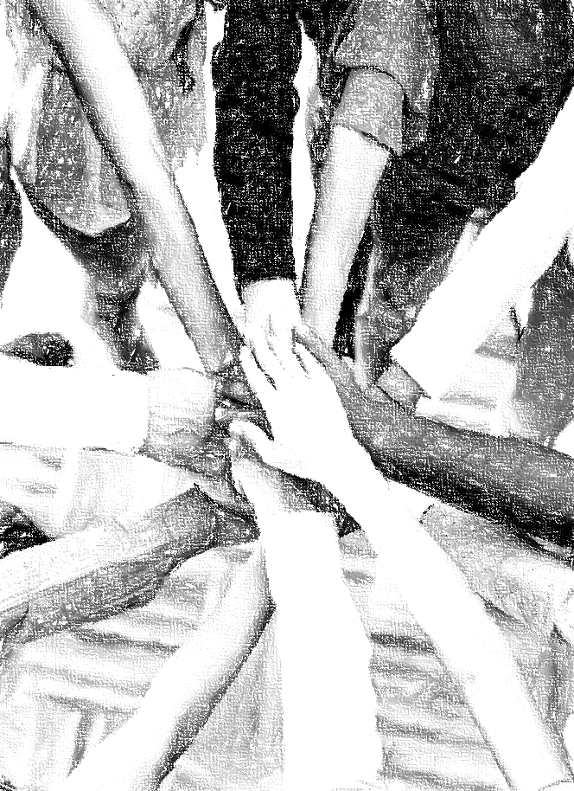
Acknowledgements
Background, Setting, Outlines, some Study Question answers, interpretative challenges, and some Summaries: Adapted from John MacArthur Study Bible at GTY.org.
Key verses, Practical Application, some Study Question answers, and some Summaries: Adapted from GotQuestions.org.
Inductive Bible Study Method: Adapted from Precept.org.
Creation – Consummation Icons: Adapted from AnswersInGenesis.org.
Definitions: Adapted from Websters 1828 Dictionary.

Slide 28
Study Leader Assistance
Tabernacle’s Description
Sample Prayers
Study Question Answer Keys

Slide 29
Sample Opening Prayer: Leviticus
Leviticus 4:13-14, "If the whole congregation of Israel sins unintentionally and the thing is hidden from the eyes of the assembly, and they do any one of the things that by the Lord’s commandments ought not to be done, and they realize their guilt, when the sin which they have committed becomes known, the assembly shall offer a bull from the herd for a sin offering and bring it in front of the tent of meeting."
Sample Prayer: Dear Heavenly Father, thank you for providing a way for your unclean and unholy people to be cleansed and restored to fellowship with you. We thank you for all that the Old Testament sacrifices teach us about the seriousness of our sinful offenses against you as we see your requirements for repentance and the death of a substitute in our place. We praise you that our Lord Jesus willingly became the final substitute to ratify the eternal covenant and bring us from death to life. May your Holy Spirit work in us to help us to realize quickly when we have offended you so that we may confess our sins, be forgiven, and cleansed of all unrighteousness. We love you Lord and ask these things through the provision of your Son, Jesus Christ.

Slide 30
Leviticus: Study Question Answers
Read Leviticus 5:17-19 and Leviticus 7:1-5 and answer the following questions.
  What was the purpose of the guilt offering? Answer: The guilt offering was made when a person disobeyed God unintentionally and without realizing it. Once the person realized his sin, he or she was to bring a guilt offering to the priest to atone for the sin and the person would be forgiven. It was an act of repentance.
  Since we know that God is the Creator of all things, gives to all, and has need of nothing (Acts 17:24-25), what reasonable conclusions can you interpret about the offerings being described as “a food offering to the Lord”? Answer: As humans we need food to survive, and of course, God does not. God is self-existent and gives to all of us what we need to live. Thus, the sacrifice of an animal to God is our giving up what we would otherwise use for food for ourselves. The life’s blood of the animal is shed to remind the sinner that without the shedding of blood there is no forgiveness of sin (Hebrews 9:22).
  Along those same lines why do you think the God who created us and knows what is best for us commanded that all the fat, kidneys, and liver be burned in this offering, but other portions of this offering were given to the priests as food? Answer: God knew that the fat, kidneys, and liver would be harmful to consume. Today medical science teaches us that the kidney and liver were designed to filter toxins from the body, and high fat diets lead to various health issues.
Refer back to Leviticus 23 and the Scriptures provided in the chart on how Jesus Christ is foreshadowed in the OT feasts to answer the questions below.
  How does the work of Jesus Christ fulfill the Passover feast described in Leviticus 23:5? Answer: Christ is God’s true, perfect, and final Passover Lamb. Because the second Person of our triune God took on human form and willingly laid down his life upon a cross to receive God’s just punishment for our sins, God can in his holiness forgive us and pass over us when He condemns sinners in the final judgment. Because Jesus is of infinite value (i.e., fully God), he was worthy to pay in full the debt we owed for our offenses against God and able to keep us from God’s eternal prison called hell (i.e., the lake of fire).
  Leviticus 23:15-21 describes the feast of the Harvest of Weeks also known as Pentecost because it occurs 50 days after the feast of First fruits. The New Testament describes the resurrection of Jesus Christ as the first fruits from the grave (1 Corinthians 15:20-24) and records the empowering of his disciples by the Holy Spirit as occurring on the Pentecost after Jesus’ resurrection (Acts 1:8,Acts 2:1-6). Reflecting on the Great Commission that Jesus gave to his all Jewish followers to go and make disciples of all nations, how can we best interpret the two leavened loaves that the priest was to wave before the Lord in this passage? Answer: The two leavened loaves the priest waved before the Lord are best interpreted as representing both Jew and Gentile sinners who are saved by our great High Priest, Jesus Christ. Unleavened bread represented the sinless nature of Messiah Jesus while leaven in the bread represented our sin nature. As leaven causes the dough to be puffed up; so also, our sin natures cause us to be pridefully think more highly of ourselves than we should, which leads to many sins in thoughts, words, and deeds.
In Leviticus 25 we read about the Sabbath year for the land (Leviticus 25:1-7), the year of Jubilee for those who have fallen on hard times (Leviticus 25:8-12), and how we are to treat those who fall upon hard times (Leviticus 25:35-38). Review these passages and answer the following questions.
  What does Scripture communicate to us about our God that He has provided a weekly Sabbath rest for us, a Sabbath for the land, and a Jubilee for those in need? Answer: Our God has compassion on his creation and a special mercy for mankind. He demonstrates his lovingkindness each day by holding all things together with each new morning. And he gives us rest each week, instructs us on how to care for the poor with his lovingkindness, and teaches us how to care for the resources He has provided.
  What does the passage teach about how we are to respond to those in our circle of influence who find themselves in need? Answer: We are to support him through interest-free loans and treat him with the same kindness we would treat a traveler in our land.

Slide 31
Sample Closing Prayer
Leviticus 26:1-4, "You shall not make idols for yourselves or erect an image or pillar, and you shall not set up a figured stone in your land to bow down to it, for I am the Lord your God. You shall keep my Sabbaths and reverence my sanctuary: I am the Lord.
If you walk in my statutes and observe my commandments and do them, then I will give you your rains in their season, and the land shall yield its increase, and the trees of the field shall yield their fruit.“
Sample Prayer: Dear Heavenly Father, we praise you as the Creator and King of the universe. You are God and there is no other. We thank you for the Sabbaths you have given to us to refresh and strengthen us, and we stand in awe that we, as believers, are temples of your Holy Spirit. Work in us Lord to obey and bear the fruit of your Spirit: love, joy, peace, patience, goodness, gentleness, and self-control. We are grateful that these things bring you glory and good to us and others. We lift our prayers to you through Jesus Christ, our Lord, for it is through His work that we may approach your throne with confidence. Amen.

Slide 32
The Tabernacle’s Description

