Slide 1
MARK
Book 41

Slide 2
What is the Holy Bible?
The Holy Bible is a collection of writings that includes 66 books in English editions. The Bible consists of two parts, the Old Testament and New Testament. The word testament means covenant. The Old Testament includes 39 books, and the New Testament includes 27 books.
These 66 books were written over approximately 1,400 years by 40 different authors in Hebrew, Aramaic, and Greek. The Old Testament writings were affirmed by Jewish leaders, and moreover, by Jesus Christ.¹ The New Testament writings were confirmed by early church leaders. The 66 books of the Bible are the inspired words of God that are used to make and mature disciples of the One true God through Jesus Christ, his Son (Matthew 28:18-20, 2 Timothy 3:16-17). The Bible was not created by mere human wisdom but was inspired by God (2 Peter 1:20-21), is interpreted by His Holy Spirit (John 16:13, Matthew 23:8-10), and will last forever (Matthew 24:35).²
If you do a phrase search on the Bible you will find the phrase "the word of the Lord" and "Thus says the Lord" more than 700 times.³ In addition, this book has given reasonable evidence to the claim of being God’s word by:​
  providing answers that conform with the reality we see around us.
  being a reliable collection of historical documents.
  containing eyewitness accounts that were written during the lifetimes of other eyewitnesses.
  recording supernatural events that took place in fulfillment of specific prophecies.⁴
Notes:
¹ See Matthew 4:4-7, 12:3-5, Mark 7:6-7, 12:26-27, and Luke 19:46 for examples.
^{2 “}What are the Books of the Bible”, GotQuestions.org
³ Blue Letter Bible
⁴ Paraphrased from Voddie Baucham

Slide 3
Our Goals in Studying the Bible
To better …..
Understand the Only true God; the Author of the Bible. (2 Timothy 3:16-17, 2 Peter 1:20-21, 1 John 5:20 , Jeremiah 9:23-24)
Learn How He works in the World and in our Lives. (Job 40:6-14, Isaiah 45:6-7, Isaiah 46:8-10, Philippians 2:12-13)
Understand Ourselves and the Hearts of Mankind. (Jeremiah 17:9, 2 Timothy 3:13, Ephesians 5:7-10)
Come to Know What Pleases and Grieves God. (1 Thessalonians 4:1, Ephesians 4:26-31, Hebrews 11:6, 1 Peter 1:14-19)
To be Transformed into Fruitful Doers of God’s Word and not just Hearers. (Romans 12:2, James 1:27, Matthew 3:8)
Tether Ourselves to God’s Word for Our Wisdom, Discernment, and Safety. (1 Corinthians 6:9-10, Matthew 24:24, Ephesians 4:11-14)
Jeremiah 9:23-24 “Thus says the Lord: "Let not the wise man boast in his wisdom, let not the mighty man boast in his might, let not the rich man boast in his riches, but let him who boasts boast in this, that he understands and knows me, that I am the Lord who practices steadfast love, justice, and righteousness in the earth. For in these things I delight, declares the Lord."

Slide 4
How to Study the Bible
#1. Observation: What does the text say.
Who?
What?
When?
Where?
How?
Why?
#2. Interpretation: What does the text mean in context with the passage, book, and whole counsel of God?
#3. Application: How is the Holy Spirit instructing me to apply this understanding at this time in my life?

Slide 5
Study Resources
Opening Prayer
Background and Setting
Book Outline
Geography Maps
Key Verses
Study Questions
Major Event Timeline
Book Summary
Application and Closing Prayer
Study Leader Support Slides

Slide 6

Opening Prayer Verse: Mark
Mark 2:10-12, "But that you may know that the Son of Man has authority on earth to forgive sins" — he said to the paralytic — "I say to you, rise, pick up your bed, and go home." And he rose and immediately picked up his bed and went out before them all, so that they were all amazed and glorified God, saying, "We never saw anything like this!"

Slide 7
Review of Matthew
Brief Summary: In the book of Matthew, God reveals to us Jesus, the Christ, the son of Abraham, the Son of David, the beloved Son of the Living God (Matthew 1). This gospel is laid out in a series of five discourses and historical narratives. Jesus is the One who fulfills all the Law and the Prophets (Matthew 5:17) and of whom Moses and the Prophets wrote (Luke 24:26-27). All authority has been given to Jesus, and he demonstrated this authority in word and deeds as he healed the sick, cleansed the lepers, gave sight to the blind, caused the deaf to hear, the mute to speak, calmed the wind and the waves, and raised the dead. Jesus went throughout Israel calling his disciples to follow him and teaching the people to “repent for the kingdom of heaven is at hand” (Matthew 4:17). Jesus taught that what defiles us before God are the things that come from our own hearts: evil thoughts, murder, adultery, sexual immorality, theft, false witness, and slander (Matthew 15:18-20). He promised rest for the weary and that his yoke is easy (Matthew 11:25-30). When Jesus taught in parables to the crowds, privately he explained everything to his disciples, and to them he foretold the signs of His Second Coming (Matthew 13:10-23, Matthew 24-25).
King Jesus upended his adversaries with their man-made traditions and denounced them for failing to shepherd God’s flock (Matthew 23:15, Ezekiel 34:1-3, Zechariah 11:8-9 ). At the conclusion of these conflicts, the false shepherds plotted to have the Son of God killed as Jesus predicted (Matthew 26:3-4, Acts 2:22-24). But what men meant for evil, God worked for good in that Christ was struck for our transgressions and raised on the third day with all authority in heaven and earth (Isaiah 53, John 19:10-11, Matthew 28:18). Before ascending into heaven to sit at the Father’s right hand (Acts 1:4-9, Psalm 110:1), Jesus left his followers with the assignment to make disciples of all nations baptizing them in the name of the Father, the Son, and the Holy Spirit and teaching them to obey all He commanded. This Jesus, with all authority, promised to be with us always to the end of the age (Matthew 28:18-20).
Connections: Matthew quotes more than 60 times from prophetic passages of the Old Testament, demonstrating how Jesus fulfilled them and is the King and Messiah of Israel. He begins his Gospel with the genealogy of Jesus, tracing Him back to Abraham, the progenitor of the Jews through Jacob. From there, Matthew quotes extensively from the prophets, frequently using the phrase “as was spoken through the prophet(s)”.¹ These verses refer to the Old Testament prophecies of His virgin birth (Isaiah 7:14) in Bethlehem (Micah 5:2), His return from Egypt after the death of Herod (Hosea 11:1), His ministry to the Gentiles (Isaiah 9:1-2; 60:1-3), His miraculous healings of both body and soul (Isaiah 53:4), His speaking in parables (Psalm 78:2), and His triumphal entry into Jerusalem (Zechariah 9:9 and Daniel 9:25-26).
Notes:
¹ Matthew 1:22-23, 2:5-6, 2:15, 4:13-16, 8:16-17, 13:35, 21:4-5

Slide 8
New Testament Table of Contents (27 Books)
THE GOSPELS & ACTS - 5
MATTHEW
MARK
LUKE
JOHN
ACTS
PAUL’S LETTERS TO CHURCHES - 9
ROMANS
1 CORINTHIANS
2 CORINTHIANS
GALATIANS
EPHESIANS
PHILIPPIANS
COLOSSIANS
1 THESSALONIANS
2 THESSALONIANS
PAUL’S LETTERS TO INDIVIDUALS - 4
1 TIMOTHY
2 TIMOTHY
TITUS
PHILEMON
LETTERS BY OTHERS – 9
HEBREWS
JAMES
1 PETER
2 PETER
1 JOHN
2 JOHN
3 JOHN
JUDE
REVELATION

Slide 9
New Testament Books by Date Written
James:
45-50 A.D.
Galatians:
49-55 A.D.
1 Thess:
51 A.D.
2 Thess:
52 A.D.
1 Cor:
53-55 A.D.
2 Cor:
55-56 A.D.
Mark:
55-60 A.D.
Matthew:
55-65 A.D.
Romans:
57-58 A.D.
Luke:
60 A.D.
1 & 2 Peter: 60-65 A.D.
Jude:
60-70 A.D.
Ephesians: 60-61 A.D.
Philippians: 60-61 A.D.
Colossians: 61 A.D.
Philemon:
61 A.D.
Titus:
62-67 A.D.
1 Timothy:
63-66 A.D.
Acts:
65 A.D.
Hebrews:
65 A.D.
2 Timothy:
67 A.D.
John:
85-90 A.D.
1, 2 & 3 John:
85-95 A.D.
Revelation: 90-95 A.D.

Slide 10


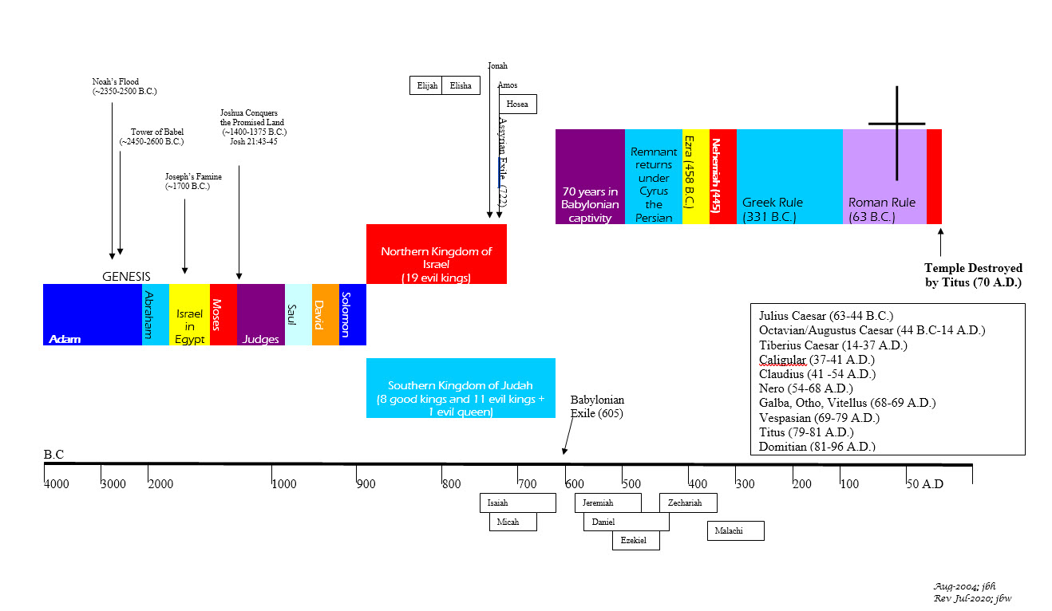





BIBLICAL CHRONOLOGICAL BACKGROUND
OT
Cyrus the Great (Cyrus II)
Darius the Mede
Darius I
Xerxes I (Esther and Mordecai)
Artaxerxes I
NT
Jehu (1 Kings 16:7)
Micaiah: (1 Kings 22:8)
Huldah: (2 Kings 22:14)
Obed (2 Chr 28:9)
Job
Daniel 9:25-26
Prophets after Noah into the United Kingdom:
Abraham:
Moses:
Samuel:
Gad:
Nathan:
Ahijah
Asaph
(Gen 20:7)
(Exo 3:10)
(1 Sam 3:20)
(1 Sam 22:5)
(2 Sam 7:2)
(1 Kings 11:29)
(2 Chron 35:15)
Haggai
Mosaic Law and Covenant
Law of sin & death, the letter kills
Ministry of condemnation carved in stone
Glory fading away
Shemaiah: (2 Chr 12:15)
Iddo: (2 Chr 12:15)
Hanani: (2 Chr 16:7)
Jehu: (2 Chr 19:2)
Jeduthun: (2 Chr 35:15)
New Covenant of Jesus Christ
The Law of the Spirit of life
Ministry of righteousness on hearts
Eternal and exceeding in glory
Timeline is not to scale

Slide 11
Mark
Author: John Mark
Date of Writing: c. 55-60 A.D.

Slide 12
About this Gospel and Its Author – John Mark
Mark, for whom this Gospel is named, was a close companion of the apostle Peter and a recurring historical figure in the book of Acts, where he is known as “John whose other name was Mark”.¹ It was to John Mark’s mother’s home in Jerusalem that Peter went when released from prison (Acts 12:12).
John Mark was a cousin of Barnabas (Colossians 4:10), who accompanied Paul and Barnabas on Paul’s first missionary journey (Acts 12:25; 13:5). But he deserted them along the way in Perga and returned to Jerusalem (Acts 13:13). When Barnabas wanted Paul to take John Mark on the second missionary journey, Paul refused. The friction that resulted between Paul and Barnabas led to their separation (Acts 15:38-40).
But John Mark’s earlier vacillation evidently gave way to great strength and maturity, and in time he proved himself even to the apostle Paul. When Paul wrote the Colossians, he instructed them that if John Mark came, they were to welcome him (Colossians 4:10). Paul even listed Mark as a fellow worker (Philemon 24). Later, Paul told Timothy to “get Mark and bring him with you, for he is very useful to me for ministry” (2 Timothy 4:11).
John Mark’s restoration to useful ministry may have been, in part, due to the ministry of Peter. Peter’s close relationship with Mark is evident from his description of him as “Mark, my son” (1 Peter 5:13). Peter, of course, was no stranger to failure himself, and his influence on the younger man was no doubt instrumental in helping him out of the instability of his youth and into the strength and maturity he would need for the work to which God had called him. In this we see Peter obeying the command of our Lord Jesus, whom he loved, to strengthen his brothers and feed the Lord’s lambs (Luke 22:31-32, John 21:15-17).
Unlike the epistles, the Gospels do not name their authors. The early church Fathers, however, unanimously affirm that Mark wrote this second Gospel. Papias, bishop of Hieropolis, writing about 140 A.D. noted:
  “And the presbyter [the apostle John] said this: Mark having become the interpreter of Peter, wrote down accurately whatsoever he remembered. It was not, however, in exact order that he related the sayings or deeds of Christ. For he neither heard the Lord nor accompanied him. But afterwards, as I said, he accompanied Peter, who accommodated his instructions to the necessities [of his hearers], but with no intention of giving a regular narrative of the Lord’s sayings. Wherefore Mark made no mistake in thus writing some things as he remembered them. For of one thing he took especial care, not to omit anything he had heard, and not to put anything fictitious into the statements.” [From the Exposition of the Oracles of the Lord]
Justin Martyr, writing about 150 A.D., referred to the Gospel of Mark as “the memoirs of Peter,” and suggested that Mark committed his Gospel to writing while in Italy. This agrees with the uniform voice of early tradition, which regarded this Gospel as having been written in Rome, for the benefit of Roman Christians. Irenaeus, writing about 185 A.D., called Mark “the disciple and interpreter of Peter,” and recorded that the second Gospel consisted of what Peter preached about Christ. The testimony of the church Fathers differs as to whether this Gospel was written before or after Peter’s death (c. 67–68 A.D.).
Evangelical scholars have suggested dates for the writing of Mark’s Gospel ranging from 50 to 70 A.D. A date before the destruction of Jerusalem and the temple in 70 A.D. is required by the comment of Jesus in Mark 13:2. Luke’s Gospel was clearly written before Acts (Acts 1:1-3). The date of the writing of Acts can probably be fixed at about 63 A.D., because that is shortly after the narrative ends. It is therefore likely, though not certain, that Mark was written at an early date, probably sometime in the 50s.
Notes:
¹ Acts 12:12, 12:25; 15:37, 15:39

Slide 13
Mark: Background and Setting
Whereas Matthew was written to a Jewish audience, Mark seems to have targeted Roman believers, particularly Gentiles. When employing Aramaic terms, Mark translated them for his readers.¹ On the other hand, in some places he used Latin expressions instead of their Greek equivalents.² He also reckoned time according to the Roman system (6:48; 13:35) and carefully explained Jewish customs.³
Mark omitted Jewish elements, such as the genealogies found in Matthew and Luke. This Gospel also makes fewer references to the Old Testament and includes less material that would be of particular interest to Jewish readers—such as that which is critical of the Pharisees and Sadducees (Sadducees are mentioned only once, in Mark 12:18). When mentioning Simon of Cyrene (Mark 15:21), Mark identifies him as the father of Rufus, a prominent member of the church at Rome (Romans 16:13). All of this supports the traditional view that Mark was written for a Gentile audience initially at Rome.
Notes:
¹ Mark 3:17; 5:41; 7:11, 7:34; 10:46; 14:36; 15:22, 15:34
² Mark 5:9; 6:27; 12:15, 12:42; 15:16, 15:39
³ Mark 7:3-4; 14:12; 15:42

Slide 14
Mark: Outline
Broadening His Ministry
  In Various Gentile Regions:
  Tyre/Sidon: He Delivers a Gentile Woman’s Daughter
  Decapolis: He Heals a Deaf-Mute
  The Eastern Shore of Galilee: He Feeds the 4,000
  Dalmanutha: He Disputes the Pharisees
  The Other Side of the Lake: He Rebukes the Disciples
  Bethsaida: He Heals a Blind Man
  Caesarea Philippi and Capernaum: He Instructs the Disciples
    He predicts his death and resurrection
    He explains the cost of discipleship
    He reveals his glory
    He clarifies Elijah’s role
    He casts out a stubborn spirit
    He warns would-be stumbling blocks
Consummating His Ministry
  Jerusalem:
  Triumphal Entry
  Purification: the fig tree, cleansing the temple
  Public Teaching
    Concerning his authority and rejection
    Concerning paying taxes
    Concerning the resurrection
    Concerning the greatest commandment
    Concerning the Messiah’s true Sonship
    Concerning the scribes
  Private Teaching to His Disciples Concerning the end times
  Arrangements for the Betrayal
  His Anointing, the Last Supper, Betrayal, Arrest, Jewish Trial
  His Roman Trial, the Crucifixion, and the Burial
  His Resurrection
Prologue: The beginning of the gospel of Jesus Christ, the Son of God
  In the Wilderness:
    John’s Message
    Jesus’ Baptism
    Jesus’ Temptation
Mark 1:1–13
Mark 1:14–7:23
Mark 7:24–9:50
Mark 10:1–52
Mark 11:1–16:20
Beginning His Ministry
  In Galilee and the Surrounding Regions:
  He Announces His Message and Calls His Disciples
  He Ministers in Capernaum and reaches out to Galilee
  He Defends His Ministry
  He Ministers to Multitudes
  He Commissions the Twelve
  He Rebukes the Scribes and Pharisees
  He Identifies His Spiritual Family
  He Preaches in Parables: the sower, the lamp, the seed
  He Demonstrates His Power: over waves, demons, sickness, death
  He Returns to His Hometown and Sends Out His Disciples
  He Feeds the 5,000, walks on water, heals many
  He Answers the Pharisees
Concluding His Ministry
The Road to Jerusalem:
  He Teaches on Divorce
  He Blesses the Children
  He Confronts the Rich Young Ruler
  He Confirms the Disciples’ Rewards
  He Prepares the Disciples for His Death
  He Challenges the Disciples to Humble Service
  He Heals a Blind Man

Slide 15
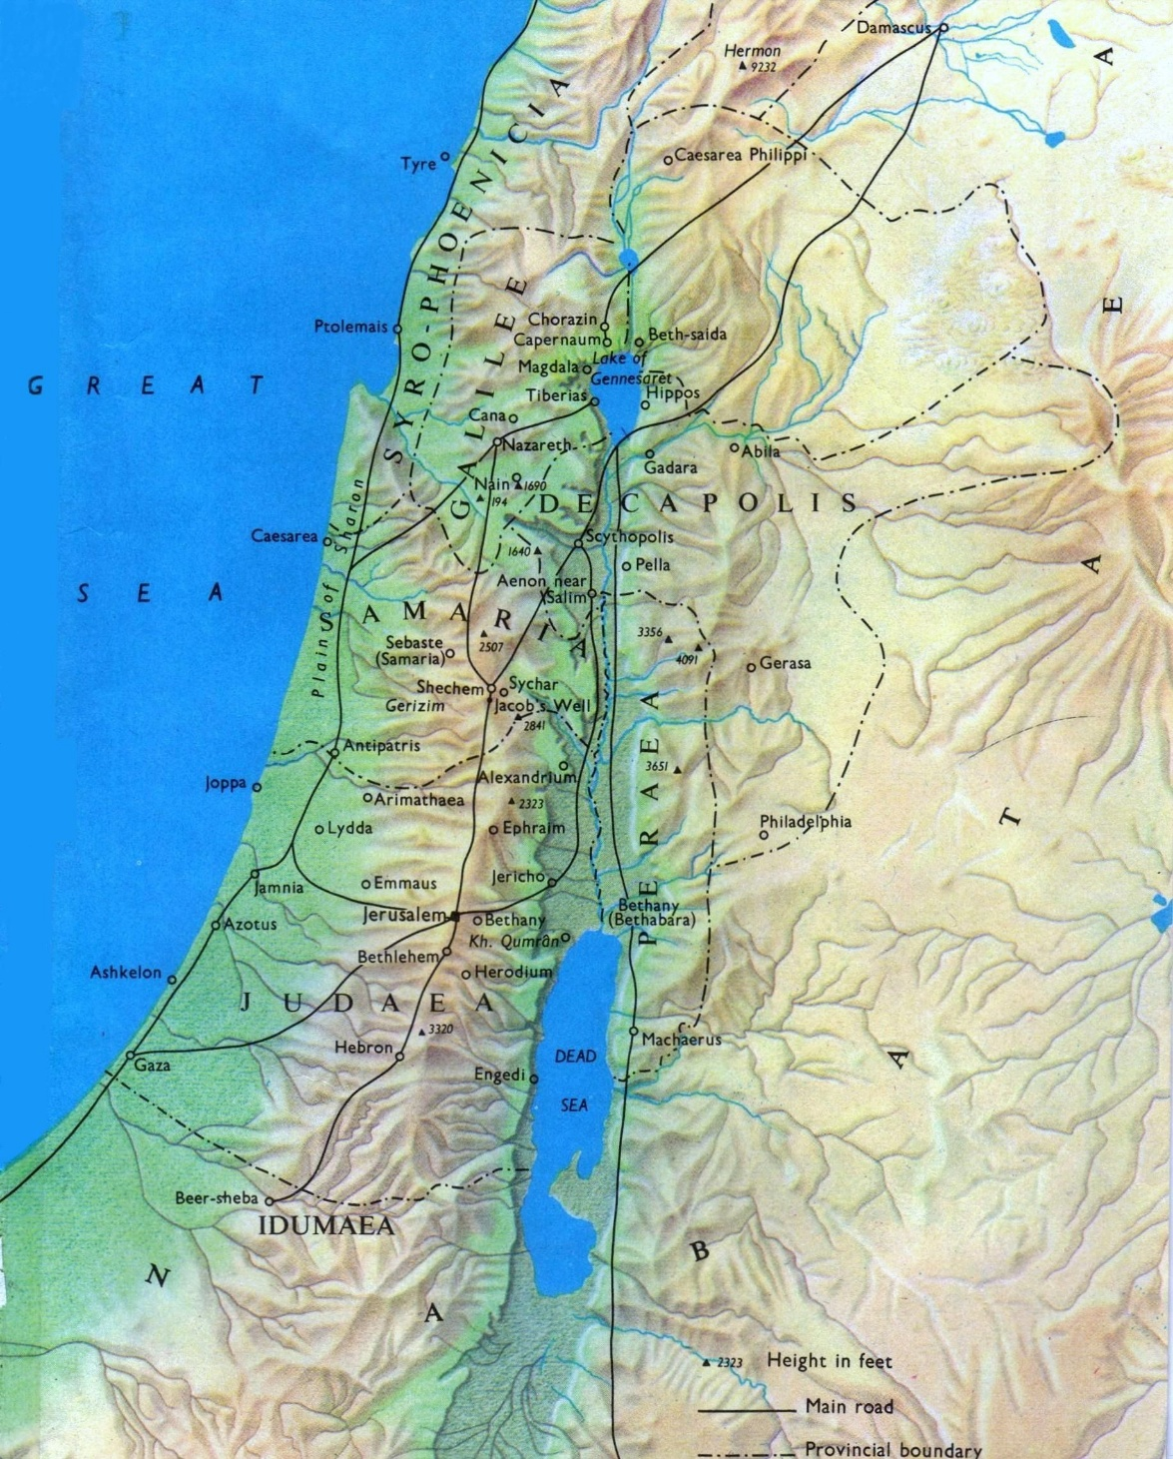
Geography:
New Testament Israel

Slide 16
Repeated Words and/or Phrases in the Book of Mark
Word/Phrase | Approx. No. | Comments
Jesus, Son of Man, Christ, King of the Jews, Son of David, Son of God | 130 | Son of Man identifies Jesus with humanity, Christ identifies Jesus as anointed Savior, King of the Jews identifies Jesus as King of Israel, Son of David identifies Jesus as Messiah and King, Son of God identifies Jesus as God incarnate.
Elders, chief priests, scribes, Pharisees | 52 | The religious leaders who were to shepherd God’s flock. Instead, they became the major adversaries of Jesus, the Great Shepherd. The Pharisees were followers of the traditions of the elders. (See Zechariah 11:4-8.)
Disciples | 42 | Used to describe those who followed the teachings of the Pharisees, John the Baptist, and Jesus. Also used of the twelve Jesus named as Apostles out of his followers.
Immediately | 39 | Majority in reference to events and miracles involving Jesus.
Demon(s), unclean spirit(s), Satan | 31
Teach(ing)/Preach(ing) | 27
Father, father | 18 | Five times referring to our Heavenly Father and the others to our earthly fathers.
Kill(ed) or crucify(ied) | 18
Hear/Listen | 17
Amazed, astonished or astounded | 17
Rise, risen, raised | 15
You can use the Blue Letter Bible to check for repeated word counts

Slide 17
Mark: Key Verses
Mark 1:1-4: “The beginning of the gospel of Jesus Christ, the Son of God. As it is written in Isaiah the prophet, ‘Behold, I send my messenger before your face, who will prepare your way, the voice of one crying in the wilderness: ‘Prepare the way of the Lord, make his paths straight,’ John appeared, baptizing in the wilderness and proclaiming a baptism of repentance for the forgiveness of sins.”
Mark 1:9-11: “In those days Jesus came from Nazareth of Galilee and was baptized by John in the Jordan. And when he came up out of the water, immediately he saw the heavens being torn open and the Spirit descending on him like a dove. And a voice came from heaven, ‘You are my beloved Son; with you I am well pleased.’"
Mark 1:17: “‘Come, follow Me,’ Jesus said, ‘and I will make you fishers of men.’”
Mark 2:10-12: “‘But that you may know that the Son of Man has authority on earth to forgive sins’ — he said to the paralytic — ‘I say to you, rise, pick up your bed, and go home.’ And he rose and immediately picked up his bed and went out before them all, so that they were all amazed and glorified God, saying, ‘We never saw anything like this!’”
Mark 2:27-28: “And he said to them, "The Sabbath was made for man, not man for the Sabbath. So, the Son of Man is lord even of the Sabbath."”
Mark 3:13-15: “And he went up on the mountain and called to him those whom he desired, and they came to him. And he appointed twelve (whom he also named apostles) so that they might be with him and he might send them out to preach and have authority to cast out demons.”
Mark 8:31-33: “And he began to teach them that the Son of Man must suffer many things and be rejected by the elders and the chief priests and the scribes and be killed, and after three days rise again. And he said this plainly. And Peter took him aside and began to rebuke him. But turning and seeing his disciples, he rebuked Peter and said, "Get behind me, Satan! For you are not setting your mind on the things of God, but on the things of man."
Mark 10:14-15: “He said to them, ‘Let the little children come to Me, and do not hinder them, for the kingdom of God belongs to such as these. I tell you the truth, anyone who will not receive the kingdom of God like a little child will never enter it.’”
Mark 10:45: “For even the Son of Man did not come to be served, but to serve, and to give His life as a ransom for many.”
Mark 11:9-11a: “And those who went before and those who followed were shouting, "Hosanna! Blessed is he who comes in the name of the Lord! Blessed is the coming kingdom of our father David! Hosanna in the highest! And he entered Jerusalem and went into the temple."
Mark 12:33: “To love him with all your heart, with all your understanding and with all your strength, and to love your neighbor as yourself is more important than all burnt offerings and sacrifices.”
Mark 15:24-27: “And they crucified him and divided his garments among them, casting lots for them, to decide what each should take. And it was the third hour when they crucified him. And the inscription of the charge against him read, "The King of the Jews." And with him they crucified two robbers, one on his right and one on his left.”
Mark 16:6: “‘Don’t be alarmed,’ he said. ‘You are looking for Jesus the Nazarene, who was crucified. He has risen! He is not here. See the place where they laid Him.’”

Slide 18
Mark: Study Questions
Jesus’ ministry in Israel and the surrounding nations was packed with authoritative teaching of the Scriptures and miraculous works. He spoke words of truth and grace and taught us how to have peace with God. He healed the sick, caused the mute to speak, the deaf to hear, defeated the demons, and raised the dead. Read Mark 6:45-52 and Mark 8:22-26 and explain how God used these two culminating events to reveal to Peter the confession he made in Mark 8:27-30.
Mark 1:14-15 gives the basic components of Jesus’ gospel message. What did Jesus say and how did he reinforce his message? As Jesus’ disciples what can we do to assist the Holy Spirit in authenticating the message of Jesus Christ?
Read Mark 7:24-30 and answer the questions below.
  What reason did Jesus give for agreeing to the request of the Syrophoenician woman?
  Explain what you understand the Holy Spirit is teaching us through this exchange.
Read Mark 3:31-35 and answer the two questions below.
  What did Jesus say identifies us as his family?
  Can you elaborate on your answer to part a above? Use the following passages in your explanation : 1 Thessalonians 4:3-5, 1 Peter 2:12-20, 1 Peter 4:2-3, Colossians 1:9-12.

Slide 19
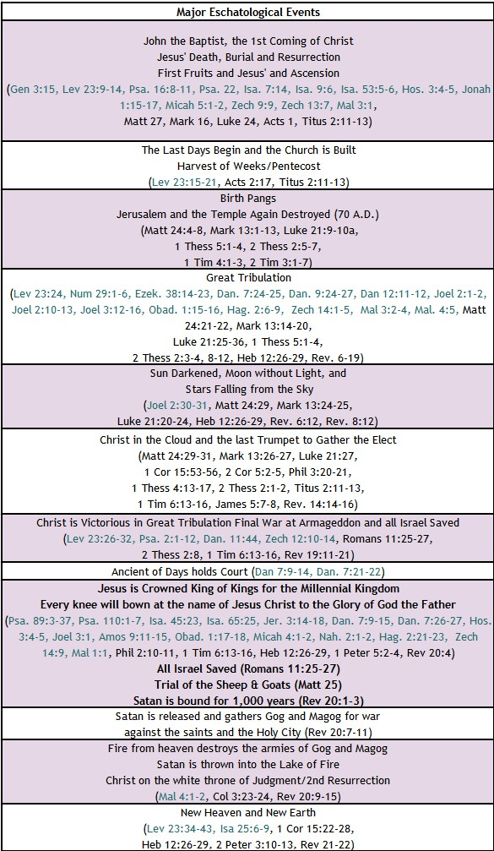


BIBLE ESCHATOLOGY
MARK
Mark 13:2-8, "And Jesus said to him, "Do you see these great buildings? There will not be left here one stone upon another that will not be thrown down.“ And as he sat on the Mount of Olives opposite the temple, Peter and James and John and Andrew asked him privately, "Tell us, when will these things be, and what will be the sign when all these things are about to be accomplished?" And Jesus began to say to them, "See that no one leads you astray. Many will come in my name, saying, ‘I am he!’ and they will lead many astray. And when you hear of wars and rumors of wars, do not be alarmed. This must take place, but the end is not yet. For nation will rise against nation, and kingdom against kingdom. There will be earthquakes in various places; there will be famines. These are but the beginning of the birth pains.
Mark 13:14-20, "But when you see the abomination of desolation standing where he ought not to be (let the reader understand), then let those who are in Judea flee to the mountains. Let the one who is on the housetop not go down, nor enter his house, to take anything out, and let the one who is in the field not turn back to take his cloak. And alas for women who are pregnant and for those who are nursing infants in those days! Pray that it may not happen in winter. For in those days there will be such tribulation as has not been from the beginning of the creation that God created until now and never will be. And if the Lord had not cut short the days, no human being would be saved. But for the sake of the elect, whom he chose, he shortened the days.”
Mark 13:24-27, "But in those days, after that tribulation, the sun will be darkened, and the moon will not give its light, and the stars will be falling from heaven, and the powers in the heavens will be shaken. And then they will see the Son of Man coming in clouds with great power and glory. And then he will send out the angels and gather his elect from the four winds, from the ends of the earth to the ends of heaven.”

Slide 20
Summary of Mark
Brief Summary: The book of Mark opens with a proclamation of its content, “The beginning of the gospel of Jesus Christ, the Son of God.” Mark’s record starts at “the beginning” of Jesus’ ministry with his forerunner, John the Baptist. John prepared the way of the Lord by calling people to repentance and baptizing them with water in the wilderness (Mark 1:1-4). It was through John’s ministry, that our Lord Jesus was baptized and ordained by the Holy Spirit descending on him like a dove and the Father’s declaration from heaven (Mark 1:9-11).
After Jesus’ baptism and victory over the wilderness temptations, He began His public ministry in Galilee and called the first four of His disciples (Mark 1:17-20). As Jesus’ following grew, these four men along with eight others were named as his Apostles (Mark 3:13-19) from among his disciples. What follows is the record of Jesus’ ministry in Israel and various Gentile regions (Mark 1:14-10:52). He touched the lives of many people, but He left an enduring impact on His disciples. At the transfiguration (Mark 9:1-9) and the Olivet Discourse (Mark 13), Jesus gave the disciples a preview of His future return in power and glory.
While Mark’s gospel incudes information similar to Matthew about the same people, places, sermons and events, Mark’s focus is on the authority and power of Jesus Christ: the Son of God, the Son of Man, the Son of David, King of the Jews; to whom we are to listen in order to enter the Kingdom of God, do the will of God, and understand the things to come.¹ Mark uses the word immediately 37 times in conjunction with key events and the miraculous works of Jesus. For example, while God granted the power to Elijah and Elisha to even resurrect the dead, these miracles were not immediate, and the power that came was clearly not from within them (see 1 Kings 17 and 2 Kings 4:8-37). The miraculous works of Jesus, the Son of God, were immediate and from Power within Him. Mark highlights this immediate and sovereign power over nature, sickness, handicaps, death, and even more so, over the demonic world. Demons, unclean spirits and Satan are mentioned over 30 times in Mark’s writings demonstrating Jesus’ victorious power over them and their subjection to Him. The account tells us that those who witnessed the work of Jesus Christ were amazed and astonished.
However, most of the Jewish leaders (chief priests, scribes, and elders) opposed Jesus, and refused to repent of the sin He exposed in them. And after his Messianic entry into Jerusalem (Mark 11:1-11), they plotted to kill the Son of God and delivered him over to Pilate to be crucified (Mark 14:43-15:41). But what they meant for evil, our Lord planned for our good to give his life as a ransom for us (Mark 10:45). Victoriously, Jesus took up his life again from the grave on the third day with our ransom secured as he foretold (Mark 8:31, 9:31). His resurrection was proclaimed by the angels at the tomb, and he appeared to many witnesses with convincing proofs.²
Connections: Mark does not quote as frequently from the Old Testament as Matthew, who was writing primarily to the Jews. He does not begin with a genealogy to link Jesus with the Jewish patriarchs or to Adam, but begins instead with His baptism, the beginning of His earthly ministry. There Mark quotes from an Old Testament prophecy regarding the messenger—John the Baptist—who would exhort the people to “prepare the way for the Lord” (Mark 1:1-4; Isaiah 40:3, Malachi 3:1) as they awaited the coming of their Messiah. Mark also includes connections back to Isaiah and Psalms.³
Notes:
¹ Mark 1:1, 2:10, 2:28, 10:47-48, 15:2, 9:7
² Mark 16:1-8, John 20:11-29, Acts 1:3, 1 Corinthians 15:1-8
³ Compare Mark 4:11-12 with Isaiah 6:9-10; Compare Mark 7:6-7 with Isaiah 29:13, Compare Mark 12:10-11 with Psalm 118:22-23

Slide 21
Mark: Practical Application
Practical Application: Mark states his record is about “the beginning of the gospel of Jesus Christ, the Son of God”. He focuses on the authority and power of Jesus Christ over nature, sickness, handicaps, death, and the demonic world. In addition, Mark highlights Jesus’ authority to forgive sins and his position as Lord of the Sabbath, the chief cornerstone, the Son of David.
The teaching recorded in Mark emphasizes that those who enter God’s kingdom do so with the same type of trust a child has in their earthly parents and those who will be great in the kingdom will be those who are servants to all. For the Lord Jesus himself came to serve and offer his life as a ransom for us (Mark 10:44-45). Self-sacrifice for the sake of Jesus Christ and his gospel should transcend our need for recognition or reward, just as Jesus was willing to be abased as He lay down His life for the sheep.

Slide 22

Closing Prayer Verse
Mark 13:5-8: “And Jesus began to say to them, "See that no one leads you astray. Many will come in my name, saying, ‘I am he!’ and they will lead many astray. And when you hear of wars and rumors of wars, do not be alarmed. This must take place, but the end is not yet. For nation will rise against nation, and kingdom against kingdom. There will be earthquakes in various places; there will be famines. These are but the beginning of the birth pains.”

Slide 23
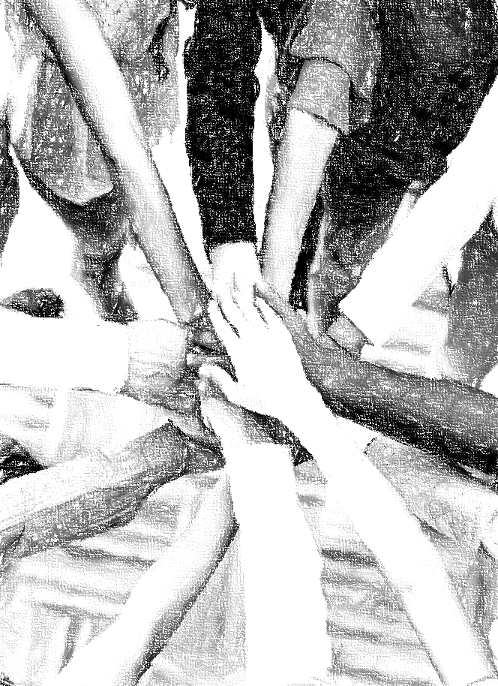
Acknowledgements
Background, Setting, Outlines, some Study Question answers, interpretative challenges, and some Summaries: Adapted from MacArthur Study Bible.
Key verses, Practical Application, some Study Question answers, and some Summaries: Adapted from GotQuestions.org.
Creation – Consummation Icons: Adapted from AnswersInGenesis.org.
Definitions: Adapted from Websters 1828 Dictionary.

Slide 24
Study Leader Assistance
Sample Prayers
Study Question Answer Keys

Slide 25
Sample Opening Prayer Verse: Mark
Mark 2:10-12, "But that you may know that the Son of Man has authority on earth to forgive sins" — he said to the paralytic — "I say to you, rise, pick up your bed, and go home." And he rose and immediately picked up his bed and went out before them all, so that they were all amazed and glorified God, saying, "We never saw anything like this!“
Sample Prayer: Dear Heavenly Father, thank you for sending your Son, Jesus Christ. We praise you that he came in the fullness of time fulfilling the prophetic word you provided and preserved in your Scriptures through many godly men. We are grateful for the eyewitness accounts to his Deity, his power, authority, mercy and grace. And we are so thankful that He gave his life to pay for our sins and exercises his authority to forgive and redeem us. Thank you for loving us enough to send Jesus to rescue us from the pit. We love you Lord and ask that your Spirit would work in us to do your will. In Jesus’ name we pray. Amen.

Slide 26
Mark: Study Question Answers
Jesus’ ministry in Israel and the surrounding nations was packed with authoritative teaching of the Scriptures and miraculous works. He spoke words of truth and grace and taught us how to have peace with God. He healed the sick, caused the mute to speak, the deaf to hear, defeated the demons, and raised the dead. Read Mark 6:45-52 and Mark 8:22-26 and explain how God used these two culminating events to reveal to Peter the confession he made in Mark 8:27-30. Answer: The account in Mark 6:45-52 begins with Jesus in hours of prayer with the Father, which would undoubtedly have included prayers for his disciples to grow in spiritual wisdom (Colossians 1:9-12). Then after Jesus walked on the water to the boat, Mark’s account ends with the disciples’ utter astonishment stating that they did not understand about the loaves because their hearts were hardened. But, when we combine Mark’s account with the account in Matthew 14:28-33, we learn more. We find that Peter got out of the boat and walked on the water with Jesus and was then saved by Jesus from drowning. And we also read that those in the boat “worshiped Him, saying, “You are certainly God’s Son!”. Then in Mark 8:22-26 when Jesus heals this particular blind man, he does it in such a way that at first the man sees unclearly, but when Jesus touches him a second time he sees plainly. Then comes Jesus’ two questions in Mark 8:27-30: “Who do people say that I am?” and “Who do you say that I am?”. Now through Jesus’ intercessory prayers and the climaxing events God orchestrated, we hear the declaration that God revealed to Peter: "You are the Christ, the Son of the living God.“ (See also Matthew 16:16.)
Mark 1:14-15 gives the basic components of Jesus’ gospel message. What did Jesus say and how did he reinforce his message? As Jesus’ disciples what can we do to assist the Holy Spirit in authenticating the message of Jesus Christ? Answer: Jesus’ most simplistic message stated: ‘the time is fulfilled, the kingdom of God is at hand; repent and believe the gospel.’ But even to the Jews who were looking for the Messiah, he explained so much more about what it means to repent and believe; and what we are to believe in. Jesus came as a ransom for sinners (Mark 10:45). The perfect Lamb of God (John 1:29) who took away our sins by paying the penalty owed to God through his death (Philippians 2:5-8). He could do this because He is the “I AM”, the Way, the Truth, and the Life (John 8:58, John 14:6), the One who took up His life from the grave (Mark 8:31, John 11:25-27). As Jesus’ disciples we are to proclaim the gospel message (e.g., John 3:16), but like Jesus we need to pray that people will see clearly, patiently address their questions in truth and love, and wait for God to bear the fruit.
Read Mark 7:24-30 and answer the questions below.
  What reason did Jesus give for agreeing to the request of the Syrophoenician woman? Answer: Jesus said her response to his declaration that the children of Israel were to be fed first, and it was not right to throw their bread to the dogs was the reason her request was granted.
  Explain what you understand the Holy Spirit is teaching us through this exchange. Answer: The woman did not become indignant when Jesus referred to Israel as the children and her (the Gentiles) as the dogs. Instead, she humbly acknowledged God’s right to choose as He knows best. In faith, she appealed to God’s mercy stating that even humans allow the little dogs to have the children’s crumbs that fall to the floor. Her statement indicated God’s crumbs were more than sufficient and that she was content with any measure of his blessings.
Read Mark 3:31-35 and answer the two questions below.
  What did Jesus say identifies us as his family? Answer: Jesus stated that his brother, sister, and mother are those who do the will of God.
  Can you elaborate on your answer to part a above? Use the following passages in your explanation: 1 Thessalonians 4:3-5, 1 Peter 2:12-20, 1 Peter 4:2-3, Colossians 1:9-12. Answer: Jesus states his family consists only of those who do God’s will. He demonstrates this on the cross when he places his mother’s care into the hands of the Apostle John since his brothers had not yet believed God (John 19:26-27). We can know we are doing the will of God when we not only believe on Jesus (John 6:27-29), but our desires and actions also begin to change because we have been made new (John 3:5-7). God’s will is that we are sanctified by the Holy Spirit. This sanctification results in lives that abstain from sexual immorality, do good deeds for God’s glory, submit to the authorities placed over us, honor others, love the saints, endure unjust suffering for His sake, grow in spiritual wisdom, walk in a manner worthy of the Lord Jesus, and bear fruit in every good work. This is the will of God. If these things are growing in our lives, we are Jesus’ brother, sister, or mother.

Slide 27
Sample Closing Prayer Verse
Mark 13:5-8: “And Jesus began to say to them, "See that no one leads you astray. Many will come in my name, saying, ‘I am he!’ and they will lead many astray. And when you hear of wars and rumors of wars, do not be alarmed. This must take place, but the end is not yet. For nation will rise against nation, and kingdom against kingdom. There will be earthquakes in various places; there will be famines. These are but the beginning of the birth pains.”
Sample Prayer: Dear Heavenly Father, thank you for telling us of the things that will come upon the earth before Jesus returns to establish his visible kingdom. You have told us beforehand so that we can be on guard and not be deceived. Thank you for the many years of protection and safety we have enjoyed in our nation. Help us not to be fearful or anxious about wars, rumors of wars, or natural disasters knowing our times are in your hands and you only allow the things in our lives that will cause us to bear more fruit. Grant us the peace, contentment, discernment, and joy that come from being securely in Jesus Christ. In his name we pray. Amen.

